Slide 1
Dynamic Sample Selection for Approximate Query Processing Brain Babcock (Stanford Univ) Surajit Chaudhuri (Microsoft Research) Gautam Das (Microsoft Research)
Presented By
Anirban Maiti
Chandrashekar Vijayarenu

Slide 2
Related Work
Research on OLAP query processing > Approximate query processing (AQP)
Star Schema for a Warehouse
Implementing these schema involves building indexes on commonly-queried attributes (derived from known query workload).
Pros: Speeds up specific queries (when the workload is known in advance)
Cons: Expensive to build indexes to cover all possible queries.
Fails to perform for ad-hoc analysis queries.
We need AQP technology along with physical database design technology.
Notes:
Why Approximate Query Processing?

Slide 3
Related Studies – Online Aggregation
Hellerstein J., Haas P., Wang H. Online Aggregation, CM SIGMOD 1997.
Approximate answers are produced during early stages of query processing.
Then gradually refined until all data has been processed.
Advantages: No pre-processing required. Allows progressive refinement of answers at runtime.
Disadvantages: Require random disk access (slow). Requires query processor code change.
SO,
Fails to have online approach to AQP.
Pre-processing is required.
Offline Sampling based approach were of interest for AQP systems.
Notes:
Why Sampling based approach for Approximate Query Processing? (Online sampling approach)

Slide 4
Icicles – Low Selectivity Problem
Recognizing the low selectivity problem, designing a biased sample that is based on known workload information was attempted by Ganti, Lee & Ramakrishnan (2000)
Tuples that have been accessed by many queries in the workload were assigned greater probabilities of being selected into the sample.
Disadvantage : Focuses only on the low selectivity problem
Notes:
(Offline sampling approach)

Slide 5
Outlier Indexing
Chaudhuri S., Das G., Datar M., Motwani R., Narasayya V. Overcoming Limitations of Sampling for Aggregation Queries, ICDE 2001
Offline sampling-based approximations for aggregate queries when the attribute being aggregated has a skewed distribution.
Disadvantage: Focuses only on the data variance problem.

Slide 6
Join Synopsis – AQUA @ Bell Labs
Developed for certain types of join queries (particularly primary-key joins)
involved pre-computing the join of samples of fact tables with dimension tables so that at runtime queries only need to be executed against single sample tables
Disadvantage: Does not extend to queries that involve non-foreign key joins.

Slide 7
Congressional Sampling – AQUA @ Bell Labs
Group by queries with aggregation
Approach: Stratifies the database by considering the set of queries involving all possible combinations of grouping columns, and produces a weighted sample that balances the approximation errors of these queries.
Disadvantages:
Naïve scheme. But does not minimize the error for any of the well-known error metrics.
Pre-processing time α 2^{g} , g = potential group-by column

Slide 8
STRAT – Stratified Sampling
The authors here formulated the problem of pre-computing a sample as an optimization problem, whose goal is to minimize the error for the given workload.
Introduced a generalized model of the workload (“lifted workload”)
Sample Selection from lifted workload - stratified sampling
Benefits of this systematic approach are demonstrated by theoretical results.
Disadvantage: ??

Slide 9
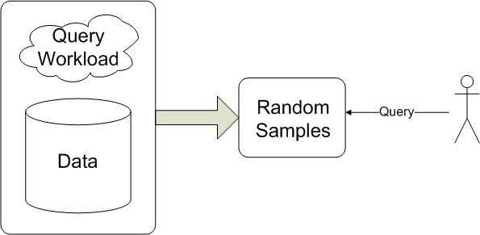
Standard Sampling AQP - Architecture
Notes:
Might give good answers when an attribute has a skewed data distribution.
Might be a good fit for commonly used queries.
Can we use this pre-processed sample(uniform/non-uniform) for any kind of query?

Slide 10
Dynamic Sample Selection
Attempts to strike a middle ground between pre-computed and online sampling
Scanning or storing significantly larger amounts of data during pre-processing
Access a small amount of stored data at runtime
Notes:
accept greater disk usage for summary structures than other sampling based AQA methods in order to increase accuracy in query responses while holding query response time constant

Slide 11
Dynamic Sample Selection - Architecture
Pre-Processing Phase:
Query
Workload
Sample
Data
Select
Strata
Build
Sample
Data
Meta-
Data

Slide 12
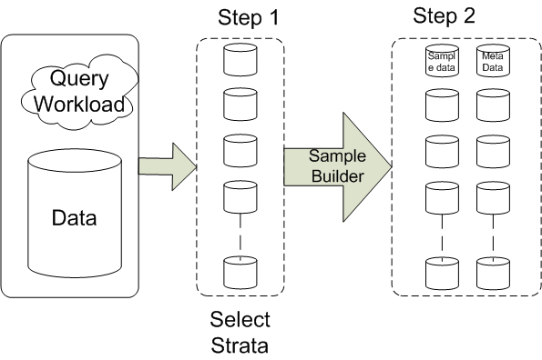
Dynamic Sample Selection - Architecture
Pre-Processing Phase:

Slide 13
Dynamic Sample Selection - Architecture
Runtime Phase:
Query
Sample
Data
Choose
Samples
Rewrite
Query
Meta-
Data

Slide 14
Motivation – Small Group Sampling
Example : Aggregation queries with “group-bys”
select
Age,
Income,
count(*)
from T
group by
Age, Income
Uniform sampling ?
Congressional sampling?
Outlier Indexing?
Small group sampling technique makes use of Dynamic Sample selection Architecture
Treat small and large groups differently
Age | Income | Designation
30 | 60 | Developer
35 | 70 | Developer
25 | 60 | Developer
25 | 70 | Lead
30 | 70 | Lead
25 | 70 | Developer
25 | 70 | Developer
30 | 60 | Developer
30 | 60 | Developer
40 | 70 | Developer
35 | 100 | Manager
25 | 60 | Developer
25 | 70 | Developer
35 | 100 | Developer
30 | 60 | Developer
Notes:
It is the small groups that are the problem case for uniform sampling.
Small group sampling technique makes use of Dynamic Sample selection Architecture.
A disadvantage of this approach was
that the primary emphasis was on the data variance problem, and while the authors did propose a hybrid solution for both the data variance as well as the low selectivity problem, the proposed solution was heuristical and therefore, suboptimal.

Slide 15
Small Group Sampling
Approach:
Overall sample – perform uniform sampling on large groups.
Small group tables - one or more sample tables for smaller groups.
Pre-Processing Phase:
Create a overall sample s_overall
2. “Age” Histogram ( Column Index: 0)
r : Base Sampling rate, determines the size of Overall Sample (eg, 30%)
t : small group fraction, max size of each small group table (eg, 20%)
s_overall
Age | Income | Designation | Bitmask
25 | 60 | Developer | 000
25 | 70 | Developer | 000
25 | 70 | Lead | 000
30 | 60 | Developer | 000
30 | 60 | Developer | 000
35 | 100 | Developer | 000
Age | Income | Designation | Bitmask
25 | 60 | Developer | 000
25 | 70 | Developer | 000
25 | 70 | Lead | 000
30 | 60 | Developer | 000
30 | 60 | Developer | 000
35 | 100 | Developer | 001
s_age
Age | Income | Designation | Bitmask
35 | 100 | Developer | 001
35 | 100 | Manager | 001
40 | 70 | Developer | 001
Small group table

Slide 16
Pre-processing Phase
“Income” Histogram(Column Index: 1)
s_overall
Age | Income | Designation | Bitmask
25 | 60 | Developer | 000
25 | 70 | Developer | 000
25 | 70 | Lead | 000
30 | 60 | Developer | 000
30 | 60 | Developer | 000
35 | 100 | Developer | 011
s_income
Age | Income | Designation | Bitmask
35 | 100 | Manager | 010
35 | 100 | Developer | 010
011
011

Slide 17
Runtime Phase
s_overall
s_age (Column Index: 0 - 001)
SELECT Age, Income, count(*) FROM Employee_tbl GROUP BY Age, Income
SELECT Age, Income, count(*) FROM s_age GROUP BY Age, Income
UNION ALL
SELECT Age, Income, count(*) FROM s_income GROUP BY Age, Income
WHERE Bitmask & 1 = 0 /* ie, 001 . (eg, 010 & 001 = 000 ; 011 & 001 = 1)*/
UNION ALL
SELECT Age, Income, count(*) * (100/30) FROM s_overall GROUP BY Age, Income
WHERE Bitmask & 3 = 0 /* 3 = 2⁰ + 2¹ ie, 011 (eg, 001 & 011 = 1; 011 & 011 = 1; 010 & 011 = 1)*/
Age | Income | Designation | Bitmask
25 | 60 | Developer | 000
25 | 70 | Developer | 000
25 | 70 | Lead | 000
30 | 60 | Developer | 000
30 | 60 | Developer | 000
35 | 100 | Developer | 011
Age | Income | Designation | Bitmask
35 | 100 | Developer | 011
35 | 100 | Manager | 011
40 | 70 | Developer | 001
s_income (Column Index: 1 - 010)
Age | Income | Designation | Bitmask
35 | 100 | Manager | 011
35 | 100 | Developer | 011

Slide 18
Relative Error – TPC-H Benchmark Database

Slide 19
Groups Missing – TPC-H Benchmark Database

Slide 20
Accuracy Metrics
Accuracy Criteria
Include as many possible groups to calculate approximate answer.
Error in the aggregate value for each group should be small.
Q = Aggregation Query.
Let G = {g₁, g₂, g₃, … g_{n}} be the set of n groups in the answer to Q
x_{i} = aggregate value for group g_{i}.
A= Approximate Answer to Q
G’ = {g_{i1}, g_{i2}, g_{i3}, … g_{in}} be the set of m groups in A
x’_{i1} = aggregate value for group g_{ij}.

Slide 21
Accuracy Metrics
Percentage of groups from Q missed in A:
2. Average Relative Error
3. Average Squared Relative Error:

Slide 22
Expected Average Squared Relative Errors
Q = Count Query over over a database with N tuples.
Let G = {g₁ . . . g_{n}} be the set of n groups in the answer;
p_{i} = fraction of the N tuples that belong to group g_{i}.
Let C denote the set of grouping columns in the query Q
Let [v_{C,gi} Є L(C)] denote the indicator function that equals 1 when the value for grouping column C in group g_{i} is one of the common values L(C) and 0 otherwise.
Au, an approximate answer for Q produced using uniform random sampling at sampling rate s/N
A_{sg}, an approximate answer for Q produced using small group sampling with an overall sample generated at sampling rate s’/N.

Slide 23
Expected Average Squared Relative Errors
Let E_{u} = E[SqRelErr(Q,A_{u})] and E_{sg} = E[SqRelErr(Q,A_{sg})] denote the expected values of the average squared relative error on Q of A_{u} and of A_{sg},respectively.

Slide 24
Thank You.

