Slide 1
Dynamic Sample Selection for Approximate Query Processing
Brian Babcock
Surajit Chaudhuri
Gautam Das
at the 2003 ACM SIGMOD International Conference
By
Shashank Kamble Gnanoba

Slide 2
Outline
Introduction to AQP
Dynamic Sampling
Small Group Sampling
Introduction
Description
Experimental Results and Graphs
Conclusion

Slide 3
Intro to AQP
Data is stored in large repositories
These data need to be queried in an aggregate form as a summarized result for data analysis
Exact answers are unnecessary
Approximate values are acceptable
We create samples to execute queries on a smaller data set
2 kinds of samples can be created: Uniform and Biased

Slide 4
Biased Sampling
Extremely useful for solving queries involving Group-By clauses
Data in a table can be skewed with extreme values and uncommon or rare values
In some cases, the bias can vary depending on the particular query to be executed
An efficient approach is to create multiple biased samples

Slide 5
Dynamic Sampling
Create a large sample containing a family of differently biased sub-samples
Use only a small portion of the sub-samples to answer a particular query during runtime
The chosen subsamples must be a “good fit” for the query
Extra disk storage space may be needed

Slide 6
Standard v Dynamic Sampling
Standard Sampling
Dynamic Sampling
SAMPLE
DATA
DATA
SAMPLE
SAMPLE
Query
Query
SAMPLE
SAMPLE

Slide 7
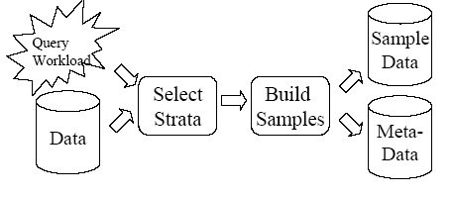
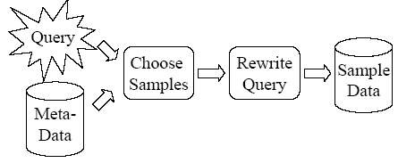
Dynamic Sampling Stages
Pre-Processing Stage
Examine data distribution and divide into strata
Create samples and additional metadata
Runtime Stage
Queries issued and re-written to run on sample tables using metadata information

Slide 8
Small Group Sampling - Intro
Designed for answering aggregation queries with “group-by” clauses
E.g. Total sales of CPUs in each state
Number of records per group may vary widely
Larger groups are well represented whereas small groups are under-represented in the sample
“California” much more common than “Alaska”
“Alaska” only appears a few times in the sample
Approximate answer for “Alaska” likely to be bad

Slide 9
Small Group Sampling - Idea
Uses a combination of a uniform random sample(overall sample) to represent large groups and one or more sample tables(small group tables) to represent smaller groups
Small group tables include 100% of the rows from the small groups which is not the case with the overall sample
Large Groups
Small Groups

Slide 10
Small Group Sampling – Pre Processing Phase
The Pre Processing phase can be implemented efficiently by making just 2 scans
First scan identifies the frequently occurring values for each column and their approximate frequencies.
Second scan, the small group tables for each column in S is constructed along with the overall sample.
This results in 3 outputs:
An overall sample table
A set of small group tables
A metadata table

Slide 11
Runtime Phase
When a query arrives at runtime, it is re-written to run against the sample tables instead of the base table.
Each query is executed against the scaled overall sample, and for each column in the query’s group-by list, the query is executed against that column’s small group table. The aggregate values are not scaled when executing against the small group sample tables.
Finally, the results from the various sample queries are aggregated together into a single approximate query answer.

Slide 12
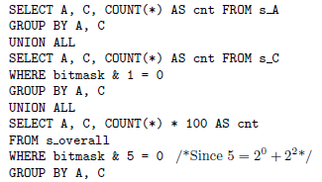
Example Query
Select A, C, Count(*) AS Cnt FROM T GROUP BY A, C
Assuming small group sampling with sampling rate 1%
Small group tables exist for A and C with indexes 0 and 2

Slide 13
Variations
The approach we took so far includes building small group tables from the database with a single-column grouping and no selection predicates
We could also use these variations:
Generate small group tables based on selected group-by queries over pairs of columns
A multilevel hierarchical small group sampling can also be implemented

Slide 14
Accuracy Metrics
We have 2 different accuracy criteria
As many of the groups as possible that are present in the exact answer should be preserved in the approximate answer
The error in the aggregate value for each group should be small

Slide 15
Comparison with Congressional Sampling
Congressional Sampling | Small group sampling
It creates only single sample, hence sample must necessarily be very general purpose in nature | Uses dynamic sample selection architecture and thus can have benefits of more specialized samples that are each tuned for a narrower , more specific class of queries.
The preprocessing time required by congressional sampling is proportional to the number of different combinations of grouping columns, which is exponential in the number of columns. This renders it impractical for typical data warehouses that have dozens or hundreds of potential grouping columns | The pre-processing time for small group sampling is linear in the number of columns in the database

Slide 16
Experimental Results
Experiments were conducted on a real-world SALES database containing about 200000 rows.
The total number of columns were 245
The database consumed 1 GB disk space
The experiment was conducted on the TPC-H benchmark

Slide 17
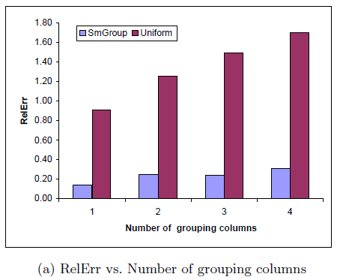
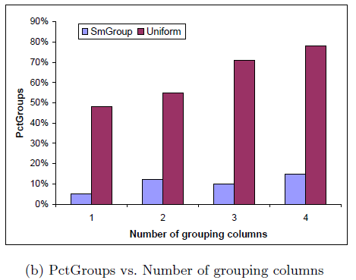
Graphs

Slide 18
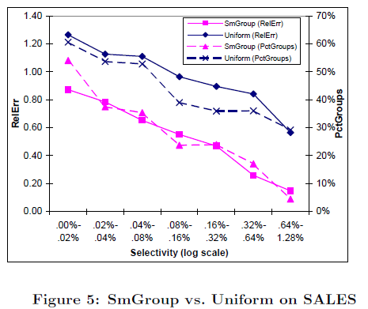
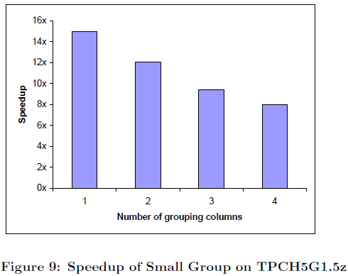
More Graphs

Slide 19
Conclusion - 1
Accuracy:
For COUNT queries, small group sampling > uniform random sampling
For COUNT queries, accuracy degrades with
Increasing number of grouping columns in the query
Decreasing average group size of the query result
Decreasing data skew
For SUM queries, small group sampling > outlier indexing

Slide 20
Conclusion - 2
Performance
Speedup depends on the sampling rate
Small group sampling requires more space to store sample tables than other techniques
However, it can gracefully take advantage of extra available space
Small group sampling has acceptable pre-processing time – although slower than uniform random sampling

Slide 21
Thank You

