Slide 1
ICICLES: Self-tuning Samples for Approximate Query Answering By Venkatesh Ganti, Mong Li Lee, and Raghu Ramakrishnan
Shruti P. Gopinath
CSE 6339

Slide 2
Outline
Introduction and background
Icicles
Icicle Maintenance
Icicle-Based Estimators
Quality & Performance
Conclusion

Slide 3
Background
Data Warehouses –huge information collection and management systems
OLAP-provide interactive response times to aggregate queries
AQUA- Approximate query answering systems are being developed

Slide 4
Introduction
Various approaches to answering approximate queries
Sampling-based
Histogram-based
Probabilistic-based
Wavelet-based
Clustering-based

Slide 5
Sampling based techniques
Uniform Random Sampling
All tuples are deemed equally important
Leads to locality in data access
Waste of precious real estate
Join of random samples of base relations may not be a random sample of the join of the base relations. This is basis for Join Synopsis by Gibbons

Slide 6
Why Icicles?
Queries follow a predictable pattern
Class of samples capture data locality of aggregate queries on foreign key joins
Sample relation space better utilized if more samples from actual result set are present
Dynamic algorithm that changes the sample to suit the queries being executed in the workload

Slide 7
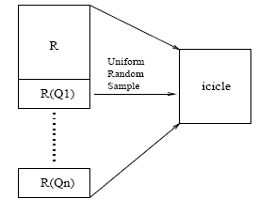
Icicles
Is a uniform random sample of a multiset of tuples L, which is the union of R and all sets of tuples that were required to answer queries in the workload (an extension of R)

Slide 8
Icicle Maintenance
We maintain an icicle such that at all times the probability of a tuple’s presence in the icicle is proportional to its “importance” (frequency) in answering of a tuple in a workload.
Uniform random
sample
R
Icicle
R(Q1)
R(Q2)
R(Q3)

Slide 9
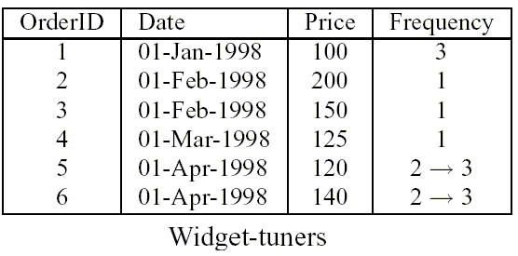
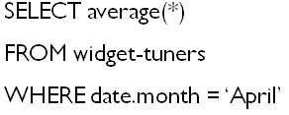
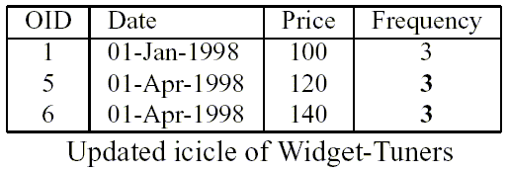
Icicle Maintenance Example

Slide 10
Icicle Maintenance

Slide 11
Icicle Maintenance Algorithm
Algorithm is efficient due to
Uniform Random Sample of L ensures that tuple’s selection in its icicle is proportional to it’s frequency
Incremental maintenance of icicle requires only the segment of R that satisfies the new query from the workload
Reservoir Sampling Algorithm

Slide 12
Icicle-Based Estimators
In spite of unified sampling being used the result is a biased sample
Traditional estimation of scaling up the count from a sample N of k by a factor of N/k is way off the mark
Frequency Relation maintained over all tuples in relation
Different Estimation mechanisms for Average, Count and Sum

Slide 13
Estimators
Average : Average taken over set of distinct sample tuples that satisfy the query predicate of the average query is a pretty good estimate of the average
Count : First compute an estimate of the number of tuples in R that contribute one tuple t in the icicle. Sum of Expected Contributions of all tuples in the sample that satisfy the given query

Slide 14
Estimators
Sum : Estimate is given by the product of the average and the count estimates
Thus E[A(A,R)]

Slide 15
Maintaining Frequency Relation
Frequency Attribute added to the Relation
Starting Frequency set to 1 for all tuples
Incremented each time tuple is used to answer a query
Frequencies of relevant tuples updated only when icicle updated with new query

Slide 16
Quality Guarantees
When queries exhibit data locality then icicle is constituted of more tuples from frequently accessed subsets of the relation
Accuracy improves with increase in number of tuples used to compute it
Class consisting of queries ‘focused’ with respect to workload will obtain more accurate approximate answers from the icicle

Slide 17
Performance Evaluation
SELECT COUNT(*), AVG(LI_Extendedprice), SUM(LI_Extendedprice)
FROM LI, C, O, S, N, R
WHERE C_Custkey=O_Custkey AND O_Orderkey=LI_Orderkey AND LI_Suppkey=S_Suppkey AND
C_Nationkey = N_Nationkey AND N_Regionkey = R_Regionkey AND
R Name = [region] AND O Orderdate >= Date[startdate] AND O Orderdate <= 12-31-1998
Q_{workload} : Template for generating workloads
SELECT COUNT(*), AVG(LI_Extendedprice), SUM(LI_Extendedprice)
FROM LICOS-icicle, N, R
WHERE C_Nationkey = N_Nationkey AND N_Regionkey = R_Regionkey AND
R Name = [region] AND O Orderdate >= Date[startdate] AND O Orderdate <= 12-31-1998
Template for obtaining approximate answers

Slide 18
Performance Evaluation
Plots definition:
Static sample:
Uniform random sample on the relation
Icicle:
Icicle evolves with the workload
Icicle-complete
The tuned icicle again on the same workload

Slide 19
Performance Evaluation

Slide 20
Performance Evaluation

Slide 21
Observations
Rapid decrease in relative error of query answers from icicles with queries focused on a set of core tuples
Icicle plot shows a convergence to the Icicle-Complete plot
Quick Convergence of Icicle plot towards Icicle-Complete means Icicle adapts fast
Improvement due to usage of icicles is not significant
At worse, can be concluded that icicles are as good as the static samples

Slide 22
Conclusion
Icicles provide class of samples that adapt according to the characteristics of the workload
Icicle is useful when the following is true:
workload focuses on relatively small subsets in relation
Calls for high accuracy of approximate answer
Has to have exact query (the more the better)
Icicle is a trade-off between accuracy and cost

Slide 23
Questions
When are icicles best suited to be used?
What are the disadvantages of Icicles?
More???

Slide 24
References
V. Ganti, M. Lee, and R. Ramakrishnan. ICICLES: Self-tuning Samples for Approximate Query Answering. VLDB Conference 2000.
S Acharya, PB Gibbons, V Poosala, S Ramaswamy Join synopses for approximate query answering. ACM SIGMOD Record 1999

Slide 25
Thank you!

