Slide 1
Ranking Queries on Uncertain Data: A Probabilistic Threshold Approach
Ming Hua, Jian Pei
Simon Fraser University Presented By:
Mahashweta Das
Wenjie Zhang, Xuemin Lin University of Texas at Arlington
The University of New South Wales & NICTA
SIGMOD 2008

Slide 2
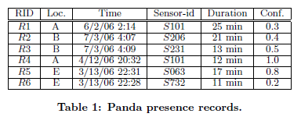
Uncertain Data
Uncertainty in data due to incompleteness of data, limitations of equipment, delay or loss in data transfer, etc.
Multiple sensors for same location
Two sensors in the same location may detect the presence of a suspect at the (approximately) same time.
Uncertain data in Table 1 summarizes the set of all possible worlds

Slide 3
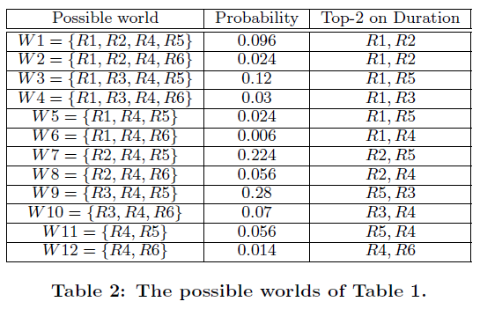
All Possible Worlds
Rules
----------------
τ1 R1
τ2 R2, R3
τ3 R4
τ4 R5, R6
0.3*0.4*0.8*1.0
(1-0.3)*(1-0.4-0.5)01.0*0.2
Top-K Query: top-2 longest duration in uncertain data

Slide 4
Probabilistic Threshold for Top-K Queries
If user-specified probability threshold (p) =0.35, {R2, R3, R5} should be returned.
This is the problem of probabilistic threshold top-k query
Return records, each of which takes a probability of at least p to be in the top-k lists in the possible worlds
0.006 + 0.056 + 0.056 + 0.07 + 0.014 = 0.202

Slide 5
Technical Challenges
Semantics of probabilistic top-k queries (PT-k queries)
Solution
Query returns a tuple which has a high probability to appear in top-k list regardless of its exact rank
Efficient computation of probabilistic top-k queries
Number of all possible worlds is huge; hence naïve method is expensive
Existing techniques require materializing all possible states based on tuples seen so far
Solution
Exact algorithm
Sampling algorithm
Poisson approximation based algorithm

Slide 6
Algorithm: Dominant Set Property
Dominant Set Property
For a tuple t ∈ P(T), the dominant set of t is the subset of tuples in P(T) that are ranked higher than t
S_{t} = {t’|t’ ∈ P(T) ∧ t’ ≺_{f} t}, P(T) = set of tuples satisfying query predicate
Using Dominant Set Property , all algorithm scan tuples in ranking order, and derive top-k probability of a tuple based on tuples preceding it in the ranking order

Slide 7
Exact Algorithm
Basic Case: Tuples are independent, each tuple involved in one rule
Scan tuples in P(T) in ranking order
Derive top-k probability of a tuple based on tuples preceding it in the ranking order
Pr(t_{i},j) : probability that tuple t_{i} is ranked at j-th position in possible worlds
Pr^{k}(t_{i}) : top-k probability of tuple t_{i}
Pr(S_{ti}, j): probability that j tuples in S_{ti} appear in possible worlds
Theorem:

Slide 8
Exact Algorithm: Example
To compute top-2 probability of each tuple
For t_{j} (1 ≤ j ≤ 2), Pr²(t_{j}) = Pr(t_{j})
Pr²(R₁) = 0.3 Pr²(R₂) = 0.4
For t_{j} (3≤ j ≤ 6),
Pr²(R₃) = Pr(R₃). [Pr(S_{R2}, 0) + Pr(S_{R2}, 1) ] by Poisson binomial recurrence
= Pr(R₃). [Pr(S_{R2}, 0) + Pr(R₂).Pr(S_{R1}, 0) + (1-Pr(R₂)).Pr(S_{R1}, 0) ]
= Pr(R₃). [Pr(S_{R2}, 0) + Pr(R₂).Pr(S_{R1}, 0) + (1-Pr(R₂)).Pr(S_{R1}, 0) ]
= ...
= 0.5 * 0.76 =0.38
Similarly, Pr²(R₄) = 0.202 Pr²(R₅) = 0.704 Pr²(R₆) = 0.014

Slide 9
Sampling Algorithm
Random variable X_{t} = 1 if t is ranked in top-k list
0 otherwise
Pr^{k}(t) = E[X_{t}]
Draw a set of samples S of possible worlds
Compute E_{s}[X_{t}] as approximation of E[X_{t}]
Generate sample units by URS with replacement (a sample unit is a possible world)
To pick a sample unit, scan data table once and include independent tuple t_{i} with Pr(t_{i})
Compute top-k tuples in sample unit
For each tuple t in top-k list, X_{t} = 1, rest tuples are set to 0
Repeat above steps to obtain sample S and compute E_{s}[X_{t}]

Slide 10
Poisson Approximation Based Algorithm
Scan tuples in P(T) in ranking order
When a tuple t is scanned, if t is an independent tuple,
Pr^{k}(t) = =
When a tuple t is scanned, if t belongs to a generation rule R,
Pr^{k}(t) =
F(k-1, ;μ), F(k-1, ;μ’) is cumlative distribution function
X follows Poisson Binomial distribution
μ : sum of membership probabilities of scanned tuples
μ’: sum of membership probabilities of scanned tuples in R
Stop scanning when Pr^{k}(t)<p under the condition:

Slide 11
Experiments
Real (Uncertain)Dataset
International Ice Patrol (IIP) Iceberg Sightings Database (http://nsidc.org/data/g00807.html)
Synthetic Dataset : evaluates performance, quality
20, 000 tuples and 2, 000 multi-tuple generation rules, where number of tuples involved in each multi-tuple generation rule follows normal distribution
Related work (ICDE 2007)
U-Top K query: returns a list of k records that has the highest probability to be the top-k list in all possible worlds
U-K Ranks query: returns a list of k records such that the i-th record has the highest probability to be the i-th best record in all possible worlds

Slide 12
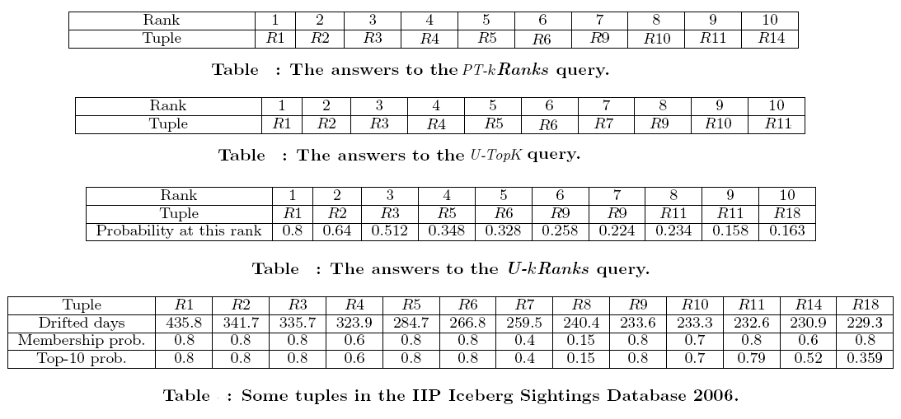
Experiments
No R14 but R7
No R10
No R14

Slide 13
Conclusion
A semantically novel formulation of probabilistic threshold top-k query on uncertain data
A exact algorithm (with rule-tuple compression and several pruning techniques to improve efficiency), a fast sampling method (with approximation quality guarantee) and a Poisson approximation based method (that works in linear time)
Comparison of proposed framework with existing U-Top K query and U-K Ranks query

Slide 14
Questions?
Thank You

