Slide 1
Tag-Based Optimization for Top-k Product Design
Mahashweta Das, Gautam Das University of Texas at Arlington
Vagelis Hristidis Florida International University

Slide 2
Motivation

Slide 3
Problem Statement
Given a database of tagged products, task is to design k new products (attribute values) that are likely to attract maximum number of desirable tags
tag-desirability is just one aspect of product design consideration
Applications
electronics, autos, apparel
musical artist, blogger
Zoom?
Flash?
Resolution?
Light Sensitivity?
Shooting mode?

Slide 4
Optimization Function
Given a database of products, each having a set of attributes and a set of desirable tags:
Build a Naive Bayes Classifier and compute P (Tag | Attributes)
Given classifier, we derive:
Expected number of desirable tags new product is annotated with:

Slide 5
Proposed Solution
Problem is NP-Complete, even for:
Boolean attributes
Top-1
Naïve Bayes Classifier
Exact Algorithm
Naïve
Exact Two-Tier Top-K
Approximation Algorithm
Hill Climbing
Approx Two-Tier Top-K
PTAS

Slide 6
Exact Algorithm
Naïve brute-force
Consider all possible 2^{m} products and compute for each possible product
Exponential Complexity
Exact two-tier top-k (ETT)
Application of Rank-Join and TA top-k algorithm in a two-tier architecture
Does not need to compute all possible products
performs significantly better than naïve brute-force
Works well for moderate data instances, does not scale to larger data
In the worst case, may have exponential running time

Slide 7
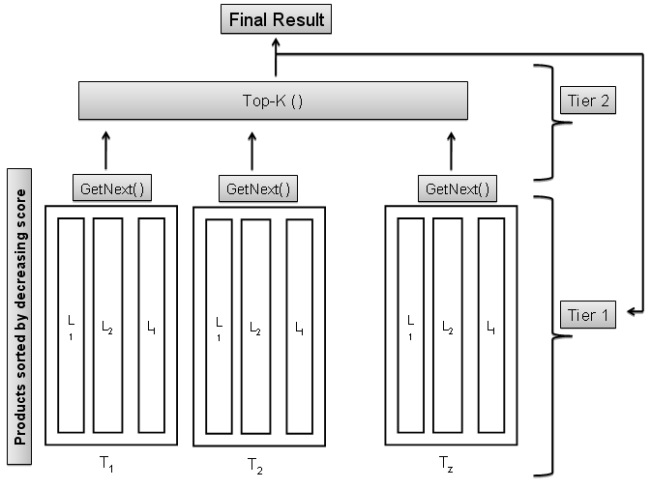
ETT: Two Tier Architecture
Determine “best” product for each tag in tier-1
Match these products in tier-2 to compute global best product across all tags

Slide 8
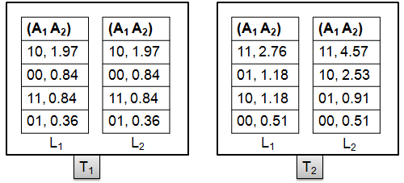
Main Algorithm
Database: {A₁, A₂, A₃, A₄ } and {T₁, T₂} and top-1
Partition attributes into 2 groups {A₁, A₂} and {A₃, A₄ } to form 2 lists of partial products
Each list has 2² = 4 entries (partial products)
Compute score for each partial product for each tag using
and sort in descending order

Slide 9
Buffer Top-K () | Product | Complete Score
 | 1111 | 1.75
 | 1010 | 1.70
Tier 2
MinK (1.75) <= MUS (1.88)
Return to Tier 1
GetNext( ) = 1010
GetNext( ) = 1111
(A₁ A₂)
10, 1.97
00, 0.84
11, 0.84
01, 0.36
(A₁ A₂)
10, 1.97
00, 0.84
11, 0.84
01, 0.36
(A₁ A₂)
11, 2.76
01, 1.18
10, 1.18
00, 0.51
(A₁ A₂)
11, 4.57
10, 2.53
01, 0.91
00, 0.51
Tier 1
Join
Join
L₁
L₂
L₁
L₂
T₁
T₂
Join | Product | Actual Score | MPFS
1 | 1010 | 0.95 | 0.95
2 | ..
.. | ..
Join | Product | Actual Score | MPFS
1 | 1111 | 0.93 | 0.93
.. | ..
.. | ..
>=
>=

Slide 10
Buffer Top-K () | Product | Complete Score
 | .. | ..
 | .. | ..
MUS: sum of last seen score from all GetNext()
Tier 2
GetNext() =
GetNext() =
(A₁ A₂)
10, 1.97
00, 0.84
11, 0.84
01, 0.36
(A₁ A₂)
10, 1.97
00, 0.84
11, 0.84
01, 0.36
(A₁ A₂)
11, 2.76
01, 1.18
10, 1.18
00, 0.51
(A₁ A₂)
11, 4.57
10, 2.53
01, 0.91
00, 0.51
Tier 1
L₁
L₂
L₁
L₂
T₁
T₂
Join | Product | Actual Score | MPFS
.. | .. | .. | ..
.. | .. | .. | ..
MPFS:

Slide 11
Questions?
Thank You

