Slide 1
Supporting Tok-k Join Queries in Relational Databases
Ihab F.Iiyas, Walid G.Aref and Ahmed K.Elmagarmid CSE 6339
Presented by
Niharika pamu

Slide 2
Outline
Introduction
Motivation
Requirements
Paper’s Contribution.
Related Work
Overview of Ripple Join
Rank Join Algorithm
Example with different strategies.
HRJN
HRJN*
Generalizing the rank join.
Performance
Observations
References

Slide 3
Introduction
Ranking queries(top-k queries).
Aim to provide only the top-k results that are ordered on some computed score
Top-k join queries.
Queries which involve joins.

Slide 4
Examples -Multimedia Retrieval by Contents
video database system (VDBMS)
Ranking wrt edge orientation
Ranking wrt color histogram
Ranking wrt texture
SIMILARITY MATCHING

Slide 5
Examples –Ranking over external sources
Hotel(h)
C1: r.cuisine=“italian”
C2:h.price+r.price<100
C3: r.area=m.area
Museum (m)
person
Restaurant (r)

Slide 6
Predicates:
p1: cheap (h:price)
p2: close (h:addr; r:addr)
p3: related (m:collection, \dinosaur")
Scoring function : p1+p2+p3
Query:
SELECT
FROM Hotel h, Restaurant r, Museum m
WHERE c1 AND c2 AND c3
ORDER BY p1 + p2 + p3
LIMIT k
prohibitively expensive

Slide 7
Motivation
MGJN : In Sort-merge joins only the order on the join column can be preserved.
NLJN: In Nested-loop joins only orders on the outer relations are preserved through the join.
HSJN : In Hash join orders from both inputs are usually destroyed after the join, when hash tables do not fit in memory.

Slide 8
SELECT A.1, B.2
FROM A, B, C
WHERE A.1 = B.1 and B.2 = C.2
ORDER BY (0.3*A.1 + 0.7*B.2)
STOP AFTER 5

Slide 9
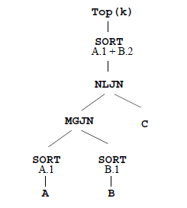
What are the problems in this??

Slide 10
Requirements
We need the new rank-join operator to:
Perform basic join operation.
Conform with current query operator interface.
Make use of the individual orders of its inputs.
Produce the first ranked join results.
Adapt to input fluctuations.

Slide 11
Paper’s Contribution
Proposes a new Rank-Join algorithm.
Analyzes the I/O cost of the algorithm along with proof of its optimality.
Implements the proposed algorithm in pipelined rank-join operators (based on ripple join).
Proposes an optimal join strategy
Provides optimization mechanism to determine best order to perform the rank-join operations.
Evaluates performance and compares other approaches

Slide 12
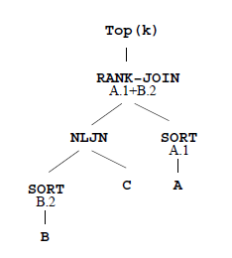

Slide 13
Related Work
Fagin et al. introduced the 1st set of algorithms to answer ranking queries
The TA Algorithm
The NRA Algorithm
The J* Algorithm
The NRA-RJ Algorithm
Importance-based join processing

Slide 14
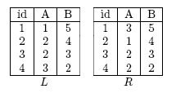
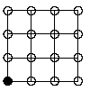
Ripple Join
JOIN : L.A = R.A L and R are descending, ordered by B
We get a tuple from L and a tuple from R
(L1(1,1,5) R1(1,3,5))
No valid join result
L
R
14

Slide 15
JOIN: L.A = R.A
We get a second tuple from L and a second tuple from R and join with prior tuples, creating all possible combinations
(L2,R2) {(2,2,4),(2,1,4)}
L
R

Slide 16
JOIN: L.A = R.A
(L2,R2) {(2,2,4),(2,1,4)}
(L2,R1) {2,2,4), (1,3,5)}
(L1,R2) {(1,1,5), (2,1,4)}
is a valid join result!
L
R

Slide 17
VARIATIONS:
Rectangle – obtain tuples from one source at a higher rate than from the other source
Block – obtain data b tuples at a time, for classic ripple join b = 1
Hash –in memory, maintain hash tables of the samples obtained so far
Faster IO Degrades to block ripple join when hash tables exceed memory size

Slide 18
Rank-Join Algorithm
Generate new valid join combinations
Compute score for each valid combination
For each incoming input, calculate the threshold value T
Store top k in priority queue Lk
Halt when lowest value of queue, scorek ≥ T

Slide 19
Select * From L, R
Where L.A = R.A
Order By L.B + R.B
Stop After 2
Initial Input:
(1). Get a valid join combination using some join strategy
Ripple Select (L1, R1) => Not a valid join result
Next input:
(1). Get a valid join combination using some join strategy
Ripple Select (L2, R2)
(L2, R2), (L2, R1), (L1, R2) => (L1, R2) is a valid join result

Slide 20
Select * From L, R
Where L.A = R.A
Order By L.B + R.B
Stop After 2
(2). Compute the score (J) for the result
J1(L1, R2) => L.B + R.B = 5 + 4 = 9
(3). Compute a threshold score
T = Max ( Last L.B + First R.B, First L.B + Last R.B )
For Ripple Selection (L2, R2) =>
T = Max ( L2.B + R1.B, L1.B + R2.B )
= Max (4+5, 5+4) = 9
J1 = 9
T = 9

Slide 21
Select * From L, R
Where L.A = R.A
Order By L.B + R.B
Stop After 2
(4). J1 >= T, so report J1 in top-k results (i.e. add it to list Lk )
Since we need top 2 (k=2), continue until k=2 and Min(J1, J2, …Jk) >= T

Slide 22
Example Continued ..
Select * From L, R
Where L.A = R.A
Order By L.B + R.B
Stop After 2
Next input:
1). Get a valid join combination using some join strategy
Ripple Select (L3, R3)
(L3, R3), (L3, R1), (L3, R2), (L1, R3), (L2, R3)
=> (L3, R3), (L2, R3) are valid join results
(2). Compute the scores (J) for the results
J2(L2, R3) = 4 + 3 = 7 J3(L3, R3) = 3 + 3= 6

Slide 23
Select * From L, R
Where L.A = R.A
Order By L.B + R.B
Stop After 2
(3). Calculate a NEW threshold T
T = Max ( Last L.B + First R.B, First L.B + Last R.B )
= Max ( L3.B + R1.B , L1.B + R3.B )= Max(3 + 5, 5 + 3) =8
T = 8
J1(L1,R2) = 9 reported
J2( L2, R3) = 7
J3(L3, R3) = 6
Note, J’s are in descending order
(4). Min (J) = 6 < T so continue

Slide 24
Select * From L, R
Where L.A = R.A
Order By L.B + R.B
Stop After 2
Next input:
(1). Get a valid join combination using some join strategy
Ripple Select ( L4, R4) => (L4, R1), (L2, R4), (L3, R4) are valid join results
(2). Compute the scores (J) for the results
J(L4, R4) = 7, J(L2, R4) = 6, J(L3, R4) = 5
(3). Calculate a NEW threshold T
T = Max( L4.B+R1.B, L1.B + R4.B ) = Max( 7, 7 ) = 7

Slide 25
Select * From L, R
Where L.A = R.A
Order By L.B + R.B
Stop After 2
T= 7
J1(L1,R2) = 9, J2(L2, R3) = 7, J3(L4, R1) = 7, J3(L3, R3) = 6, J4(L2, R4) = 6,
J5(L3, R4) = 5
(4). Min(J1, J2) = 7 >= T (k = 2), so report J2 and STOP
Comment: When reach all records, T does not need to be calculated, unless, calculate T first, and compare each J(i) with T immediately.

Slide 26
Example With Different Strategy
Select * From L, R
Where L.A = R.A
Order By L.B + R.B
Stop After 2
Instead of Select Ripple, Select Rectangle Ripple…
Obtain all tuples in L and only 1st tuple in R
Initial Input
(1). Get a valid join combination using some join strategy
Rectangle Ripple (L1 to L4, R1) => (L4, R1) is a valid join result
(2). Compute the score (J) for the result
J1(L4, R1) = 2 + 5 = 7
(3). Calculate a NEW threshold T
T = Max( L4.B+R1.B, L1.B + R1.B ) = Max( 7, 10 ) = 10

Slide 27
Select * From L, R
Where L.A = R.A
Order By L.B + R.B
Stop After 2
(4). Min(J1, J2) = 7 < T = 10 (k = 2), so just continue
Next Input
(1). Get a valid join combination using some join strategy
Rectangle Ripple (L1 to L4, R2) => (L1, R2) is a new valid join result
(2). Compute the score (J) for the result
J2(L1, R2) = 9
(3). Calculate a NEW threshold T
T = Max( L1.B+R1.B, L1.B + R2.B ) = Max( 10, 9 ) = 10

Slide 28
Select * From L, R
Where L.A = R.A
Order By L.B + R.B
Stop After 2
(4). Min(J1, J2) = 9 < T = 10 (k = 2), so continue
J2 cannot be reported because of threshold = 10, but this was the top-ranked join result in prior strategy…
This suggests using join strategies that reduce the threshold value as quickly as possible to be able to report top-ranked join results early on.

Slide 29
Hash Rank Join (HRJN) Operator
Built on idea of hash ripple join.
Inputs are stored in two hash tables
A queue holds ordered join results
Ltop, Rtop, Lbottom, Rbottom are used to calculate T
Advantages:
Smaller space requirement
Can be pipelined

Slide 30
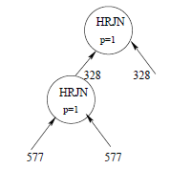
Problems in Implementation:
Buffer problem
Local Ranking Problem

Slide 31
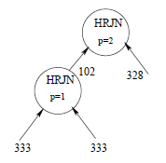
Solution:
Use Block Ripple Join to Solve Local Ranking Problem –- Set p = 2

Slide 32
HRJN*
Score-Guided Strategy
Consider L = 100, 50, 25, 10…. R= 10, 9, 8, 5..
For 3 tuples from each input,
T = max(108,35) = 108 T1= 108 , T2 =35
For 4 tuples from R and 2 tuples from L,
T = max(105,60) = 105 T1= 105 , T2 =60
If T1 > T2, more inputs should be taken from R and reduce T1.
Therefore value of Threshold T will reduce => faster reporting of ranked join results.

Slide 33
Generalizing Rank-Join
Using indexes
an index on only one of the two inputs
an index on each of the two inputs.
Eliminate duplications
Faster termination

Slide 34
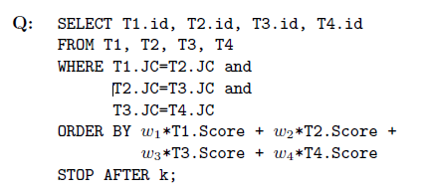
Performance

Slide 35
Performance

Slide 36
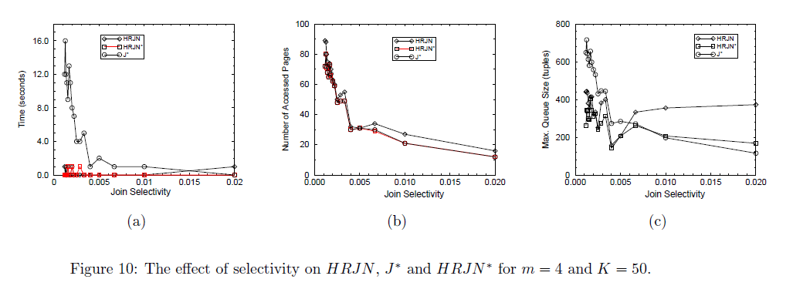

Slide 37
Observation
Integrates well with query plans and supports top – k queries
Produces results as fast as possible
Minimizes space requirements
Eliminates needs for sorting after join

Slide 38
Conclusion
New join-rank algorithm
Hash Rank Join
HRJN*
General rank-join algorithm
Experiments Result

Slide 39
References
“Supporting top-k join queries in relational databases” - Ihab Ilyas, Walid Aref, Ahmed Elmagarmid
http://www.cs.uwaterloo.ca/~ilyas/RankDB/
http://crystal.uta.edu/~cse6339/Slides09/Final%20Supporting%20top-k%20queries%20in%20Relational%20databases.pptx

Slide 40
THANK YOU!!!!!!

