Slide 1

Introduction to Environmental Systems Research Institute or ESRI’s ArcGIS
Neelabh Pant
http://Crystal.uta.edu/mastdb/pant.html
University of Texas, Arlington.
February 2017

Slide 2
Overview
What is GIS?
Common uses
Software
Interface & navigation
Adding layers
Customizing & displaying layers
Select features by attribute
File management
Data sources

Slide 3
What is GIS?
GIS--what’s in the S?
  Systems: the technology
  Science: the concepts and theory
  Studies: the societal context the legal context, issues of privacy, confidentiality, economics of geographic information
Geographic Information Systems (GIS) is a computer-based methodology for collecting, managing, analyzing, modeling, and presenting geographic or spatial data.
Notes:
More background information on GIS: bit.ly/T7Du2n

Slide 4
What is ArcGIS
ArcGIS is a geographic information system (GIS) for working with maps and geographic information.
It is used for: creating and using maps; compiling geographic data; analyzing mapped information; sharing and discovering geographic information; using maps and geographic information in a range of applications; and managing geographic information in a database

Slide 5
Two Types of Spatial Data
    Vector
      Points (single x,y coordinate)
      Lines (strings of x,y coordinates)
      Polygons (closed string of x,y coordinates)
    Raster
      A grid of (often) square-shaped cells
      Individual cells together are used to create a layer of points, lines and areas
Notes:
What is raster data? bit.ly/13o1cxK

Slide 6
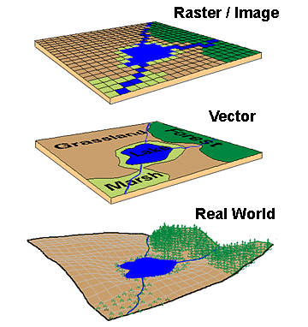
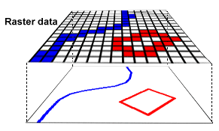
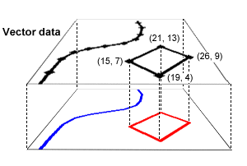
Raster vs. Vector data

Slide 7
Shape File xxx.shp
.shp — shape format; the feature geometry itself
.shx — shape index format; a positional index of the feature geometry to allow seeking forwards and backwards quickly
.dbf — attribute format

Slide 8
<filename>.shp | stores the spatial or feature information
<filename>.dbf | dBASE file contains attribute information about the spatial features
<filename>.shx | stores the index of the features
<filename>.sbn | stores the spatial index of features
<filename>.sbx | also stores information pertaining to the spatial index of features
<filename>.prj | contains project information (generic extension)

Slide 9
Geodatabases
(xxx.mdb)
Core ArcGIS data model
    A comprehensive model for representing and managing geographic data
Personal Geodatabase
    Single user editing / multiple readers
    Stored in MS Access
ArcSDE (Spatial Database Engine) Geodatabase
    Stored in an Enterprise DBMS
    Supports multiuser editing via versioning
    Requires ArcEditor or ArcInfo to edit

Slide 10
What is ArcSDE?
ArcSDE is ESRI's technology for accessing and managing geospatial data within relational databases.
ArcGIS
ArcSDE
Personal
Geodatabase
File
Geodatabase
ArcSDE
Geodatabase
Oracle
SQL Server
DB2
Informix
PostgreSQL

Slide 11
Common Uses
Analyzing potential environmental hazards
Emergency services planning and routing
Citing new facilities:
  wind farms
  power plants
  vineyards
Identifying food deserts in urban areas
Much more!

Slide 12
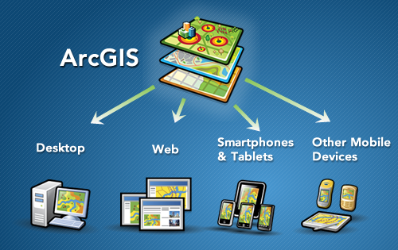

Slide 13
ESRI
Environmental Systems Research Institute
ESRI is now Esri
Industry leader for GIS software
Program is ArcGIS/ArcMap
  Now up to version 10.1.
Notes:
Esri is the maker of the foremost GIS software package. ArcGIS refers to a suite of GIS products from Esri, including the desktop program, ArcMap. However, the desktop program is also sometimes referred to as “ArcGIS”.

Slide 14
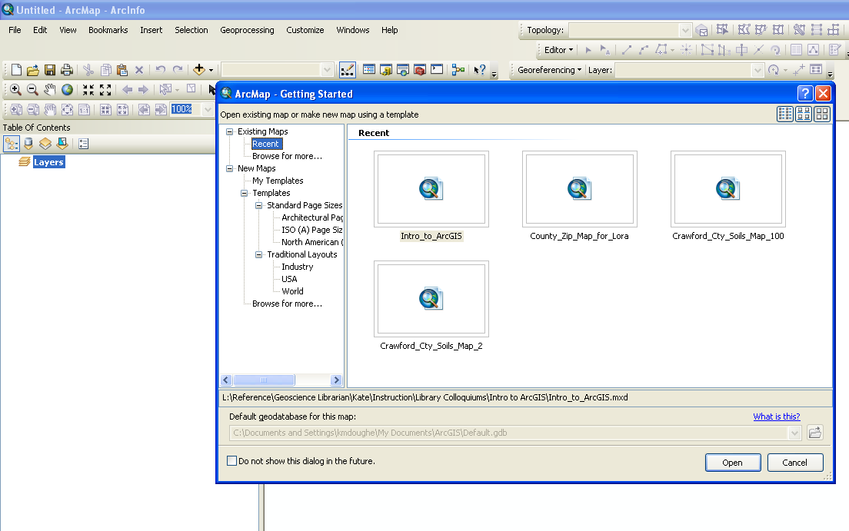
Notes:
This “Getting Started” dialog box is what the user sees when the program is first opened. It will ask if you want to open a recent map document or start with a saved template. A new user can just click “New Maps” in the left-hand panel, then “blank map” in the right panel.

Slide 15
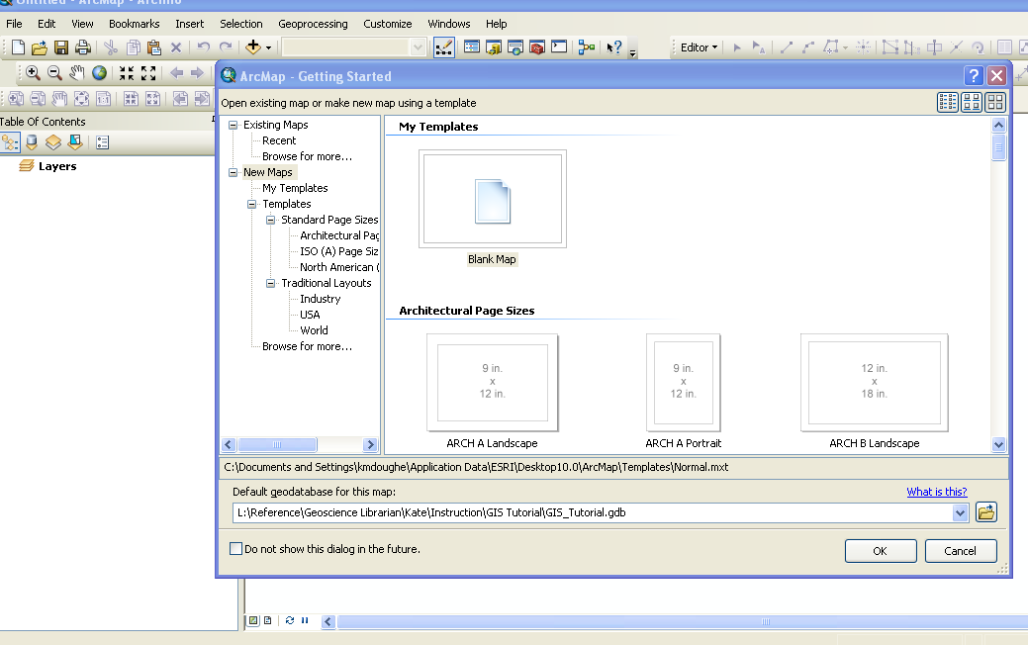
Notes:
Your new geodatabase is now associated with your new map document. Click OK.

Slide 16
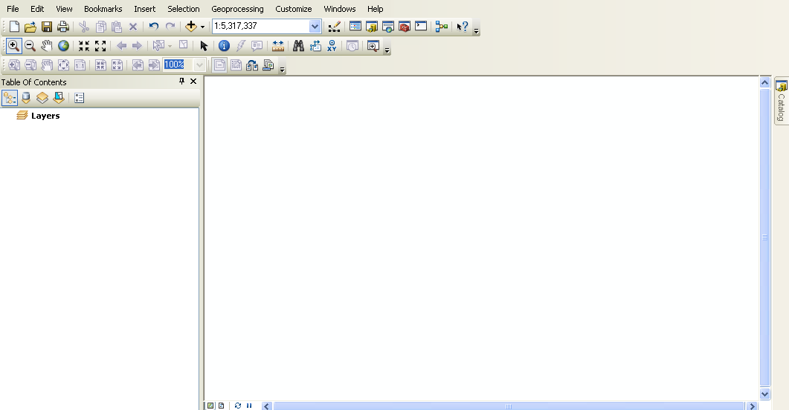
Table of contents that shows the doc’s layers.
The “data frame” that displays the spatial data.
Notes:
This is the ArcMap interface. There a table of contents panel on the left that will list all the layers in our map document once they’ve been added. On the right is the “data frame” that will display the data layers.

Slide 17
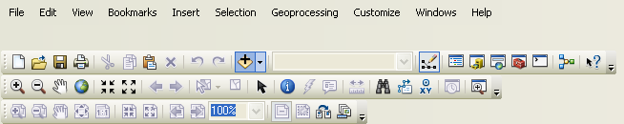
Identify feature
Go to full map extent
Go to previous extent
Go to next extent
Select features (by hand)
Select elements (to move or edit)
Clear selected features
Add data
Notes:
An overview of some of the main icons on the Tools toolbar.

Slide 18
How to work in ArcGIS

Slide 19
Add Layers
Download required shapefiles.
Create a library from where all the data can be retrieved easily.
Notes:
This tutorial uses data downloaded from the sources shown above. (Note: it’s preferable to download data to your default geodatabase, though that’s not the case in this tutorial). The data on your machine can then be loaded into ArcMap. For more on file geodatabases and the data types that can be stored in them, see bit.ly/WXFSdk.

Slide 20
Click to add data
Notes:
Click the “add data” button to load your geospatial data into ArcMap.

Slide 21
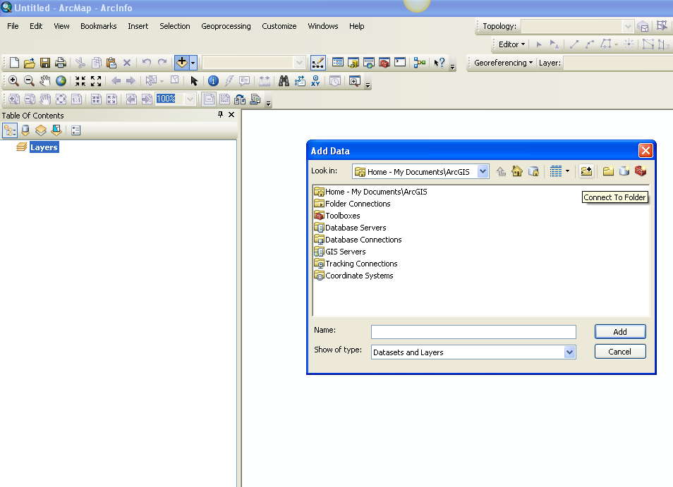
Notes:
ArcMap isn’t like Windows, where you can just browse to any location. First you have to “connect” to the folder you want to use in order for it to appear as a choice in your drop-down list, using the “Connect to Folder” button. Only the folders I’ve connected to will appear in the “Look in” drop-down. The folders needed for this map have already been connected.

Slide 22
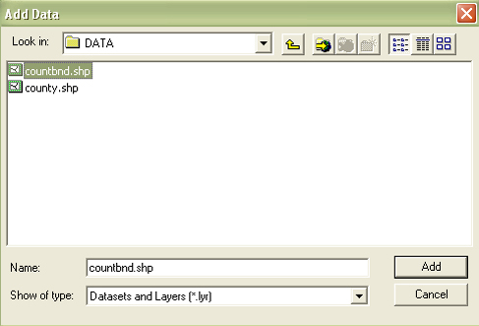
Notes:
Choose from available files.

Slide 23
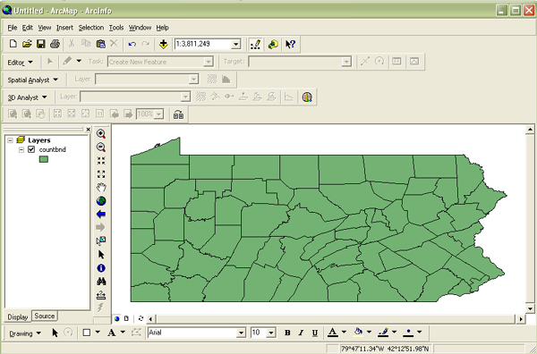
Notes:
The added file is displayed in the data frame on the right, and is listed in the table of contents (TOC) on the left.

Slide 24

In ArcGIS you can add layers several ways. From the File pull-down menu, select Add Data or use the Add Data Button .
Navigate to where data is stored and select "Centre.shp" to add to your Table of Contents.
Notes:
About coordinate systems: bit.ly/SoWYVB

Slide 25
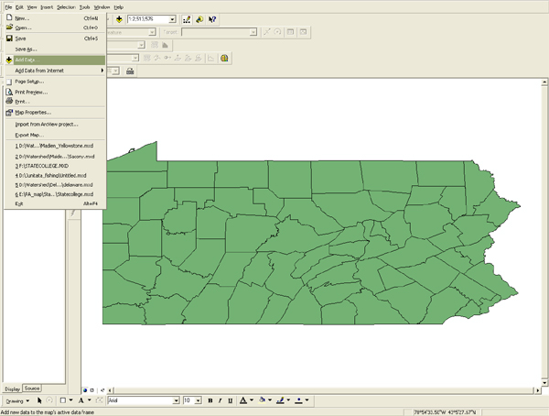
Notes:
This is what the data frame/Arkansas looks like once all layers have been added. Let’s zoom in to Washington County. There are a number of ways to do that. One option is to use the “spyglass with plus sign” icon and draw a box around the area. Or, since the parcels layer covers the desired extent we can right-click on it in the TOC and select “zoom to”…

Slide 26
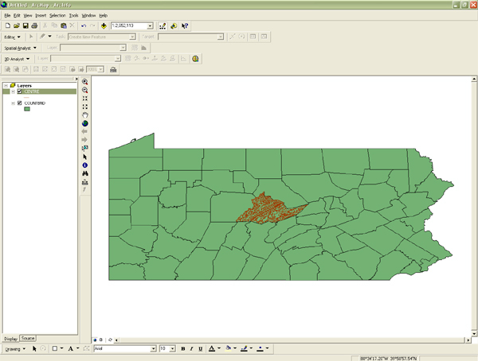
Notes:
pennsylvania

Slide 27
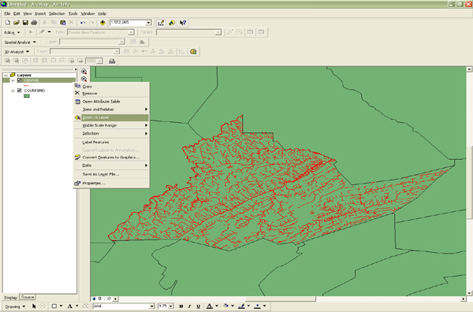
Notes:
Layer names can be edited to be more intuitive. Click on the name in the TOC until you get the typing cursor. Renaming them here in the map document will not change the names of the actual files on your computer – just in the TOC in ArcMap.

Slide 28
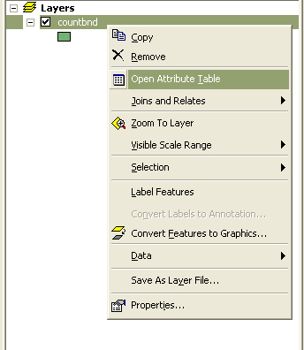
Open the Attribute Table
Notes:
In most cases the spatial data comes with associated attribute data. Right-click on the states layer and select “Open Attribute Table” to view it.

Slide 29
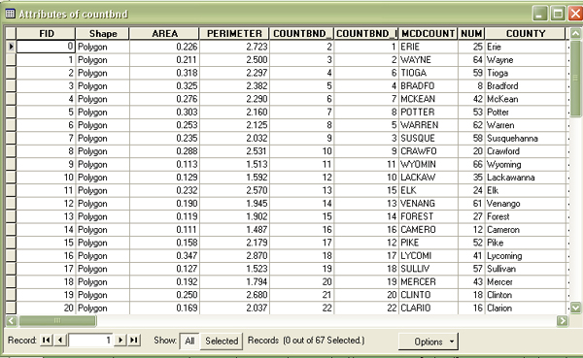
Notes:
Each table will have an FID column (unique feature ID auto-generated by the system) and a shape column (for point, line, or polygon). For example, a parcel is represented by a polygon, a road is a line, and statue would be a point or dot. The rest of the information is supplied by the originator of the dataset.

Slide 30

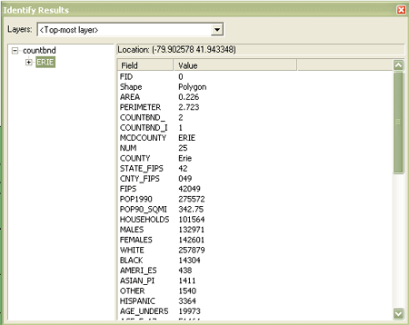
A quick way to get information about a particular county is to use the Identify Results Tool . Click on the Identify tool and select a county in the View. The identify results box will appear.

Slide 31
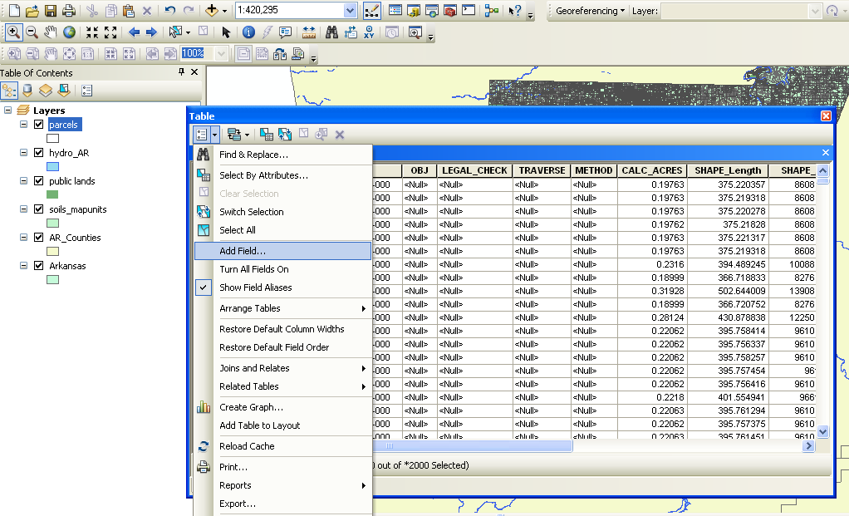
Add New Columns to Attribute Table
Notes:
Right-click on the parcel layer in the TOC and choose “Open Attribute Table”. Then, click the drop-down arrow next to the first icon in the new window and choose “Add Field…”.

Slide 32
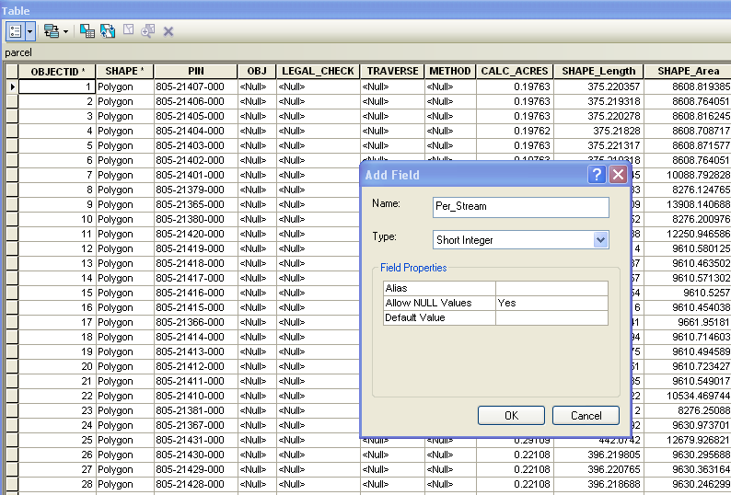
Notes:
Name your field.

Slide 33
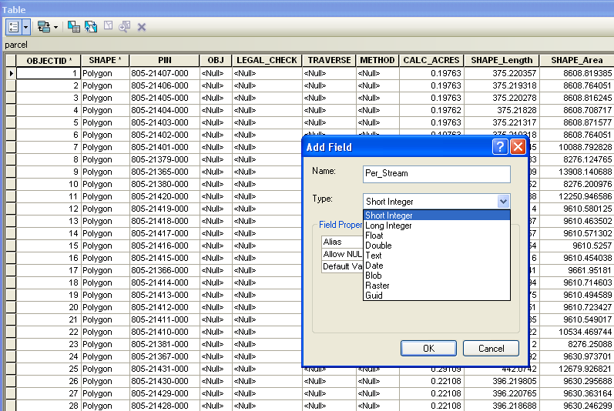
Notes:
Choose a field type…

Slide 34
Field Types
Whole Numbers
Decimals
Short Integer
(integers from -32,768
to 32,767)
Long Integer
(integers from -2,147,483,648 to 2,147,483,647)
Double
(up to 6 decimal places)
Float
(unlimited # of decimal places)
Notes:
The field type definitions look scary, but just remember that if you will be using whole numbers, use an integer field. Usually all you need is a short integer. If you need to enter decimals, use a non-integer field. Again, your choice will depend on how many characters you’ll need. More on field types: bit.ly/XWtPmH.

Slide 35
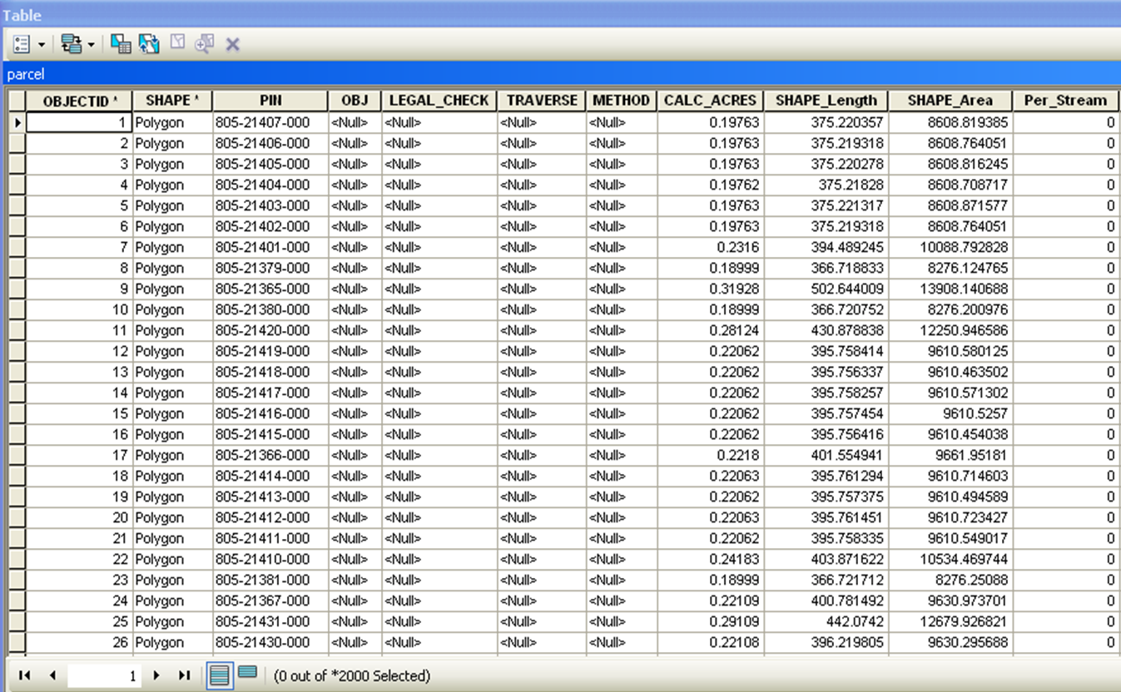
Notes:
Under some circumstances you can set a default value for the field. In this case we would like to set a default value of 0. However this option is unavailable for the file type of this layer. Another option is to use the field calculator. Right-click on the column header and select the field calculator to give all rows a value of “0” in that column. It could take a good amount of time to process, depending on the number of rows involved – in this case about half an hour. Just leave ArcMap alone and work on something else in the meantime. An image of the field calculator window is included within the next few slides.

Slide 36
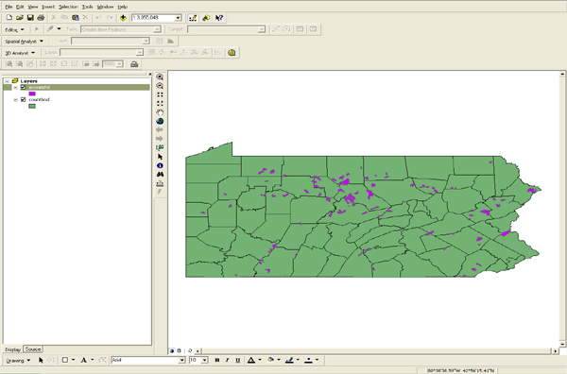
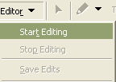


Slide 38
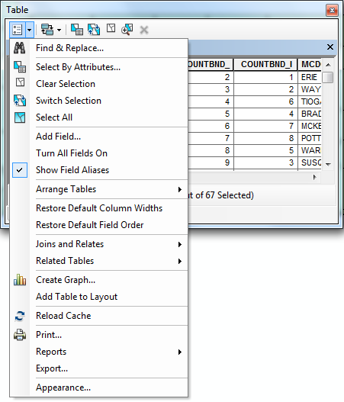

Slide 39
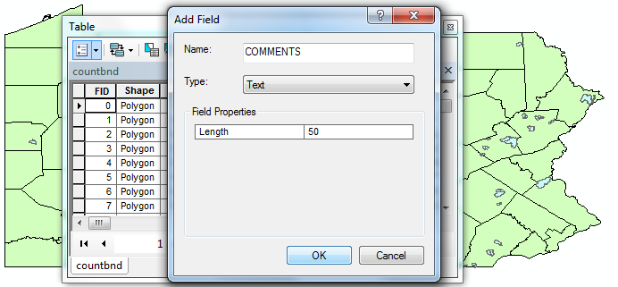

Slide 40
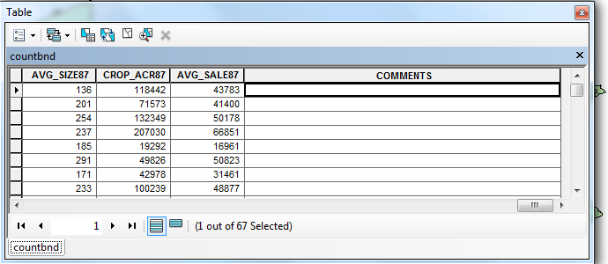

Slide 41
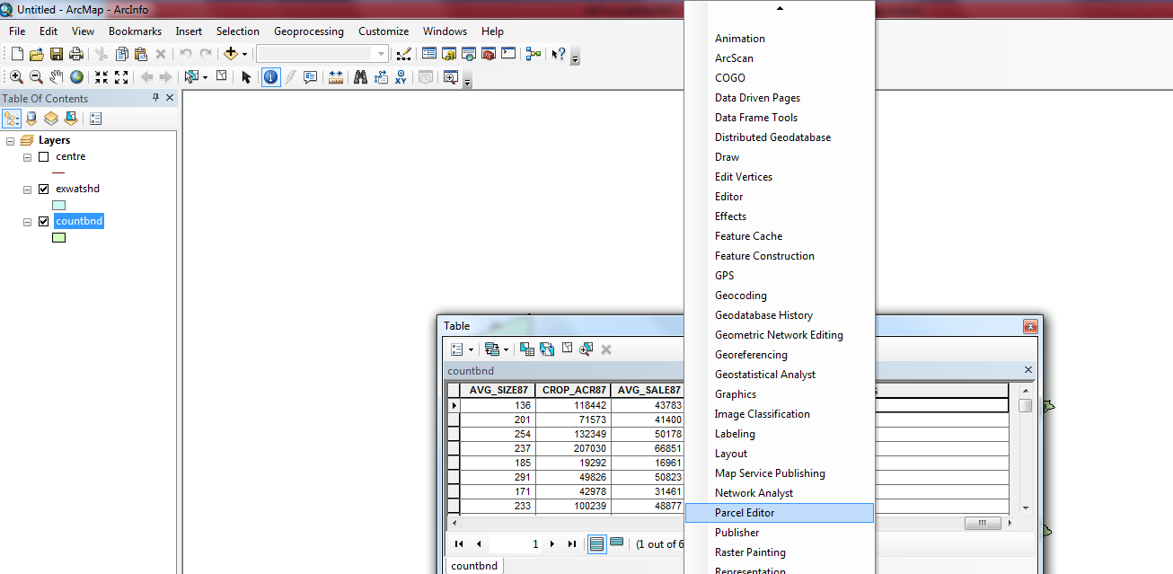

Slide 42
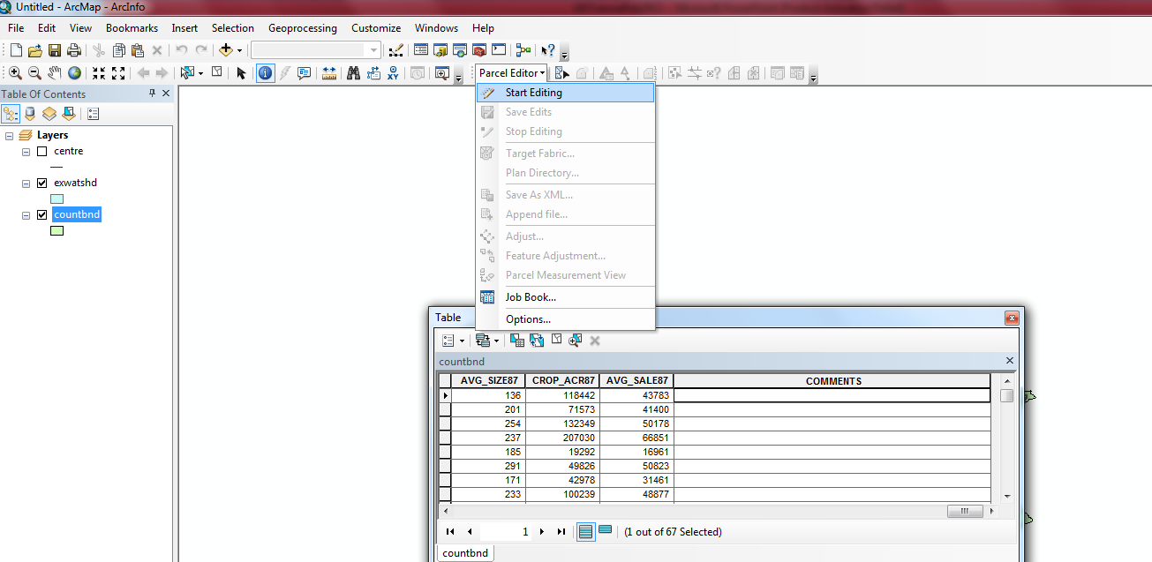

Slide 43
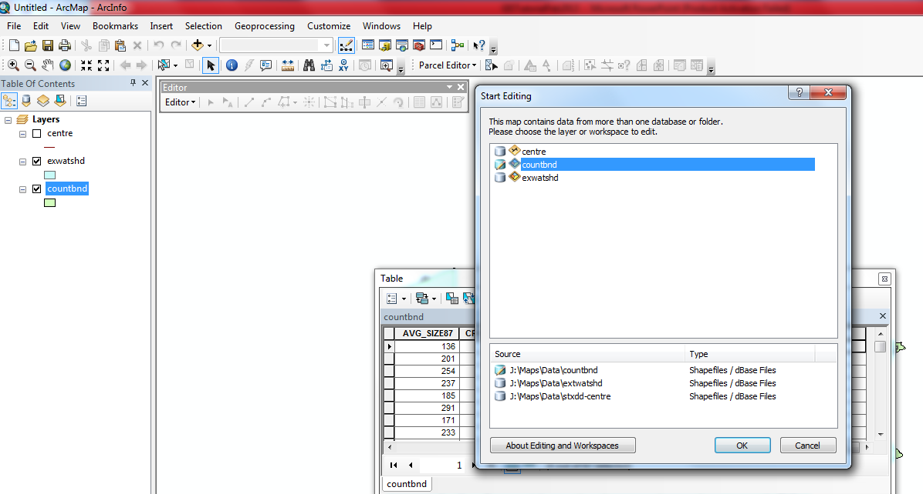

Slide 44
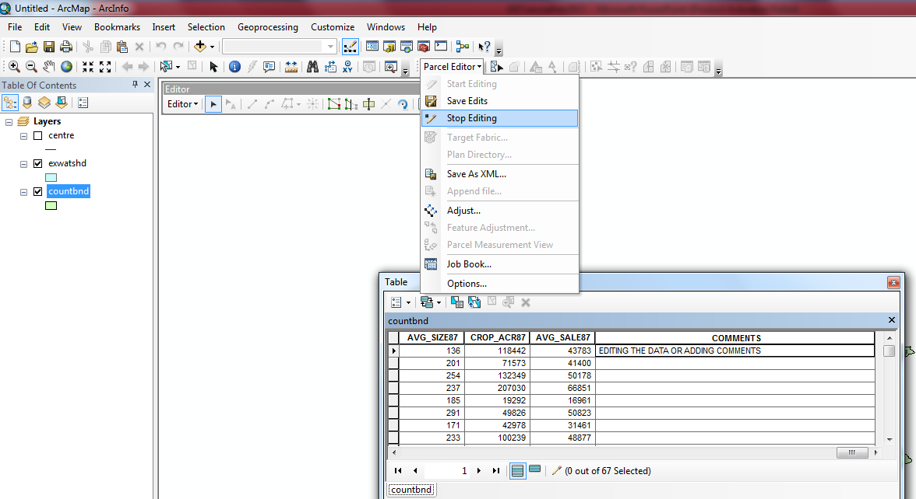

Slide 45
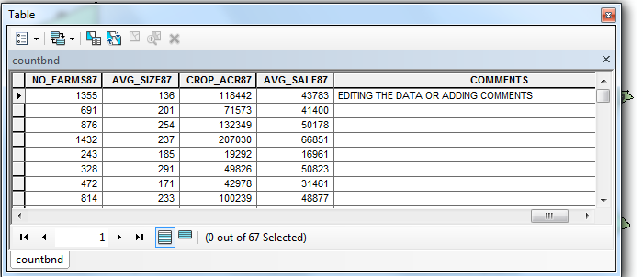

Slide 46
Share Maps and Layers with Packages
Package up all the information used to create a layer or map document for easy sharing by email, a shared drive on the LAN, etc.
Right-click a layer in the TOC and select “Create Layer Package”

Slide 47
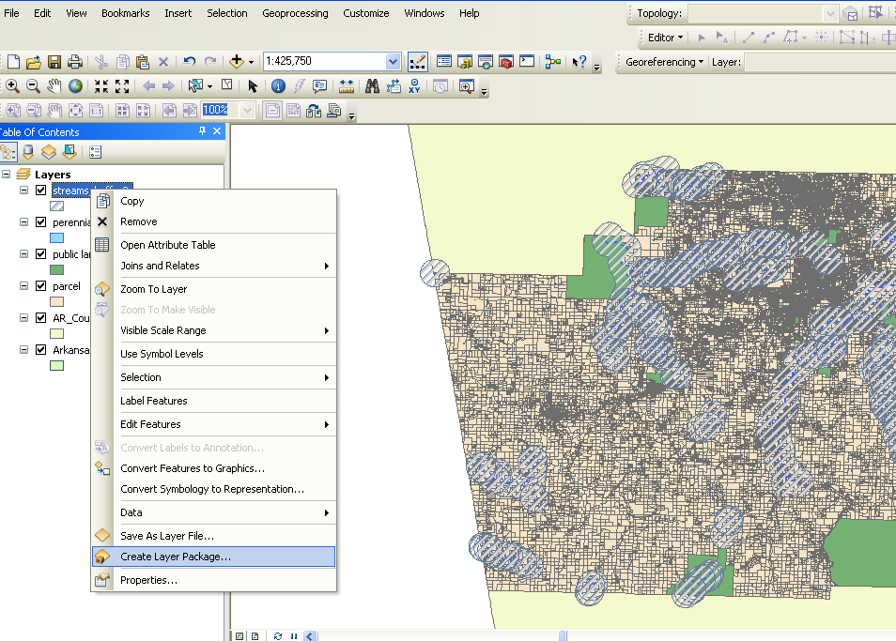
Notes:
More about layer packages: bit.ly/TPkglN

Slide 48
Share a Map Package
To package up an entire map document for sharing, use File | Create Map Package

Slide 49
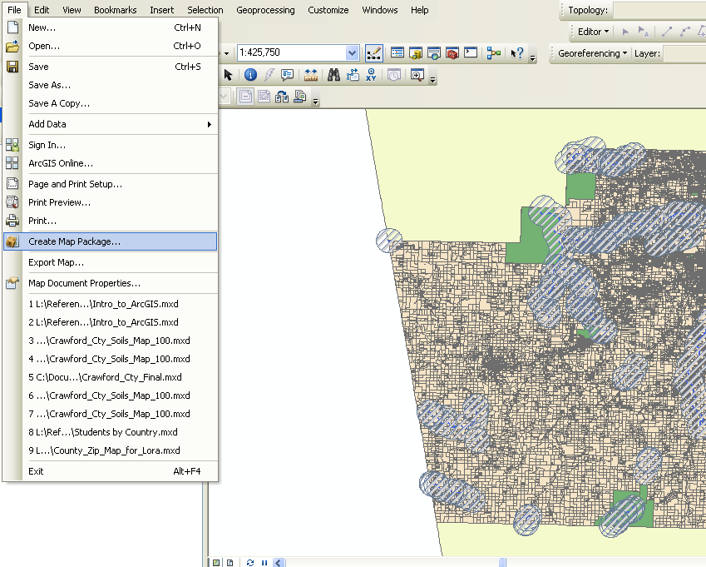

Slide 50
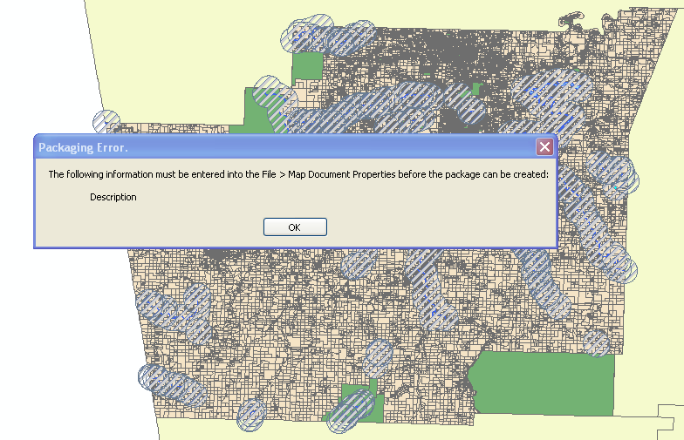
ArcMap will force you to create some limited metadata before creating a sharable package. Click OK.

Slide 51
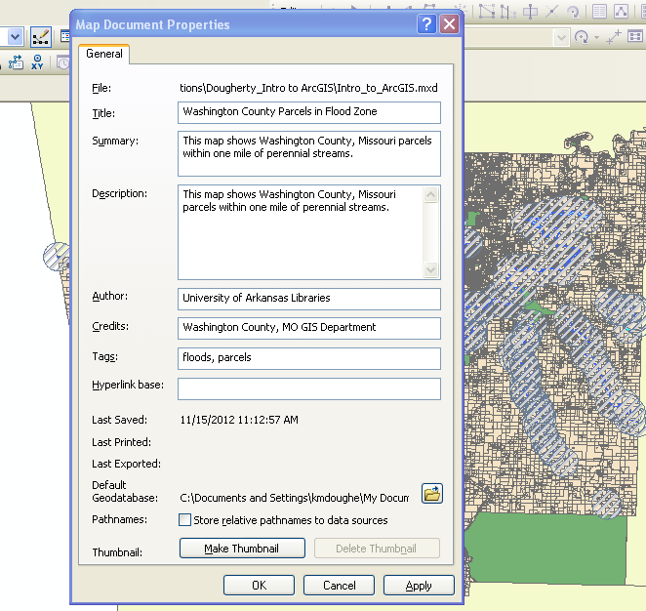

Slide 52
Creating Packages
Save the package as a file and share as you usually would
You must “validate” your package before saving
  Detects any errors that would impede sharing

Slide 53
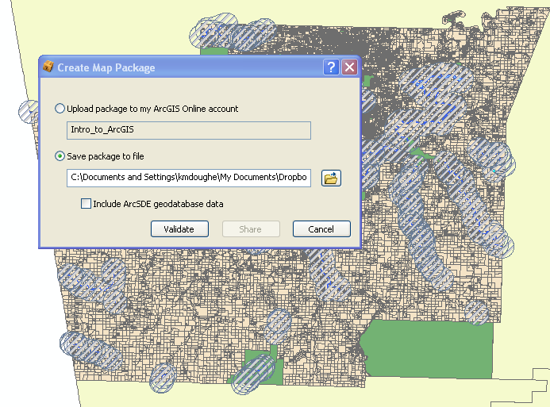

Slide 54
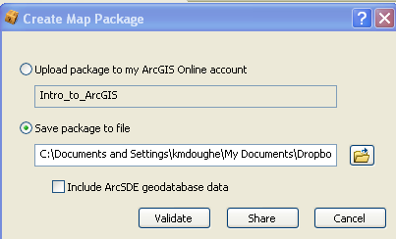
Validation
Any errors need to be corrected. Click on any error messages to see a help document.
Warnings are warnings only – can go ahead and publish.
If no problems, the share button will become active.
Notes:
More about map packages: bit.ly/TPkmdc

Slide 55
What Else Can You Do with GIS?
Create/digitize your own data
Import GPS data
Use web map services for mashups in your own applications.
Much More!
Notes:
About adding a table of statistics: bit.ly/VUnvGI
About joining tables: bit.ly/VQ9hJm

Slide 56
GIS Software at University of Texas, Arlington.
University Hall Laboratory (014)
ArcGIS version 10.1 (Latest!)
180 days free trial available online
Direct link→ http://www.esri.com/software/arcgis/explorer-desktop/download
Notes:
More on GIS software: bit.ly/3vaUYY

Slide 57
Sources of GIS Data
Search for selected base layers (reference maps) from right within the application
ArcGis.com (ESRI official website)
geo.data.gov (federal portal)
pasda.psu.edu (Pennsylvania Spatial Data Access)
Kate Dougherty, Geosciences & Maps Librarian’s online presentation.

Slide 58
Good luck!
Thank you!

