Slide 1
Introduction to spatial file formats and spatial databases
The University of Texas at Arlington Neelabh Pant
http://Crystal.uta.edu/mastdb/pant.html
02/06/2017

Slide 2
Outline
Keyhole Markup Language (KML)
WHAT/HOW/WHERE about KML
Sample KML files
Features
KMZ File
Shapefiles (.shp)
What it is
How to create one
Technical specification
Main file record content
Organization of the index file
Organization of the Dbase file
Spatial Database
PostGIS SQL

Slide 3
What/how/where about kml? (1)
KML is an XML-based language schema describing a geographic vocabulary used by geobrowser applications on 2/3 dimensional Earth maps.
Developed by Keyhole, Inc. along with Earth Viewer application in 2001.
Acquired by Google in 2004.
KML was converted for use for the Google Earth, Google Maps and Google Mobile applications.
The word Keyhole comes from an American Military reconnaissance satellite program developed in the 1970’s.
The Google Earth program both produces and consumes KML files.

Slide 4
What/how/where about kml? (2)
KML uses 3-dimensional geographic reference system of longitude, latitude and altitude to describe a basic point of view in space over or on the surface of the Earth.
It also adds more specific control over that view with heading, tilt and roll factors.
Can also add text information, graphic overlays, 3-D polygons, paths, icons and add embedded files (image or auditory) to enhance the geobrowser experience.
Like all XML, KML must begin with XML header information followed by the KML root element tags.

Slide 5
Sample kml file
<<?xml version="1.0" encoding="UTF-8"?>
<kml xmlns="http://www.opengis.net/kml/2.2">
<Placemark>
<Woolf Hall</name>
<description>Industrial, Mechanical Engineering Building.</description>
<Point>
<coordinates> - 97.11311723710504,32.73153178072037,…</coordinates>
</Point>
</Placemark>
</kml>
A Placemark object contains the following elements:
Name - the label for the Placemark
Description – about the placemark
Point – the position of the Placemark (latitude, longitude, and optionally altitude)

Slide 6
features
Coordinates: elements consisting of three floating point values
Latitude: is degree of north or south of the Equator (0 degrees). Values range from -90 to 90 degrees.
Longitude: is the angular distance in degrees, relative to the Prime Meridian. Values West range from -180 to 0 degrees and East range from 0 to 180 degrees.
Altitude: is the distance of the camera from the earth’s surface in meters interpreted according to the altitudeMode element.
altitudeMode values include:
relativeToGround – default in meters above the ground or level of water body.
clampToGround – exactly terrain or sea level height.
Absolute – meters above sea level
Heading is the direction (azimuth) in degrees from due North 0 to 360 degrees
Tilt is the rotation in degrees around the X axis
Roll is the rotation, in degrees around the Z axis. Values range from －180 to +180 degrees.

Slide 7
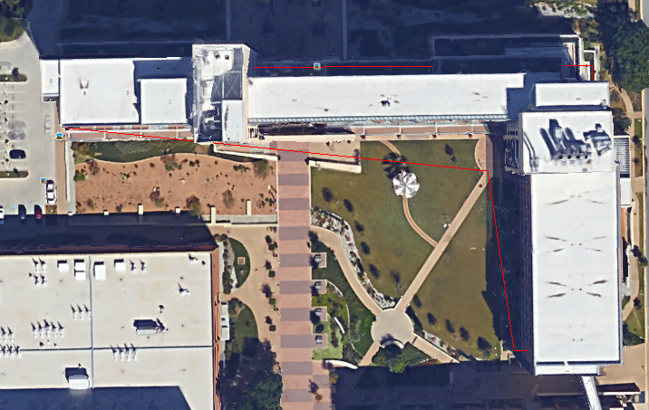
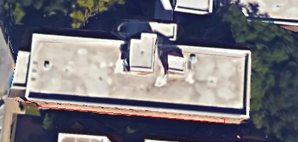
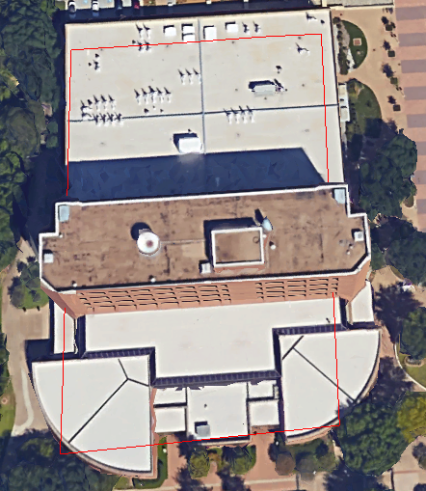
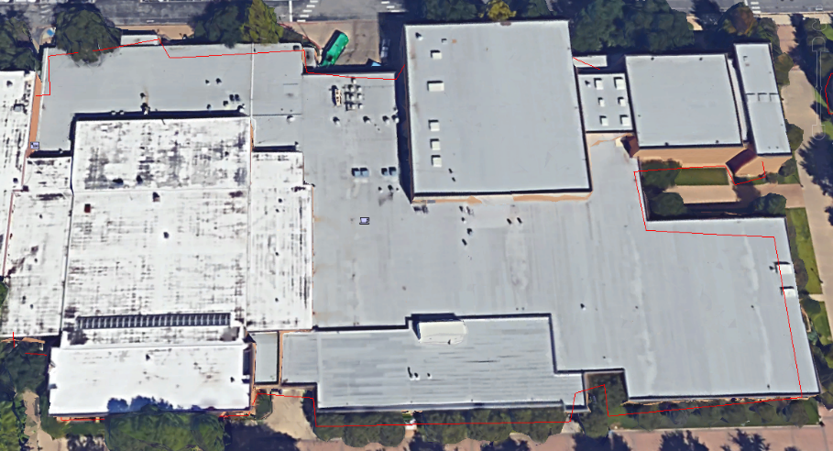
examples

Slide 9
KMZ File
A KMZ File consists of a main KML file and zero or more supporting files
All the files are compressed within a package in a zipped folder with .kmz suffix.
KMZ files can be stored, emailed and loaded from a web server.
When a KMZ file is unzipped, the main .kml file and its supporting files are separated in to their original formats and directory sturucture, with their original filenames and extentions.
The kml file can be run with Google Earth.

Slide 10
What is a Shapefile
A shapefile stores geometry and attribute information for the spatial features in a data set.
The geometry for a feature is stored as a shape comprising a set of vector coordinates.
Supports points, lines and area features. Area features are represented as closed loops.

Slide 11
How to create a Shapefile
Export – Export any data source to a shapefile using ARC/INFO, Spatial Database Engine (SDE) or ArcView GIS.
Digitize – Shapefiles can be created directly by digitizing shapes using ArcView GIS feature creation tools.
Programming – using ARC Macro Language (AML) you can create shapefiles within your programs.
Converting KML files to Shapefiles can create .shp format files.
My favorite is ogr2gui_0.7.

Slide 12
Technical specifications
An ESRI shapefile consists of
A main file (.shp)
An index file (.shx)
A dBase file (.dbf)
Main File (.shp) : it is a direct access, variable record length file in which each record describes a shape with a list of its vertices.
Index file (.shx) : Shape index format. It stores indexof the features which consists of positional index of the feature geometry to allow seeking forwards and backwards quickly
dBase file (.dbf) : dBase file contains attribute information about the spatial features.

Slide 13
Main file record content (1)
Shapefile or (.shp) file consists of a shape type followed by the geometric data for the shape.
Length of Record : It depends on the number of parts and vertices in a shape.
For each shape type, first describe the shape and then its mapping to record its content on disk.

Slide 14
Main file record content (2)
SHAPE TYPES IN X,Y SPACE :
1. Point – A point consists of a pair of double-precision coordinates in the order of X, Y.
Point
{
Double X //X coordinate
Double Y //Y coordinate
}
2. MultiPoint – A multipoint represents a set of points, as follows:
Multipoint
{
Double[4] box //Bounding Box
Integer NumPoint //Number of Points
Point[NumPoints] Points //The Points in the Set
}
The bounding box is stored in the order of Xmin, Ymin, Xmax, Ymax.

Slide 15
Main file record content (2)
3. Polygon – A polygon consists of one or more rings. A ring is a connected sequence of four or more points that form a closed, non-self intersecting loop.
The order of vertices or orientation for a ring indicates which side of the ring is the interior of the polygon.
Polygon
{
Double[4] Box //Bounding Box
Integer NumParts //Number of Parts
Integer[NumParts] Parts //Index to First Point in Part
Point[NumPoints] Points //Points for All Parts
}
Box: The Bounding Box for the polygon stored in the order Xmin, Ymin, Xmax, Ymax.
NumParts: The number of rings in the polygon.
NumPoints: The total number of points for all the rings
Parts: The array of length NumParts. It stores the index of its first point in the points array.
Points: An array of length NumPoints. It holds the array index of the starting point of each ring.

Slide 16
Organization of the index file
SHX is a file extention for a compiled shape entities file format.
SHX is the compiled machine code version of an SHP ASCII-based entities file.
The SHX file is binary, so one needs a hex editor to look inside.
The index file (.shx) contains a 100-byte header followed by 8-byte, fixed-length records which consist of the following two fields.
Bytes Types Usage
0-3 int32 Record Offset (in 16-bit words)
4-7 int32 Record length (in 16-bit words)
Using this index, it is possible to seek backwards in the shapefile by,
First, seeking backwards in the shape index (which is possible because it uses fixed-length records)
Second, reading the record offset, and using that offset to seek to the correct position in the .shp file.
It is also possible to seek forwards an arbitrary number of records using the same method.

Slide 17
Organization of dbase file
DBF is a file format typically used by database software.
DBF stands for DataBase file. Originally used in dBase II, and continued through dBase Version IV.
DBF files can be opened by Microsoft Excel and Microsoft Access.
This file contains the Attribute information, or the descriptive characteristics of the features.
Examples: “Name”, if the feature is a point representing a city, “Road Name”, or “Speed”, if the feature is a line representing a street or “Population” if the feature is a polygon representing a county area or country.

Slide 18
What is a spatial database and data
Database that:
Stores spatial objects
Manipulates spatial objects just like other objects in the database
Data which describes either location or shape
Example: House or Fire Hydrant Location, Roads, Rivers, Pipelines, Power lines, Forests, Parks, Municipalities, Lakes
In the abstract, reductionist view of the computer, these entities are represented as Points, Lines and Polygons.

Slide 19
Spatial Relationships
Not just interested in location, also interested in “relationships” between objects that are very hard to model outside the spatial domain.
The most common relationships are
Proximity : distance
Adjacency : “touching” and “connectivity”
Containment : inside/overlapping

Slide 20
Advantages of spatial databases
Offset complicated tasks to the DB server
Organization and indexing done for you
Do not have to re-implement operators
Do not have to re-implement functions
Spatial querying using SQL
Use simple SQL expressions to determine spatial relationship
Distance
Adjacency
Containment
Use simple SQL expressions to perform spatial operations
Area
Length
Intersection
Union
Buffer

Slide 21
Open geospatial consortium (ogc) complaint functions (1)
Area: Returns the area of the surface if it is a polygon or a multi-polygon
AsText: Returns the Well Known Text (WKT) representation of the geometry
Geometry: Returns the geometry (Multipoint, Multi-Linestring, Multi-Polygon etc.)
GeomFromText: Returns geometry from text
Length: Returns the length of the geometry if it is a linestring in meters
Perimeter: Returns the length measurement of the boundary
Contains(g1, g2): Returns True if g2 is in g1
Crosses(g1, g2): Returns true if geometries have some interior points common
Disjoint(g1, g2): Returns true if geometries do not share any space together

Slide 22
Open geospatial consortium (ogc) complaint functions (2)
Distance(g1, g2): Returns minimum distance between two geometries
Dwithin(g1, g2, radius): Returns true if geometries are within specified distance (radius)
Equals(g1, g2): Returns true if geometries represent the same geometries
Intersect(g1, g2): Returns true if geometries spatially intersect each other
Overlap(g1, g2): Returns true if geometries share space, but not completely contained by each other
Touches(g1, g2): Returns true if geometries have at least one point in common
Within(g1, g2): Returns trues if g1 is completely inside g2

Slide 23
Different spatial databases
ESRI ArcSDE (on top of several different DBs)
Oracle Spatial
IBM DB2 Spatial Extender
Informix Spatial DataBlade
MS SQL Server (with ESRI SDE)
Geomedia on MS Access
PostGIS / PostgreSQL
SQLite / SpatiaLite

Slide 24
Postgis SQL – introduction (1)
PostGIS is a spatial extention for PostgreSQL
PostgreSQL is the most advanced open source object-relational database management system (ORDBMS). Where MySQL did not have triggers, PostgreSQL did.
It is well documented at www.postgresql.org/docs/9.5 (latest version)
PostGIS aims to be an “OpenGIS Simple Features for SQL”
complaint spatial database/
The developer of PostGIS is David Blasby from Refractions Research
dblasby@refraction.net
http://postgis.refractions.net

Slide 25
introduction (2)
PostGIS turns PostgreSQL Database Management System into a spatial database
It adds supports for the three functions:
Spatial types
Spatial Indexes (R-Trees and GiSTs – Generalized Search Tree)
Spatial functions
OpenGIS and standards
There aren’t any good open source spatial databases available (except SpataiLite, about which we’ll talk later)
Commercial ones are very expensive

Slide 26
Spatial index
An ordinary database provides “access methods” – commonly known as indexes – to allow for fast and random access to subset of data.
It is usually done with B-tree indexes.
Because polygons can overlap, can be contained in one another, and are arrayed in a two-dimensional (or more) space, B-tree cannot be used to efficiently index them.
Real spatial-databases provide a “spatial-index”.
A spatial0index can answer queries like, “which objects are within this particular bounding box?”

Slide 27
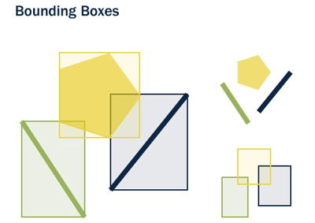
Spatial index (bounding box)
A bounding box is the smallest rectangle – parallel to the coordinate axis.
It is capable of containing a given figure.

Slide 28
Bounding box (why are they used?)
Bounding boxes are used because answering questions like
“is A inside B?”
Is very computationally expensive for polygons but very fast in the case of rectangles.
Even the most complex polygons and line-strings can be represented by a simple bounding box.
So a question like
“What lines are inside this polygon?” will be instead
“What lines have bounding boxes that are contained inside this polygon’s bounding box?”

Slide 29
Spatial index (contd..)
Used the GiST (Generalized Search Tree) index
Fast index creation
Handles compression
Use bounding box of the feature
Can implement R-Trees

Slide 30
R-Tree indexing
Generalize all the geometries to the bounding box
Small to store
Operations are simple
Typical search is to find all the objects that overlap a box
Result is an approximation
Too many features are returned
Used to solve overlap and distance problems

Slide 31
D
D
K
L
F
J
E
I
H
M
G

Slide 32
A
D
D
C
K
L
F
J
E
B
I
H
M
G
A
B
C
D
E
F
G
H
I
J
K
L
M

Slide 33
A
D
D
C
K
L
F
J
E
X
B
I
H
M
G
A
B
C
D
E
F
G
H
I
J
K
L
M

Slide 34
A
D
D
C
K
L
F
J
E
X
B
I
H
M
G
A
B
C
D
E
F
G
H
I
J
K
L
M

Slide 35
A
D
D
C
K
L
F
J
E
X
B
I
H
M
G
A
B
C
D
E
F
G
H
I
J
K
L
M

Slide 36
A
D
D
C
K
L
F
J
E
X
B
I
H
M
G
N
A
B
C
D
E
F
G
H
I
J
K
L
M

Slide 37
A
D
D
C
K
L
F
J
E
X
B
I
H
M
G
A
N
A
B
C
D
E
F
G
H
I
J
K
L
M

Slide 38
A
D
D
C
K
L
F
J
E
X
B
I
H
M
G
A
N
A
B
C
N
D
D
E
E
F
F
G
H
I
J
K
L
M

Slide 39
A
D
D
C
K
L
F
J
E
X
B
I
H
M
G
A
B
C
N
A
Since N = Leaf,
stop and return N
D
D
E
E
F
F
G
H
I
J
K
L
M

Slide 40
A
D
D
C
K
L
F
J
E
X
B
I
H
M
G
A
B
C
D
E
F
X
G
H
I
J
K
L
M

Slide 41
PostGIS – last words
PostGIS spatially enables PostgreSQL by adding spatial objects, functions and indexing
PostGIS is free software
PostGIS follows the OpenGIS Simple Features for SQL

Slide 42
Sqlite
SQLite is a software library that implements a self contained, serverless, zero-configuration, transactional SQL Database engine.
No complex client/server architecture
Doesn’t need installation or configuration

Slide 43
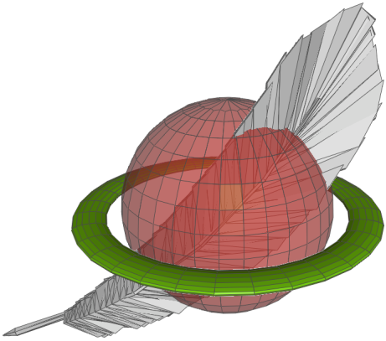
Spatialite
SpatiaLite is an open source library intended to extend the SQLite core to support fully fledged Spatial SQL capabilities.
It adds support for the three function:
Spatial types
Spatial Indexes (R*-Trees)
Spatial functions
SpatiaLite is smoothly integrated into SQLite to provide a complete and powerful Spatial DBMS

