Slide 1
Analysis of Algorithms
CSE 2320 – Algorithms and Data Structures
Vassilis Athitsos
University of Texas at Arlington

Slide 2
Analysis of Algorithms
Given an algorithm, some key questions to ask are:
  How efficient is this algorithm?
  Can we predict its running time on specific inputs?
  Should we use this algorithm or should we use an alternative?
  Should we try to come up with a better algorithm?
Chapter 2 establishes some guidelines for answering these questions.
Using these guidelines, sometimes we can obtain easy answers.
  At other times, getting the answers may be more difficult.

Slide 3
Empirical Analysis
This is an alternative to the more mathematically oriented methods we will consider.
Running two alternative algorithms on the same data and comparing the running times can be a useful tool.
  1 second vs. one minute is an easy-to-notice difference.
However, sometimes empirical analysis is not a good option.
  For example, if it would take days or weeks to run the programs.

Slide 4
Data for Empirical Analysis
How do we choose the data that we use in the experiments?

Slide 5
Data for Empirical Analysis
How do we choose the data that we use in the experiments?
  Actual data.
    Pros:
    Cons:
  Random data.
    Pros:
    Cons:
  Perverse data.
    Pros:
    Cons:

Slide 6
Data for Empirical Analysis
How do we choose the data that we use in the experiments?
  Actual data.
    Pros: give the most relevant and reliable estimates of performance.
    Cons: may be hard to obtain.
  Random data.
    Pros: easy to obtain, make the estimate not data-specific.
    Cons: may be too unrealistic.
  Perverse data.
    Pros: gives us worst case estimate, so we can obtain guarantees of performance.
    Cons: the worst case estimate may be much worse than average performance.

Slide 7
Comparing Running Times
When comparing running times of two implementations, we must make sure the comparison is fair.
We are often much more careful optimizing "our" algorithm compared to the "competitor" algorithm.
Implementations using different programming languages may tell us more about the difference between the languages than the difference between implementations.
An easier case is when both implementations use mostly the same codebase, and differ in a few lines.
  Example: the different implementations of Union-Find in Chapter 1.

Slide 8
Avoid Insufficient Analysis
Not performing analysis of algorithmic performance can be a problem.
  Many (perhaps the majority) of programmers have no background in algorithms.
  People with background in algorithmic analysis may be too lazy, or too pressured by deadlines, to use this background.
Unnecessarily slow software is a common consequence when skipping analysis.

Slide 9
Avoid Excessive Analysis
Worrying too much about algorithm performance can also be a problem.
  Sometimes, slow is fast enough.
  A user will not even notice an improvement from a millisecond to a microsecond.
  The time spent optimizing the software should never exceed the total time saved by these optimizations.
    E.g., do not spend 20 hours to reduce running time by 5 hours on a software that you will only run 3 times and then discard.
Ask yourself: what are the most important bottlenecks in my code, that I need to focus on?
Ask yourself: is this analysis worth it? What do I expect to gain?

Slide 10
Mathematical Analysis of Algorithms
Some times it may be hard to mathematically predict how fast an algorithm will run.
However, we will study a relatively small set of techniques that applies on a relatively broad range of algorithms.
First technique: find key operations and key quantities.
  Identify the important operations in the program that constitute the bottleneck in the computations.
    This way, we can focus on estimating the number of times these operations are performed, vs. trying to estimate the number of CPU instructions and/or nanoseconds the program will take.
  Identify a few key quantities that measure the size of the data that determine the running time.

Slide 11
Finding Key Operations
We said it is a good idea to identify the important operations in the code, that constitute the bottleneck in the computations.
How can we do that?

Slide 12
Finding Key Operations
We said it is a good idea to identify the important operations in the code, that constitute the bottleneck in the computations.
How can we do that?
  One approach is to just think about it.
  Another approach is to use software profilers, which show how much time is spent on each line of code.

Slide 13
Finding Key Operations
What were the key operations for Union Find?
  ???
What were the key operations for Binary Search?
  ???
What were the key operations for Selection Sort?
  ???

Slide 14
Finding Key Operations
What were the key operations for Union Find?
  Checking and changing ids in Find.
  Checking and changing ids in Union.
What were the key operations for Binary Search?
  Comparisons between numbers.
What were the key operations for Selection Sort?
  Comparisons between numbers.
In all three cases, the running time was proportional to the total number of those key operations.

Slide 15
Finding Key Quantities
We said that it is a good idea to identify a few key quantities that measure the size of the data and that are the most important in determining the running time.
What were the key quantities for Union-Find?
  ???
What were the key quantities for Binary Search?
  ???
What were the key quantities for Selection Sort?
  ???

Slide 16
Finding Key Quantities
We said that it is a good idea to identify a few key quantities that measure the size of the data and that are the most important in determining the running time.
What were the key quantities for Union-Find?
  Number of nodes, number of edges.
What were the key quantities for Binary Search?
  Size of the array.
What were the key quantities for Selection Sort?
  Size of the array.

Slide 17
Finding Key Quantities
These key quantities are different for each set of data that the algorithm runs on.
Focusing on these quantities greatly simplifies the analysis.
  For example, there is a huge number of integer arrays of size 1,000,000, that could be passed as inputs to Binary Search or to Selection Sort.
  However, to analyze the running time, we do not need to worry about the contents of these arrays (which are too diverse), but just about the size, which is expressed as a single number.

Slide 18
Describing Running Time
Rule: most algorithms have a primary parameter N, that measures the size of the data and that affects the running time most significantly.
Example: for binary search, N is ???
Example: for selection sort, N is ???
Example: for Union-Find, N is ???

Slide 19
Describing Running Time
Rule: most algorithms have a primary parameter N, that measures the size of the data and that affects the running time most significantly.
Example: for binary search, N is the size of the array.
Example: for selection sort, N is the size of the array.
Example: for Union-Find, N is ???
  Union-Find is one of many exceptions.
  Two key parameters, number of nodes, and number of edges, must be considered to determine the running time.

Slide 20
Describing Running Time
Rule: most algorithms have a primary parameter N, that affects the running time most significantly.
When we analyze an algorithm, our goal is to find a function f(N), such that the running time of the algorithm is proportional to f(N).
Why proportional and not equal?

Slide 21
Describing Running Time
Rule: most algorithms have a primary parameter N, that affects the running time most significantly.
When we analyze an algorithm, our goal is to find a function f(N), such that the running time of the algorithm is proportional to f(N).
Why proportional and not equal?
Because the actual running time is not a defining characteristic of an algorithm.
  Running time depends on programming language, actual implementation, compiler used, machine executing the code, …

Slide 22
Describing Running Time
Rule: most algorithms have a primary parameter N, that affects the running time most significantly.
When we analyze an algorithm, our goal is to find a function f(N), such that the running time of the algorithm is proportional to f(N).
We will now take a look at the most common functions that are used to describe running time.

Slide 23
The Constant Function: f(N) = 1
f(N) = 1. What does it mean to say that the running time of an algorithm is described by 1?

Slide 24
The Constant Function: f(N) = 1
f(N) = 1. What does it mean to say that the running time of an algorithm is described by 1?
It means that the running time of the algorithm is proportional to 1, which means…

Slide 25
The Constant Function: f(N) = 1
f(N) = 1: What does it mean to say that the running time of an algorithm is described by 1?
It means that the running time of the algorithm is proportional to 1, which means…
  that the running time is constant, or at least bounded by a constant.
This happens when all instructions of the program are executed only once, or at least no more than a certain fixed number of times.
If f(N) = 1, we say that the algorithm takes constant time. This is the best case we can ever hope for.

Slide 26
The Constant Function: f(N) = 1
What algorithm (or part of an algorithm) have we seen whose running time is constant?

Slide 27
The Constant Function: f(N) = 1
What algorithm (or part of an algorithm) have we seen whose running time is constant?
The find operation in the quick-find version of Union-Find.

Slide 28
Logarithmic Time: f(N) = log N
f(N) = log N: the running time is proportional to the logarithm of N.
How good or bad is that?

Slide 29
Logarithmic Time: f(N) = log N
f(N) = log N: the running time is proportional to the logarithm of N.
How good or bad is that?
  log 1000 ~= ???.
  The logarithm of one million is about ???.
  The logarithm of one billion is about ???.
  The logarithm of one trillion is about ???.

Slide 30
Logarithmic Time: f(N) = log N
f(N) = log N: the running time is proportional to the logarithm of N.
How good or bad is that?
  log 1000 ~= 10.
  The logarithm of one million is about 20.
  The logarithm of one billion is about 30.
  The logarithm of one trillion is about 40.
Function log N grows very slowly:
This means that the running time when N = one trillion is only four times the running time when N = 1000. This is really good scaling behavior.

Slide 31
Logarithmic Time: f(N) = log N
If f(N) = log N, we say that the algorithm takes logarithmic time.
What algorithm (or part of an algorithm) have we seen whose running time is proportional to log N?

Slide 32
Logarithmic Time: f(N) = log N
If f(N) = log N, we say that the algorithm takes logarithmic time.
What algorithm (or part of an algorithm) have we seen whose running time is proportional to log N?
Binary Search.
The Find function on the weighted-cost quick-union version of Union-Find.

Slide 33
Logarithmic Time: f(N) = log N
Logarithmic time commonly occurs when solving a big problem is solved in a sequence of steps, where:
  Each step reduces the size of the problem by some constant factor.
  Each step requires no more than a constant number of operations.
Binary search is an example:
  Each step reduces the size of the problem by a factor of 2.
  Each step requires only one comparison, and a few variable updates.

Slide 34
Linear Time: f(N) = N
f(N) = N: the running time is proportional to N.
This happens when we need to do some fixed amount of processing on each input element.
What algorithms (or parts of algorithms) are examples?

Slide 35
Linear Time: f(N) = N
f(N) = N: the running time is proportional to N.
This happens when we need to do some fixed amount of processing on each input element.
What algorithms (or parts of algorithms) are examples?
  The Union function in the quick-find version of Union-Find.
  Sequential search for finding the min or max value in an array.
  Sequential search for determining whether a value appears somewhere in an array.
    Is this ever useful? Can't we always just do binary search?

Slide 36
Linear Time: f(N) = N
f(N) = N: the running time is proportional to N.
This happens when we need to do some fixed amount of processing on each input element.
What algorithms (or parts of algorithms) are examples?
  The Union function in the quick-find version of Union-Find.
  Sequential search for finding the min or max value in an array.
  Sequential search for determining whether a value appears somewhere in an array.
    Is this ever useful? Can't we always just do binary search?
    If the array is not already sorted, binary search does not work.

Slide 37
N log N Time
f(N) = N log N: the running time is proportional to
N log N.
This running time is commonly encountered, especially in algorithms working as follows:
  Break problem into smaller subproblems.
  Solve subproblems independently.
  Combine the solutions of the subproblems.
Many sorting algorithms have this complexity.
Comparing linear to N log N time.
  N = 1 million, N log N is about ???
  N = 1 billion, N log N is about ???
  N = 1 trillion, N log N is about ???

Slide 38
N log N Time
Comparing linear to N log N time.
  N = 1 million, N log N is about 20 million.
  N = 1 billion, N log N is about 30 billion.
  N = 1 trillion, N log N is about 40 trillion.
N log N is worse than linear time, but not by much.

Slide 39
Quadratic Time
f(N) = N²: the running time is proportional to the square of N.
In this case, we say that the running time is quadratic to N.
Any example where we have seen quadratic time?

Slide 40
Quadratic Time
f(N) = N²: the running time is proportional to the square of N.
In this case, we say that the running time is quadratic to N.
Any example where we have seen quadratic time?
  Selection Sort.

Slide 41
Quadratic Time
Comparing linear, N log N, and quadratic time.
Quadratic time algorithms become impractical (too slow) much faster than linear and N log N time algorithms.
Of course, what we consider "impractical" depends on the application.
  Some applications are more tolerant of longer running times.
N | N log N | N²
10⁶ (1 million) | about 20 million | 10¹² (one trillion)
10⁹ (1 billion) | about 30 billion | 10¹⁸ (one quintillion)
10¹² (1 trillion) | about 40 trillion | 10²⁴ (one septillion)

Slide 42
Cubic Time
f(N) = N³: the running time is proportional to the cube of N.
In this case, we say that the running time is cubic to N.

Slide 43
Cubic Time
Example of a problem whose solution has cubic running time: the assignment problem.
  We have two sets A and B. Each set contains N items.
  We have a cost function C(a, b), assigning a cost to matching an item a of A with an item b of B.
  Find the optimal one-to-one correspondence (i.e., a way to match each element of A with one element of B and vice versa), so that the sum of the costs is minimized.

Slide 44
Cubic Time
Wikipedia example of the assignment problem:
  We have three workers, Jim, Steve, and Alan.
  We have three jobs that need to be done.
  There is a different cost associated with each worker doing each job.
  What is the optimal job assignment?
Cubic running time means that it is too slow to solve this problem for, let's say, N = 1 million.
 | Clean bathroom | Sweep floors | Wash windows
Jim | $1 | $3 | $3
Steve | $3 | $2 | $3
Alan | $3 | $4 | $2

Slide 45
Exponential Time
f(N) = 2^{N}: this is what we call exponential running time.
Such algorithms are usually too slow unless N is small.
Even for N = 100, 2^{N} is too large and the algorithm will not terminate in our lifetime, or in the lifetime of the Universe.
Exponential time arises when we try all possible combinations of solutions.
  Example: travelling salesman problem: find an itinerary that goes through each of N cities, visits no city twice, and minimizes the total cost of the tickets.
Quantum computers (if they ever arrive) may solve some of these problems with manageable running time.

Slide 46
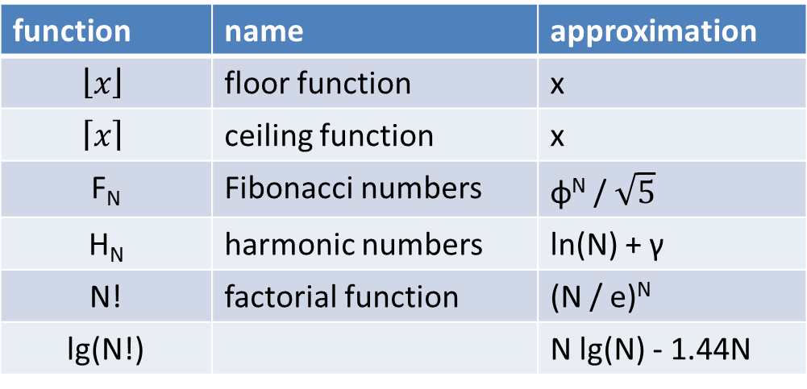
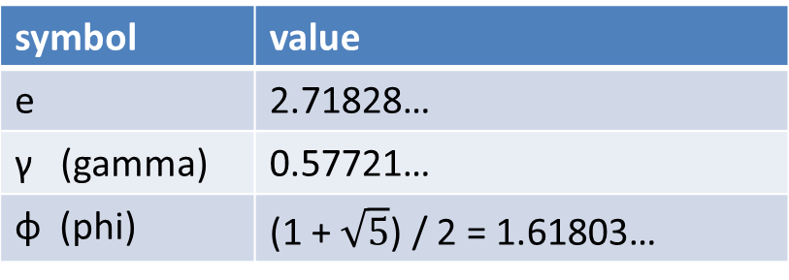
Some Useful Constants and Functions
symbol | value
e | 2.71828…
γ (gamma) | 0.57721…
φ (phi) | (1 + $\sqrt{5}$) / 2 = 1.61803…
These tables are for reference. We may use such symbols and functions as we discuss specific algorithms.
function | name | approximation
$$\left\lfloor x\right\rfloor$$ | floor function | x
$$\left\lceil x\right\rceil$$ | ceiling function | x
F_{N} | Fibonacci numbers | φ^{N} / $\sqrt{5}$
H_{N} | harmonic numbers | ln(N) + γ
N! | factorial function | (N / e)^{N}
lg(N!) |  | N lg(N) - 1.44N

Slide 47
Motivation for Big-Oh Notation
Given an algorithm, we want to find a function that describes the running time of the algorithm.
Key question: how much data can this algorithm handle in a reasonable time?
There are some details that we would actually NOT want this function to include, because they can make a function unnecessarily complicated.
  Constants.
  Behavior fluctuations on small data.
The Big-Oh notation, which we will see in a few slides, achieves that, and greatly simplifies algorithmic analysis.

Slide 48
Why Constants Are Not Important
Does it matter if the running time is f(N) or 5*f(N)?

Slide 49
Why Constants Are Not Important
Does it matter if the running time is f(N) or 5*f(N)?
For the purposes of algorithmic analysis, it typically does NOT matter.
Constant factors are NOT an inherent property of the algorithm. They depend on parameters that are independent of the algorithm, such as:
  Choice of programming language.
  Quality of the code.
  Choice of compiler.
  Machine capabilities (CPU speed, memory size, …)

Slide 50
Why Asymptotic Behavior Matters
Asymptotic behavior: The behavior of a function as the input approaches infinity.
h*f(N)
c*f(N)
N: Size of data
g(N)
f(N)
Running Time for input of size N

Slide 51
Why Asymptotic Behavior Matters
Which of these functions works best asymptotically?
h*f(N)
c*f(N)
N: Size of data
g(N)
f(N)
Running Time for input of size N

Slide 52
Why Asymptotic Behavior Matters
Which of these functions works best asymptotically?
  g(N) seems to grow VERY slowly after a while.
h*f(N)
c*f(N)
N: Size of data
g(N)
f(N)
Running Time for input of size N

Slide 53
Big-Oh Notation
A function g(N) is said to be O(f(N)) if there exist constants c₀ and N₀ such that:
g(N) < c₀ f(N) for all N > N₀.
THIS IS THE SINGLE MOST IMPORTANT THING YOU LEARN IN THIS COURSE.
Typically, g(N) is the running time of an algorithm, in your favorite units, implementation, and machine. This can be a rather complicated function.
In algorithmic analysis, we try to find a f(N) that is simple, and such that g(N) = O(f(N)).

Slide 54
Why Use Big-Oh Notation?
A function g(N) is said to be O(f(N)) if there exist constants c₀ and N₀ such that:
g(N) < c₀ f(N) for all N > N₀.
The Big-Oh notation greatly simplifies the analysis task, by:
  Ignoring constant factors. How is this achieved?
    By the c₀ in the definition. We are free to choose ANY constant c₀ we want, to make the formula work.
    Thus, Big-Oh notation is independent of programming language, compiler, machine performance, and so on…

Slide 55
Why Use Big-Oh Notation?
A function g(N) is said to be O(f(N)) if there exist constants c₀ and N₀ such that:
g(N) < c₀ f(N) for all N > N₀.
The Big-Oh notation greatly simplifies the analysis task, by:
  Ignoring behavior for small inputs. How is this achieved?
    By the N₀ in the implementation. If a finite number of values are not compatible with the formula, just ignore them.
    Thus, big-Oh notation focuses on asymptotic behavior.

Slide 56
Why Use Big-Oh Notation?
A function g(N) is said to be O(f(N)) if there exist constants c₀ and N₀ such that:
g(N) < c₀ f(N) for all N > N₀.
The Big-Oh notation greatly simplifies the analysis task, by:
  Allowing us to describe complex running time behaviors of complex algorithms with simple functions, such as N, log N, N², 2^{N}, and so on.
    Such simple functions are sufficient for answering many important questions, once you get used to Big-Oh notation.

Slide 57
Inferences from Big-Oh Notation
Binary search takes logarithmic time.
This means that, if g(N) is the running time, there exist constants c₀ and N₀ such that:
g(N) < c₀ log(N) for all N > N₀.
Can this function handle trillions of data in reasonable time?
  NOTE: the question is about time, not about memory.

Slide 58
Inferences from Big-Oh Notation
Binary search takes logarithmic time.
This means that, if g(N) is the running time, there exist constants c₀ and N₀ such that:
g(N) < c₀ log(N) for all N > N₀.
Can this function handle trillions of data in reasonable time?
  NOTE: the question is about time, not about memory.
The answer is an easy YES!
  We don't even know what c₀ and N₀ are, and we don't care.
  The key thing is that the running time is O(log(N)).

Slide 59
Inferences from Big-Oh Notation
Selection Sort takes quadratic time.
This means that, if g(N) is the running time, there exist constants c₀ and N₀ such that:
g(N) < c₀ N² for all N > N₀.
Can this function handle one billion data in reasonable time?

Slide 60
Inferences from Big-Oh Notation
Selection Sort takes quadratic time.
This means that, if g(N) is the running time, there exist constants c₀ and N₀ such that:
g(N) < c₀ N² for all N > N₀.
Can this function handle one billion data in reasonable time?
The answer is an easy NO!
  Again, we don't know what c₀ and N₀ are, and we don't care.
  The key thing is that the running time is quadratic.

Slide 61
Is Big-Oh Notation Always Enough?
NO! Big-Oh notation does not always tell us which of two algorithms is preferable.

Slide 62
Is Big-Oh Notation Always Enough?
NO! Big-Oh notation does not always tell us which of two algorithms is preferable.
  Example 1: if we know that the algorithm will only be applied to relatively small N, we may prefer a running time of N² nanoseconds over log(N) centuries.
  Example 2: even constant factors can be important. For many applications, we strongly prefer a running time of 3N over 1500N.

Slide 63
Is Big-Oh Notation Always Enough?
NO! Big-Oh notation does not always tell us which of two algorithms is preferable.
  Example 1: if we know that the algorithm will only be applied to relatively small N, we may prefer a running time of N² nanoseconds over log(N) centuries.
  Example 2: even constant factors can be important. For many applications, we strongly prefer a running time of 3N over 1500N.
Big-Oh notation is not meant to tells us everything about running time.
But, Big-Oh notation tells us a lot, and is often much easier to compute than actual running times.

Slide 64
Simplifying Big-Oh Notation
Suppose that we are given this running time:
g(N) = 35N² + 41N + log(N) + 1532.
How can we express g(N) in Big-Oh notation?

Slide 65
Simplifying Big-Oh Notation
Suppose that we are given this running time:
g(N) = 35N² + 41N + log(N) + 1532.
How can we express g(N) in Big-Oh notation?
Typically we say that g(N) = O(N²).
The following are also correct, but unnecessarily complicated, and thus less useful, and rarely used.
  g(N) = O(N²) + O(N).
  g(N) = O(N²) + O(N) + O(logN) + O(1).
  g(N) = O(35N² + 41N + log(N) + 1532).

Slide 66
Simplifying Big-Oh Notation
Suppose that we are given this running time:
g(N) = 35N² + 41N + log(N) + 1532.
We say that g(N) = O(N²).
Why is this mathematically correct?
  Why can we ignore the non-quadratic terms?
This is where the Big-Oh definition comes into play. We can find an N₀ such that, for all N > N₀:
g(N) < 36N².
  If you don't believe this, do the calculations for practice.

Slide 67
Simplifying Big-Oh Notation
Suppose that we are given this running time:
g(N) = 35N² + 41N + log(N) + 1532.
We say that g(N) = O(N²).
Why is this mathematically correct?
  Why can we ignore the non-quadratic terms?
Another way to show correctness: as N goes to infinity, what is the limit of g(N) / N² ?

Slide 68
Simplifying Big-Oh Notation
Suppose that we are given this running time:
g(N) = 35N² + 41N + log(N) + 1532.
We say that g(N) = O(N²).
Why is this mathematically correct?
  Why can we ignore the non-quadratic terms?
Another way to show correctness: as N goes to infinity, what is the limit of g(N) / N² ?
  35.
  This shows that the non-quadratic terms become negligible as N gets larger.

Slide 69
Trick Question
Let g(N) = N log N.
Is it true that g(N) = O(N¹⁰⁰)?

Slide 70
Trick Question
Let g(N) = N log N.
Is it true that g(N) = O(N¹⁰⁰)?
Yes. Let's look again at the definition of Big-Oh:
A function g(N) is said to be O(f(N)) if there exist constants c₀ and N₀ such that:
g(N) < c₀ f(N) for all N > N₀.
Note the "<" sign to the right of g(N).
Thus, if g(N) = O(f(N)) and f(N) < h(N), it follows that g(N) = O(h(N)).

Slide 71
Omega (Ω) and Theta (Θ) Notations
If f(N) = O(g(N)), then we also say that g(N) = Ω(f(N)).
If f(N) = O(g(N)) and f(N) = Ω(g(N)), then we say that f(N) = Θ(g(N)).
The Theta notation is clearly stricter than the Big-Oh notation:
  We can say that N² = O(N¹⁰⁰).
  We cannot say that N² = Θ(N¹⁰⁰).

Slide 72
Big-Oh vs. Theta (Θ) Notation
The Big-Oh notation indicates a worst-case bound.
However, oftentimes (almost all the time) we say g(N) = O(f(N)) when we could say that g(N) = Θ(f(N)).
This is not wrong, it is simply not as strict as it could be. Still, in practice we use Big-Oh notation much more frequently than we use Θ notation.
  This is somewhat similar to saying x <=3 when we actually know that x = 3.

Slide 73
Big-Oh vs. Theta (Θ) Notation
Why do we use so often Big-Oh instead of Θ? Partly habit, and partly because we care so much about worst cases.
  E.g., saying that the running time is O(N log N) establishes that the running time is not worse than O(N log N).
Also, for some problems, coming up with an algorithm that solves the problem in Θ(f(N)) only means that the problem is solvable in O(f(N)). Why?

Slide 74
Big-Oh vs. Theta (Θ) Notation
Why do we use so often Big-Oh instead of Θ? Partly habit, and partly because we care so much about worst cases.
  E.g., saying that the running time is O(N log N) establishes that the running time is not worse than O(N log N).
Also, for some problems, coming up with an algorithm that solves the problem in Θ(f(N)) only means that the problem is solvable in O(f(N)). Why?
  Because the algorithm we came up with may not be optimal.
  Unless we prove that our algorithm is optimal, it is mathematically possible that a better algorithm exists, with lower running time.

Slide 75
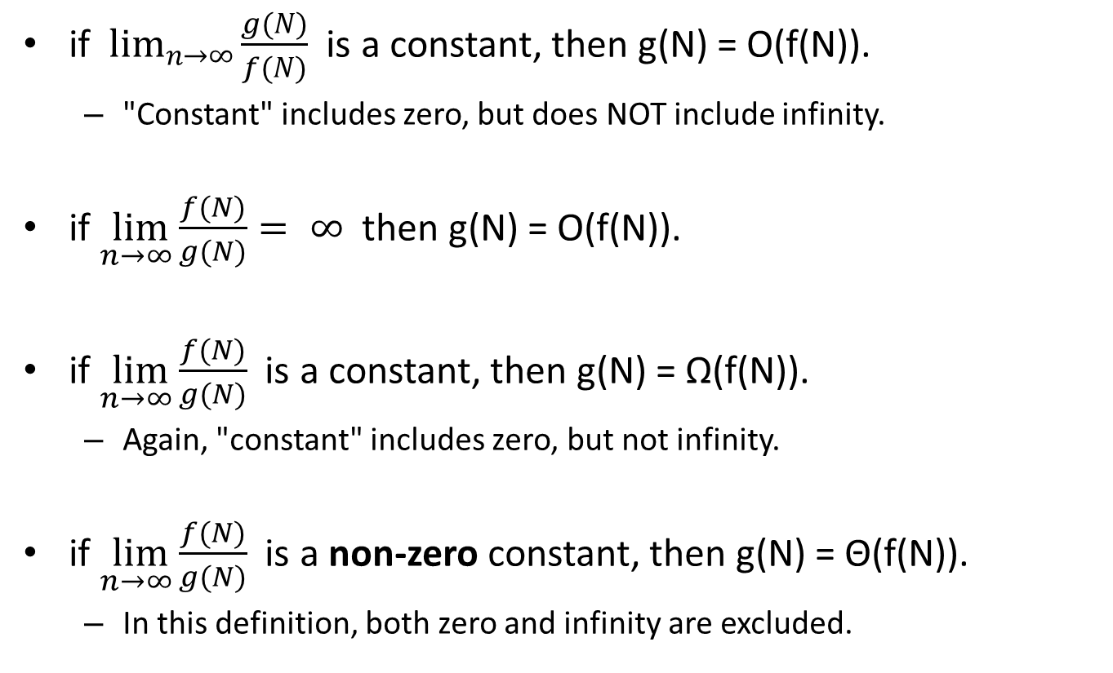
Using Limits
if $\lim_{n→∞}{\frac{g(N)}{f(N)}}$ is a constant, then g(N) = O(f(N)).
  "Constant" includes zero, but does NOT include infinity.
if $\lim_{n→∞}{\frac{f(N)}{g(N)}}= ∞$ then g(N) = O(f(N)).
if $\lim_{n→∞}{\frac{f(N)}{g(N)}}$ is a constant, then g(N) = Ω(f(N)).
  Again, "constant" includes zero, but not infinity.
if $\lim_{n→∞}{\frac{f(N)}{g(N)}}$ is a non-zero constant, then g(N) = Θ(f(N)).
  In this definition, both zero and infinity are excluded.

Slide 76
Using Limits - Comments
The previous formulas relating limits to big-Oh notation show once again that big-Oh notation ignores:
  constants
  behavior for small values of N.
How do we see that?
  In the previous formulas, it is sufficient that the limit is equal to a constant. The value of the constant does not matter.
  In the previous formulas, only the limit at infinity matters. This means that we can ignore behavior up to any finite value, if we need to.

Slide 77
Basic Recurrences
How do we compute the running time of an algorithm in Big-Oh notation?
Sometimes it is easy, sometimes it is hard.
We will learn a few simple tricks that work in many cases that we will encounter this semester.

Slide 78
Case 1: Check All Items, Eliminate One
In this case, the algorithm proceeds in a sequence of similar steps, where:
  each step loops through all items in the input, and eliminates one item.
Any examples of such an algorithm?

Slide 79
Case 1: Check All Items, Eliminate One
In this case, the algorithm proceeds in a sequence of similar steps, where:
  each step loops through all items in the input, and eliminates one item.
Any examples of such an algorithm?
  Selection Sort.

Slide 80
Case 1: Check All Items, Eliminate One
Let g(N) be an approximate estimate of the running time, measured in time units of our convenience.
  In this case, we choose as time unit the time that it takes to examine one item.
  Obviously, this is a simplification, since there are other things that such an algorithm will do, in addition to just examining one item.
  That is one of the plusses of using Big-Oh notation. We can ignore parts of the algorithm that take a relatively small time to run, and focus on the part that dominates running time.

Slide 81
Case 1: Check All Items, Eliminate One
Let g(N) be the running time.
Then, g(N) = ???

Slide 82
Case 1: Check All Items, Eliminate One
Let g(N) be the running time.
Then, g(N) = g(N-1) + N. Why?
  Because we need to examine all items (N units of time), and then we need to run the algorithm on N-1 items.
g(N) = g(N-1) + N
= g(N-2) + (N-1) + N
= g(N-3) + (N-2) + (N-1) + N
...
= 1 + 2 + 3 + ... + (N-1) + N
= N(N + 1) / 2
= O(N²)
Conclusion: The algorithm takes quadratic time.

Slide 83
Case 2: Halve the Problem in Constant Time
In this case, each step of the algorithm consists of:
  performing a constant number of operations, and then reducing the size of the input by half.
Any example of such an algorithm?

Slide 84
Case 2: Halve the Problem in Constant Time
In this case, each step of the algorithm consists of:
  performing a constant number of operations, and then reducing the size of the input by half.
Any example of such an algorithm?
  Binary Search.
What is a convenient unit of time to use here?

Slide 85
Case 2: Halve the Problem in Constant Time
In this case, each step of the algorithm consists of:
  performing a constant number of operations, and then reducing the size of the input by half.
Any example of such an algorithm?
  Binary Search.
What is a convenient unit of time to use here?
  The time it takes to do the constant number of operations to halve the input.

Slide 86
Case 2: Halve the Problem in Constant Time
In this case, each step of the algorithm consists of:
  performing a constant number of operations, and then reducing the size of the input by half.
g(2^{n}) = ???

Slide 87
Case 2: Halve the Problem in Constant Time
In this case, each step of the algorithm consists of:
  performing a constant number of operations, and then reducing the size of the input by half.
g(2^{n}) = 1 + g(2^{n-1})
= 2 + g(2^{n-2})
= 3 + g(2^{n-3})
...
= n + g(2⁰)
= n + 1.
O(n) time for N = 2^{n}.
Substituting n for log N: O(log N) time.

Slide 88
Case 3: Halve the Input in
Linear Time
In this case, each step of the algorithm consists of:
  Performing a linear (i.e., O(N)) number of operations, and then reducing the size of the input by half.
g(N) = ???

Slide 89
Case 3: Halve the Input in
Linear Time
In this case, each step of the algorithm consists of:
  Performing a linear (i.e., O(N)) number of operations, and then reducing the size of the input by half.
g(N) = g(N/2) + N
= g(N/4) + N/2 + N
= g(N/8) + N/4 + N/2 + N
...
= 1 + 2 + 4 + ... + N/4 + N/2 + N
= ???

Slide 90
Case 3: Halve the Input in
Linear Time
In this case, each step of the algorithm consists of:
  Performing a linear (i.e., O(N)) number of operations, and then reducing the size of the input by half.
g(N) = g(N/2) + N
= g(N/4) + N/2 + N
= g(N/8) + N/4 + N/2 + N
...
= 1 + 2 + 4 + ... + N/4 + N/2 + N
= about 2N
O(N) time.

Slide 91
Case 3: Halve the Input in
Linear Time
In this case, each step of the algorithm consists of:
  Performing a linear (i.e., O(N)) number of operations, and then reducing the size of the input by half.
g(N) = g(N/2) + N
= g(N/4) + N/2 + N
= g(N/8) + N/4 + N/2 + N
...
= about 2N
What is our unit of time here?

Slide 92
Case 3: Halve the Input in
Linear Time
In this case, each step of the algorithm consists of:
  Performing a linear (i.e., O(N)) number of operations, and then reducing the size of the input by half.
g(N) = g(N/2) + N
= g(N/4) + N/2 + N
= g(N/8) + N/4 + N/2 + N
...
= about 2N
What is our unit of time here?
  1/N * time to do the linear number of operations at the first step.

Slide 93
Case 4: Break Problem Into Two Halves in Linear Time
In this case, each step of the algorithm consists of:
  Doing O(N) operations to split the problem into two halves.
  Calling the algorithm recursively on each half.
  Doing O(N) operations to combine the two answers.
g(N) = ???

Slide 94
Case 4: Break Problem Into Two Halves in Linear Time
In this case, each step of the algorithm consists of:
  Doing O(N) operations to split the problem into two halves.
  Calling the algorithm recursively on each half.
  Doing O(N) operations to combine the two answers.
g(N) = 2g(N/2) + N
= 4g(N/4) + N + N
= 8g(N/8) + N + N + N
...
= N log N
What is our unit of time here?

Slide 95
Case 4: Break Problem Into Two Halves in Linear Time
In this case, each step of the algorithm consists of:
  Doing O(N) operations to split the problem into two halves.
  Calling the algorithm recursively on each half.
  Doing O(N) operations to combine the two answers.
g(N) = 2g(N/2) + N
= 4g(N/4) + N + N
= 8g(N/8) + N + N + N
...
= N log N
What is our unit of time here?
  1/N * time to do the O(N) operations at the first step.

Slide 96
Case 4: Break Problem Into Two Halves in Linear Time
In this case, each step of the algorithm consists of:
  Doing O(N) operations to split the problem into two halves.
  Calling the algorithm recursively on each half.
  Doing O(N) operations to combine the two answers.
Note: we have not seen any examples of this case yet, but we will see several such examples when we study sorting algorithms.

Slide 97
Case 5: Break Problem Into Two Halves in Constant Time
In this case, each step of the algorithm consists of:
  Doing O(1) operations to split the problem into two halves.
  Calling the algorithm recursively on each half.
  Doing O(1) operations to combine the two answers.
g(N) = ???

Slide 98
Case 5: Break Problem Into Two Halves in Constant Time
In this case, each step of the algorithm consists of:
  Doing O(1) operations to split the problem into two halves.
  Calling the algorithm recursively on each half.
  Doing O(1) operations to combine the two answers.
g(N) = 2g(N/2) + 1
= 4g(N/4) + 2 + 1
= 8g(N/8) + 4 + 2 + 1
...
= about N
What is our unit of time here?

Slide 99
Case 5: Break Problem Into Two Halves in Constant Time
In this case, each step of the algorithm consists of:
  Doing O(1) operations to split the problem into two halves.
  Calling the algorithm recursively on each half.
  Doing O(1) operations to combine the two answers.
g(N) = 2g(N/2) + 1
= 4g(N/4) + 2 + 1
= 8g(N/8) + 4 + 2 + 1
...
= about N
What is our unit of time here?
  The time to do the O(1) operations at the first step.

