Slide 1
Analysis of Algorithms:
Methods and Examples
CSE 2320 – Algorithms and Data Structures
Vassilis Athitsos
University of Texas at Arlington

Slide 2
Why Asymptotic Behavior Matters
Asymptotic behavior: The behavior of a function as the input approaches infinity.
h(N)
c*f(N)
N: Size of data
g(N)
f(N)
Running Time for input of size N

Slide 3
Why Asymptotic Behavior Matters
Which of these functions is smallest asymptotically?
h(N)
c*f(N)
N: Size of data
g(N)
f(N)
Running Time for input of size N

Slide 4
Why Asymptotic Behavior Matters
Which of these functions is smallest asymptotically?
  g(N) seems to grow very slowly after a while.
h(N)
c*f(N)
N: Size of data
g(N)
f(N)
Running Time for input of size N

Slide 5
Why Asymptotic Behavior Matters
Which of these functions is smallest asymptotically?
  However, the picture is not conclusive (need to see what happens for larger N).
h(N)
c*f(N)
N: Size of data
g(N)
f(N)
Running Time for input of size N

Slide 6

Why Asymptotic Behavior Matters
Which of these functions is smallest asymptotically?
  Proving that $g(N) = O(f(N))$ would provide a conclusive answer.
h(N)
c*f(N)
N: Size of data
g(N)
f(N)
Running Time for input of size N

Slide 7
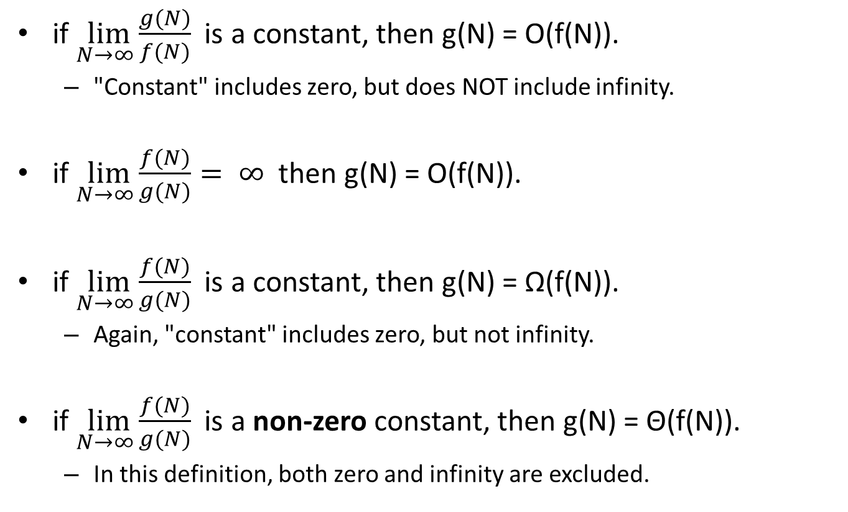
Using Limits
if $\lim_{N→∞}{\frac{g(N)}{f(N)}}$ is a constant, then g(N) = O(f(N)).
  "Constant" includes zero, but does NOT include infinity.
if $\lim_{N→∞}{\frac{f(N)}{g(N)}}= ∞$ then g(N) = O(f(N)).
if $\lim_{N→∞}{\frac{f(N)}{g(N)}}$ is a constant, then g(N) = Ω(f(N)).
  Again, "constant" includes zero, but not infinity.
if $\lim_{N→∞}{\frac{f(N)}{g(N)}}$ is a non-zero constant, then g(N) = Θ(f(N)).
  In this definition, both zero and infinity are excluded.

Slide 8
Using Limits - Comments
The previous formulas relating limits to big-Oh notation show once again that big-Oh notation ignores:
  constants
  behavior for small values of N.
How do we see that?

Slide 9
Using Limits - Comments
The previous formulas relating limits to big-Oh notation show once again that big-Oh notation ignores:
  constants
  behavior for small values of N.
How do we see that?
  In the previous formulas, it is sufficient that the limit is equal to a constant. The value of the constant does not matter.
  In the previous formulas, only the limit at infinity matters. This means that we can ignore behavior up to any finite value, if we need to.

Slide 10

Using Limits: An Example
Show that $\frac{n5+3n4+2n3+n2+n+12}{5n3+n+3}=Θ(???)$.

Slide 11
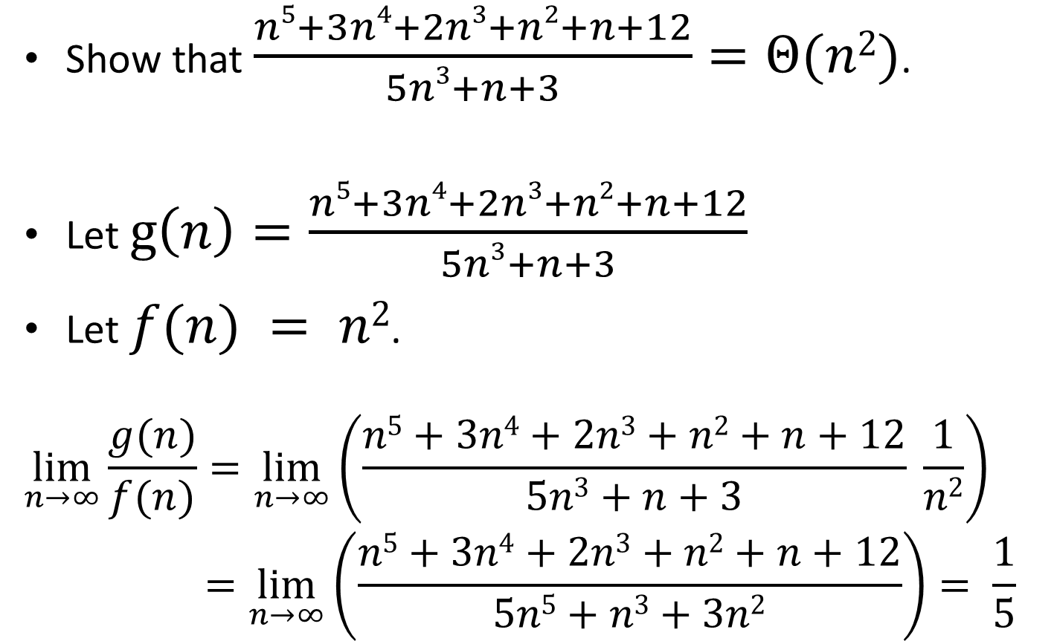
Using Limits: An Example
Show that $\frac{n5+3n4+2n3+n2+n+12}{5n3+n+3}=Θ(n2)$.
Let $g\left(n\right)=\frac{n5+3n4+2n3+n2+n+12}{5n3+n+3}$
Let $f(n) = n2$.
$$\lim_{n→∞}{\frac{g(n)}{f(n)}=\lim_{n→∞}\left(\frac{n5+3n4+2n3+n2+n+12}{5n3+n+3} \frac{1}{n2}\right)} \\ =\lim_{n→∞}\left(\frac{n5+3n4+2n3+n2+n+12}{5n5+n3+3n2}\right)= \frac{1}{5}$$

Slide 12
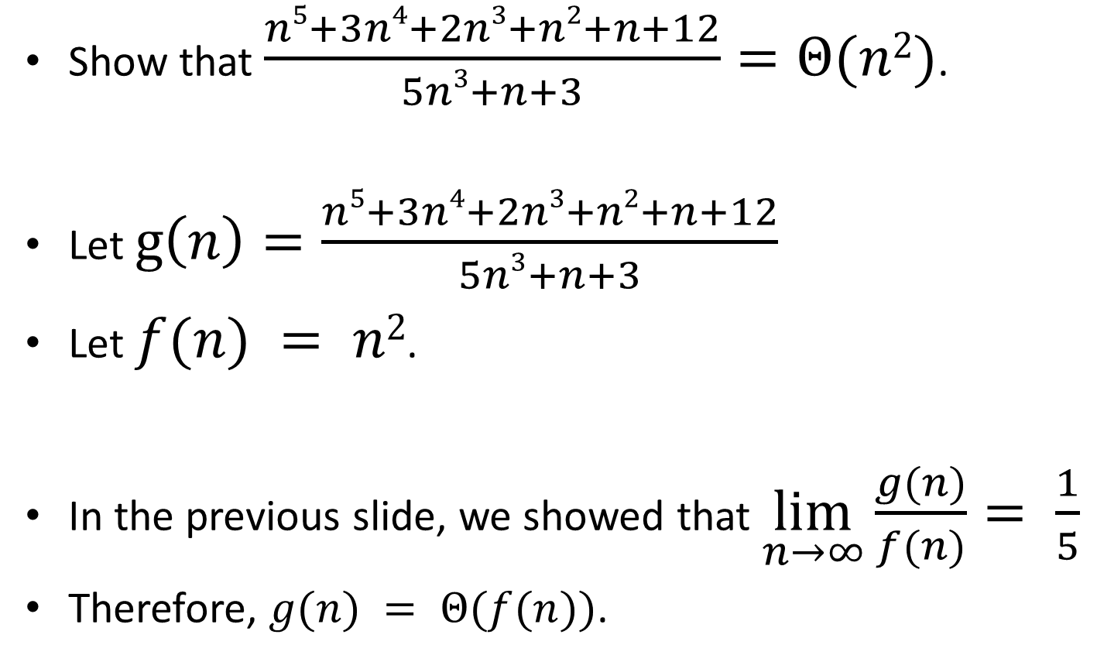
Using Limits: An Example
Show that $\frac{n5+3n4+2n3+n2+n+12}{5n3+n+3}=Θ(n2)$.
Let $g\left(n\right)=\frac{n5+3n4+2n3+n2+n+12}{5n3+n+3}$
Let $f(n) = n2$.
In the previous slide, we showed that $\lim_{n→∞}\frac{g(n)}{f(n)}= \frac{1}{5}$
Therefore, $g(n) = Θ(f(n))$.

Slide 13

Big-Oh Transitivity
If $g\left(N\right)=O\left(f\left(N\right)\right)$ and $f\left(N\right)=O(h\left(N\right))$, then
$g\left(N\right)=O(h\left(N\right))$.
How can we prove that?

Slide 14
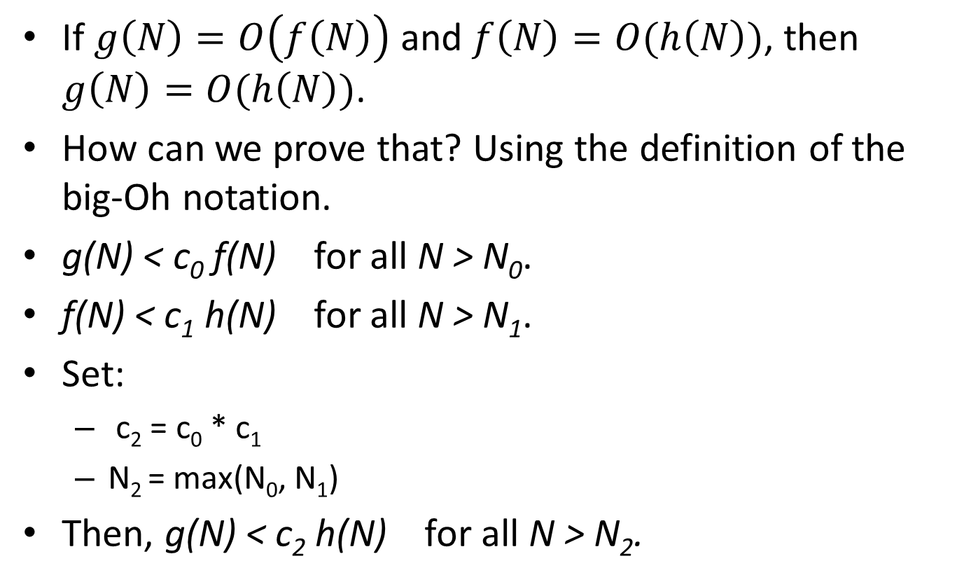
Big-Oh Transitivity
If $g\left(N\right)=O\left(f\left(N\right)\right)$ and $f\left(N\right)=O(h\left(N\right))$, then
$g\left(N\right)=O(h\left(N\right))$.
How can we prove that? Using the definition of the big-Oh notation.
g(N) < c₀ f(N) for all N > N₀.
f(N) < c₁ h(N) for all N > N₁.
Set:
  c₂ = c₀ * c₁
  N₂ = max(N₀, N₁)
Then, g(N) < c₂ h(N) for all N > N₂.

Slide 15
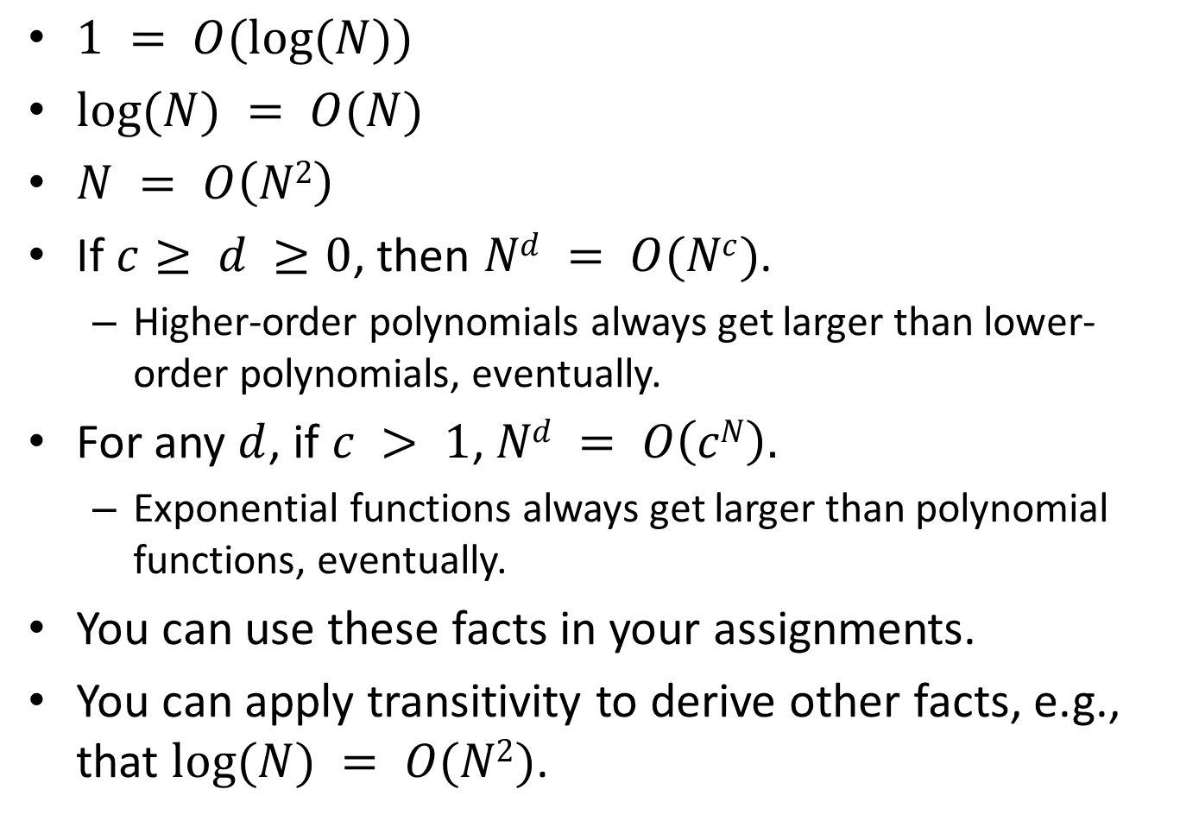
Big-Oh Hierarchy
$1 = O(log⁡(N))$
$log⁡(N) = O(N)$
$N = O\left(N2\right)$
If $c≥ d ≥0$, then $Nd = O(Nc)$.
  Higher-order polynomials always get larger than lower-order polynomials, eventually.
For any $d$, if $c > 1$, $Nd = O\left(cN\right).$
  Exponential functions always get larger than polynomial functions, eventually.
You can use these facts in your assignments.
You can apply transitivity to derive other facts, e.g., that $log⁡(N) = O(N2)$.

Slide 16
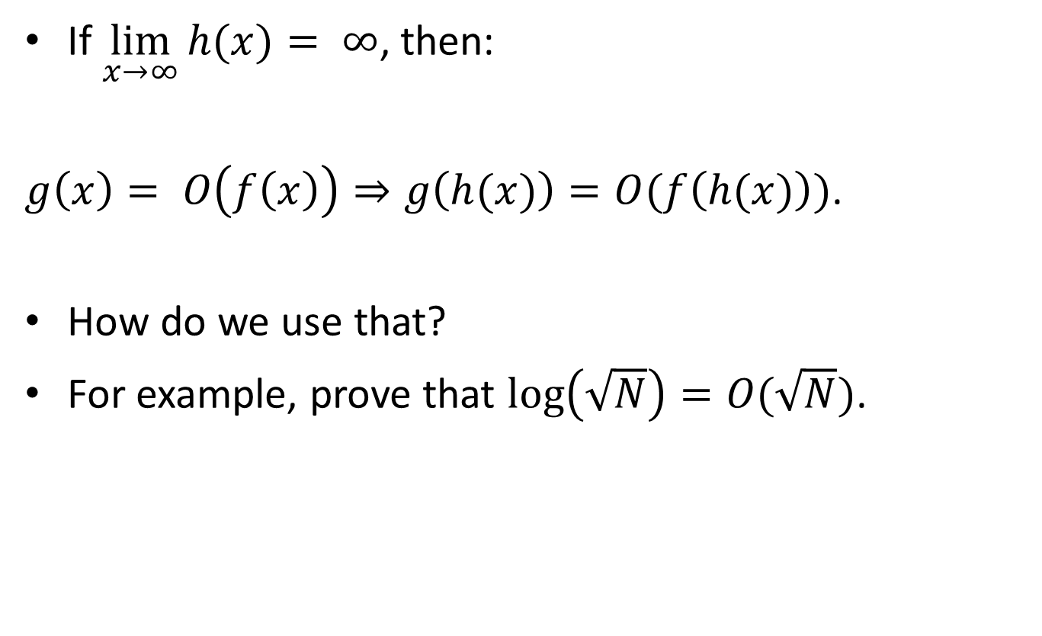
Using Substitutions
If $\lim_{x→∞}{h(x)}= ∞$, then:
$g\left(x\right)= O\left(f\left(x\right)\right)⇒g\left(h(x)\right)=O(f\left(h(x)\right))$.
How do we use that?
For example, prove that $\log\left(\sqrt{N}\right)=O(\sqrt{N})$.

Slide 17
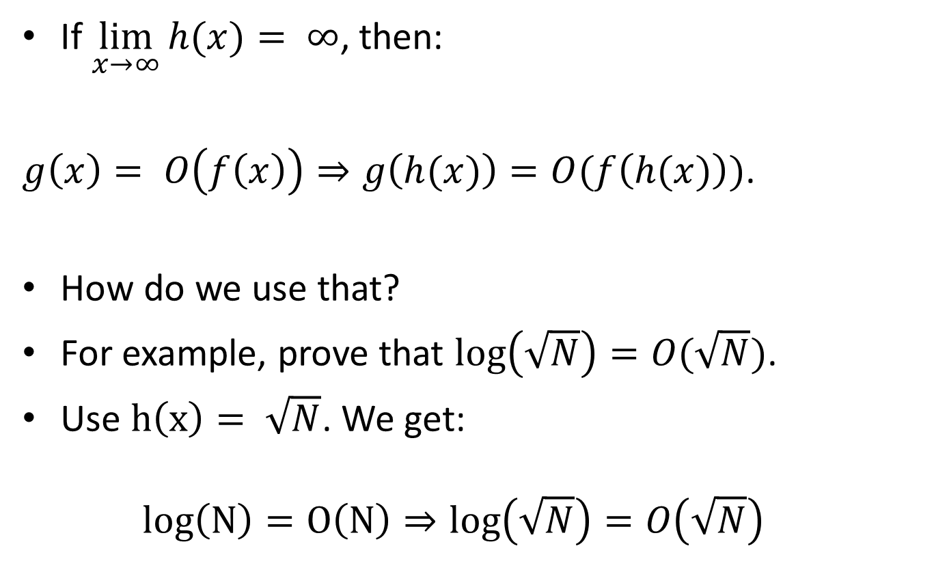
Using Substitutions
If $\lim_{x→∞}{h(x)}= ∞$, then:
$g\left(x\right)= O\left(f\left(x\right)\right)⇒g\left(h(x)\right)=O(f\left(h(x)\right))$.
How do we use that?
For example, prove that $\log\left(\sqrt{N}\right)=O(\sqrt{N})$.
Use $h\left(x\right)= \sqrt{N}$. We get:
$log\left(N\right)=O\left(N\right)⇒log\left(\sqrt{N}\right)=O\left(\sqrt{N}\right)$

Slide 18
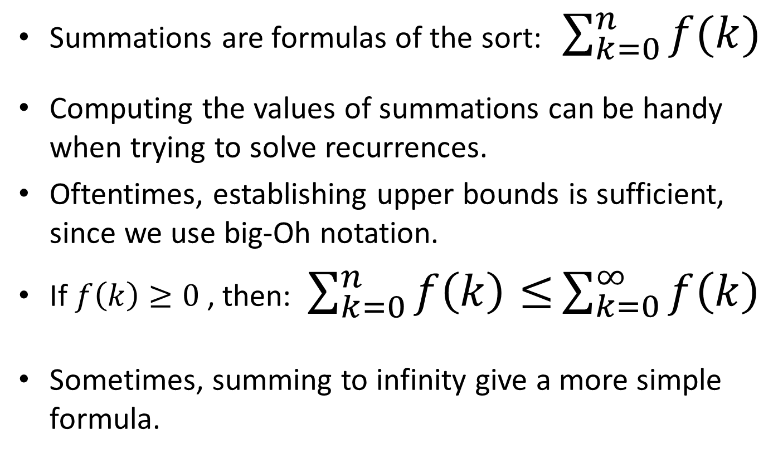
Summations
Summations are formulas of the sort:$\sum_{k=0}^{n}{f(k)}$
Computing the values of summations can be handy when trying to solve recurrences.
Oftentimes, establishing upper bounds is sufficient, since we use big-Oh notation.
If $f\left(k\right)≥0$, then: $\sum_{k=0}^{n}{f\left(k\right)≤}\sum_{k=0}^{∞}{f\left(k\right)}$
Sometimes, summing to infinity give a more simple formula.

Slide 19
Geometric Series
A geometric series is a sequence C_{k} of numbers, such that C_{k} = D * C_{k-1} , where D is a constant.
How can we express C₁ in terms of C₀?
  C₁ = D * C₀
How can we express C₂ in terms of C₀?
  C₂ = D * C₁ = D² * C₀
How can we express C_{k} in terms of C₀?
  C_{k} = D^{k} * C₀
So, to define a geometric series, we just need two parameters: D and C₀.

Slide 20
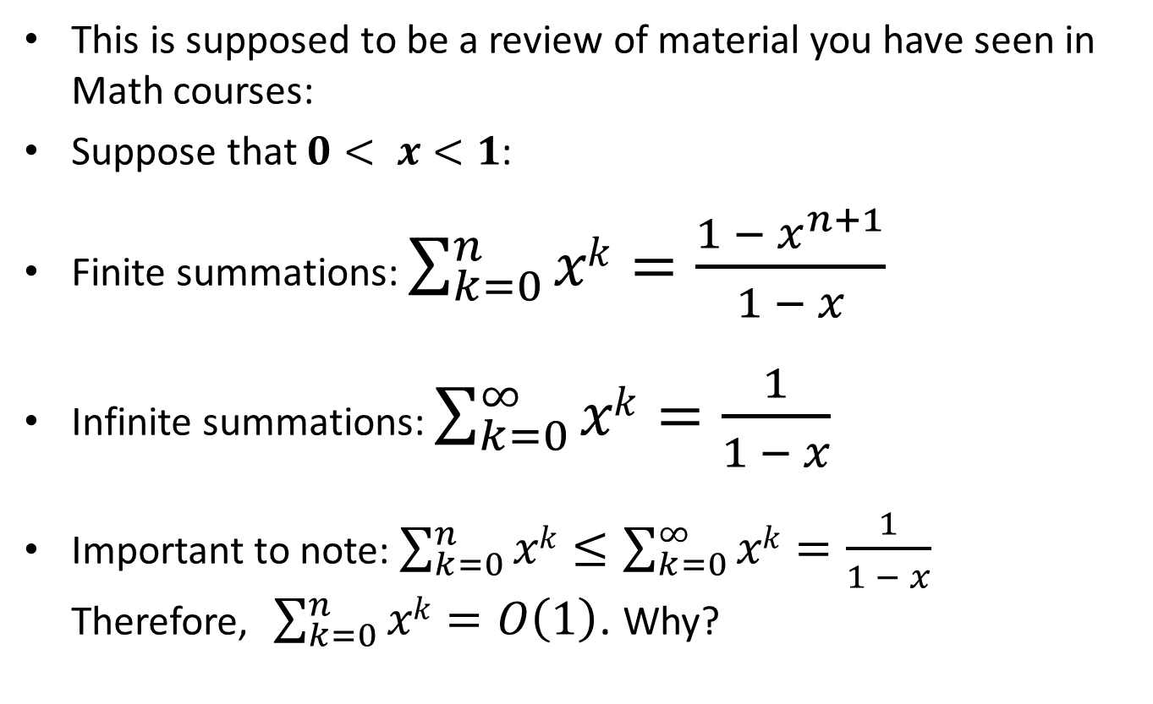
Summation of Geometric Series
This is supposed to be a review of material you have seen in Math courses:
Suppose that $0< x<1$:
Finite summations: $\sum_{k=0}^{n}{xk}=\frac{{1 − x}^{n+1}}{1 − x}$
Infinite summations: $\sum_{k=0}^{∞}{xk}=\frac{1}{1 − x}$
Important to note: $\sum_{k=0}^{n}{xk}≤\sum_{k=0}^{∞}{xk}=\frac{1}{1 − x}$
Therefore, $\sum_{k=0}^{n}{xk}=O\left(1\right)$. Why?

Slide 21
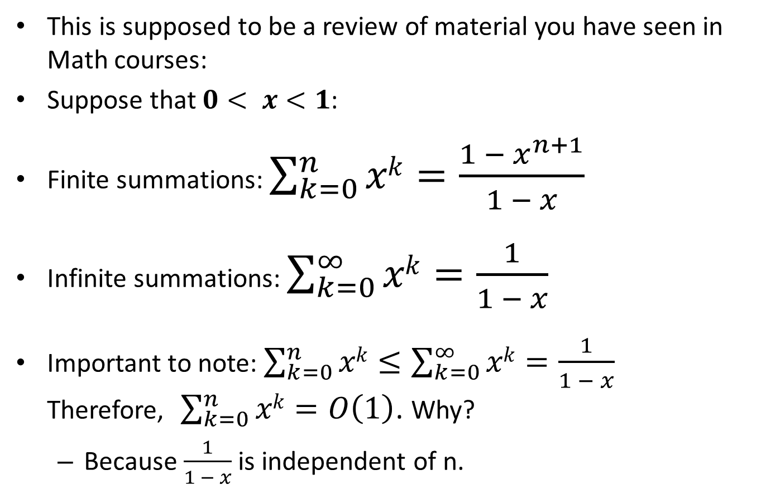
Summation of Geometric Series
This is supposed to be a review of material you have seen in Math courses:
Suppose that $0< x<1$:
Finite summations: $\sum_{k=0}^{n}{xk}=\frac{{1 − x}^{n+1}}{1 − x}$
Infinite summations: $\sum_{k=0}^{∞}{xk}=\frac{1}{1 − x}$
Important to note: $\sum_{k=0}^{n}{xk}≤\sum_{k=0}^{∞}{xk}=\frac{1}{1 − x}$
Therefore, $\sum_{k=0}^{n}{xk}=O\left(1\right)$. Why?
  Because $\frac{1}{1 − x}$ is independent of n.

Slide 22
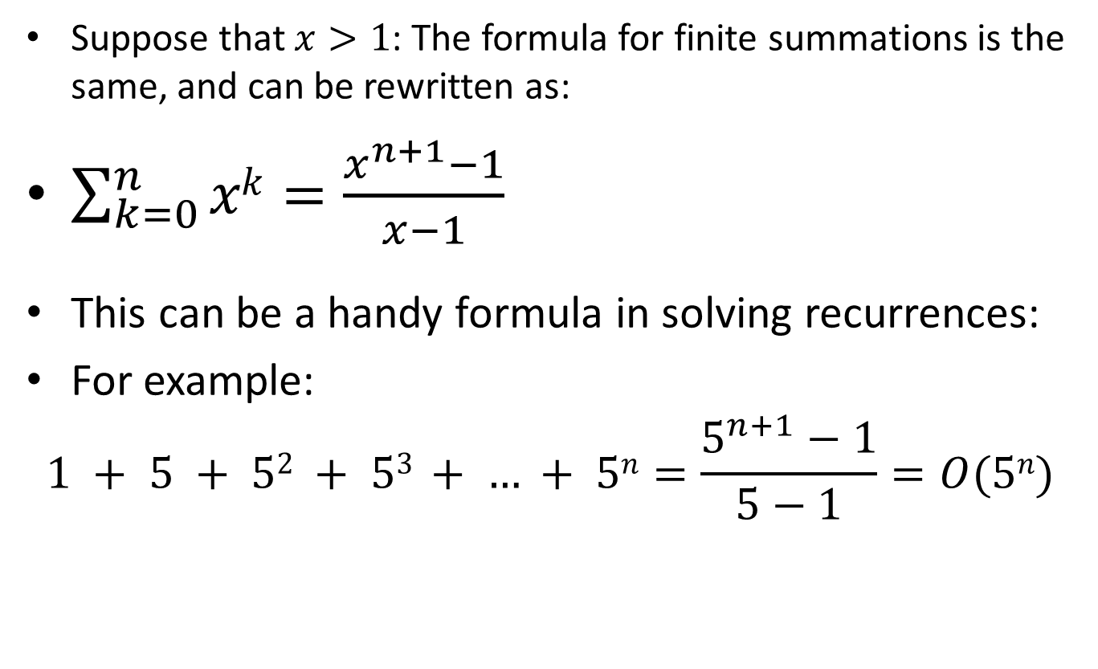
Summation of Geometric Series
Suppose that $x>1$: The formula for finite summations is the same, and can be rewritten as:
$\sum_{k=0}^{n}{xk}=\frac{x^{n+1}−1}{x−1}$
This can be a handy formula in solving recurrences:
For example:
$$1 + 5 + 52 + 53 + … + 5n=\frac{5^{n+1}−1}{5−1}=O(5n)$$

Slide 23
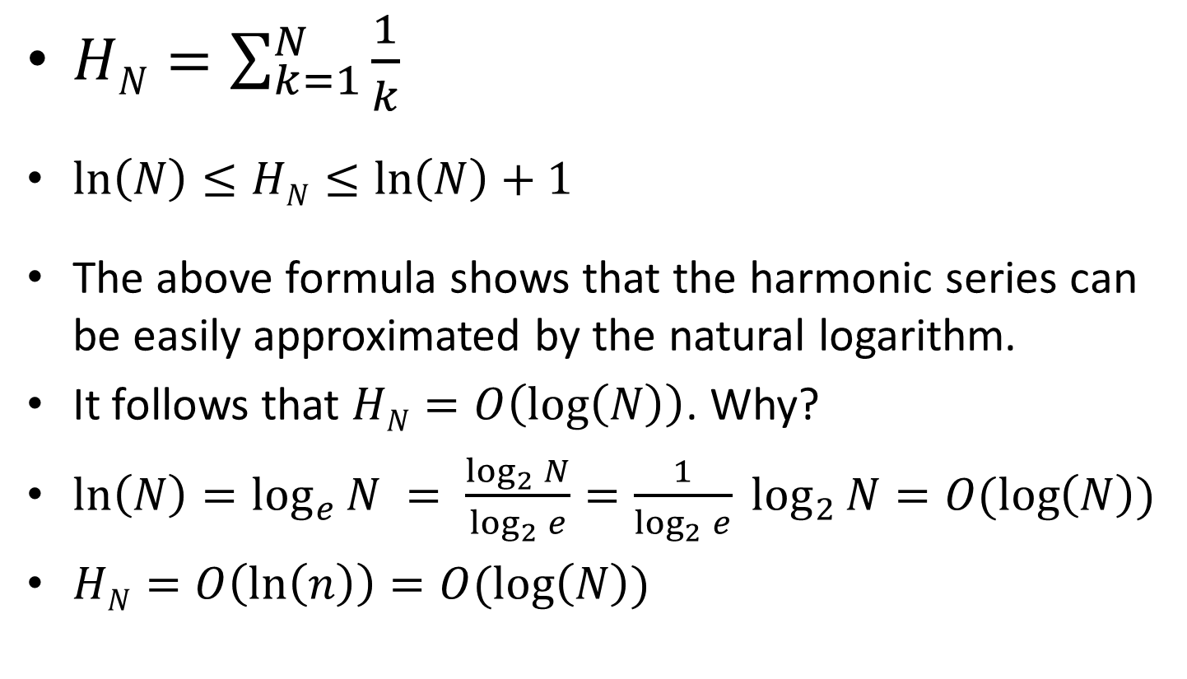
Harmonic Series
$HN=\sum_{k=1}^{N}{\frac{1}{k}}$
$\ln\left(N\right)≤HN≤\ln\left(N\right)+1$
The above formula shows that the harmonic series can be easily approximated by the natural logarithm.
It follows that $HN=O\left(\log\left(N\right)\right)$. Why?
$\ln\left(N\right)=\log_{e}{N }= \frac{\log_{2}{N}}{\log_{2}{e}}=\frac{1}{\log_{2}{e}} \log_{2}{N=O(\log\left(N\right))}$
$HN=O\left(\ln\left(n\right)\right)=O(\log\left(N\right))$

Slide 24
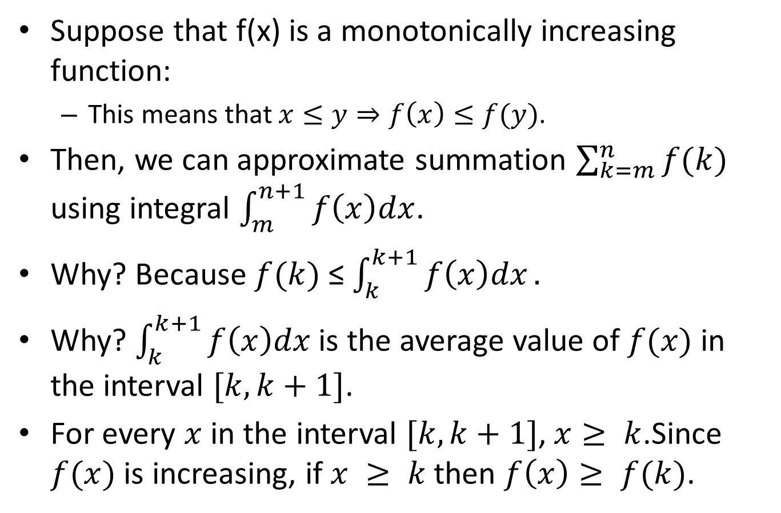
Approximation by Integrals
Suppose that f(x) is a monotonically increasing function:
  This means that $x≤y⇒f\left(x\right)≤f(y)$.
Then, we can approximate summation $\sum_{k=m}^{n}{f(k)}$ using integral $\int_{m}^{n+1}{f\left(x\right)dx}$.
Why? Because $f(k)$ ≤ $\int_{k}^{k+1}{f\left(x\right)dx}.$
Why? $\int_{k}^{k+1}{f\left(x\right)dx}$ is the average value of $f(x)$ in the interval $[k, k+1]$.
For every $x$in the interval $[k, k+1]$, $x≥ k$.Since $f(x)$ is increasing, if $x ≥ k$ then $f\left(x\right)≥ f(k)$.

Slide 25
Solving Recurrences: Example 1
Suppose that we have an algorithm that at each step:
  takes O(N²) time to go over N items.
  eliminates one item and then calls itself with the remaining data.
How do we write this recurrence?

Slide 26
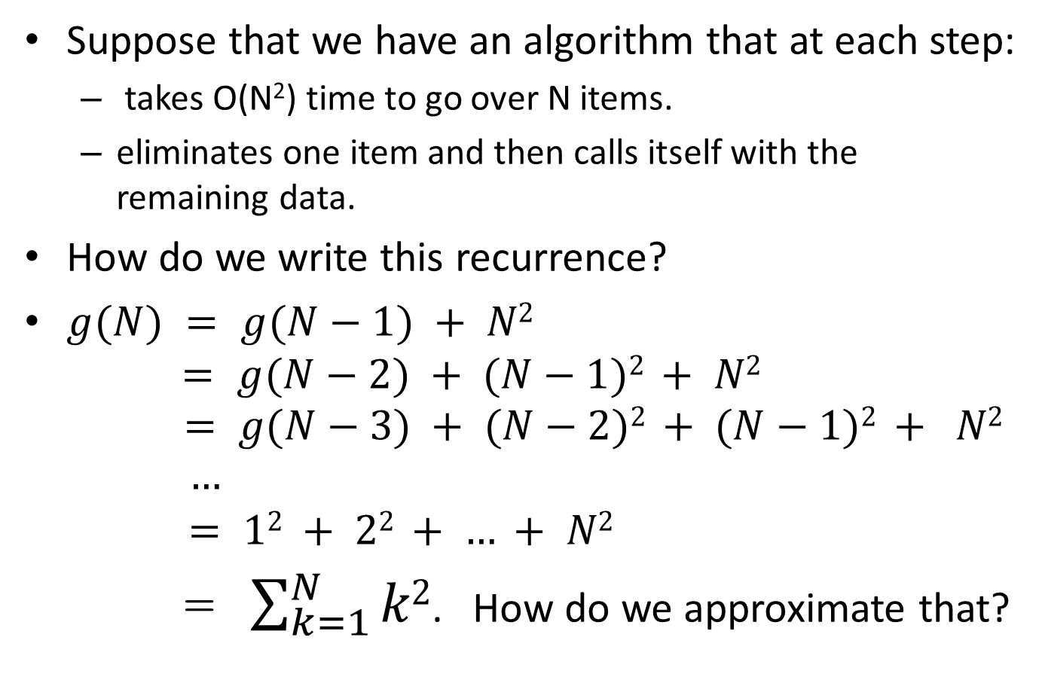
Solving Recurrences: Example 1
Suppose that we have an algorithm that at each step:
  takes O(N²) time to go over N items.
  eliminates one item and then calls itself with the remaining data.
How do we write this recurrence?
$g(N) = g(N−1) + N2$
$= g(N−2) + (N−1)2 + N2$
$$= g(N−3) + (N−2)2 + (N−1)2 + N2$$
$$…$$
$$= 12 + 22 + … + N2$$
= $\sum_{k=1}^{N}{k2}$. How do we approximate that?

Slide 27
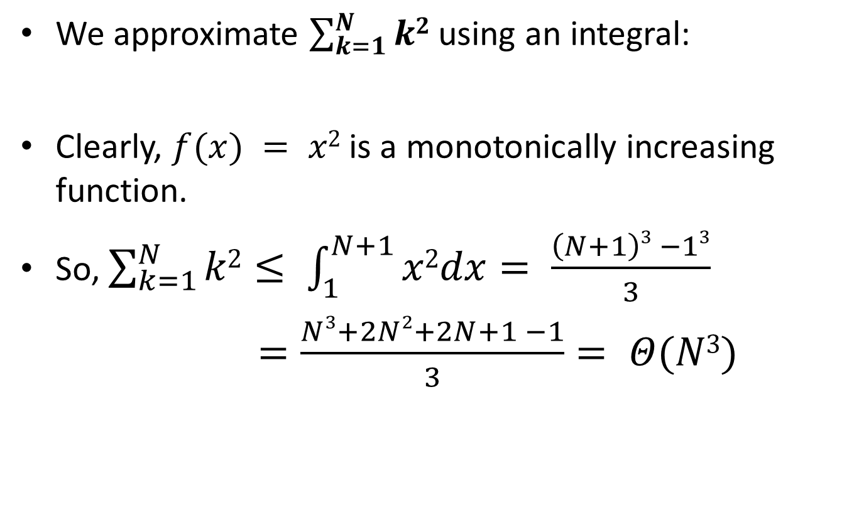
Solving Recurrences: Example 1
We approximate $\sum_{k=1}^{N}{k2}$ using an integral:
Clearly, $f(x) = x2$ is a monotonically increasing function.
So, $\sum_{k=1}^{N}{k2}≤ \int_{1}^{N+1}{x2dx}= \frac{\left(N+1\right)3 −13}{3}$
$=\frac{Ν3+2Ν2+2Ν+1 −1}{3}= Θ(N3)$

Slide 28
Solving Recurrences: Example 2
Suppose that we have an algorithm that at each step:
  takes O(log(N)) time to go over N items.
  eliminates one item and then calls itself with the remaining data.
How do we write this recurrence?

Slide 29
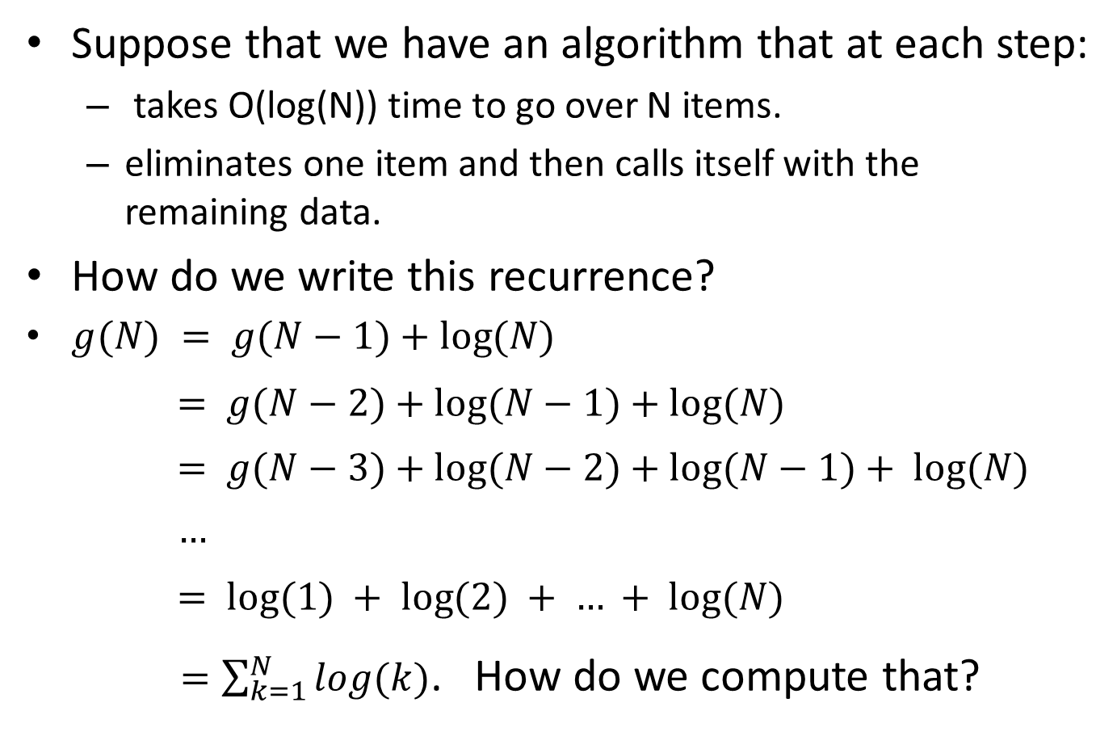
Solving Recurrences: Example 2
Suppose that we have an algorithm that at each step:
  takes O(log(N)) time to go over N items.
  eliminates one item and then calls itself with the remaining data.
How do we write this recurrence?
$g(N) = g(N−1)+log⁡(N)$
$$= g(N−2)+log⁡(N−1)+log⁡(N)$$
$$= g(N−3)+log⁡(N−2)+log⁡(N−1)+ log⁡(N)$$
$$…$$
$$= log⁡(1) + log⁡(2) + … + log⁡(N)$$
$=\sum_{k=1}^{N}{log(k)}$. How do we compute that?

Slide 30
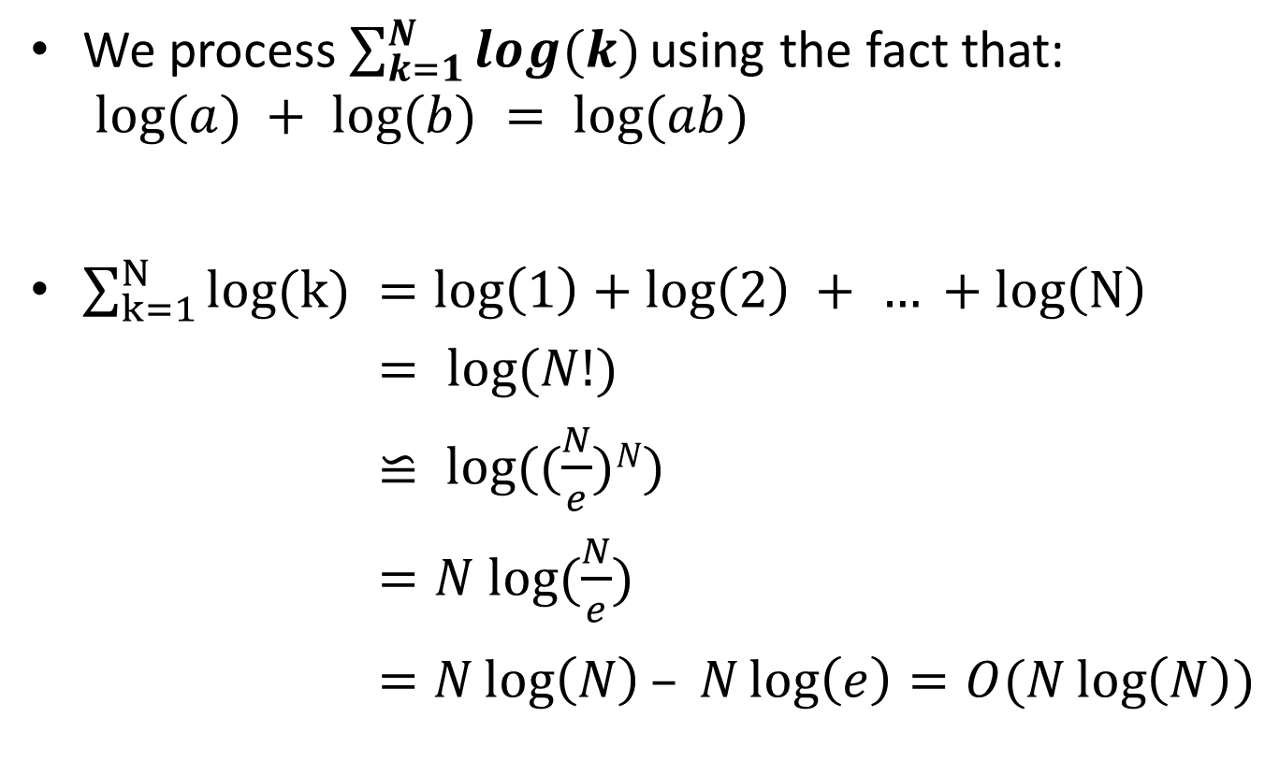
Solving Recurrences: Example 2
We process $\sum_{k=1}^{N}{log(k) }$using the fact that:
$log⁡(a) + log⁡(b) = log⁡(ab)$
$\sum_{k=1}^{N}{log(k) }=\log\left(1\right)+\log\left(2\right) + … +log\left(N\right)$
$= log⁡(N!)$
$≌ log⁡((\frac{N}{e})N)$
$=N log⁡(\frac{N}{e})$
$=N\log\left(N\right)– N\log\left(e\right)=O(N\log\left(N\right))$

Slide 31
Solving Recurrences: Example 3
Suppose that we have an algorithm that at each step:
  takes O(1) time to go over N items.
  calls itself 3 times on data of size N-1.
  takes O(1) time to combine the results.
How do we write this recurrence?

Slide 32

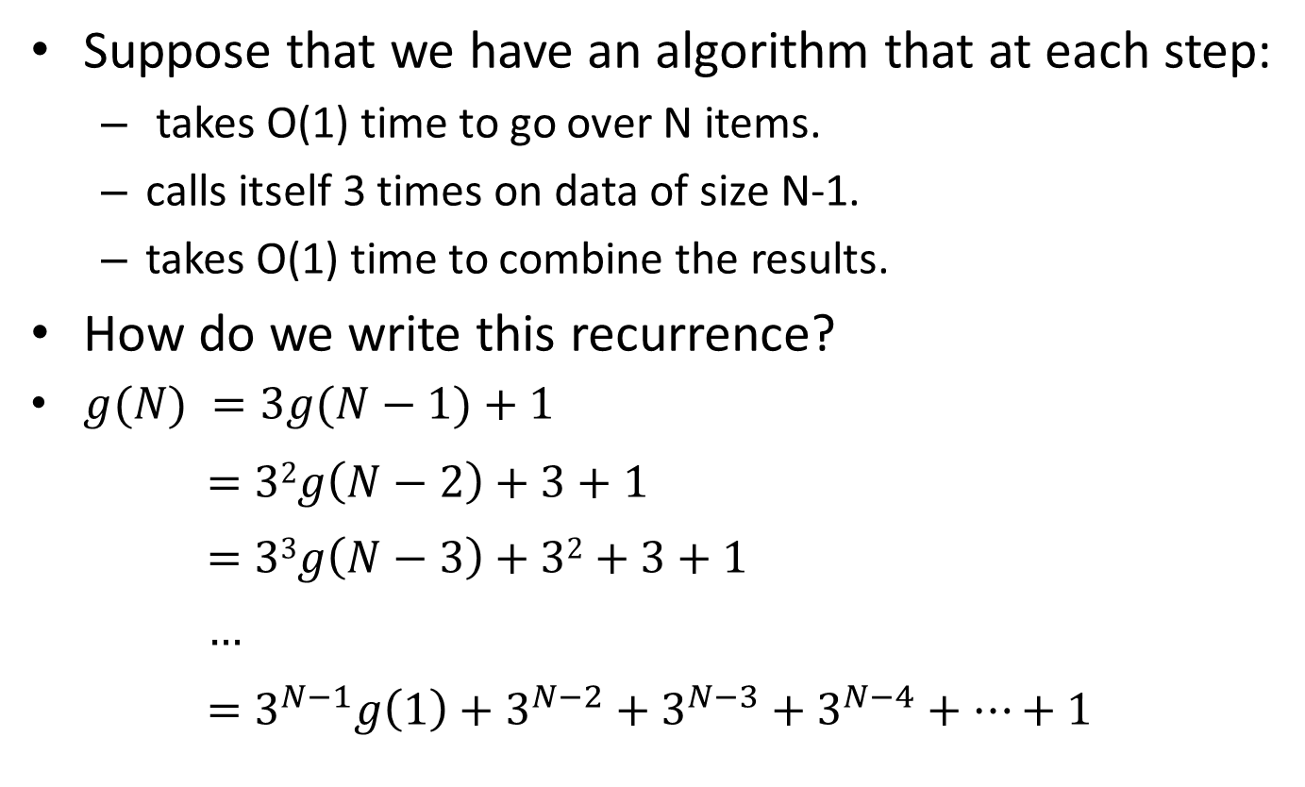
Solving Recurrences: Example 3
Suppose that we have an algorithm that at each step:
  takes O(1) time to go over N items.
  calls itself 3 times on data of size N-1.
  takes O(1) time to combine the results.
How do we write this recurrence?
$g(N) =3g(N−1)+1$
$$=32g\left(N−2\right)+3+1$$
$$=33g\left(N−3\right)+32+3+1$$
$$…$$
$$=3^{N−1}g\left(1\right)+3^{N−2}+3^{N−3}+3^{N−4}+…+1$$
Note: $g(1)$ is just a constant
finite summation

Slide 33
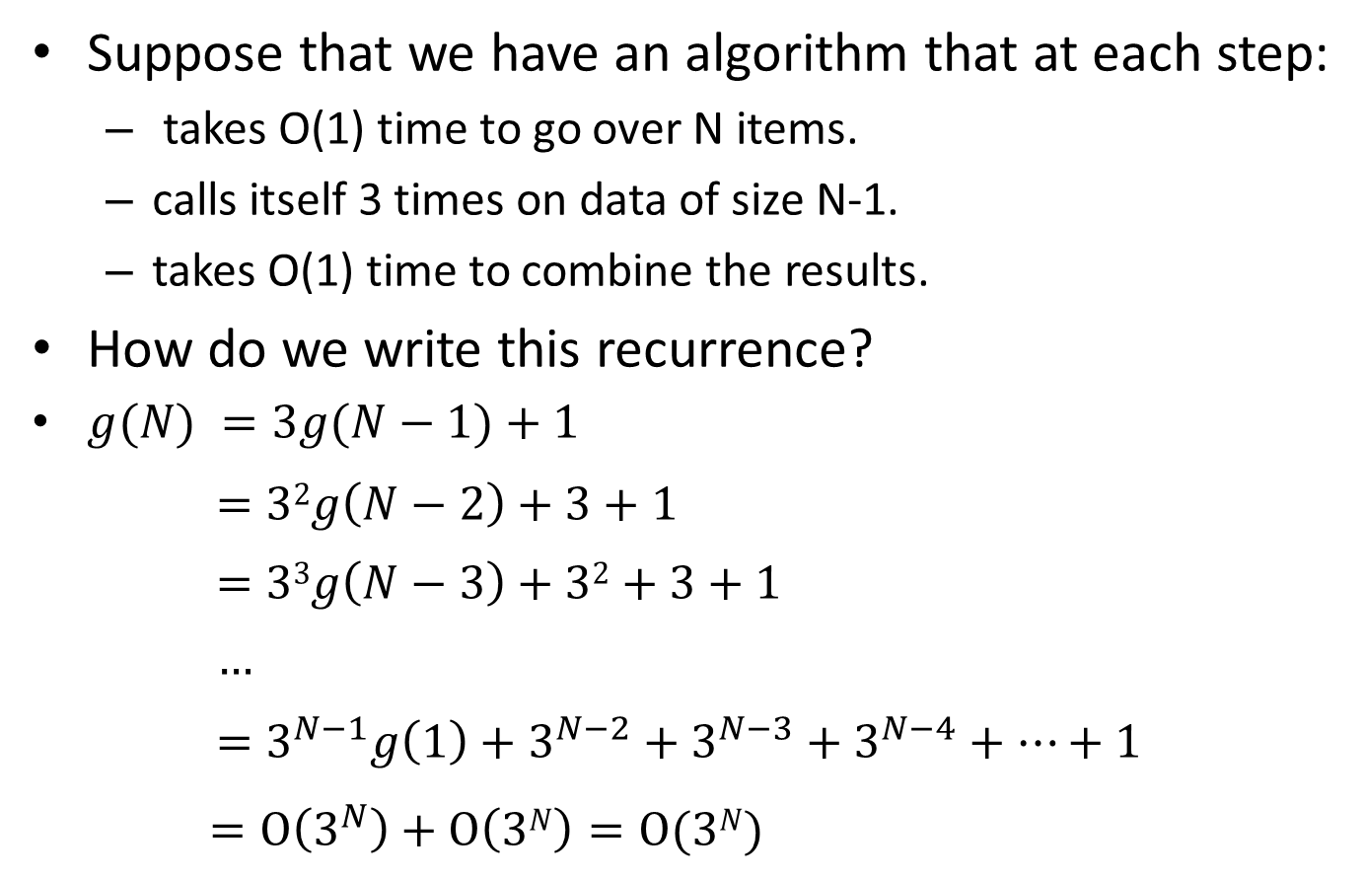
Solving Recurrences: Example 3
Suppose that we have an algorithm that at each step:
  takes O(1) time to go over N items.
  calls itself 3 times on data of size N-1.
  takes O(1) time to combine the results.
How do we write this recurrence?
$g(N) =3g(N−1)+1$
$$=32g\left(N−2\right)+3+1$$
$$=33g\left(N−3\right)+32+3+1$$
$$…$$
$$=3^{N−1}g\left(1\right)+3^{N−2}+3^{N−3}+3^{N−4}+…+1$$
$=O\left(3^{N}\right)+O\left(3N\right)=O(3N)$

Slide 34
Solving Recurrences: Example 4
Suppose that we have an algorithm that at each step:
  calls itself N times on data of size N/2.
  takes O(1) time to combine the results.
How do we write this recurrence?

Slide 35
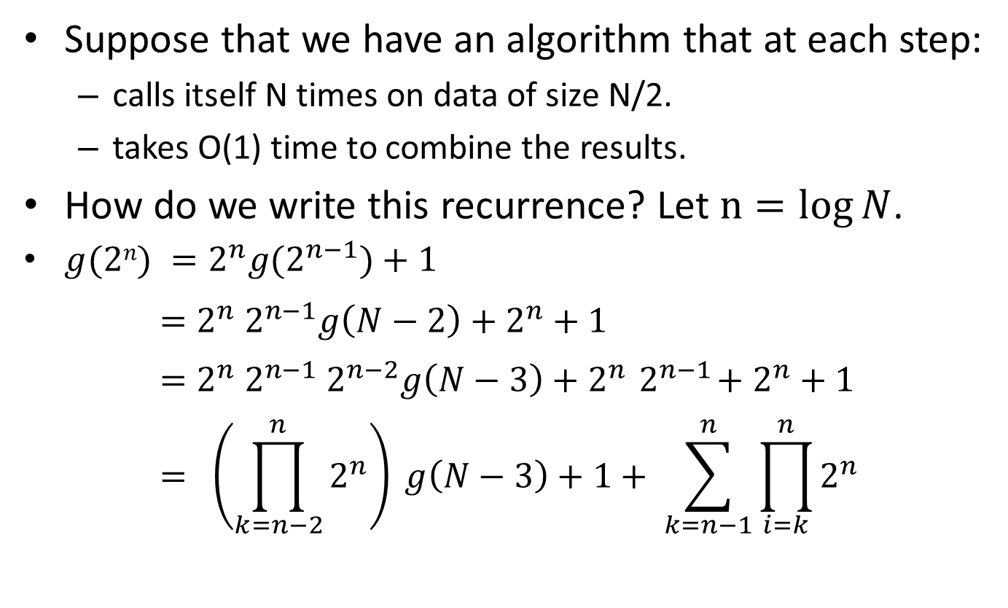
Solving Recurrences: Example 4
Suppose that we have an algorithm that at each step:
  calls itself N times on data of size N/2.
  takes O(1) time to combine the results.
How do we write this recurrence? Let $n=log{N}$.
$g(2n) =2^{n}g(2^{n−1})+1$
$$=2^{n}{ 2}^{n−1}g\left(N−2\right)+2^{n}+1$$
$$=2^{n}{ 2}^{n−1}{ 2}^{n−2}g\left(N−3\right)+2^{n}{ 2}^{n−1}+2^{n}+1$$
$$= \left(\prod_{k=n−2}^{n}{2^{n}}\right) g\left(N−3\right)+1+ \sum_{k=n−1}^{n}{\prod_{i=k}^{n}{2^{n}}}$$

Slide 36
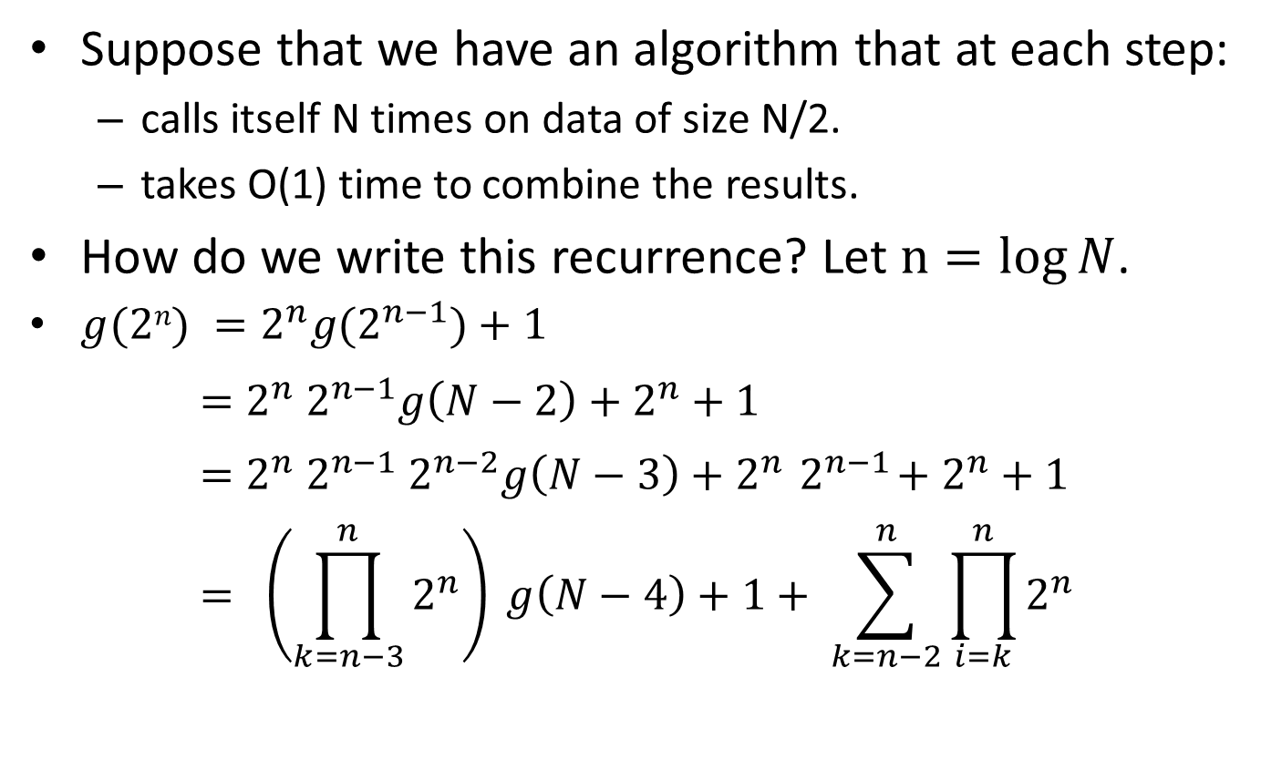
Solving Recurrences: Example 4
Suppose that we have an algorithm that at each step:
  calls itself N times on data of size N/2.
  takes O(1) time to combine the results.
How do we write this recurrence? Let $n=log{N}$.
$g(2n) =2^{n}g(2^{n−1})+1$
$$=2^{n}{ 2}^{n−1}g\left(N−2\right)+2^{n}+1$$
$$=2^{n}{ 2}^{n−1}{ 2}^{n−2}g\left(N−3\right)+2^{n}{ 2}^{n−1}+2^{n}+1$$
$$= \left(\prod_{k=n−3}^{n}{2^{n}}\right) g\left(N−4\right)+1+ \sum_{k=n−2}^{n}{\prod_{i=k}^{n}{2^{n}}}$$

Slide 37
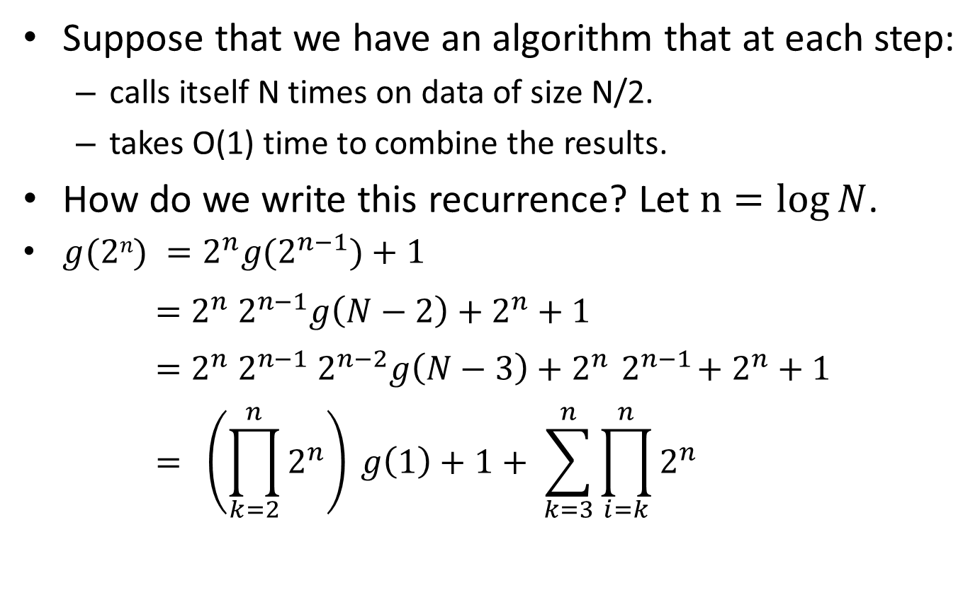
Solving Recurrences: Example 4
Suppose that we have an algorithm that at each step:
  calls itself N times on data of size N/2.
  takes O(1) time to combine the results.
How do we write this recurrence? Let $n=log{N}$.
$g(2n) =2^{n}g(2^{n−1})+1$
$$=2^{n}{ 2}^{n−1}g\left(N−2\right)+2^{n}+1$$
$$=2^{n}{ 2}^{n−1}{ 2}^{n−2}g\left(N−3\right)+2^{n}{ 2}^{n−1}+2^{n}+1$$
$$= \left(\prod_{k=2}^{n}{2^{n}}\right) g\left(1\right)+1+ \sum_{k=3}^{n}{\prod_{i=k}^{n}{2^{n}}}$$

Slide 38
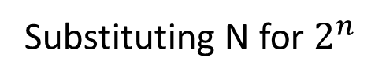

Solving Recurrences: Example 4
$$\left(\prod_{k=2}^{n}{2^{n}}\right)=2^{n}2^{n−1}2^{n−2} …2^{2}2^{1}$$
$=2^{(n+n−1+n−2+…+1)}$
$=2^{\frac{n(n+1)}{2}}$
$$= {\left(2^{n}\right)}^{\frac{n+1}{2}}$$
$$=N^{\frac{log⁡(N)+1}{2}}$$
$$=O(N^{\frac{\log\left(N\right)}{2}})$$
Substituting N for $2^{n}$

Slide 39
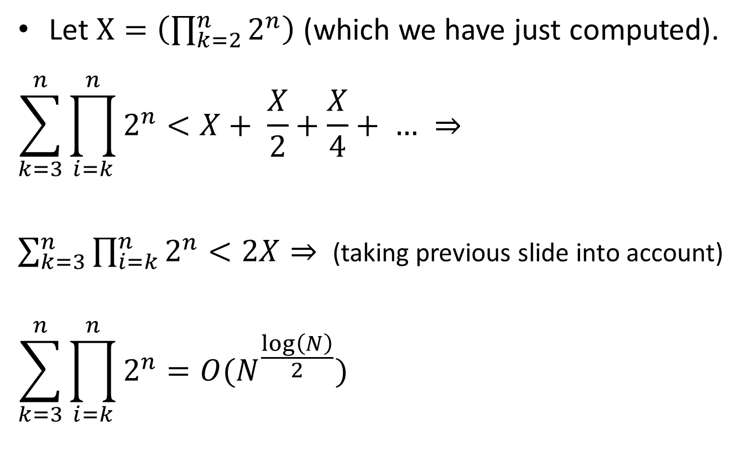
Solving Recurrences: Example 4
Let $X=\left(\prod_{k=2}^{n}{2^{n}}\right)$ (which we have just computed).
$$\sum_{k=3}^{n}{\prod_{i=k}^{n}{2^{n}}}<X+ \frac{X}{2}+\frac{X}{4}+ … ⇒$$
$\sum_{k=3}^{n}{\prod_{i=k}^{n}{2^{n}}}<2X⇒$ (taking previous slide into account)
$$\sum_{k=3}^{n}{\prod_{i=k}^{n}{2^{n}}}=O(N^{\frac{\log\left(N\right)}{2}})$$

Slide 40

Solving Recurrences: Example 4
Based on the previous two slides, we can conclude that the solution of:$g(N) =Ng(N/2)+1$ is that:
$$g\left(N\right)=O(N^{\frac{\log\left(N\right)}{2}})$$

Slide 41

Big-Oh Notation: Example Problem
Is $N=O(\sin\left(N\right)N^{2})$?
Answer:

Slide 42
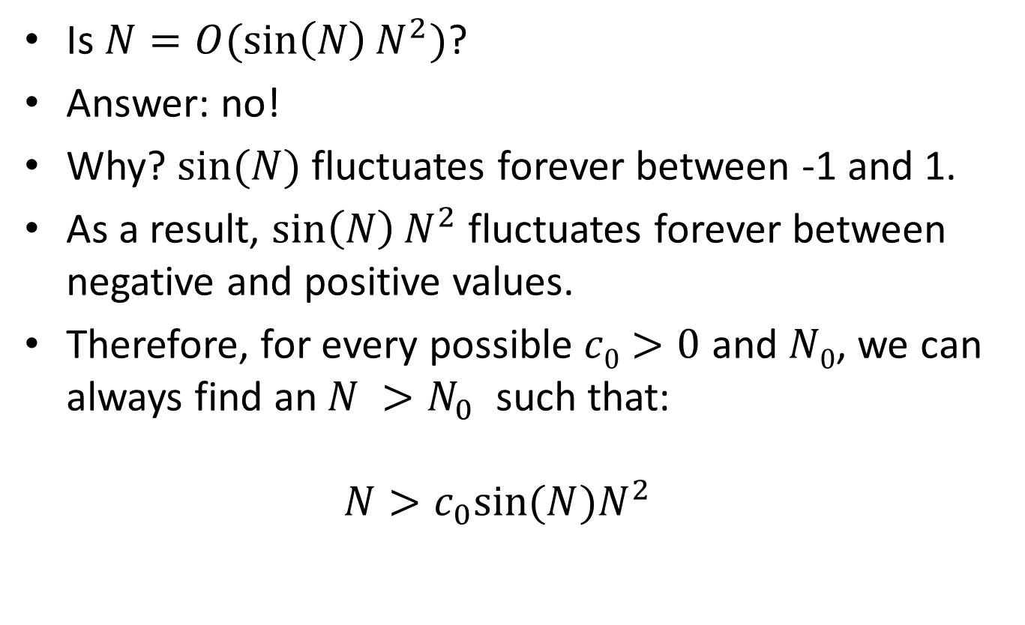
Big-Oh Notation: Example Problem
Is $N=O(\sin\left(N\right)N^{2})$?
Answer: no!
Why? $sin⁡(N)$ fluctuates forever between -1 and 1.
As a result, $\sin\left(N\right)N^{2}$ fluctuates forever between negative and positive values.
Therefore, for every possible $c0>0$ and $N0$, we can always find an $N >N_{0}$ such that:
$N>c_{0}sin⁡(N)N^{2}$

