Slide 1
Analysis of Algorithms:
Methods and Examples
CSE 2320 – Algorithms and Data Structures
Vassilis Athitsos
University of Texas at Arlington

Slide 2
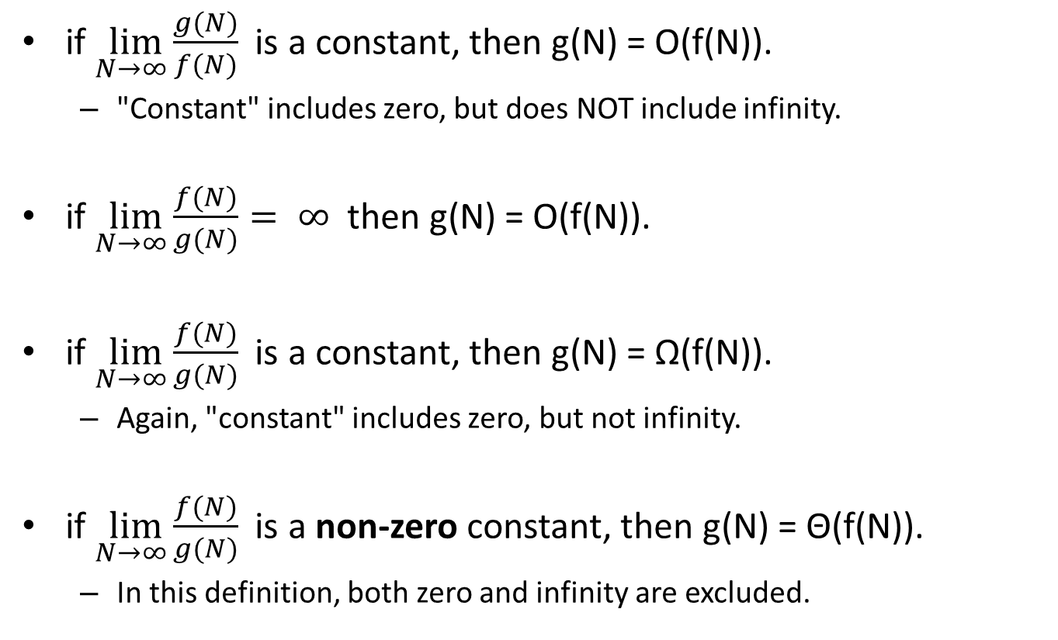
Using Limits
if $\lim_{N→∞}{\frac{g(N)}{f(N)}}$ is a constant, then g(N) = O(f(N)).
  "Constant" includes zero, but does NOT include infinity.
if $\lim_{N→∞}{\frac{f(N)}{g(N)}}= ∞$ then g(N) = O(f(N)).
if $\lim_{N→∞}{\frac{f(N)}{g(N)}}$ is a constant, then g(N) = Ω(f(N)).
  Again, "constant" includes zero, but not infinity.
if $\lim_{N→∞}{\frac{f(N)}{g(N)}}$ is a non-zero constant, then g(N) = Θ(f(N)).
  In this definition, both zero and infinity are excluded.

Slide 3

Using Limits: An Example
Show that $\frac{n5+3n4+2n3+n2+n+12}{5n3+n+3}=Θ(???)$.

Slide 4
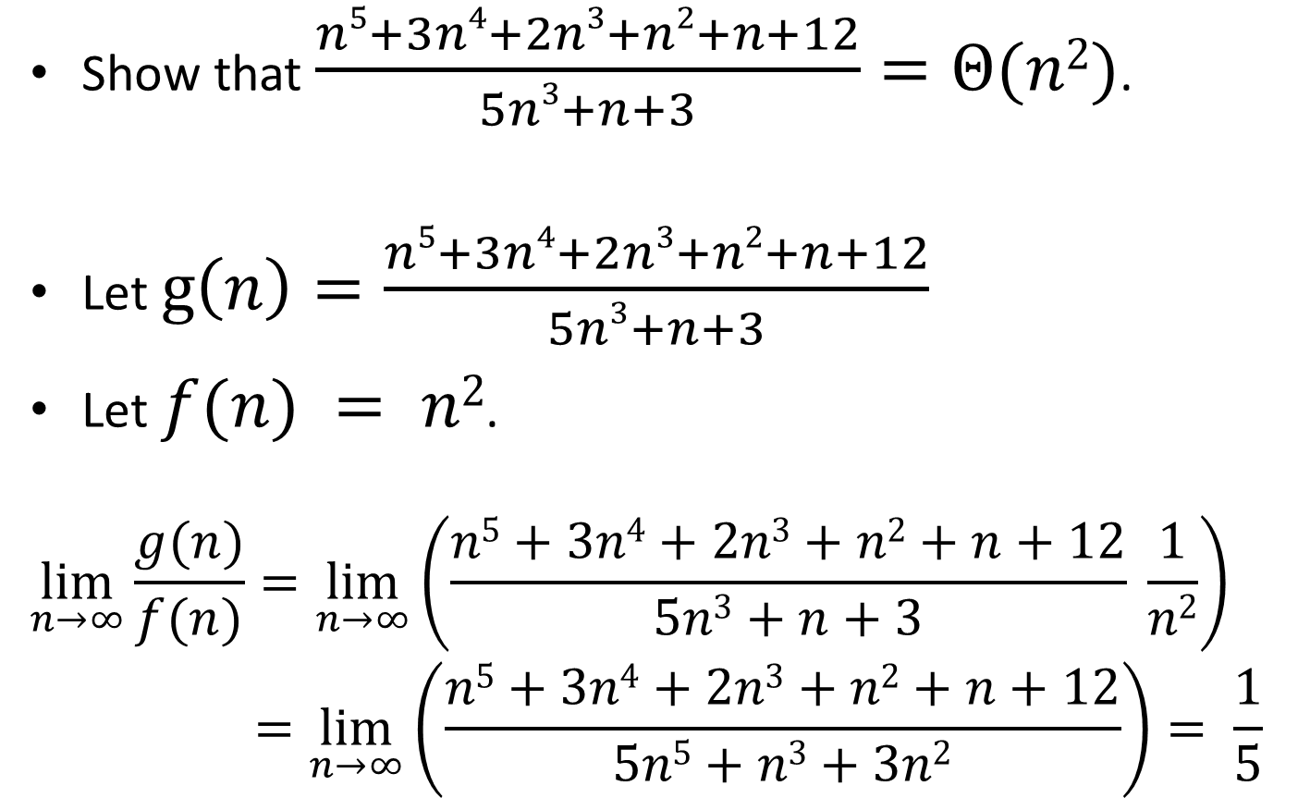
Using Limits: An Example
Show that $\frac{n5+3n4+2n3+n2+n+12}{5n3+n+3}=Θ(n2)$.
Let $g\left(n\right)=\frac{n5+3n4+2n3+n2+n+12}{5n3+n+3}$
Let $f(n) = n2$.
$$\lim_{n→∞}{\frac{g(n)}{f(n)}=\lim_{n→∞}\left(\frac{n5+3n4+2n3+n2+n+12}{5n3+n+3} \frac{1}{n2}\right)} \\ =\lim_{n→∞}\left(\frac{n5+3n4+2n3+n2+n+12}{5n5+n3+3n2}\right)= \frac{1}{5}$$

Slide 5
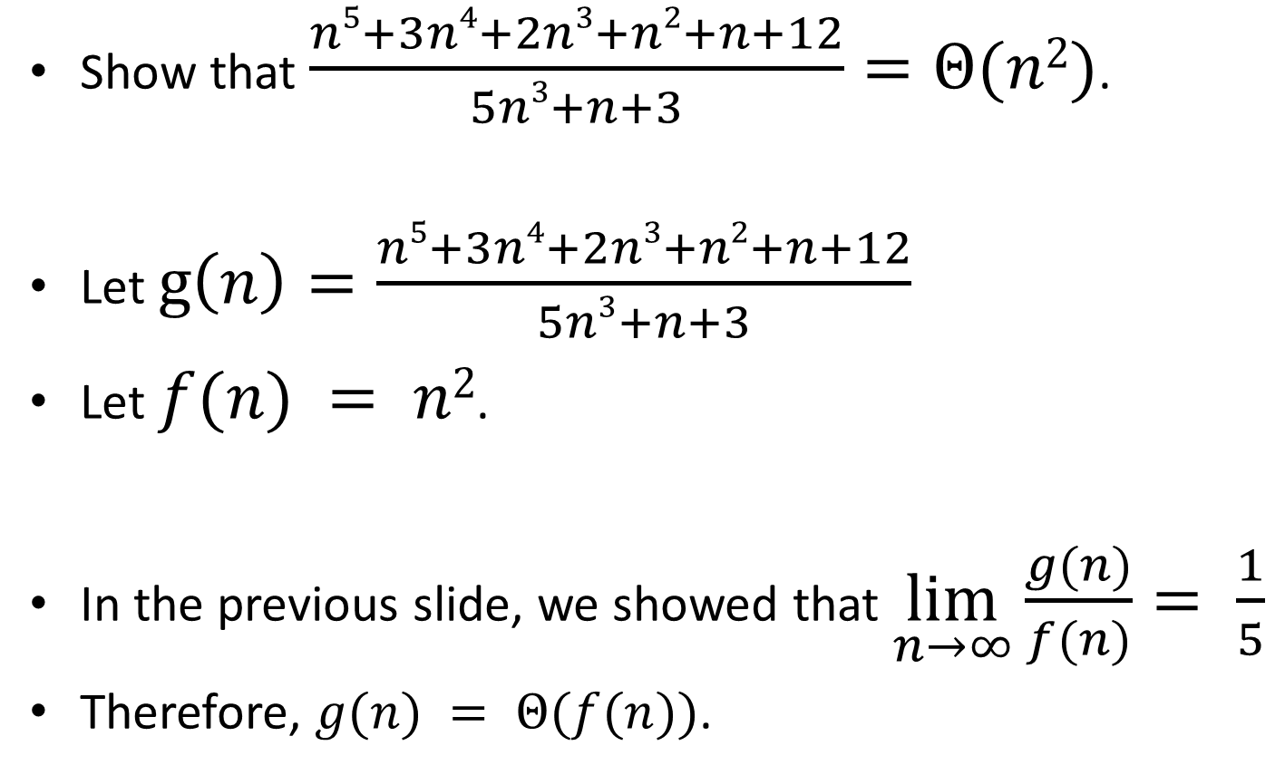
Using Limits: An Example
Show that $\frac{n5+3n4+2n3+n2+n+12}{5n3+n+3}=Θ(n2)$.
Let $g\left(n\right)=\frac{n5+3n4+2n3+n2+n+12}{5n3+n+3}$
Let $f(n) = n2$.
In the previous slide, we showed that $\lim_{n→∞}\frac{g(n)}{f(n)}= \frac{1}{5}$
Therefore, $g(n) = Θ(f(n))$.

Slide 6

Big-Oh Transitivity
If $g\left(N\right)=O\left(f\left(N\right)\right)$ and $f\left(N\right)=O(h\left(N\right))$, then
$g\left(N\right)=O(h\left(N\right))$.
How can we prove that?

Slide 7
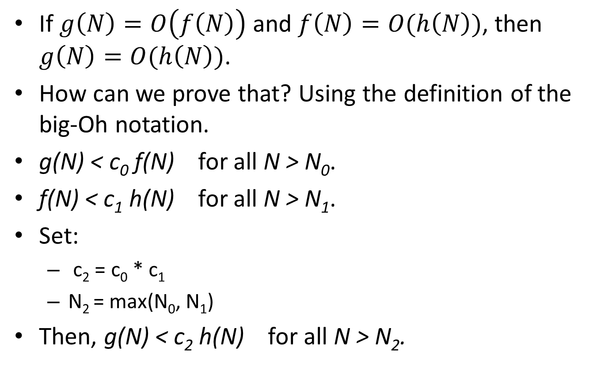
Big-Oh Transitivity
If $g\left(N\right)=O\left(f\left(N\right)\right)$ and $f\left(N\right)=O(h\left(N\right))$, then
$g\left(N\right)=O(h\left(N\right))$.
How can we prove that? Using the definition of the big-Oh notation.
g(N) < c₀ f(N) for all N > N₀.
f(N) < c₁ h(N) for all N > N₁.
Set:
  c₂ = c₀ * c₁
  N₂ = max(N₀, N₁)
Then, g(N) < c₂ h(N) for all N > N₂.

Slide 8
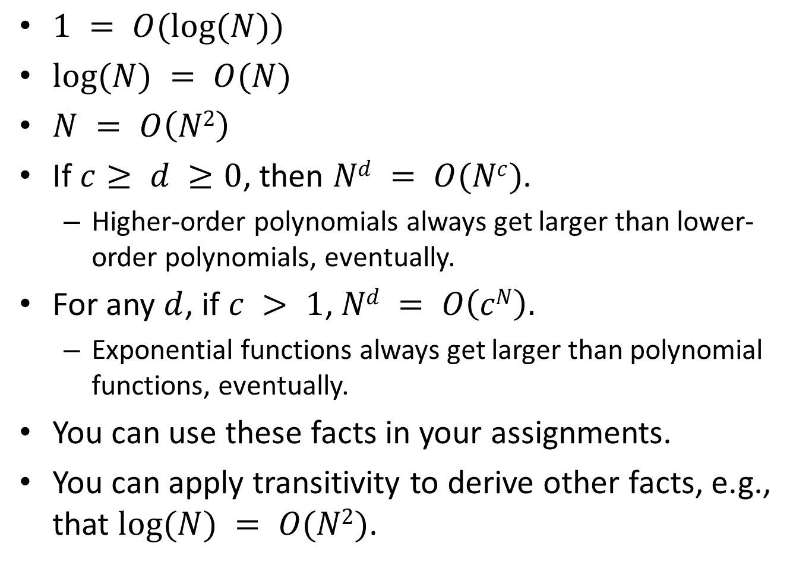
Big-Oh Hierarchy
$1 = O(log⁡(N))$
$log⁡(N) = O(N)$
$N = O\left(N2\right)$
If $c≥ d ≥0$, then $Nd = O(Nc)$.
  Higher-order polynomials always get larger than lower-order polynomials, eventually.
For any $d$, if $c > 1$, $Nd = O\left(cN\right).$
  Exponential functions always get larger than polynomial functions, eventually.
You can use these facts in your assignments.
You can apply transitivity to derive other facts, e.g., that $log⁡(N) = O(N2)$.

Slide 9
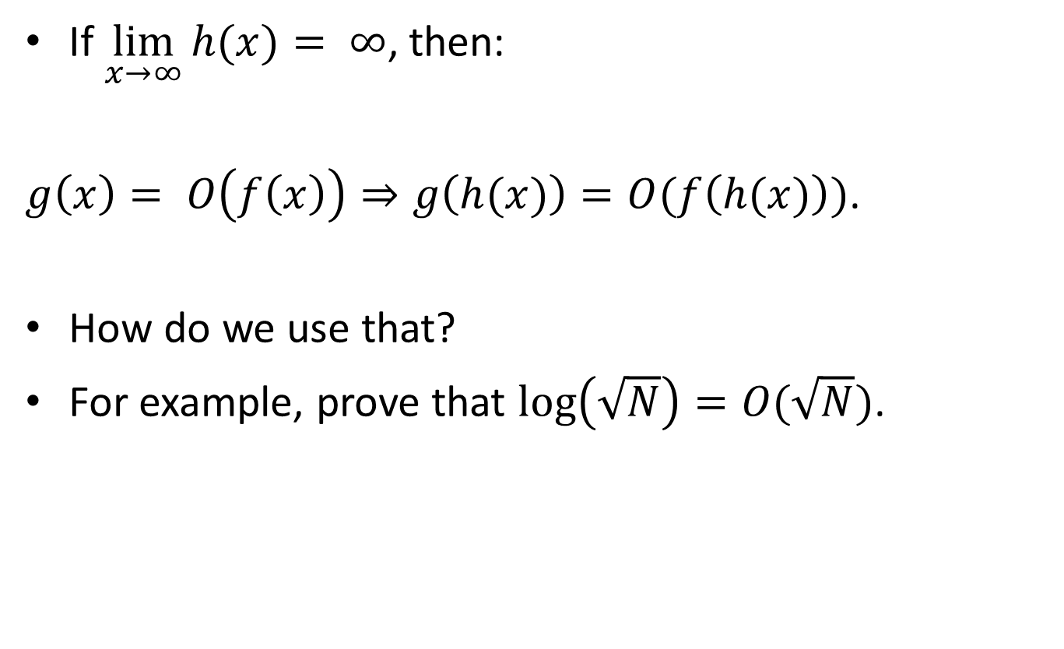
Using Substitutions
If $\lim_{x→∞}{h(x)}= ∞$, then:
$g\left(x\right)= O\left(f\left(x\right)\right)⇒g\left(h(x)\right)=O(f\left(h(x)\right))$.
How do we use that?
For example, prove that $\log\left(\sqrt{N}\right)=O(\sqrt{N})$.

Slide 10
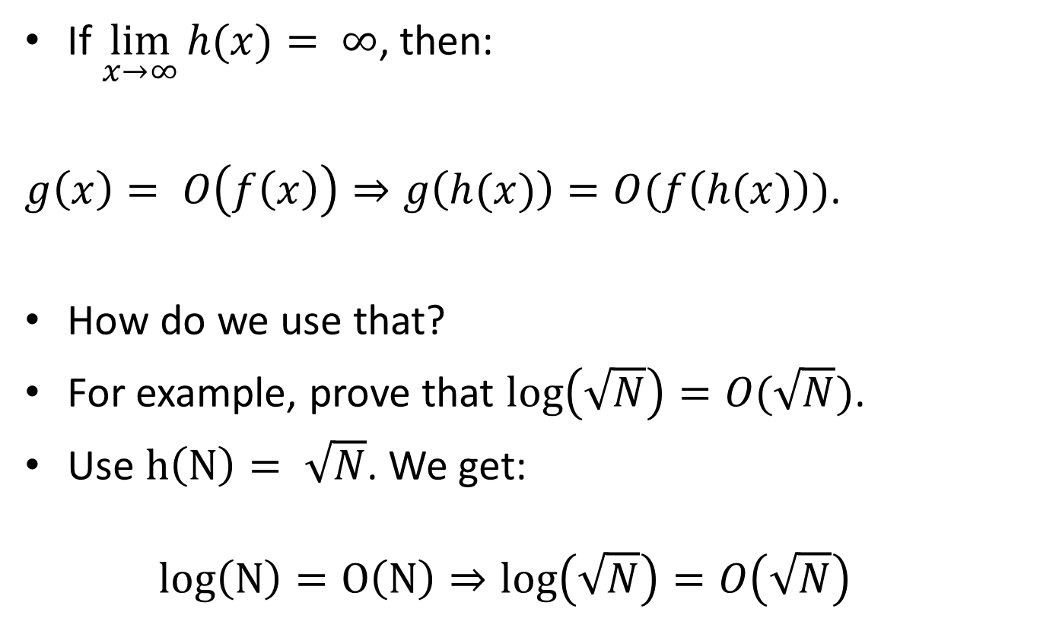
Using Substitutions
If $\lim_{x→∞}{h(x)}= ∞$, then:
$g\left(x\right)= O\left(f\left(x\right)\right)⇒g\left(h(x)\right)=O(f\left(h(x)\right))$.
How do we use that?
For example, prove that $\log\left(\sqrt{N}\right)=O(\sqrt{N})$.
Use $h\left(N\right)= \sqrt{N}$. We get:
$log\left(N\right)=O\left(N\right)⇒log\left(\sqrt{N}\right)=O\left(\sqrt{N}\right)$

Slide 11
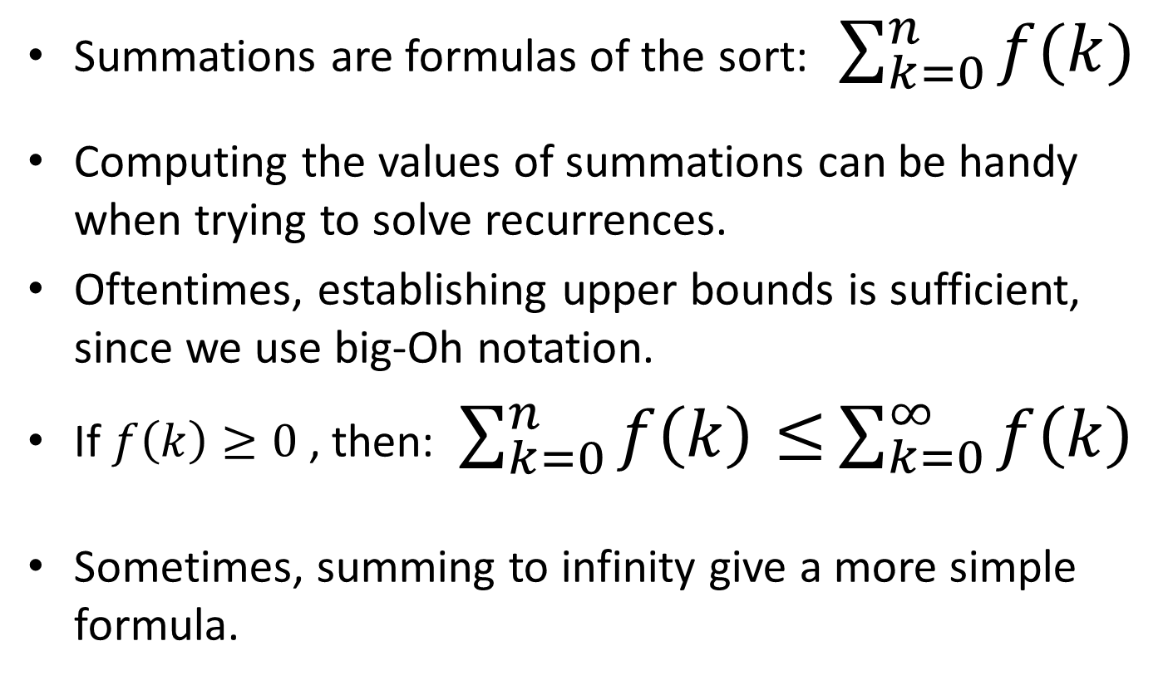
Summations
Summations are formulas of the sort:$\sum_{k=0}^{n}{f(k)}$
Computing the values of summations can be handy when trying to solve recurrences.
Oftentimes, establishing upper bounds is sufficient, since we use big-Oh notation.
If $f\left(k\right)≥0$, then: $\sum_{k=0}^{n}{f\left(k\right)≤}\sum_{k=0}^{∞}{f\left(k\right)}$
Sometimes, summing to infinity give a more simple formula.

Slide 12
Geometric Series
A geometric series is a sequence C_{k} of numbers, such that C_{k} = D * C_{k-1} , where D is a constant.
How can we express C₁ in terms of C₀?
  C₁ = D * C₀
How can we express C₂ in terms of C₀?
  C₂ = D * C₁ = D² * C₀
How can we express C_{k} in terms of C₀?
  C_{k} = D^{k} * C₀
So, to define a geometric series, we just need two parameters: D and C₀.

Slide 13
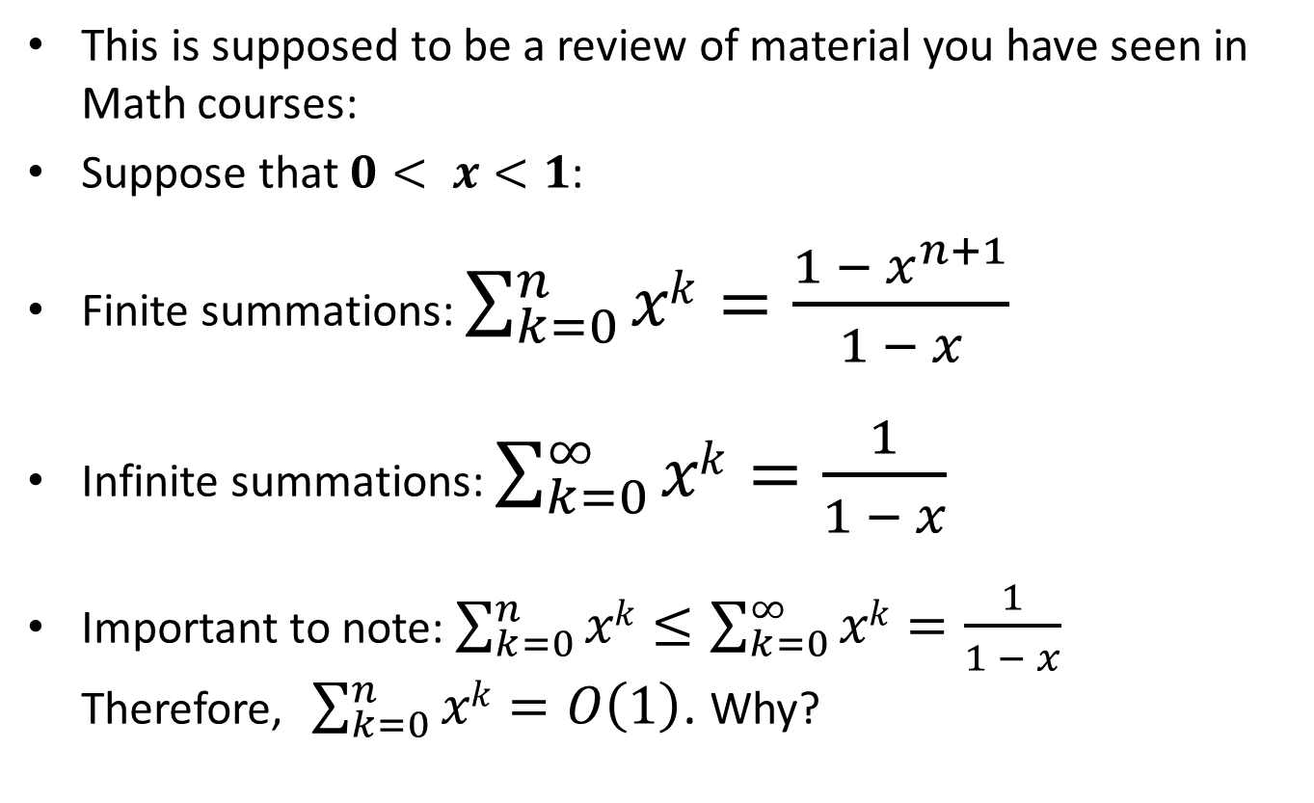
Summation of Geometric Series
This is supposed to be a review of material you have seen in Math courses:
Suppose that $0< x<1$:
Finite summations: $\sum_{k=0}^{n}{xk}=\frac{{1 − x}^{n+1}}{1 − x}$
Infinite summations: $\sum_{k=0}^{∞}{xk}=\frac{1}{1 − x}$
Important to note: $\sum_{k=0}^{n}{xk}≤\sum_{k=0}^{∞}{xk}=\frac{1}{1 − x}$
Therefore, $\sum_{k=0}^{n}{xk}=O\left(1\right)$. Why?

Slide 14
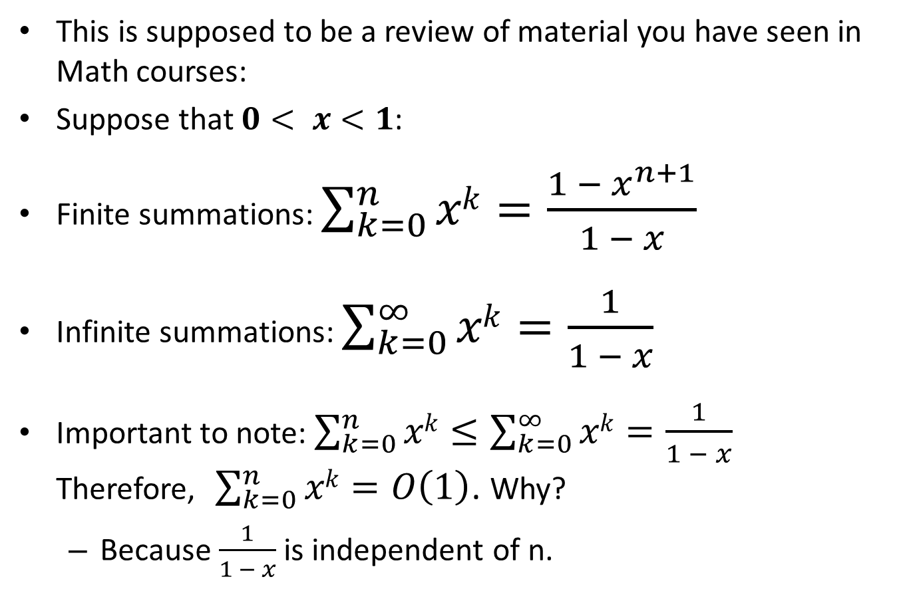
Summation of Geometric Series
This is supposed to be a review of material you have seen in Math courses:
Suppose that $0< x<1$:
Finite summations: $\sum_{k=0}^{n}{xk}=\frac{{1 − x}^{n+1}}{1 − x}$
Infinite summations: $\sum_{k=0}^{∞}{xk}=\frac{1}{1 − x}$
Important to note: $\sum_{k=0}^{n}{xk}≤\sum_{k=0}^{∞}{xk}=\frac{1}{1 − x}$
Therefore, $\sum_{k=0}^{n}{xk}=O\left(1\right)$. Why?
  Because $\frac{1}{1 − x}$ is independent of n.

Slide 15
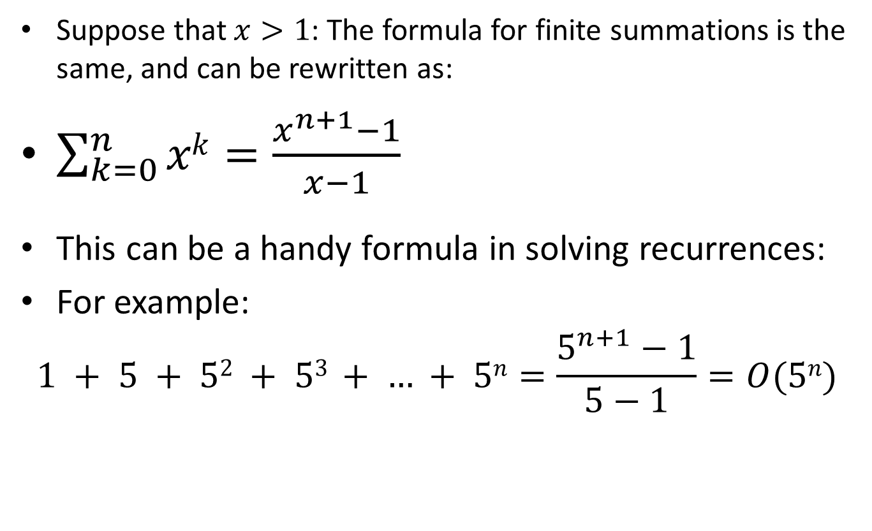
Summation of Geometric Series
Suppose that $x>1$: The formula for finite summations is the same, and can be rewritten as:
$\sum_{k=0}^{n}{xk}=\frac{x^{n+1}−1}{x−1}$
This can be a handy formula in solving recurrences:
For example:
$$1 + 5 + 52 + 53 + … + 5n=\frac{5^{n+1}−1}{5−1}=O(5n)$$

Slide 16
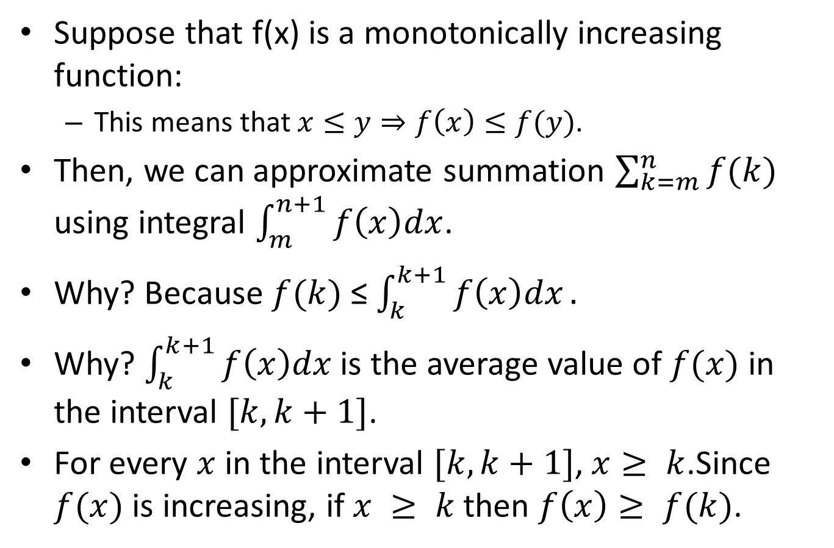
Approximation by Integrals
Suppose that f(x) is a monotonically increasing function:
  This means that $x≤y⇒f\left(x\right)≤f(y)$.
Then, we can approximate summation $\sum_{k=m}^{n}{f(k)}$ using integral $\int_{m}^{n+1}{f\left(x\right)dx}$.
Why? Because $f(k)$ ≤ $\int_{k}^{k+1}{f\left(x\right)dx}.$
Why? $\int_{k}^{k+1}{f\left(x\right)dx}$ is the average value of $f(x)$ in the interval $[k, k+1]$.
For every $x$in the interval $[k, k+1]$, $x≥ k$.Since $f(x)$ is increasing, if $x ≥ k$ then $f\left(x\right)≥ f(k)$.

Slide 17
Solving Recurrences: Example 1
Suppose that we have an algorithm that at each step:
  takes O(N²) time to go over N items.
  eliminates one item and then calls itself with the remaining data.
How do we write this recurrence?

Slide 18
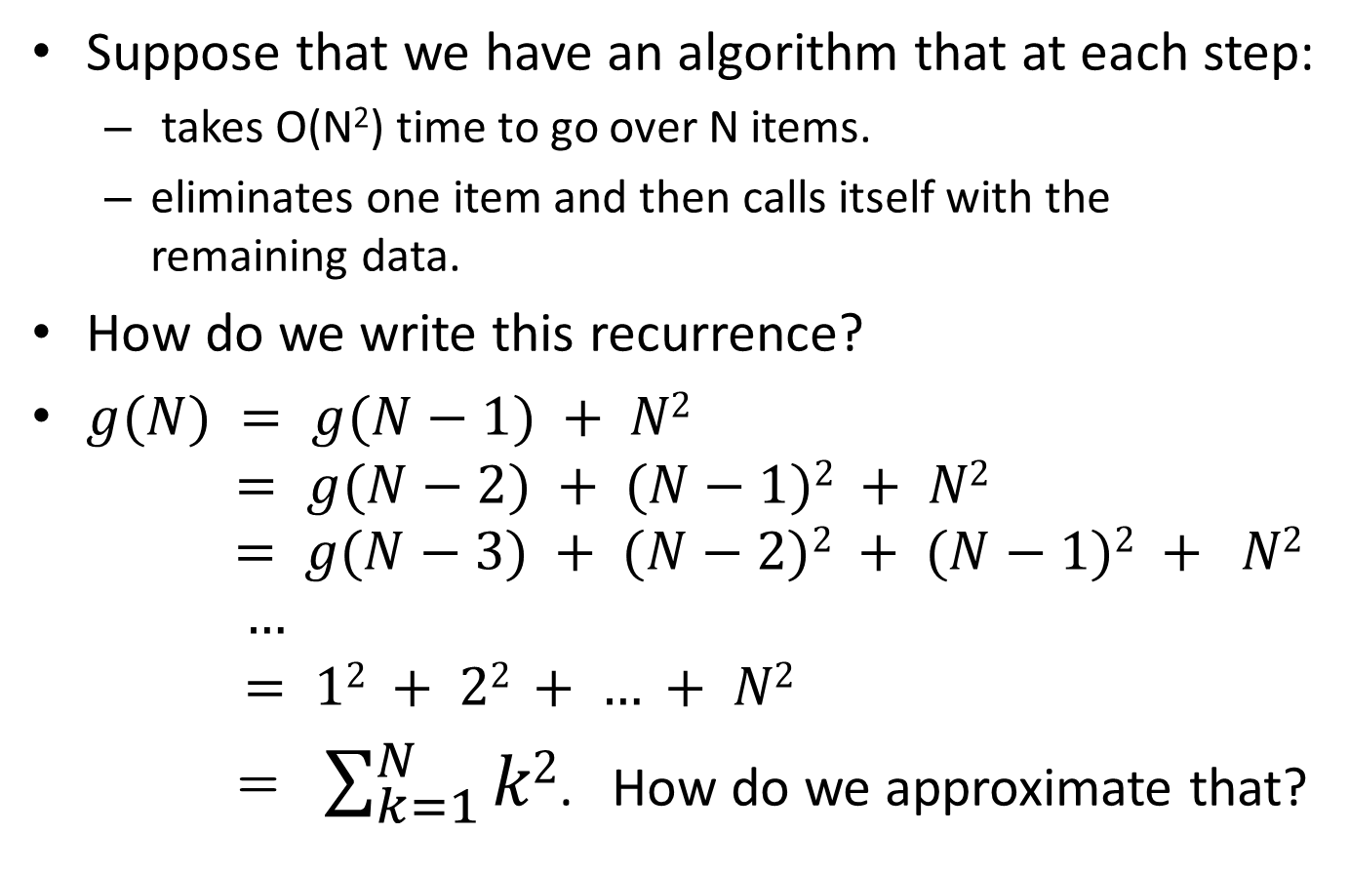
Solving Recurrences: Example 1
Suppose that we have an algorithm that at each step:
  takes O(N²) time to go over N items.
  eliminates one item and then calls itself with the remaining data.
How do we write this recurrence?
$g(N) = g(N−1) + N2$
$= g(N−2) + (N−1)2 + N2$
$$= g(N−3) + (N−2)2 + (N−1)2 + N2$$
$$…$$
$$= 12 + 22 + … + N2$$
= $\sum_{k=1}^{N}{k2}$. How do we approximate that?

Slide 19
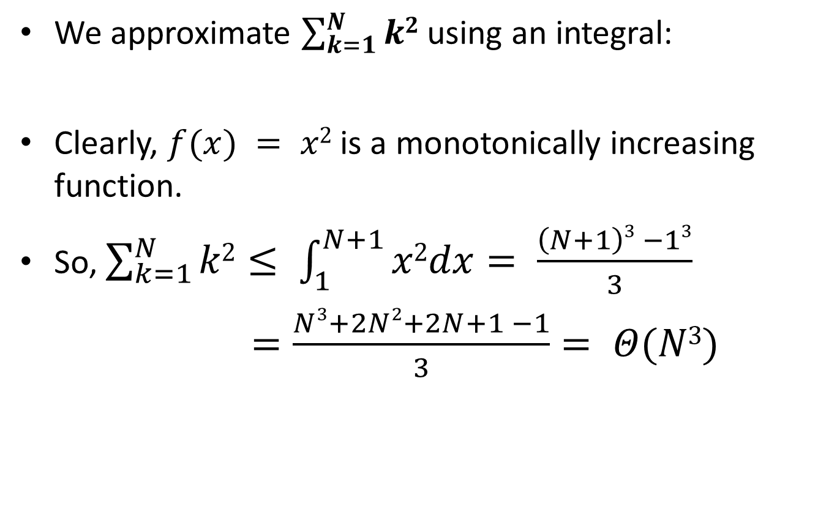
Solving Recurrences: Example 1
We approximate $\sum_{k=1}^{N}{k2}$ using an integral:
Clearly, $f(x) = x2$ is a monotonically increasing function.
So, $\sum_{k=1}^{N}{k2}≤ \int_{1}^{N+1}{x2dx}= \frac{\left(N+1\right)3 −13}{3}$
$=\frac{Ν3+2Ν2+2Ν+1 −1}{3}= Θ(N3)$

Slide 20
Solving Recurrences: Example 2
Suppose that we have an algorithm that at each step:
  takes O(log(N)) time to go over N items.
  eliminates one item and then calls itself with the remaining data.
How do we write this recurrence?

Slide 21
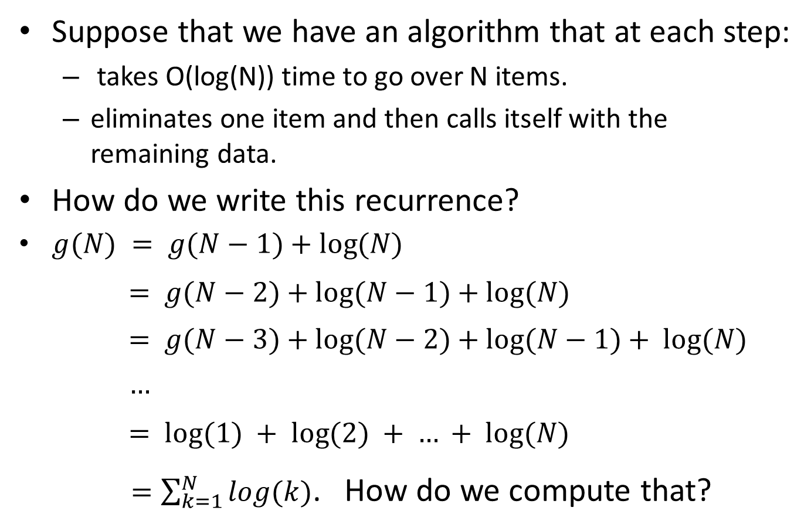
Solving Recurrences: Example 2
Suppose that we have an algorithm that at each step:
  takes O(log(N)) time to go over N items.
  eliminates one item and then calls itself with the remaining data.
How do we write this recurrence?
$g(N) = g(N−1)+log⁡(N)$
$$= g(N−2)+log⁡(N−1)+log⁡(N)$$
$$= g(N−3)+log⁡(N−2)+log⁡(N−1)+ log⁡(N)$$
$$…$$
$$= log⁡(1) + log⁡(2) + … + log⁡(N)$$
$=\sum_{k=1}^{N}{log(k)}$. How do we compute that?

Slide 22
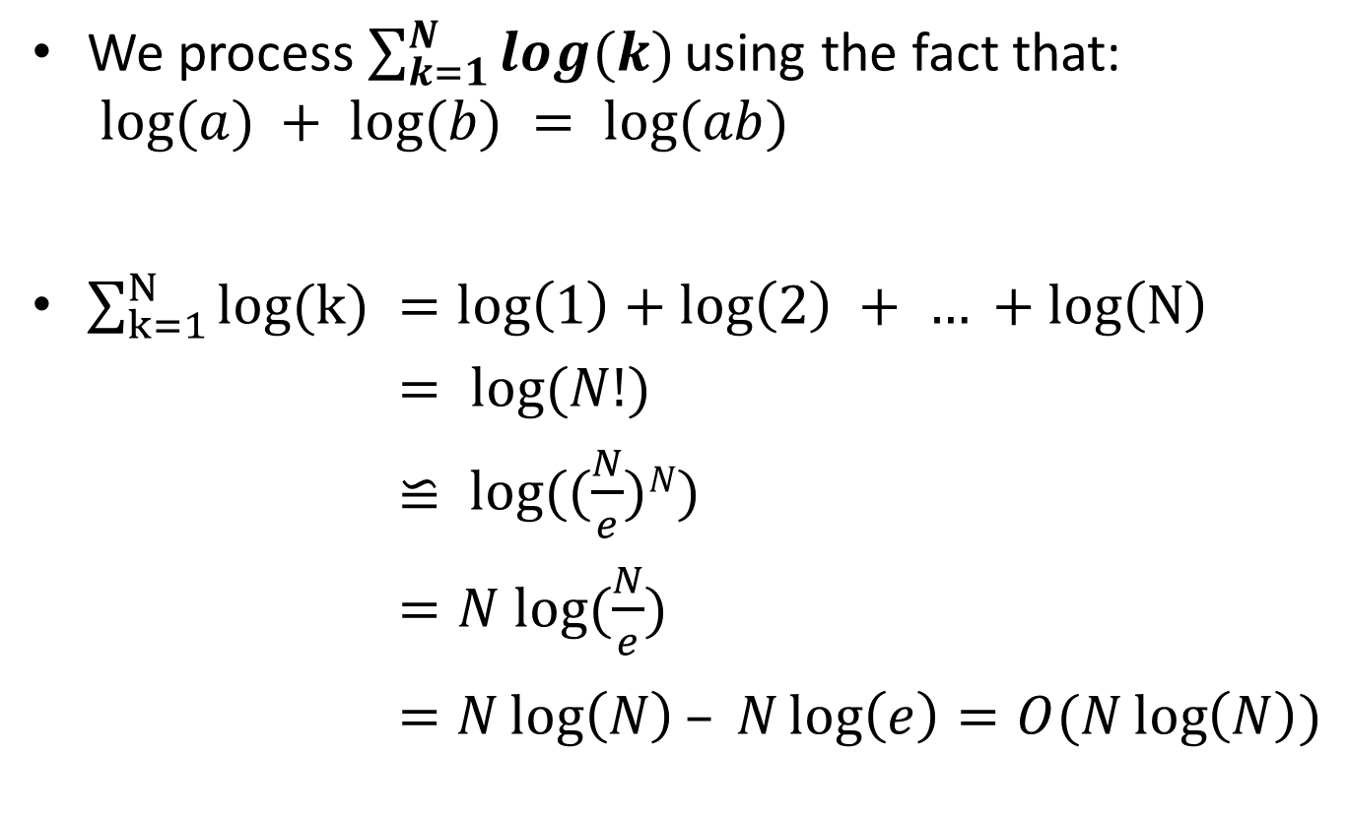
Solving Recurrences: Example 2
We process $\sum_{k=1}^{N}{log(k) }$using the fact that:
$log⁡(a) + log⁡(b) = log⁡(ab)$
$\sum_{k=1}^{N}{log(k) }=\log\left(1\right)+\log\left(2\right) + … +log\left(N\right)$
$= log⁡(N!)$
$≌ log⁡((\frac{N}{e})N)$
$=N log⁡(\frac{N}{e})$
$=N\log\left(N\right)– N\log\left(e\right)=O(N\log\left(N\right))$

Slide 23
Solving Recurrences: Example 3
Suppose that we have an algorithm that at each step:
  takes O(1) time to go over N items.
  calls itself 3 times on data of size N-1.
  takes O(1) time to combine the results.
How do we write this recurrence?

Slide 24

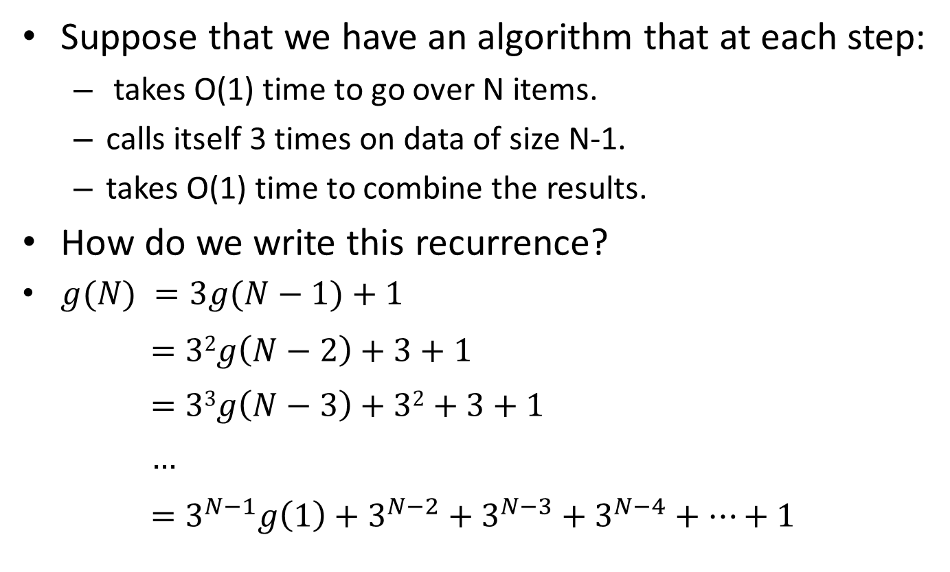
Solving Recurrences: Example 3
Suppose that we have an algorithm that at each step:
  takes O(1) time to go over N items.
  calls itself 3 times on data of size N-1.
  takes O(1) time to combine the results.
How do we write this recurrence?
$g(N) =3g(N−1)+1$
$$=32g\left(N−2\right)+3+1$$
$$=33g\left(N−3\right)+32+3+1$$
$$…$$
$$=3^{N−1}g\left(1\right)+3^{N−2}+3^{N−3}+3^{N−4}+…+1$$
Note: $g(1)$ is just a constant
finite summation

Slide 25
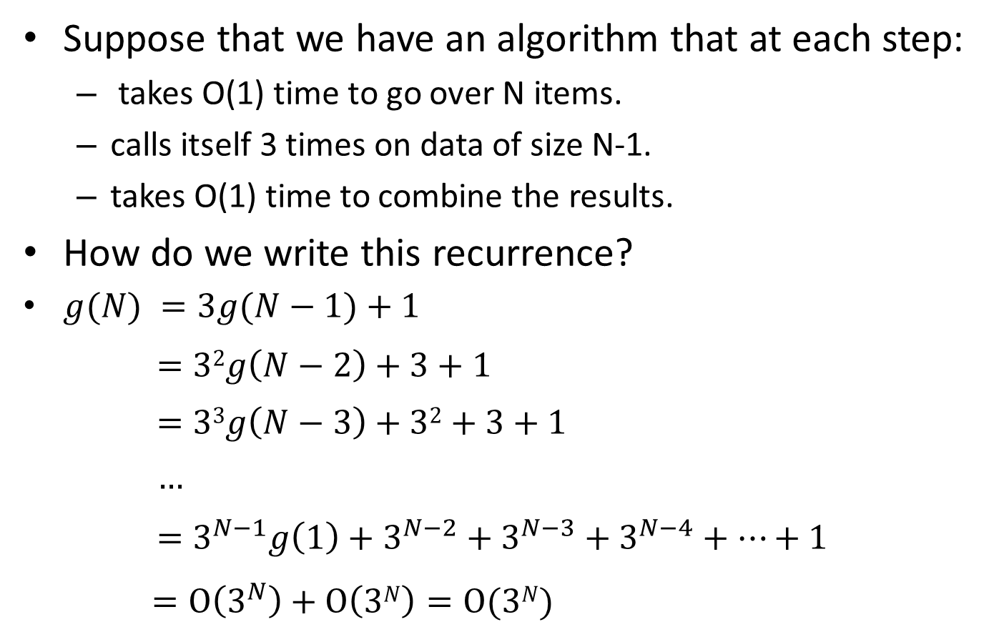
Solving Recurrences: Example 3
Suppose that we have an algorithm that at each step:
  takes O(1) time to go over N items.
  calls itself 3 times on data of size N-1.
  takes O(1) time to combine the results.
How do we write this recurrence?
$g(N) =3g(N−1)+1$
$$=32g\left(N−2\right)+3+1$$
$$=33g\left(N−3\right)+32+3+1$$
$$…$$
$$=3^{N−1}g\left(1\right)+3^{N−2}+3^{N−3}+3^{N−4}+…+1$$
$=O\left(3^{N}\right)+O\left(3N\right)=O(3N)$

Slide 26
Solving Recurrences: Example 4
Suppose that we have an algorithm that at each step:
  calls itself N times on data of size N/2.
  takes O(1) time to combine the results.
How do we write this recurrence?

Slide 27
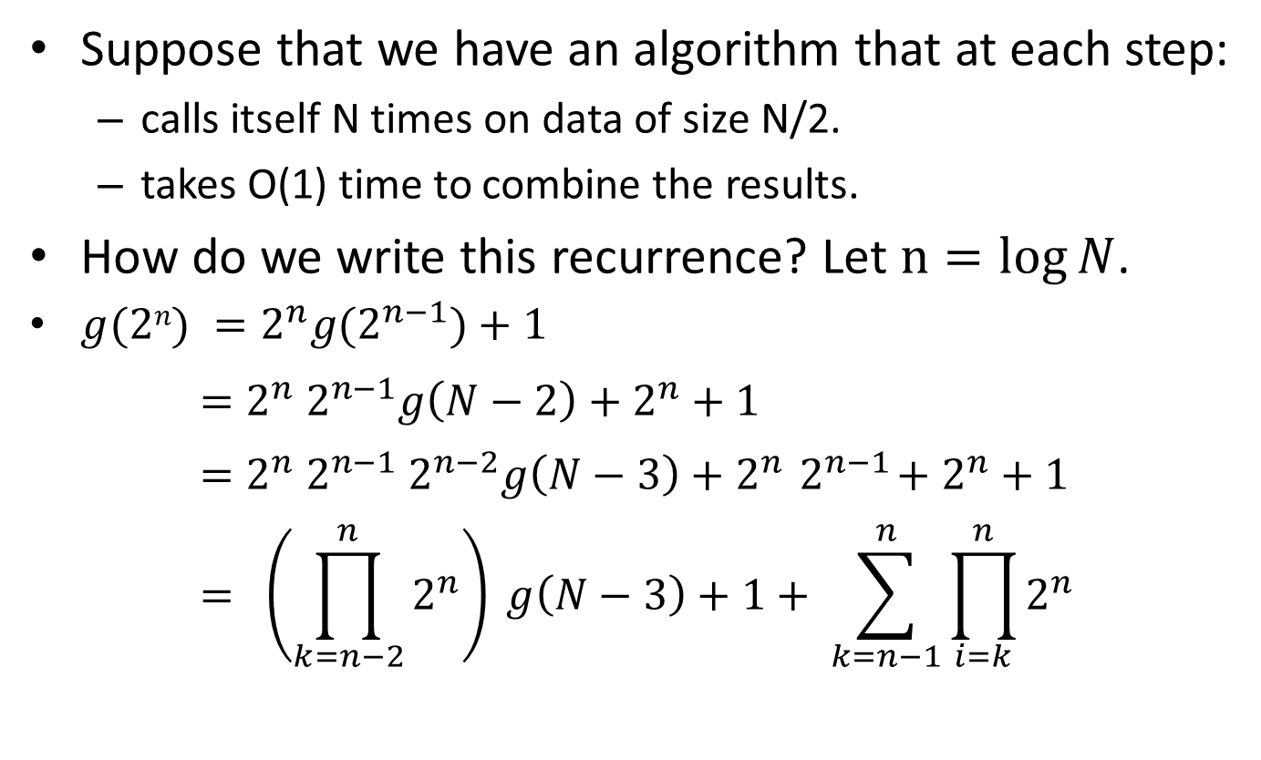
Solving Recurrences: Example 4
Suppose that we have an algorithm that at each step:
  calls itself N times on data of size N/2.
  takes O(1) time to combine the results.
How do we write this recurrence? Let $n=log{N}$.
$g(2n) =2^{n}g(2^{n−1})+1$
$$=2^{n}{ 2}^{n−1}g\left(N−2\right)+2^{n}+1$$
$$=2^{n}{ 2}^{n−1}{ 2}^{n−2}g\left(N−3\right)+2^{n}{ 2}^{n−1}+2^{n}+1$$
$$= \left(\prod_{k=n−2}^{n}{2^{n}}\right) g\left(N−3\right)+1+ \sum_{k=n−1}^{n}{\prod_{i=k}^{n}{2^{n}}}$$

Slide 28
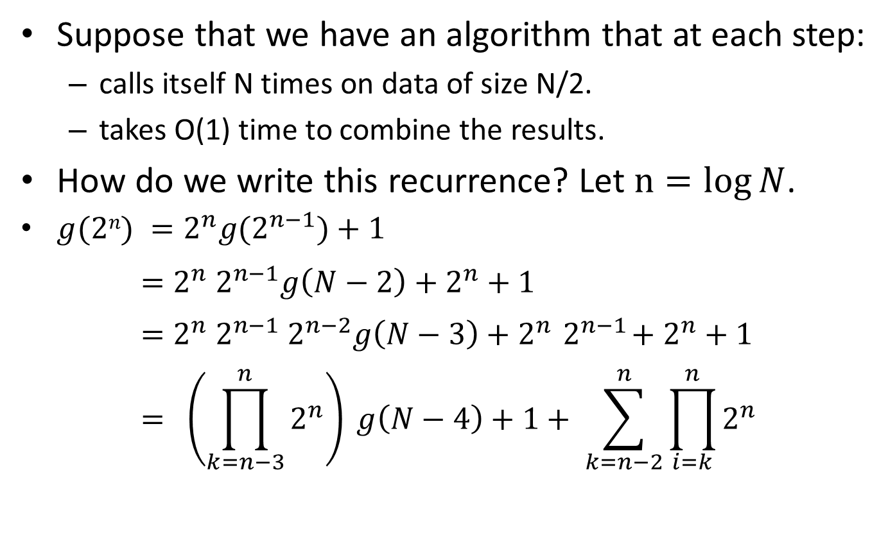
Solving Recurrences: Example 4
Suppose that we have an algorithm that at each step:
  calls itself N times on data of size N/2.
  takes O(1) time to combine the results.
How do we write this recurrence? Let $n=log{N}$.
$g(2n) =2^{n}g(2^{n−1})+1$
$$=2^{n}{ 2}^{n−1}g\left(N−2\right)+2^{n}+1$$
$$=2^{n}{ 2}^{n−1}{ 2}^{n−2}g\left(N−3\right)+2^{n}{ 2}^{n−1}+2^{n}+1$$
$$= \left(\prod_{k=n−3}^{n}{2^{n}}\right) g\left(N−4\right)+1+ \sum_{k=n−2}^{n}{\prod_{i=k}^{n}{2^{n}}}$$

Slide 29
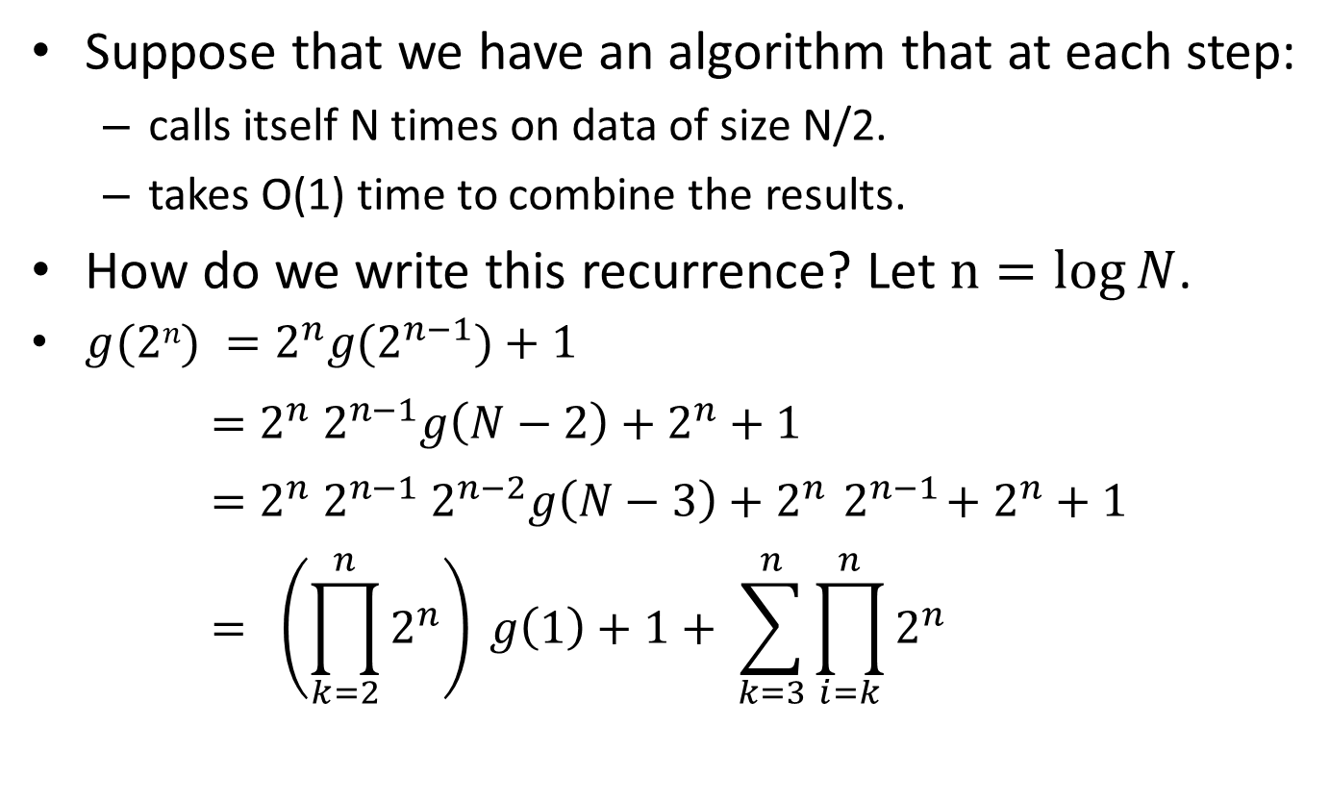
Solving Recurrences: Example 4
Suppose that we have an algorithm that at each step:
  calls itself N times on data of size N/2.
  takes O(1) time to combine the results.
How do we write this recurrence? Let $n=log{N}$.
$g(2n) =2^{n}g(2^{n−1})+1$
$$=2^{n}{ 2}^{n−1}g\left(N−2\right)+2^{n}+1$$
$$=2^{n}{ 2}^{n−1}{ 2}^{n−2}g\left(N−3\right)+2^{n}{ 2}^{n−1}+2^{n}+1$$
$$= \left(\prod_{k=2}^{n}{2^{n}}\right) g\left(1\right)+1+ \sum_{k=3}^{n}{\prod_{i=k}^{n}{2^{n}}}$$

Slide 30
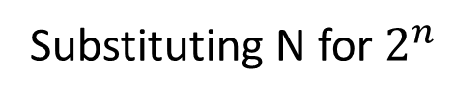

Solving Recurrences: Example 4
$$\left(\prod_{k=2}^{n}{2^{n}}\right)=2^{n}2^{n−1}2^{n−2} …2^{2}2^{1}$$
$=2^{(n+n−1+n−2+…+1)}$
$=2^{\frac{n(n+1)}{2}}$
$$= {\left(2^{n}\right)}^{\frac{n+1}{2}}$$
$$=N^{\frac{log⁡(N)+1}{2}}$$
$$=O(N^{\frac{\log\left(N\right)}{2}})$$
Substituting N for $2^{n}$

Slide 31
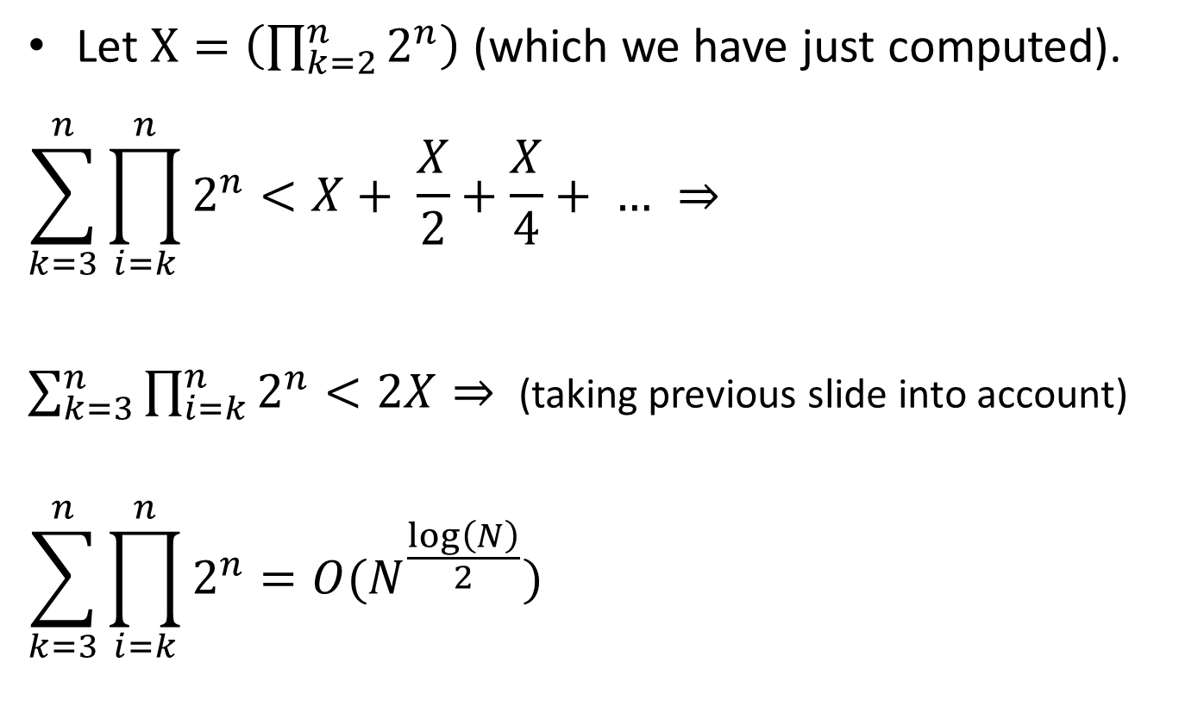
Solving Recurrences: Example 4
Let $X=\left(\prod_{k=2}^{n}{2^{n}}\right)$ (which we have just computed).
$$\sum_{k=3}^{n}{\prod_{i=k}^{n}{2^{n}}}<X+ \frac{X}{2}+\frac{X}{4}+ … ⇒$$
$\sum_{k=3}^{n}{\prod_{i=k}^{n}{2^{n}}}<2X⇒$ (taking previous slide into account)
$$\sum_{k=3}^{n}{\prod_{i=k}^{n}{2^{n}}}=O(N^{\frac{\log\left(N\right)}{2}})$$

Slide 32

Solving Recurrences: Example 4
Based on the previous two slides, we can conclude that the solution of:$g(N) =Ng(N/2)+1$ is that:
$$g\left(N\right)=O(N^{\frac{\log\left(N\right)}{2}})$$

Slide 33

Big-Oh Notation: Example Problem
Is $N=O(\sin\left(N\right)N^{2})$?
Answer:

Slide 34
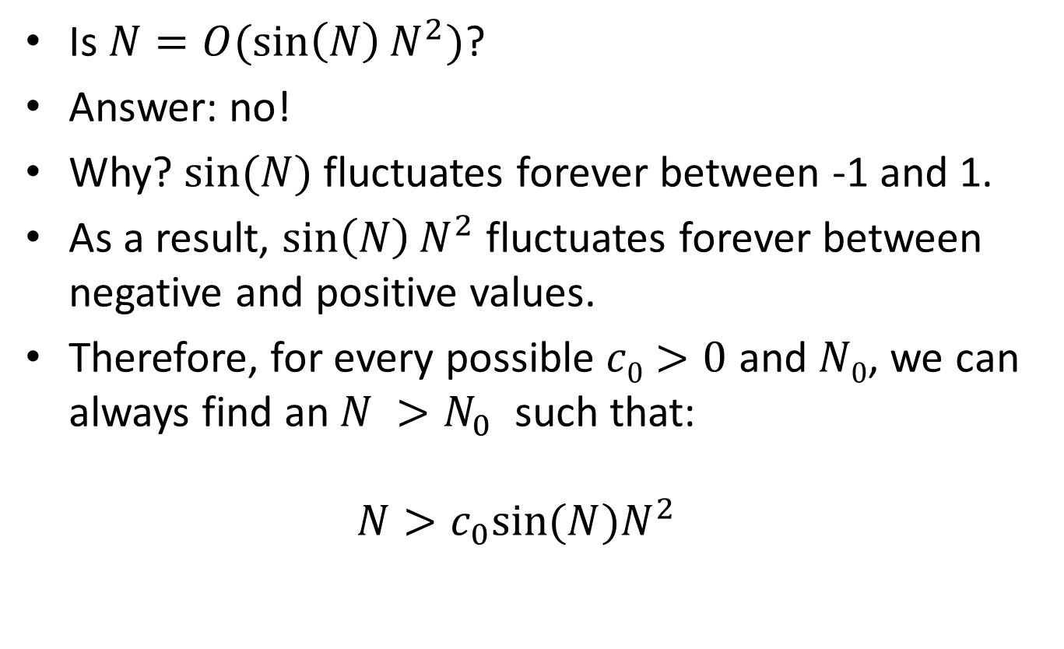
Big-Oh Notation: Example Problem
Is $N=O(\sin\left(N\right)N^{2})$?
Answer: no!
Why? $sin⁡(N)$ fluctuates forever between -1 and 1.
As a result, $\sin\left(N\right)N^{2}$ fluctuates forever between negative and positive values.
Therefore, for every possible $c0>0$ and $N0$, we can always find an $N >N_{0}$ such that:
$N>c_{0}sin⁡(N)N^{2}$

