Slide 1
UCI Datasets
CSE 4311 – Machine Learning
Vassilis Athitsos
Computer Science and Engineering Department
University of Texas at Arlington

Slide 2
Programming Assignment - Datasets
The assignment introduces three dataset.
Each dataset has a training set and a test set.
  These are the first four lines of the training set of the Yeast dataset:
  0.5000 0.4600 0.6400 0.3600 0.5000 0 0.4900 0.2200 1
  0.5300 0.5600 0.4900 0.4600 0.5000 0 0.5200 0.2200 1
  0.5200 0.5300 0.5800 0.6900 0.5000 0 0.5000 0.2200 1
  0.6700 0.6200 0.5400 0.4300 0.5000 0 0.5300 0.2200 1

Slide 3
Programming Assignment - Datasets
Each row is a training example.
All columns except for the last column represent the training input, which is a vector.
The last column is the class label, which can be a number or a string.
Training
input 1
Training
label 1
  0.5000 0.4600 0.6400 0.3600 0.5000 0 0.4900 0.2200 1
  0.5300 0.5600 0.4900 0.4600 0.5000 0 0.5200 0.2200 1
  0.5200 0.5300 0.5800 0.6900 0.5000 0 0.5000 0.2200 1
  0.6700 0.6200 0.5400 0.4300 0.5000 0 0.5300 0.2200 1

Slide 4
Programming Assignment - Datasets
Each row is a training example.
All columns except for the last column represent the training input, which is a vector.
The last column is the class label, which can be a number or a string.
Training
input 2
Training
label 2
  0.5000 0.4600 0.6400 0.3600 0.5000 0 0.4900 0.2200 1
  0.5300 0.5600 0.4900 0.4600 0.5000 0 0.5200 0.2200 1
  0.5200 0.5300 0.5800 0.6900 0.5000 0 0.5000 0.2200 1
  0.6700 0.6200 0.5400 0.4300 0.5000 0 0.5300 0.2200 1

Slide 5
Programming Assignment - Datasets
Each column (except for the last column) is called a dimension, or an attribute, or a feature.
In the Yeast dataset, there are 8 attributes/dimensions/features.
Different datasets have different numbers of attributes.
Attribute 1
Attribute 2
Attribute 8
Training
labels
  0.5000 0.4600 0.6400 0.3600 0.5000 0 0.4900 0.2200 1
  0.5300 0.5600 0.4900 0.4600 0.5000 0 0.5200 0.2200 1
  0.5200 0.5300 0.5800 0.6900 0.5000 0 0.5000 0.2200 1
  0.6700 0.6200 0.5400 0.4300 0.5000 0 0.5300 0.2200 1

Slide 6
Programming Assignment - Datasets
So, for example, what is the value for attribute 4 of the third training input?
  0.5000 0.4600 0.6400 0.3600 0.5000 0 0.4900 0.2200 1
  0.5300 0.5600 0.4900 0.4600 0.5000 0 0.5200 0.2200 1
  0.5200 0.5300 0.5800 0.6900 0.5000 0 0.5000 0.2200 1
  0.6700 0.6200 0.5400 0.4300 0.5000 0 0.5300 0.2200 1

Slide 7
Programming Assignment - Datasets
So, for example, what is the value for attribute 4 of the third training input?
It is 0.6900.
We use matrix notation, indices start from 1, not 0.
Training
input 3
Attribute 4
Training
label 3
  0.5000 0.4600 0.6400 0.3600 0.5000 0 0.4900 0.2200 1
  0.5300 0.5600 0.4900 0.4600 0.5000 0 0.5200 0.2200 1
  0.5200 0.5300 0.5800 0.6900 0.5000 0 0.5000 0.2200 1
  0.6700 0.6200 0.5400 0.4300 0.5000 0 0.5300 0.2200 1

Slide 8
Class Labels Can Be Strings
Your code needs to convert class labels to one-hot vectors.
I suggest a two step approach, as shown on the slides discussing multiclass problems:
  Step 1: map class labels to consecutive integers that start from 1.
  Step 2: map integer class labels to one-hot vectors.
  For easy reference, the next few slides are a copy of the slides we have seen before, that describe these two steps.

Slide 9
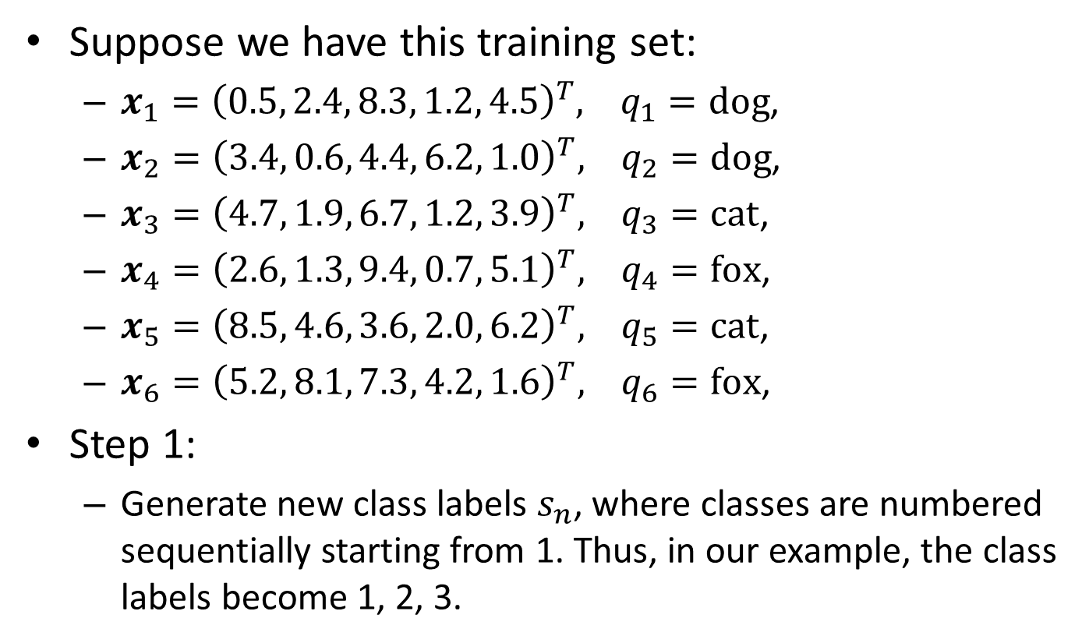
Converting to One-Hot-Vectors
Suppose we have this training set:
  $x_{1}={\left(0.5, 2.4, 8.3, 1.2, 4.5\right)}^{T}, q_{1}=dog$,
  $x_{2}={\left(3.4, 0.6, 4.4, 6.2, 1.0\right)}^{T}, q_{2}=dog$,
  $x_{3}={\left(4.7, 1.9, 6.7, 1.2, 3.9\right)}^{T}, q_{3}=cat$,
  $x_{4}={\left(2.6, 1.3, 9.4, 0.7, 5.1\right)}^{T}, q_{4}=fox$,
  $x_{5}={\left(8.5, 4.6, 3.6, 2.0, 6.2\right)}^{T}, q_{5}=cat$,
  $x_{6}={\left(5.2, 8.1, 7.3, 4.2, 1.6\right)}^{T}, q_{6}=fox$,
Step 1:
  Generate new class labels $s_{n}$, where classes are numbered sequentially starting from 1. Thus, in our example, the class labels become 1, 2, 3.

Slide 10
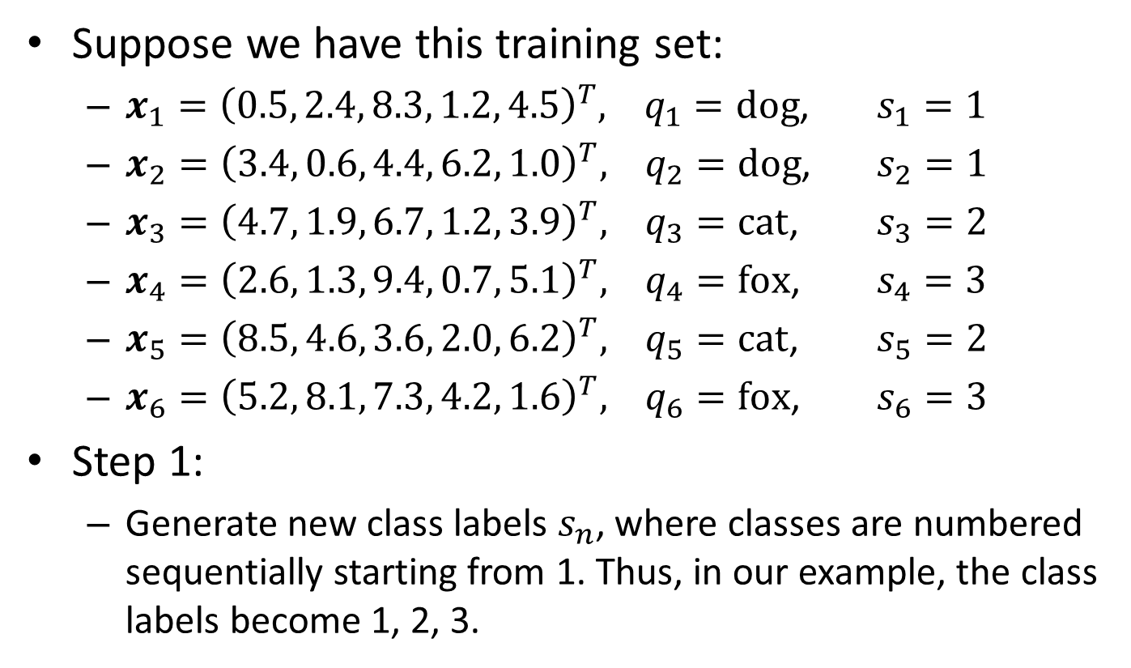
Converting to One-Hot-Vectors
Suppose we have this training set:
  $x_{1}={\left(0.5, 2.4, 8.3, 1.2, 4.5\right)}^{T}, q_{1}=dog$, $s_{1}=1$
  $x_{2}={\left(3.4, 0.6, 4.4, 6.2, 1.0\right)}^{T}, q_{2}=dog$, $s_{2}=1$
  $x_{3}={\left(4.7, 1.9, 6.7, 1.2, 3.9\right)}^{T}, q_{3}=cat$, $s_{3}=2$
  $x_{4}={\left(2.6, 1.3, 9.4, 0.7, 5.1\right)}^{T}, q_{4}=fox$, $s_{4}=3$
  $x_{5}={\left(8.5, 4.6, 3.6, 2.0, 6.2\right)}^{T}, q_{5}=cat$, $s_{5}=2$
  $x_{6}={\left(5.2, 8.1, 7.3, 4.2, 1.6\right)}^{T}, q_{6}=fox$, $s_{6}=3$
Step 1:
  Generate new class labels $s_{n}$, where classes are numbered sequentially starting from 1. Thus, in our example, the class labels become 1, 2, 3.

Slide 11
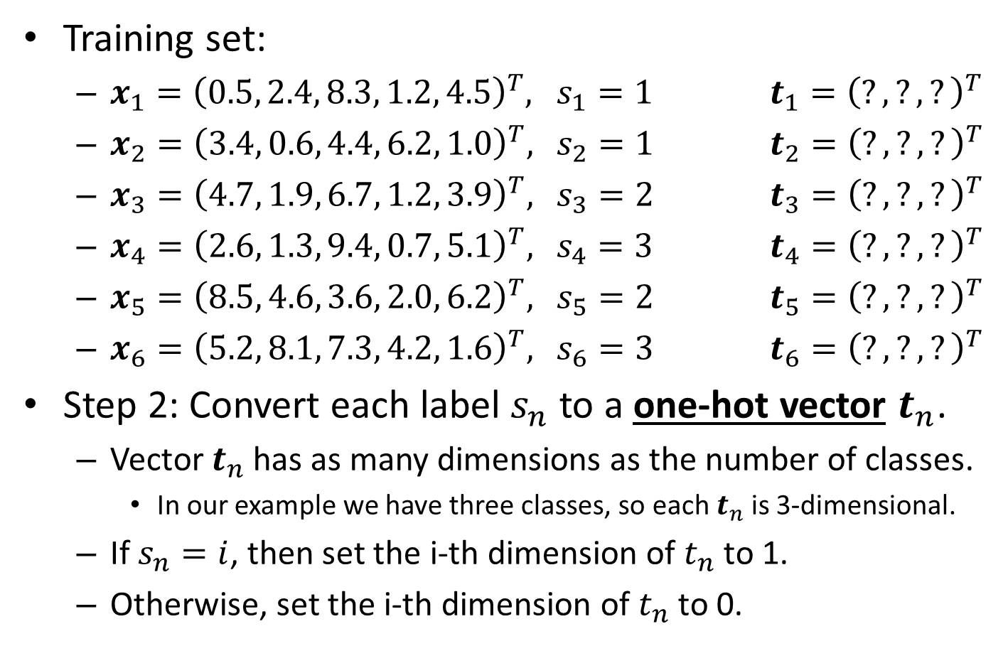
Converting to One-Hot-Vectors
Training set:
  $x_{1}={\left(0.5, 2.4, 8.3, 1.2, 4.5\right)}^{T},$ $s_{1}=1$ $t_{1}={\left(?, ?, ?\right)}^{T}$
  $x_{2}={\left(3.4, 0.6, 4.4, 6.2, 1.0\right)}^{T},$ $s_{2}=1$ $t_{2}={\left(?, ?, ?\right)}^{T}$
  $x_{3}={\left(4.7, 1.9, 6.7, 1.2, 3.9\right)}^{T},$ $s_{3}=2$ $t_{3}={\left(?, ?, ?\right)}^{T}$
  $x_{4}={\left(2.6, 1.3, 9.4, 0.7, 5.1\right)}^{T},$ $s_{4}=3$ $t_{4}={\left(?, ?, ?\right)}^{T}$
  $x_{5}={\left(8.5, 4.6, 3.6, 2.0, 6.2\right)}^{T},$ $s_{5}=2$ $t_{5}={\left(?, ?, ?\right)}^{T}$
  $x_{6}={\left(5.2, 8.1, 7.3, 4.2, 1.6\right)}^{T},$ $s_{6}=3$ $t_{6}={\left(?, ?, ?\right)}^{T}$
Step 2: Convert each label $s_{n}$ to a one-hot vector $t_{n}$.
  Vector $t_{n}$ has as many dimensions as the number of classes.
    In our example we have three classes, so each $t_{n}$ is 3-dimensional.
  If $s_{n}=i$, then set the i-th dimension of $t_{n}$ to 1.
  Otherwise, set the i-th dimension of $t_{n}$ to 0.

Slide 12
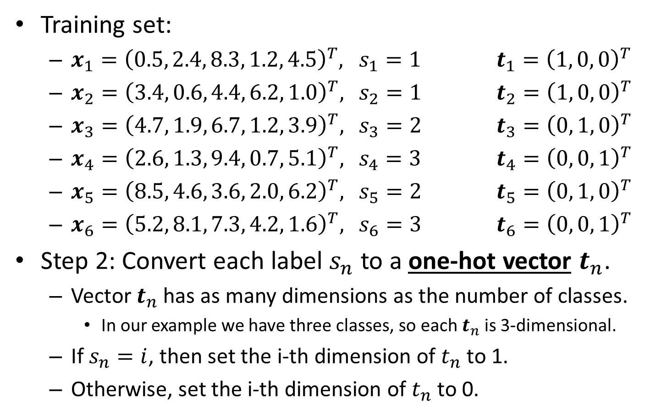
Converting to One-Hot-Vectors
Training set:
  $x_{1}={\left(0.5, 2.4, 8.3, 1.2, 4.5\right)}^{T},$ $s_{1}=1$ $t_{1}={\left(1, 0, 0\right)}^{T}$
  $x_{2}={\left(3.4, 0.6, 4.4, 6.2, 1.0\right)}^{T},$ $s_{2}=1$ $t_{2}={\left(1, 0, 0\right)}^{T}$
  $x_{3}={\left(4.7, 1.9, 6.7, 1.2, 3.9\right)}^{T},$ $s_{3}=2$ $t_{3}={\left(0, 1, 0\right)}^{T}$
  $x_{4}={\left(2.6, 1.3, 9.4, 0.7, 5.1\right)}^{T},$ $s_{4}=3$ $t_{4}={\left(0, 0, 1\right)}^{T}$
  $x_{5}={\left(8.5, 4.6, 3.6, 2.0, 6.2\right)}^{T},$ $s_{5}=2$ $t_{5}={\left(0, 1, 0\right)}^{T}$
  $x_{6}={\left(5.2, 8.1, 7.3, 4.2, 1.6\right)}^{T},$ $s_{6}=3$ $t_{6}={\left(0, 0, 1\right)}^{T}$
Step 2: Convert each label $s_{n}$ to a one-hot vector $t_{n}$.
  Vector $t_{n}$ has as many dimensions as the number of classes.
    In our example we have three classes, so each $t_{n}$ is 3-dimensional.
  If $s_{n}=i$, then set the i-th dimension of $t_{n}$ to 1.
  Otherwise, set the i-th dimension of $t_{n}$ to 0.

