Slide 1
Tensorflow and Keras
CSE 4311 – Neural Networks and Deep Learning
Vassilis Athitsos
Computer Science and Engineering Department
University of Texas at Arlington

Slide 2
Pros and Cons of Using a Library
Many machine learning methods are already implemented in programming libraries.
A common question is: which library is the “best”.
The answer depends a lot on the context.
When studying and trying to understand a method, sometimes the answer is “no library”.
  It is important to do some implementations from scratch.
  In such an implementation, every single detail must be explicitly addressed.
  Oftentimes, implementations expose issues that we have not yet fully understood, and that we need to revisit.
Using a library can boost productivity, minimize coding time.
Library code can also be optimized to run very efficiently.

Slide 3
Semester Plan
Assignment 3 is about implementation from scratch.
There are many people using neural networks daily who have never done such an implementation.
It is not an easy assignment, but it helps demystify the training process.
Subsequent assignments are about neural network variations.
  Implementing those variations from scratch has little added value over assignment 3.
  Implementing them using a library allows us to implement more methods during the semester.
So, starting with assignment 4, we will be using the Keras library.

Slide 4
Keras, Tensorflow, PyTorch
Tensorflow is a Python programming library for implementing neural network.
Keras is an additional library, that is implemented on top of Tensorflow.
Keras provides a more simple, high-level interface than Tensorflow.
Tensorflow allows you to do more things “under the hood”, if you do not want to simply implement standard “off-the-shelf” methods.
PyTorch is an alternative to Tensorflow and Keras for implementing neural networks, that is also commonly used.
  We will not be covering PyTorch this semester, but hopefully it should be easier to learn once you are familiar with Keras.

Slide 5
Installing Keras on Your Computer
Install Anaconda
Open Anaconda Prompt or Anaconda Power Shell
Type:
conda install -c anaconda keras
You can use the Spyder editor (comes with Anaconda) to write code, test and debug.
Some people recommend that you create an Anaconda “environment” and install Keras within the environment.
  That is useful for computers where Keras is installed multiple times, possibly by different users, and Keras is combined in multiple ways with different other packages.
  For this class, if you use your own computer, this is not needed.

Slide 6
Running Keras Online
Google Colab is an online environment where you can write and run Python and Keras code.
https://colab.research.google.com/
Keras is already installed, so this is very convenient.
It is a useful job skill to get familiar with Colab.
  Easy to pick up, if you do everything else you need to do in this class.
Given that there are many different Python libraries with many different versions, that may not be backward compatible, using Colab ensures that we can run your code.
Most of the times, the code I write on Anaconda runs on Colab with no problems.

Slide 7
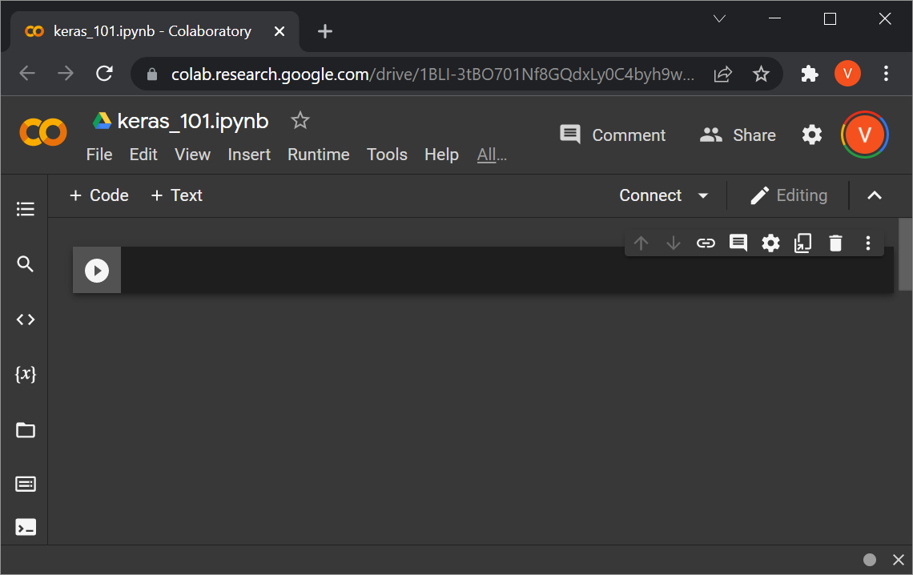
Colab Basics
Go to Google Colab, sign in with your Google Account.
Go to File->New notebook
Give a name to your notebook, like keras_101.ipynb.

Slide 8
If Using Colab, Some Prep
On Google Drive, I created a top-level folder called cse4392.
In that folder, I copied:
  uci_data.py
    This is posted on the website, under this lecture, and contains some helper code.
  The uci_datasets directory with all the text files.
Then, on Google Colab:
  Create and run a cell with this code:
from google.colab import drive
drive.mount('/content/drive')
  Create and run another cell with this code:
cd /content/drive/MyDrive/cse4392
The next slides show these steps in more detail.

Slide 9
Code Cells in Colab
To create a new code cell in Colab, click the “+ Code” button.
To run the code on that cell, click the “play” button to the left of the cell, or press SHIFT+ENTER.

Slide 10
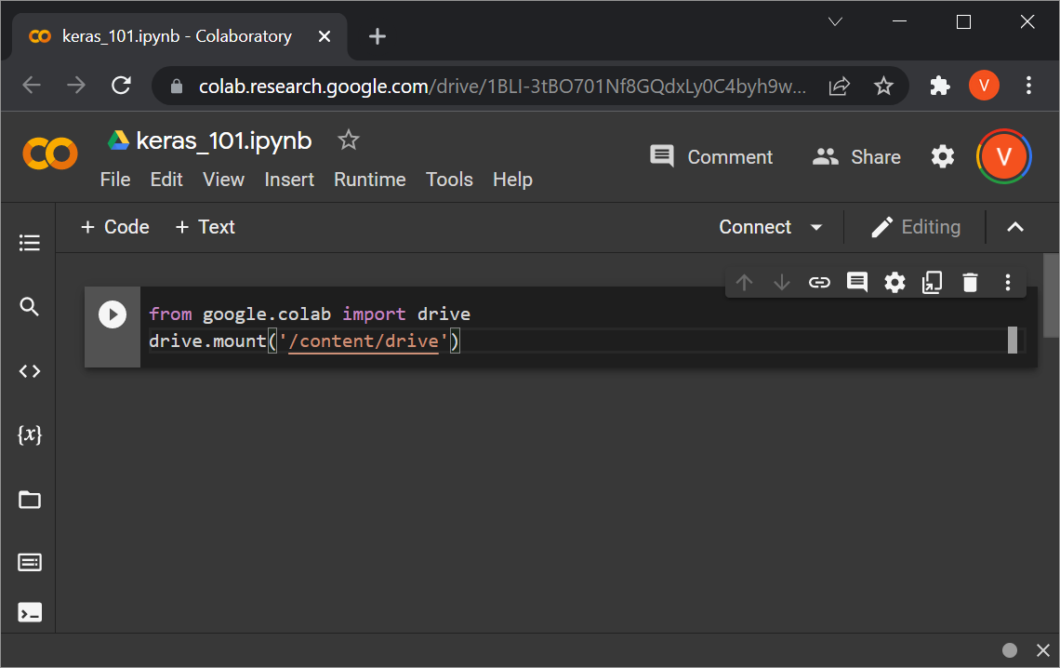
Pasting Code to Colab
Pasting code to Colab from Powerpoint does not work for me.
First I paste from Powerpoint to a Google Drive text file.
Then I copy-paste from the Google Drive file to the Colab notebook.

Slide 11
Mounting Google Drive
Put in the code that you see, and run the cell.
You may get this prompt “Permit this notebook to access your Google Drive files?” If so, click “Connect to Google Drive”. You get a couple more prompts to connect to your account and give permissions to Google Drive.

Slide 12
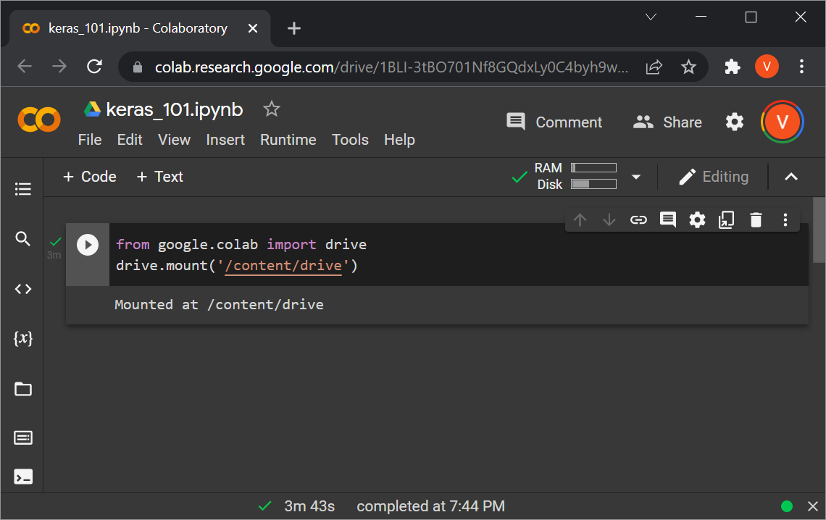
Mounting Google Drive
Once you deal with all the prompts, you get a confirmation that the drive is mounted.

Slide 13
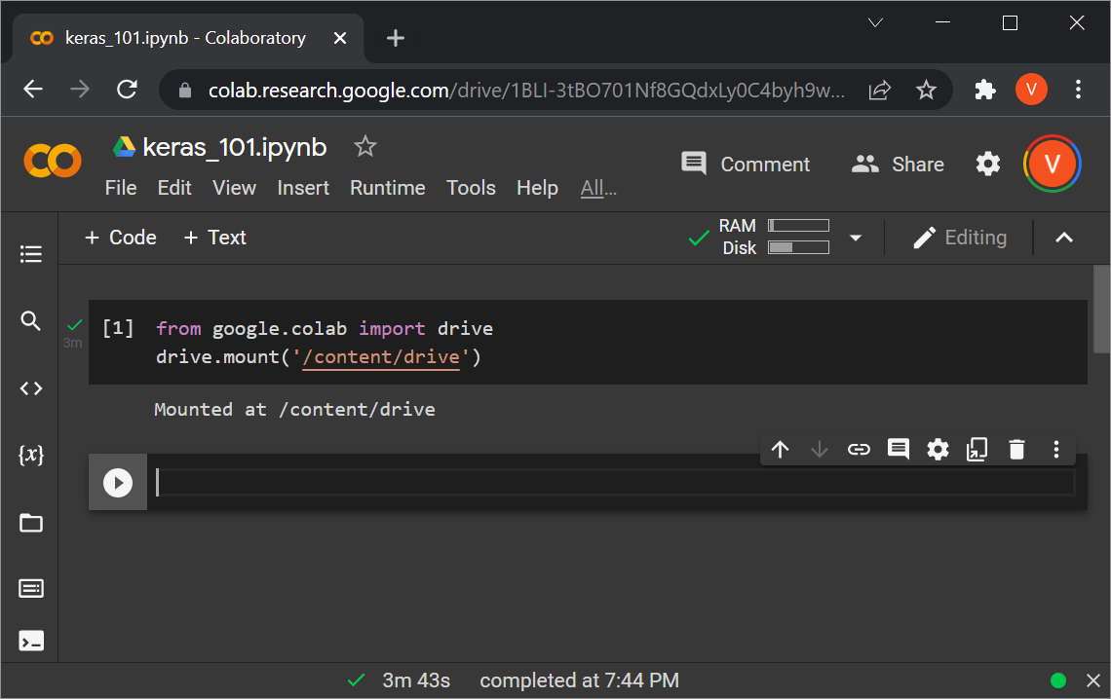
Mounting Google Drive
Click on “+ Code” again, to add a new cell.

Slide 14
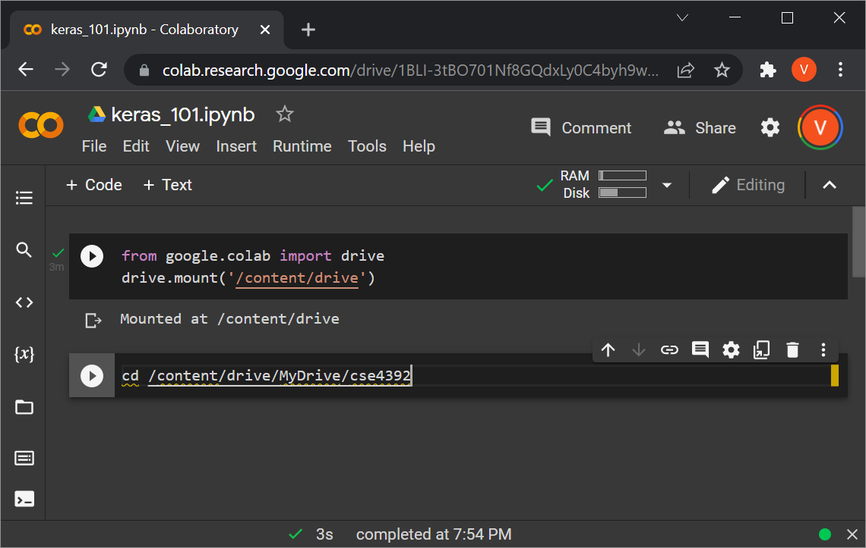
Mounting Google Drive
In the new cell, type (or paste) the code that you see.

Slide 15
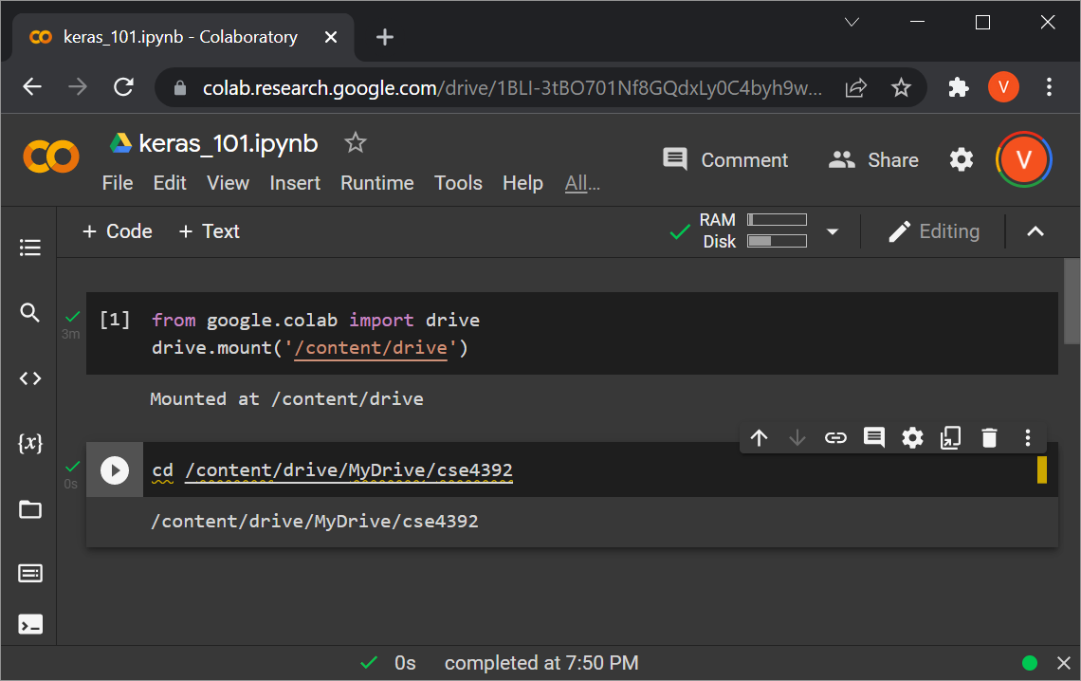
Mounting Google Drive
Execute the new cell.
You get a confirmation that the working directory has changed.

Slide 16
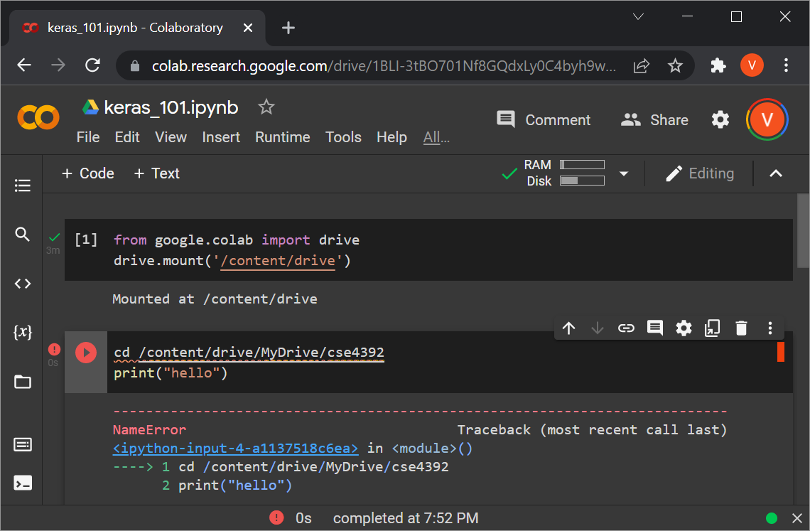
Mounting Google Drive
For some weird reason, the cd command only works (for me) when it is the ONLY line in the cell.
Here is how it fails otherwise:

Slide 17
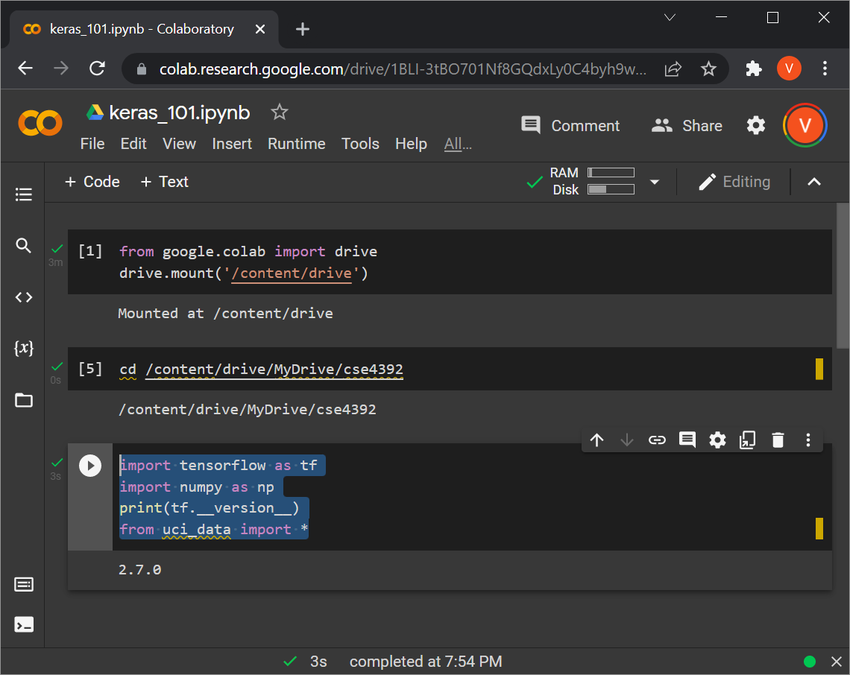
Continuing with Rest of Code
Now you can create new cells and put in whatever code you like.

Slide 18
Keras: A First Example
import tensorflow as tf
import numpy as np
from uci_data import *
(training_set, test_set) = read_uci1("uci_datasets", "pendigits")
(training_inputs, training_labels) = training_set
(test_inputs, test_labels) = test_set
input_shape = training_inputs[0].shape
number_of_classes = np.max([np.max(training_labels), np.max(test_labels)]) + 1
model = tf.keras.Sequential([
tf.keras.Input(shape = input_shape),
tf.keras.layers.Dense(number_of_classes, activation='sigmoid')
])
model.compile(optimizer='adam',
loss=tf.keras.losses.SparseCategoricalCrossentropy(),
metrics=['accuracy'])
model.fit(training_inputs, training_labels, epochs=10)
test_loss, test_acc = model.evaluate(test_inputs, test_labels , verbose=0)
print('\nTest accuracy: %.2f%%' % (test_acc * 100))
This is a small Keras example.
It trains and tests a neural network on the pendigits dataset.
In the next slides we will see what each part does.

Slide 19
Imports
import tensorflow as tf
import numpy as np
from uci_data import *
We will have to import tensorflow and numpy for pretty much all our code from now on.
uci_data.py is my code, with some auxiliary functions.
  It is posted on the class website, under this lecture.

Slide 20
Loading a Dataset
(training_set, test_set) = read_uci1("uci_datasets", "pendigits")
(training_inputs, training_labels) = training_set
(test_inputs, test_labels) = test_set
No tensorflow or Keras code is here yet.
We are just loading the pendigits dataset, using my read_uci1 helper function, defined at uci_data.py.
training_inputs is a numpy array
  training_inputs.shape gives the dimensions of the array, which is (7494, 16)
  7494 rows (number of training inputs)
  16 columns (number of attributes)

Slide 21
Loading a Dataset
(training_set, test_set) = read_uci1("uci_datasets", "pendigits")
(training_inputs, training_labels) = training_set
(test_inputs, test_labels) = test_set
training_labels is a 7494x1 2D array.
  It could also be a 1D array of 7494 elements, I tested that and it works.
My code makes sure that class labels have been mapped to consecutive integers starting at 0.
  The Keras code later assumes that this mapping has been done.

Slide 22
Loading a Dataset
(training_set, test_set) = read_uci1("uci_datasets", "pendigits")
(training_inputs, training_labels) = training_set
(test_inputs, test_labels) = test_set
test_inputs is a 3498x16 2D array.
  3498 rows, which is the number of test objects.
  16 columns, which is the number of attributes.
  Obviously, the number of attributes in the test inputs should match the number of attributes in the training inputs.
test_labels is a 3498x1 2D array.

Slide 23
Verifying the Array Sizes
A (very) common source of bugs in Tensorflow and Keras is wrong array dimensions and sizes. For example:
  Using an MxN matrix where NxM is expected.
  Using an Mx1 2D matrix where a 1D matrix of size M is expected.
It is useful to keep track of what array dimensions, and sizes for those dimensions, are expected.
When testing and debugging, you can use code like this:
print(training_inputs.shape)
print(training_labels.shape)
print(test_inputs.shape)
print(test_labels.shape)
Output:
(7494, 16)
(7494, 1)
(3498, 16)
(3498, 1)

Slide 24
Parameters for the Network
input_shape = training_inputs[0].shape
number_of_classes = np.max([np.max(training_labels),
np.max(test_labels)]) + 1
Variable input_shape is the dimensionality of the data.
  It will be the number of units on the input layer.
Variable number_of_classes is the number
of classes.
print("input_shape = ", input_shape)
print("number_of_classes = ", number_of_classes)
Output:
input_shape = (16,) number_of_classes = 10

Slide 25
Creating a 2-Layer Network
model = tf.keras.Sequential([
tf.keras.Input(shape = input_shape),
tf.keras.layers.Dense(number_of_classes, activation='sigmoid')
])
Here is our first piece of Keras code.
We are creating a two-layer network.
Function tf.keras.Sequential creates a network that is a sequence of layers.
  That is the only type of networks we know so far.
The argument is a list, where every element specifies a layer.

Slide 26
Creating a 2-Layer Network
model = tf.keras.Sequential([
tf.keras.Input(shape = input_shape),
tf.keras.layers.Dense(number_of_classes, activation='sigmoid')
])
tf.keras.Input(shape = input_shape) creates an input layer, and input_shape specifies the number of input units.
Soon, when we discuss convolutional neural networks, we will see that input_shape can be a list of 2 or 3 numbers, because our inputs will be 2D or 3D arrays representing images.
  For now, input_shape will be a list of a single number, because our inputs are simple vectors.

Slide 27
Creating a 2-Layer Network
model = tf.keras.Sequential([
tf.keras.Input(shape = input_shape),
tf.keras.layers.Dense(number_of_classes, activation='sigmoid')
])
tf.keras.layers.Dense(number_of_classes, activation='sigmoid') creates a fully connected layer.
  This is the last layer we specify, so this will be the output layer.
  We want one output unit for each class, so this is specified by passing number_of_classes as first argument.
  The activation parameter specifies that we will use the sigmoid activation function
    We will see more options for activation functions in later lectures.

Slide 28
Creating a 2-Layer Network
model.compile(optimizer='adam',
loss=tf.keras.losses.SparseCategoricalCrossentropy(),
metrics=['accuracy'])
model.compile needs to be called before we train the network.
  This is one of the Keras-specific “rituals” that we just have to learn and follow.
The arguments we pass to model.compile specify some important hyperparameters of the network.
  optimizer='adam‘ specifies one specific variant of gradient descent, that we will describe later.

Slide 29
Loss Function
model.compile(optimizer='adam',
loss=tf.keras.losses.SparseCategoricalCrossentropy(),
metrics=['accuracy'])
loss=tf.keras.losses.SparseCategoricalCrossentropy() specifies that we will use a loss function called “Cross Entropy”.
  The loss parameter specifies the loss function (which we can also call the “error” function).
  The cross-entropy loss function is an alternative to the sum-of-squared differences that we have seen in the backpropagation slides.
  We will study cross entropy, and other loss functions, in a few lectures.

Slide 30
Loss Function
model.compile(optimizer='adam',
loss=tf.keras.losses.SparseCategoricalCrossentropy(),
metrics=['accuracy'])
metrics=['accuracy'] makes no difference in training.
  It simply specifies that we would like to see the classification accuracy on the training set printed after each training round.
  In general, it is useful to print out some metrics after each training round, to see how much progress is being made.

Slide 31
Loss Function
model.fit(training_inputs, training_labels, epochs=10)
model.fit is the function that actually trains the network.
We specify the training inputs and training labels.
  Obviously, their dimensions must match the input units and output units that we have already specified.
  All class labels in training_labels should be non-negative integers that are smaller than the number of output units.
    Our previous lines of code made sure of that.
Parameter epochs specifies the number of training rounds.
  “Epochs” is the term commonly used to specify the number of training rounds in backpropagation.

Slide 32
Output During Training
Epoch 1/10 235/235 [==============================] - 0s 955us/step - loss: 43.5318 - accuracy: 0.1715
Epoch 2/10 235/235 [==============================] - 0s 1ms/step - loss: 15.4048 - accuracy: 0.3979
Epoch 3/10 235/235 [==============================] - 0s 983us/step - loss: 8.0585 - accuracy: 0.5701
…
For every epoch, we see various statistics. Most important for now:
  loss shows the value of the loss function after each epoch.
  accuracy shows the classification accuracy on the training set after each epoch.

Slide 33
Testing the Network
test_loss, test_acc = model.evaluate(test_inputs, test_labels, verbose=0)
print('\nTest accuracy: %.2f%%' % (test_acc * 100))
model.evaluate applies the network on a test set.
test_inputs and test_labels specify the test set.
The verbose parameter specifies how much extra output we want (none in our case).
Output:
Test accuracy: 96.28%

Slide 34
Some Benchmarks
I tried different setups for running code that trains (10 epochs) and tests a 2-layer network on the pendigits dataset.
Running the training and test code (model.fit() and model.evaluate() on Colab took about 5 seconds.
The same code, running locally on my computer (with Spyder/Anaconda), took less than two seconds.
My solution for the backpropagation assignment (which uses numpy, but not Tensorflow or Keras) took about 5 seconds running on my computer.

Slide 35
Side Note, Regarding Assignment 3
If you use the Keras code from these slides as your solution for assignment 3, it will not be correct.
Various specs given in the assignment (and our backpropagation slides) do not match what is done in the Keras code we used.
This is great, because I do NOT want you to use Keras for the assignment.
  The whole point is to implement backpropagation from scratch.
At the same time, in terms of computations, both the Keras version and our assignment should be similar.
The differences in time is due:
  Optimizations in Keras, making the code run faster.
  The shared nature of Colab, which makes runtimes less predictable.

Slide 36
Some Benchmarks
Another experiment: a 4-layer network for the pendigits dataset, with 50 nodes in each hidden unit.
  Still training for 10 epochs.
Running the training and test code (model.fit() and model.evaluate() on Colab took about 11 seconds.
The same code, running locally on my computer (with Spyder/Anaconda), took about 3 seconds.
My solution for the backpropagation assignment (which uses numpy, but not Tensorflow or Keras) took about 8 seconds running on my computer.

Slide 37
GPU vs. CPU Processing
Note: computers with graphics cards should run the code several times faster than computers without such cards.
  The computer I used here did NOT have a graphics card.
  I will try to add some results with a graphics card in the next few days.
A nice feature of Tensorflow and Keras is that they automatically exploit GPUs, if your system has them.
  Your code remains the same.

Slide 38
Code for a 4-Layer Network
model = tf.keras.Sequential([
tf.keras.Input(shape = input_shape),
tf.keras.layers.Dense(50, activation='sigmoid'),
tf.keras.layers.Dense(50, activation='sigmoid'),
tf.keras.layers.Dense(number_of_classes, activation='sigmoid')
])
To create the 4-layer network used in the previous timing experiments, just call tf.keras.Sequential() as shown above.
It is very straightforward.
  Each hidden layer has 50 units, is fully connected, and uses the sigmoid activation function.

Slide 39
Evaluating the Network on an Input
Suppose that we have already trained a 2-layer model on the pendigits dataset, as shown in the previous slides.
Here we see how to (and how not to) apply the model to a new input vector.
To do that, we use the predict() method.
test_index = 10 # nothing special about this value
input_vector = test_inputs[test_index,:]
nn_output = model.predict(input_vector)
We would hope that nn_output contains the output of the model (which is a vector of as many dimensions as the number of classes).
The above is an example of how NOT to do it. We get an error.

Slide 40
Evaluating the Network on an Input
test_index = 10 # nothing special about this value
input_vector = test_inputs[test_index,:]
nn_output = model.predict(input_vector)
The code above gives an error.
  This is a good example of often frustrating errors we get because of incompatible array shapes.
Problem: input_vector is a 1D vector. The predict() method wants a 2D vector where each row is an input.
Fix:
test_index = 10 # nothing special about this value
input_vector = test_inputs[test_index,:]
input_vector = np.reshape(input_vector, (1, 16))
nn_output = model.predict(input_vector)

Slide 41
Evaluating the Network on an Input
Fix:
test_index = 10 # nothing special about this value
input_vector = test_inputs[test_index,:]
input_vector = np.reshape(input_vector, (1, 16))
nn_output = model.predict(input_vector)
The numpy.reshape() method is used to convert input vector from a 1D array of 16 elements to a 1x16 2D array.
Now model.predict() is happy.
nn_output is a 1x10 2D array.
If we want to convert nn_output to a 1D array we do:
nn_output = nn_output.flatten()

Slide 42
From Output to Class Prediction
As we know, to convert the output to a class prediction, we need to find the argmax.
  In other words, we find the output unit that gave the highest response.
test_index = 10 # nothing special about this value
input_vector = test_inputs[test_index,:]
input_vector = np.reshape(input_vector, (1, 16))
nn_output = model.predict(input_vector)
nn_output = nn_output.flatten()
predicted_class = np.argmax(nn_output)
actual_class = test_labels[test_index]
print("predicted class label = %d\nactual class label = %d\n" %
(predicted_class, actual_class))
Output:
predicted class label = 0
actual class label = 7

Slide 43
From Output to Class Prediction
As we know, to convert the output to a class prediction, we need to find the argmax.
  In other words, we find the output unit that gave the highest response.
test_index = 10 # nothing special about this value
input_vector = test_inputs[test_index,:]
input_vector = np.reshape(input_vector, (1, 16))
nn_output = model.predict(input_vector)
nn_output = nn_output.flatten()
predicted_class = np.argmax(nn_output)
actual_class = test_labels[test_index]
print("predicted class label = %d\nactual class label = %d\n" %
(predicted_class, actual_class))
Note the use of argmax, it returns the position of the maximum value in the array.

Slide 44
Classification Ties
It can happen that two or more output units tie for the highest output value.
Your code should be able to detect that.
It so happens that our 2-layer network produces lots of ties.
  In a few slides we will see what causes that and how to fix it.
  For test_index = 10, six units tie for the highest value.
(indices,) = np.nonzero(nn_output == nn_output[predicted_class])
print("indices =", indices)
Output:
indices = [0 3 4 5 6 7]

Slide 45
Classification Ties
It can happen that two or more output units tie for the highest output value.
Your code should be able to detect that.
It so happens that our 2-layer network produces lots of ties.
  In a few slides we will see what causes that and how to fix it.
  For test_index = 10, six units tie for the highest value.
(indices,) = np.nonzero(nn_output == nn_output[predicted_class])
print("indices =", indices)
Numpy trick 1: the expression my_array == number returns a boolean numpy array, where the value at position i is True iff my_array[i] == number.

Slide 46
Classification Ties
It can happen that two or more output units tie for the highest output value.
Your code should be able to detect that.
It so happens that our 2-layer network produces lots of ties.
  In a few slides we will see what causes that and how to fix it.
  For test_index = 10, six units tie for the highest value.
(indices,) = np.nonzero(nn_output == nn_output[predicted_class])
print("indices =", indices)
Numpy trick 2: function call np.nonzero(my_array) returns an array of all indices in my_array that are not zero.
  For a boolean array, values of True are non-zero.

Slide 47
Classification Ties
It can happen that two or more output units tie for the highest output value.
Your code should be able to detect that.
It so happens that our 2-layer network produces lots of ties.
  In a few slides we will see what causes that and how to fix it.
  For test_index = 10, six units tie for the highest value.
(indices,) = np.nonzero(nn_output == nn_output[predicted_class])
print("indices =", indices)
The best way to become familiar with these tricks (and other numpy tricks we’ll be introducing) is to try them out yourselves, and make sure you understand what they do.

Slide 48
Classification Accuracy and Ties
In that example, how accurate was the classification?
We cannot say 100% accurate, because we did not get a single correct answer.
We cannot say 100% wrong, because the correct class label, “7”, was one of six class labels that tied for highest value.
In such cases, it is fair to say that the result was 16.67% accurate.
  This is 100% divided by the number of classes that tied.
Obviously, if there are ties but the correct class label is not included in those ties, then the result is 0% accurate.
  Which means, it is 100% wrong.

Slide 49
Code for Measuring Accuracy
predicted_class = np.argmax(nn_output)
actual_class = test_labels[test_index]
print("predicted: %d\nactual: %d\n" % (predicted_class, actual_class))
(indices,) = np.nonzero(nn_output == nn_output[pred])
print("indices =", indices)
number_of_ties = np.prod(indices.shape)
if (nn_output[actual_class] == nn_output[predicted_class]):
accuracy = 1.0 / number_of_ties
else:
accuracy = 0
print("accuracy = %.4f" % (accuracy))
Output:
indices = [0 3 4 5 6 7]
accuracy = 0.1667

Slide 50
Normalizing Input Values
The reason for that many ties is numerical.
If we print nn_output for our example, we see that six values are numerically equal to 1.
This can happen, if the input to the sigmoid function is too high.
To avoid such numerical issues, it is good to normalize the input values.
Without such normalization, input values can be arbitrarily high or low.
The backpropagation assignment specifies that you should divide all input vectors by the “MAXIMUM ABSOLUTE value over all attributes over all training objects”.
  Then, all attribute values are between -1 and 1.

Slide 51
Normalizing Input Values
This code does the required normalization, feel free to use in your assignment:
(training_set, test_set) = read_uci1("uci_datasets", "pendigits")
(training_inputs, training_labels) = training_set
(test_inputs, test_labels) = test_set
max_value = np.max(np.abs(training_inputs))
training_inputs = training_inputs / max_value
test_inputs = test_inputs/ max_value
Normalizing like that before training the model, my code found no classification ties in any of the 3498 test objects of the pendigit dataset.

Slide 52
Normalizing Input Values
Normalizing like that, we get no ties in any of the 3498 test objects of the pendigit dataset.

Slide 53
Recap
We have seen how to use Keras to train and test multi-layer networks.
  So far we have only used fully-connected layers.
  So far we have only used the sigmoid activation function.
Topics for the next few lectures: some additional options for our networks.
  Different activation functions.
  Different optimization choices (all variants of gradient descent).
  Working with images.
  Convolutional neural networks for images.

