Slide 1
Images and Convolutions
CSE 4311 – Neural Networks and Deep Learning
Vassilis Athitsos
Computer Science and Engineering Department
University of Texas at Arlington

Slide 2
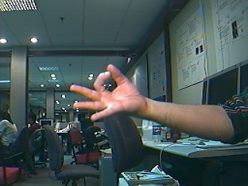
Grayscale Images
A grayscale image is a 2D array of intensity values.
Dimensions: rows x columns.
A pixel is an image location, specified by two coordinates: row and column.
The value of every pixel is an 8-bit unsigned integer (from 0 to 255) specifying how “white” that pixel is.
0 is the darkest black.
255 is the brightest white.
Here are the “colors” (shades of gray, really) corresponding to some other values:
50
100
150
200

Slide 3
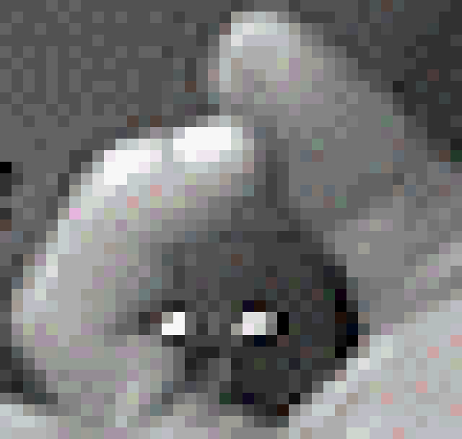
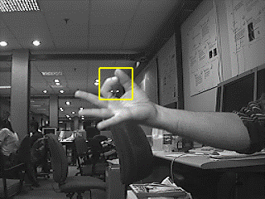
Grayscale Images
To see the pixelated nature of images, you can zoom in on a small part of an image.
Then, the individual pixel squares become noticeable.

Slide 4
Color Images
A color image is a 3D array of intensity values.
Dimensions: rows x columns x 3.
The color of every pixel is an RGB value:
three 8-bit unsigned integers (from 0 to 255) specifying how “red”, “green”, and “blue” that pixel is.
This is why we often refer to color images as RGB images.
Here are some examples of colors, and the RGB values they correspond to:
50, 50, 50
200, 200, 200
255, 0, 0
0, 255, 0
0, 0, 255
200 , 200, 100
204,193,218
255, 192, 0

Slide 5
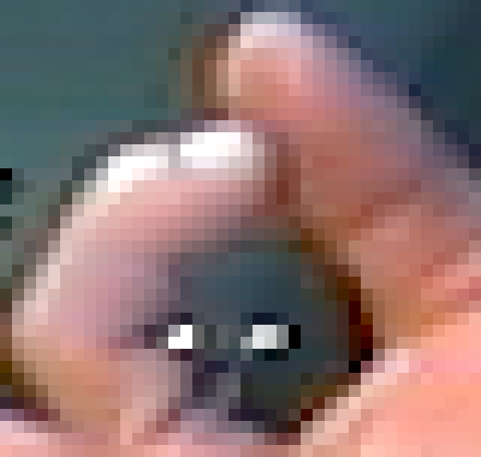
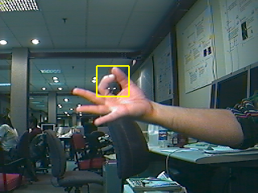
Pixelated Nature of Color Images
Again, we can zoom in on a small part of the image to see the individual pixel squares.

Slide 6
Image Representations
Pixel values are typically stored using 8-bit unsigned integers, whose values are between 0 and 255.
1 value per pixel for grayscale images.
3 values per pixel for RGB images.
However, when working with images, we will encounter and use other representations.
Oftentimes image values are converted to floating point numbers in the [0,1] range, to make them appropriate inputs for neural networks.
Sometimes image values can be 16-bit integers, if they are produced from cameras with the appropriate “dynamic range”.
Depth cameras often produce RGBD images, where the fourth value specifies the depth of the pixel.
In graphics, a fourth value is used to specify the transparency of each pixel.

Slide 7
Images in Python
import numpy as np
import matplotlib.pyplot as plt
img = plt.imread('hand1_gray.png')
plt.imshow(img)
There are many Python libraries that facilitate various aspects of working with images.
OpenCV, PIL, matplotlib, …
We will use these libraries as needed.
For now, we start witn matplotlib, which implements some functionality familiar to Matlab users.

Slide 8
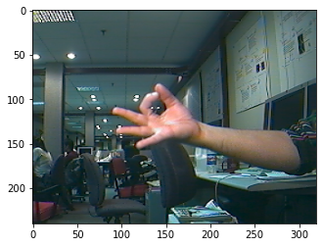
Images in Python
import numpy as np
import matplotlib.pyplot as plt
img = plt.imread('hand1_color.png')
plt.imshow(img)
If you execute this code:
imread() reads the image from the file, and returns a numpy array.
imshow() displays the image as shown on the right.
Note that (0,0) is the top left corner.

Slide 9
Images in Python
print("image dimensions:", img.shape)
mn = np.min(img)
mx = np.max(img)
print("range: [%.4f, %.4f]" % (mn, mx))
print("data type:", img.dtype)
Four values per pixel: (red, green, blue, transparency).
Values are floats between 0 and 1.
To avoid bugs, always verify the format of the images you use.
I expected imread to return RGB values in uint8 format, I was wrong.
Output:
image dimensions: (240, 320, 4)
range: [0.0000, 1.0000]
data type: float32

Slide 10
Image File Formats
There many file formats for image files.
The most common:
JPEG (extension .jpg)
GIF (extension .gif)
PNG (extension .png)
JPEG and GIF use lossy compression: when saving an image in those formats, some pixel values are changed, in order to obtain a smaller file size.
When you save an image and you load it back, the values are a bit different.
PNG uses lossless compression: it still tries to reduce the file size, if possible, but it will preserve the original pixel values.
When you save an image and you load it back, the values are the same.

Slide 11
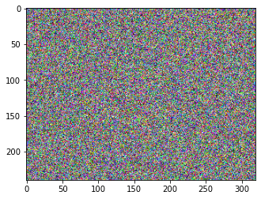
Creating a Random Image
ri = np.random.randint(0, 256, (240,320,3), dtype='uint8')
plt.imshow(ri)
This code creates a random RGB image, to use it for testing different image formats.
Size: 240 rows, 320 columns.
Note that we specify uint8 as the data type.
ri contains unsigned 8-bit integers between 0 and 255.

Slide 12
Saving as JPEG, and Reading Again
Output:
dtype: uint8 . shape: (240, 320, 3)
min value = 0.0000, max_value = 255.0000
jpg: 1764 values same, 228636 different
mean difference: 127.0737
plt.imsave("random.jpg", ri)
r2 = plt.imread("random.jpg")
mn = np.min(r2)
mx = np.max(r2)
print("dtype:", r2.dtype, ". shape:", r2.shape)
print("min value = %.4f, max_value = %.4f" % (mn, mx))
indices = np.nonzero(ri != r2)
t = np.prod(ri.shape)
n = indices[0].shape[0]
print("jpg: %d pixels same, %d different" % (t-n, n))
print("mean difference: %.4f" % (np.mean(abs(ri-r2))))

Slide 13
JPEG: Observations
Output:
dtype: uint8 . shape: (240, 320, 3)
min value = 0.0000, max_value = 255.0000
jpg: 1764 values same, 228636 different
mean difference: 127.0737
plt.imsave("random.jpg", ri)
r2 = plt.imread("random.jpg")
mn = np.min(r2)
mx = np.max(r2)
print("dtype:", r2.dtype, ". shape:", r2.shape)
print("min value = %.4f, max_value = %.4f" % (mn, mx))
This code verifies the type of image that we loaded.
Each pixel has 3 values, as expected.
The values are of type uint8, between 0 and 255.

Slide 14
JPEG: Observations
Output:
dtype: uint8 . shape: (240, 320, 3)
min value = 0.0000, max_value = 255.0000
jpg: 1764 values same, 228636 different
mean difference: 127.0737
indices = np.nonzero(ri != r2)
t = np.prod(ri.shape)
n = indices[0].shape[0]
print("jpg: %d pixels same, %d different" % (t-n, n))
print("mean difference: %.4f" % (np.mean(abs(ri-r2))))
This code checks the differences between the original image and the image we loaded from the file.
We see that most pixel values are different.
The average difference is around 127, which is relatively high.
The randomness of the image is a very bad fit for the JPEG format.

Slide 15
Saving as GIF, and Reading Again
Output:
dtype: uint8 . shape: (240, 320, 4)
min value = 6.0000, max_value = 255.0000
gif: 5279 values same, 225121 different
mean difference: 122.5283
plt.imsave("random.gif", ri)
r2 = plt.imread("random.gif")
mn = np.min(r2)
mx = np.max(r2)
print("dtype:", r2.dtype, ". shape:", r2.shape)
print("min value = %.4f, max_value = %.4f" % (mn, mx))
r2b = r2[:,:,0:3]
indices = np.nonzero(ri != r2b)
t = np.prod(ri.shape)
n = indices[0].shape[0]
print("gif: %d pixels same, %d different" % (t-n, n))
print("mean difference: %.4f" % (np.mean(abs(ri-r2[:,:,0:3]))))

Slide 16
GIF: Observations
Output:
dtype: uint8 . shape: (240, 320, 4)
min value = 6.0000, max_value = 255.0000
gif: 5279 values same, 225121 different
mean difference: 122.5283
plt.imsave("random.gif", ri)
r2 = plt.imread("random.gif")
mn = np.min(r2)
mx = np.max(r2)
print("dtype:", r2.dtype, ". shape:", r2.shape)
print("min value = %.4f, max_value = %.4f" % (mn, mx))
This code verifies the type of image that we loaded.
The values are of type uint8, between 0 and 255.
Each pixel has four values, in the JPEG case there were three values.
The fourth value is transparency, always equal to 255.
An example why it is important to doublecheck the image type.

Slide 17
GIF: Observations
Output:
dtype: uint8 . shape: (240, 320, 4)
min value = 6.0000, max_value = 255.0000
gif: 5279 values same, 225121 different
mean difference: 122.5283
r2b = r2[:,:,0:3]
indices = np.nonzero(ri != r2b)
t = np.prod(ri.shape)
n = indices[0].shape[0]
print("gif: %d pixels same, %d different" % (t-n, n))
print("mean difference: %.4f" % (np.mean(abs(ri-r2[:,:,0:3]))))
This code checks the differences between the original image and the image we loaded from the file.
(As in the JPEG case) We see that most pixel values are different.
The average difference is around 123, similar to the JPEG case where the average difference was around 127.

Slide 18
Saving as PNG, and Reading Again
Output:
dtype: float32 . shape: (240, 320, 4)
min value = 0.0000, max_value = 1.0000
png: 230400 values same, 0 different
mean difference: 0.0000
plt.imsave("random.png", ri)
r2f = plt.imread("random.png")
mn = np.min(r2)
mx = np.max(r2)
print("dtype:", r2.dtype, ". shape:", r2.shape)
print("min value = %.4f, max_value = %.4f" % (mn, mx))
r2i = np.round(r2[:,:,0:3]*255)
indices = np.nonzero(ri != r2i)
t = np.prod(ri.shape)
n = indices[0].shape[0]
print("png: %d pixels same, %d different" % (t-n, n))
print("mean difference: %.4f" % (np.mean(abs(ri-r2i[:,:,0:3]))))

Slide 19
PNG: Observations
Output:
dtype: float32 . shape: (240, 320, 4)
min value = 0.0000, max_value = 1.0000
png: 230400 values same, 0 different
mean difference: 0.0000
plt.imsave("random.png", ri)
r2f = plt.imread("random.png")
mn = np.min(r2)
mx = np.max(r2)
print("dtype:", r2.dtype, ". shape:", r2.shape)
print("min value = %.4f, max_value = %.4f" % (mn, mx))
This code verifies the type of image that we loaded.
The values are of type float32, between 0 and 1.
This is different than the uint8 type we got in the JPEG and GIF cases.
Each pixel has four values. The fourth value is transparency, always equal to 1.0.
This matches the GIF case, and but not the JPEG case.

Slide 20
PNG: Observations
Output:
dtype: float32 . shape: (240, 320, 4)
min value = 0.0000, max_value = 1.0000
png: 230400 values same, 0 different
mean difference: 0.0000
r2i = np.round(r2[:,:,0:3]*255)
indices = np.nonzero(ri != r2i)
t = np.prod(ri.shape)
n = indices[0].shape[0]
print("png: %d pixels same, %d different" % (t-n, n))
print("mean difference: %.4f" % (np.mean(abs(ri-r2i[:,:,0:3]))))
(Unlike the JPEG and GIF cases) Since the loaded image r2 has float32 values, we convert them to integers before comparing with the original image ri.
(Unlike the JPEG and GIF cases) All pixel values are the same.

Slide 21
Comments on Image Types
Your code can get images from many different sources.
The specific image representation can depend on multiple things:
File format.
Functions and APIs that you use to read the image. Different APIs may produce different image types when reading the same file.
In Python’s matplotlib package, imread('random.png') produces an image of float32 values, with four values per pixel.
In Matlab, imread('random.png') produces an image of uint8 values, with three values per pixel.
Possible parameters that these functions take as arguments can also influence the image representation.

Slide 22
Comments on Image Types
Incorrect assumptions about the image representation are a common source of bugs.
Your code could be doing operations on uint8 numbers instead of float numbers, getting wrong results due to overflow.
Your code may assume that the values are between 0 and 1, but they are between 0 and 255 (leading to numerical problems during training).
Your code may assume that your grayscale image has one value per pixel, but it may have 3 or 4 values per pixel.
Displaying an image may require the image to have values of a certain type, and within a certain range. For example, matplotlib.pyplot.imread:
Works fine with uint 8 images with values in the 0-255 range.
Works fine with float images with values in the 0.0-1.0 range.
Does not work without extra parameters with float images with values in the 0-255 range.
Bottom line: always doublecheck image type, shape, range.

Slide 23
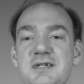
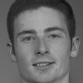
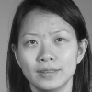
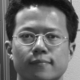
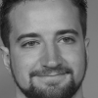
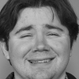
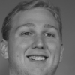
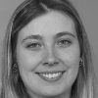
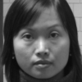
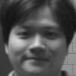
Image Classification
Goal: recognize the category that each image belongs to.
Example: face recognition
Input: an image of a face.
Output: the ID of the person.
example inputs
Person 534
Person 789
Person 956
Person 126
Person 120
Person 521
Person 457
Person 917
Person 017
Person 398
desired outputs (class labels)

Slide 24
Image Classification
Example: The MNIST dataset of handwritten digits.
Input: a 28x28 grayscale image showing a single handwritten digit.
Output: the class label (10 possible cases, from zero to nine).
60,000 training images.
10,000 test images.
example inputs
one
one
two
three
three
four
four
five
six
six
seven
eight
nine
nine
zero
desired outputs (class labels)

Slide 25
Loading the MNIST Dataset
import tensorflow as tf
import numpy as np
import matplotlib.pyplot as plt
dataset = tf.keras.datasets.mnist
(training_set, test_set) = dataset.load_data()
(training_images, training_labels) = training_set
(test_images, test_labels) = test_set
The MNIST dataset is preloaded in Keras.
The code above loads the dataset and creates four arrays:
training_images, training_labels
test_images, test_labels

Slide 26
Format of the Data
print("training images shape:", training_images.shape, "")
print("training images dtype:", training_images.dtype, "")
print("training labels shape:", training_labels.shape, "")
print("test images shape:", test_images.shape, "")
print("test images dtype:", test_images.dtype, "")
print("test labels shape:", test_labels.shape, "")
Output:
training images shape: (60000, 28, 28)
training images dtype: uint8
training labels shape: (60000,)
test images shape: (10000, 28, 28)
test images dtype: uint8
test labels shape: (10000,)

Slide 27
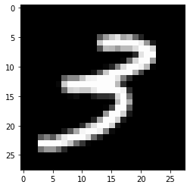
Visualizing Examples
training_index = 581
example_image = training_images[training_index]
label = training_labels[training_index]
plt.imshow(example_image, cmap='gray')
print("dtype:", example_image.dtype)
print("shape:", example_image.shape)
print("class label:", label)
Output:
dtype: uint8
shape: (28, 28)
class label: 3

Slide 28
Building a Neural Network
model = tf.keras.Sequential([
tf.keras.layers.Flatten(input_shape=(28, 28)),
tf.keras.layers.Dense(512, activation='tanh'),
tf.keras.layers.Dense(10, activation="softmax")
])
model.compile(optimizer='adam',
loss=tf.keras.losses.SparseCategoricalCrossentropy(),
metrics=['accuracy'])
We are building a 3-layer model.
Notice the “Flatten” layer.
Input images are 28x28.
The Flatten layer flattens its 2D input into a 1D array of length 784.

Slide 29
Model Summary
model.summary()
We are building a 3-layer model.
Notice the “Flatten” layer.
Input images are 28x28.
The Flatten layer flattens its input into a 1D array of length 784.
Output:
Model: "sequential_1"
_________________________________________________________________
Layer (type) Output Shape Param #
=================================================================
flatten_1 (Flatten) (None, 784) 0
dense_2 (Dense) (None, 512) 401920
dense_3 (Dense) (None, 10) 5130
=================================================================
Total params: 407,050
Trainable params: 407,050
Non-trainable params: 0
_________________________________________________________________

Slide 30
Training and Testing
training_inputs = training_images / 255.0
test_inputs = test_images / 255.0
model.fit(training_inputs, training_labels, epochs=15)
test_loss, test_acc = model.evaluate(test_inputs, test_labels, verbose=0)
print('\nTest accuracy: %.2f%%' % (test_acc * 100))
Output:
Epoch 1/15
1875/1875 [==============================] - 5s 3ms/step - loss: 0.2696 - accuracy: 0.9210
...
Epoch 15/15
1875/1875 [==============================] - 4s 2ms/step - loss: 0.0072 - accuracy: 0.9977
Test accuracy: 98.14%

Slide 31
Training and Testing
training_inputs = training_images / 255.0
test_inputs = test_images / 255.0
model.fit(training_inputs, training_labels, epochs=15)
test_loss, test_acc = model.evaluate(test_inputs, test_labels, verbose=0)
print('\nTest accuracy: %.2f%%' % (test_acc * 100))
Notice that we do data normalization before training the model.
We divide training and test inputs by 255, to make sure that their ranges are between 0 and 1.

Slide 32
(training_number, rows, cols) = training_images.shape
(test_number, rows, cols) = test_images.shape
model = tf.keras.Sequential([
tf.keras.layers.Dense(512, activation='tanh'),
tf.keras.layers.Dense(10, activation="softmax")
])
model.compile(optimizer='adam',
loss=tf.keras.losses.SparseCategoricalCrossentropy(),
metrics=['accuracy'])
training_inputs = training_images / 255.0
training_inputs = training_inputs.reshape(training_number, rows*cols)
test_inputs = test_images / 255.0
test_inputs = test_inputs.reshape(test_number, rows*cols)
model.fit(training_inputs, training_labels, epochs=15)
test_loss, test_acc = model.evaluate(test_inputs, test_labels, verbose=0)
Instead of using a “Flatten” layer, we can vectorize the data explicitly:

Slide 33
Convolution
Convolution is an extremely common image operation.
This operation requires an image and a kernel.
The kernel is also called a “filter”, and convolution is also called a “filtering” operation.
Note: if you are familiar with convolutions from signal processing, here we define convolutions slightly differently (filters are not reversed, convolutions and filtering are treated as the same thing).
Typically the kernel has an odd number of rows and an odd number of columns.
This is not strictly necessary, but it makes the notation and code more convenient.
The kernel specifies the convolutional function.
Similar to how a matrix specifies a linear function.
The image is the input to the convolution function.

Slide 34
Example With Numbers
Input image: 7x9
58 | 17 | 75 | 9 | 51 | 54 | 21 | 18 | 91
6 | 65 | 19 | 93 | 52 | 36 | 31 | 23 | 98
24 | 74 | 69 | 78 | 82 | 94 | 48 | 44 | 44
36 | 65 | 19 | 49 | 80 | 88 | 24 | 32 | 12
83 | 46 | 37 | 44 | 65 | 56 | 85 | 93 | 26
2 | 55 | 63 | 45 | 38 | 63 | 20 | 44 | 41
5 | 30 | 79 | 31 | 82 | 59 | 23 | 19 | 60
For the time being, we postpone the discussion of how to compute values at the boundaries (top and bottom row, left and right column).
We assume that the filter has an odd number of rows, and an odd number of columns.
This way, the center of a filter corresponds to a specific position on the filter (position 2,2 for a 3x3 filter).
Kernel: 3x3
5 | 4 | 1
2 | 1 | 2
6 | 9 | 7
Result: 7x9
 | 1841

Slide 35
Example With Numbers
Input image: 7x9
58 | 17 | 75 | 9 | 51 | 54 | 21 | 18 | 91
6 | 65 | 19 | 93 | 52 | 36 | 31 | 23 | 98
24 | 74 | 69 | 78 | 82 | 94 | 48 | 44 | 44
36 | 65 | 19 | 49 | 80 | 88 | 24 | 32 | 12
83 | 46 | 37 | 44 | 65 | 56 | 85 | 93 | 26
2 | 55 | 63 | 45 | 38 | 63 | 20 | 44 | 41
5 | 30 | 79 | 31 | 82 | 59 | 23 | 19 | 60
How do we compute result(2,2)?
Align the filter with the image, so that the center of the filter aligns with position (2,2) of the image.
We must sum up all these values:
result(2,2): 1841
Alternatively, we can say that result(2,2) is a dot product.
We vectorize the image window and the kernel.
We take the dot product between those two vectors.
Kernel: 3x3
5 | 4 | 1
2 | 1 | 2
6 | 9 | 7
58*5 | 17*4 | 75*1
6*2 | 65*1 | 19*2
24*6 | 74*9 | 69*7
Result: 7x9
 | 1841

Slide 36
Example With Numbers
Input image: 7x9
58 | 17 | 75 | 9 | 51 | 54 | 21 | 18 | 91
6 | 65 | 19 | 93 | 52 | 36 | 31 | 23 | 98
24 | 74 | 69 | 78 | 82 | 94 | 48 | 44 | 44
36 | 65 | 19 | 49 | 80 | 88 | 24 | 32 | 12
83 | 46 | 37 | 44 | 65 | 56 | 85 | 93 | 26
2 | 55 | 63 | 45 | 38 | 63 | 20 | 44 | 41
5 | 30 | 79 | 31 | 82 | 59 | 23 | 19 | 60
How do we compute result(2,3)?
Kernel: 3x3
5 | 4 | 1
2 | 1 | 2
6 | 9 | 7
Result: 7x9
 | 1841 | ?

Slide 37
Example With Numbers
Input image: 7x9
58 | 17 | 75 | 9 | 51 | 54 | 21 | 18 | 91
6 | 65 | 19 | 93 | 52 | 36 | 31 | 23 | 98
24 | 74 | 69 | 78 | 82 | 94 | 48 | 44 | 44
36 | 65 | 19 | 49 | 80 | 88 | 24 | 32 | 12
83 | 46 | 37 | 44 | 65 | 56 | 85 | 93 | 26
2 | 55 | 63 | 45 | 38 | 63 | 20 | 44 | 41
5 | 30 | 79 | 31 | 82 | 59 | 23 | 19 | 60
How do we compute result(2,3)?
Align the filter with the image, so that the center of the filter aligns with position (2,3) of the image.
We must sum up all these values:
result(2,3): 2340
Kernel: 3x3
5 | 4 | 1
2 | 1 | 2
6 | 9 | 7
17*5 | 75*4 | 9*1
65*2 | 19*1 | 93*2
74*6 | 69*9 | 78*7
Result: 7x9
 | 1841 | 2340

Slide 38
Example With Numbers
Input image: 7x9
58 | 17 | 75 | 9 | 51 | 54 | 21 | 18 | 91
6 | 65 | 19 | 93 | 52 | 36 | 31 | 23 | 98
24 | 74 | 69 | 78 | 82 | 94 | 48 | 44 | 44
36 | 65 | 19 | 49 | 80 | 88 | 24 | 32 | 12
83 | 46 | 37 | 44 | 65 | 56 | 85 | 93 | 26
2 | 55 | 63 | 45 | 38 | 63 | 20 | 44 | 41
5 | 30 | 79 | 31 | 82 | 59 | 23 | 19 | 60
How do we compute result(3,3)?
Align the filter with the image, so that the center of the filter aligns with position (3,3) of the image.
We must sum up all these values:
result(3,3): 1771
Kernel: 3x3
5 | 4 | 1
2 | 1 | 2
6 | 9 | 7
65*5 | 19*4 | 93*1
74*2 | 69*1 | 78*2
65*6 | 19*9 | 49*7
Result: 7x9
 | 1841 | 2340
 |  | 1771

Slide 39
Example With Numbers
Input image: 7x9
58 | 17 | 75 | 9 | 51 | 54 | 21 | 18 | 91
6 | 65 | 19 | 93 | 52 | 36 | 31 | 23 | 98
24 | 74 | 69 | 78 | 82 | 94 | 48 | 44 | 44
36 | 65 | 19 | 49 | 80 | 88 | 24 | 32 | 12
83 | 46 | 37 | 44 | 65 | 56 | 85 | 93 | 26
2 | 55 | 63 | 45 | 38 | 63 | 20 | 44 | 41
5 | 30 | 79 | 31 | 82 | 59 | 23 | 19 | 60
How do we compute result(i,j)?
Align the filter with the image, so that the center of the filter aligns with position (i,j) of the image.
Multiply each value of the filter with the corresponding value in the image.
Sum up the results.
Kernel: 3x3
5 | 4 | 1
2 | 1 | 2
6 | 9 | 7
Result: 7x9
 | 1841 | 2340 | 2387 | 2477 | 2368 | 1825 | 1541
 | 1503 | 1771 | 2014 | 2765 | 2229 | 1619 | 1089
 | 1831 | 1888 | 2059 | 2407 | 2619 | 2722 | 2093
 | 1693 | 1879 | 1668 | 1971 | 2067 | 1817 | 1378
 | 1674 | 1793 | 2000 | 2127 | 1997 | 1641 | 1718

Slide 40
Boundary Values
Input image: 7x9
58 | 17 | 75 | 9 | 51 | 54 | 21 | 18 | 91
6 | 65 | 19 | 93 | 52 | 36 | 31 | 23 | 98
24 | 74 | 69 | 78 | 82 | 94 | 48 | 44 | 44
36 | 65 | 19 | 49 | 80 | 88 | 24 | 32 | 12
83 | 46 | 37 | 44 | 65 | 56 | 85 | 93 | 26
2 | 55 | 63 | 45 | 38 | 63 | 20 | 44 | 41
5 | 30 | 79 | 31 | 82 | 59 | 23 | 19 | 60
What do we do at position 1, 1?
According to previous instructions: “Align the filter with the image, so that the center of the filter aligns with position (1,1) of the image.”
Problem: some part of the filter does not align with any values in the image.
The same issue arises at the top and bottom row, and the left and right column.
If the filter had size 5x7, we would have this problem at the top 2 rows, bottom 2 rows, left 3 columns, right 3 columns.
Kernel: 3x3
5 | 4 | 1
2 | 1 | 2
6 | 9 | 7
Result: 7x9
 | 1841 | 2340 | 2387 | 2477 | 2368 | 1825 | 1541
 | 1503 | 1771 | 2014 | 2765 | 2229 | 1619 | 1089
 | 1831 | 1888 | 2059 | 2407 | 2619 | 2722 | 2093
 | 1693 | 1879 | 1668 | 1971 | 2067 | 1817 | 1378
 | 1674 | 1793 | 2000 | 2127 | 1997 | 1641 | 1718

Slide 41
Boundary Values
Input image: 7x9
58 | 17 | 75 | 9 | 51 | 54 | 21 | 18 | 91
6 | 65 | 19 | 93 | 52 | 36 | 31 | 23 | 98
24 | 74 | 69 | 78 | 82 | 94 | 48 | 44 | 44
36 | 65 | 19 | 49 | 80 | 88 | 24 | 32 | 12
83 | 46 | 37 | 44 | 65 | 56 | 85 | 93 | 26
2 | 55 | 63 | 45 | 38 | 63 | 20 | 44 | 41
5 | 30 | 79 | 31 | 82 | 59 | 23 | 19 | 60
Main answer: we do not care about boundary values.
A convolution is usually an intermediate step.
Some other module will use the convolution result to do something.
It is up to that other module to make sure that it ignores boundary values.
In practice, since we do not care, we can follow various conventions, see next slides.
Kernel: 3x3
5 | 4 | 1
2 | 1 | 2
6 | 9 | 7
Result: 7x9
 | 1841 | 2340 | 2387 | 2477 | 2368 | 1825 | 1541
 | 1503 | 1771 | 2014 | 2765 | 2229 | 1619 | 1089
 | 1831 | 1888 | 2059 | 2407 | 2619 | 2722 | 2093
 | 1693 | 1879 | 1668 | 1971 | 2067 | 1817 | 1378
 | 1674 | 1793 | 2000 | 2127 | 1997 | 1641 | 1718

Slide 42
Boundary Values
Input image: 7x9
58 | 17 | 75 | 9 | 51 | 54 | 21 | 18 | 91
6 | 65 | 19 | 93 | 52 | 36 | 31 | 23 | 98
24 | 74 | 69 | 78 | 82 | 94 | 48 | 44 | 44
36 | 65 | 19 | 49 | 80 | 88 | 24 | 32 | 12
83 | 46 | 37 | 44 | 65 | 56 | 85 | 93 | 26
2 | 55 | 63 | 45 | 38 | 63 | 20 | 44 | 41
5 | 30 | 79 | 31 | 82 | 59 | 23 | 19 | 60
Option 1: just use image values that align with filter values.
So, for position (1,1) of the result, we sum up:
Kernel: 3x3
5 | 4 | 1
2 | 1 | 2
6 | 9 | 7
 | 58*1 | 17*2
 | 6*9 | 65*7
Result: 7x9
601
 | 1841 | 2340 | 2387 | 2477 | 2368 | 1825 | 1541
 | 1503 | 1771 | 2014 | 2765 | 2229 | 1619 | 1089
 | 1831 | 1888 | 2059 | 2407 | 2619 | 2722 | 2093
 | 1693 | 1879 | 1668 | 1971 | 2067 | 1817 | 1378
 | 1674 | 1793 | 2000 | 2127 | 1997 | 1641 | 1718

Slide 43
Boundary Values
Input image: 7x9
58 | 17 | 75 | 9 | 51 | 54 | 21 | 18 | 91
6 | 65 | 19 | 93 | 52 | 36 | 31 | 23 | 98
24 | 74 | 69 | 78 | 82 | 94 | 48 | 44 | 44
36 | 65 | 19 | 49 | 80 | 88 | 24 | 32 | 12
83 | 46 | 37 | 44 | 65 | 56 | 85 | 93 | 26
2 | 55 | 63 | 45 | 38 | 63 | 20 | 44 | 41
5 | 30 | 79 | 31 | 82 | 59 | 23 | 19 | 60
Option 1: just use image values that align with filter values.
So, for position (1,2) of the result, we sum up:
Kernel: 3x3
5 | 4 | 1
2 | 1 | 2
6 | 9 | 7
58*2 | 17*1 | 75*2
6*6 | 65*9 | 19*7
Result: 7x9
601 | 1037
 | 1841 | 2340 | 2387 | 2477 | 2368 | 1825 | 1541
 | 1503 | 1771 | 2014 | 2765 | 2229 | 1619 | 1089
 | 1831 | 1888 | 2059 | 2407 | 2619 | 2722 | 2093
 | 1693 | 1879 | 1668 | 1971 | 2067 | 1817 | 1378
 | 1674 | 1793 | 2000 | 2127 | 1997 | 1641 | 1718

Slide 44
Boundary Values
Input image: 7x9
58 | 17 | 75 | 9 | 51 | 54 | 21 | 18 | 91
6 | 65 | 19 | 93 | 52 | 36 | 31 | 23 | 98
24 | 74 | 69 | 78 | 82 | 94 | 48 | 44 | 44
36 | 65 | 19 | 49 | 80 | 88 | 24 | 32 | 12
83 | 46 | 37 | 44 | 65 | 56 | 85 | 93 | 26
2 | 55 | 63 | 45 | 38 | 63 | 20 | 44 | 41
5 | 30 | 79 | 31 | 82 | 59 | 23 | 19 | 60
Option 1: just use image values that align with filter values.
So, for position (1,2) of the result, we sum up:
This way we can fill up all boundary values in the result.
Kernel: 3x3
5 | 4 | 1
2 | 1 | 2
6 | 9 | 7
58*2 | 17*1 | 75*2
6*6 | 65*9 | 19*7
Result: 7x9
601 | 1037 | 1339 | 1576 | 1455 | 1051 | 821 | 1321 | 1147
1119 | 1841 | 2340 | 2387 | 2477 | 2368 | 1825 | 1541 | 1258
1040 | 1503 | 1771 | 2014 | 2765 | 2229 | 1619 | 1089 | 939
1405 | 1831 | 1888 | 2059 | 2407 | 2619 | 2722 | 2093 | 1264
787 | 1693 | 1879 | 1668 | 1971 | 2067 | 1817 | 1378 | 1053
745 | 1674 | 1793 | 2000 | 2127 | 1997 | 1641 | 1718 | 1352
128 | 491 | 773 | 886 | 702 | 731 | 618 | 502 | 482

Slide 45
Boundary Values
Input image: 7x9
58 | 17 | 75 | 9 | 51 | 54 | 21 | 18 | 91
6 | 65 | 19 | 93 | 52 | 36 | 31 | 23 | 98
24 | 74 | 69 | 78 | 82 | 94 | 48 | 44 | 44
36 | 65 | 19 | 49 | 80 | 88 | 24 | 32 | 12
83 | 46 | 37 | 44 | 65 | 56 | 85 | 93 | 26
2 | 55 | 63 | 45 | 38 | 63 | 20 | 44 | 41
5 | 30 | 79 | 31 | 82 | 59 | 23 | 19 | 60
Option 2: just put zeros at the boundary of the result.
If aligning the center of the filter with location (i,j) gets part of the filter out of bounds, then we put a zero at result[i,j].
Kernel: 3x3
5 | 4 | 1
2 | 1 | 2
6 | 9 | 7
Result: 7x9
0 | 0 | 0 | 0 | 0 | 0 | 0 | 0 | 0
0 | 1841 | 2340 | 2387 | 2477 | 2368 | 1825 | 1541 | 0
0 | 1503 | 1771 | 2014 | 2765 | 2229 | 1619 | 1089 | 0
0 | 1831 | 1888 | 2059 | 2407 | 2619 | 2722 | 2093 | 0
0 | 1693 | 1879 | 1668 | 1971 | 2067 | 1817 | 1378 | 0
0 | 1674 | 1793 | 2000 | 2127 | 1997 | 1641 | 1718 | 0
0 | 0 | 0 | 0 | 0 | 0 | 0 | 0 | 0

Slide 46
Boundary Values
Input image: 7x9
58 | 17 | 75 | 9 | 51 | 54 | 21 | 18 | 91
6 | 65 | 19 | 93 | 52 | 36 | 31 | 23 | 98
24 | 74 | 69 | 78 | 82 | 94 | 48 | 44 | 44
36 | 65 | 19 | 49 | 80 | 88 | 24 | 32 | 12
83 | 46 | 37 | 44 | 65 | 56 | 85 | 93 | 26
2 | 55 | 63 | 45 | 38 | 63 | 20 | 44 | 41
5 | 30 | 79 | 31 | 82 | 59 | 23 | 19 | 60
Option 3: remove the boundary altogether.
Then, the result will have a smaller size than the original image.
Kernel: 3x3
5 | 4 | 1
2 | 1 | 2
6 | 9 | 7
Result: 5x7
1841 | 2340 | 2387 | 2477 | 2368 | 1825 | 1541
1503 | 1771 | 2014 | 2765 | 2229 | 1619 | 1089
1831 | 1888 | 2059 | 2407 | 2619 | 2722 | 2093
1693 | 1879 | 1668 | 1971 | 2067 | 1817 | 1378
1674 | 1793 | 2000 | 2127 | 1997 | 1641 | 1718

Slide 47
Code for Convolution
def convolve2D(img, kernel):
(rows, cols, bands) = img.shape
result = np.zeros((rows, cols, bands))
(krows, kcols) = kernel.shape
M = int((krows-1)/2)
N = int((kcols-1)/2)
for r in range(M,rows-M):
for c in range(N,cols-N):
for b in range(0,bands):
window = img[(r-M):(r+M+1), (c-N):(c+N+1), b]
products = window * kernel # pointwise multiplication
result[r,c,b] = products.sum()
return result
Note that this code implements option 2 for boundary values:
The result has the same dimensions as the input image.
Boundary values are set to 0.

Slide 48
Intuition on Convolution
result = np.zeros((rows, cols, bands))
for r in range(M,rows-M):
for c in range(N,cols-N):
for b in range(0,bands):
window = img[(r-M):(r+M+1), (c-N):(c+N+1), b]
products = window * kernel # pointwise multiplication
result[r,c,b] = products.sum()
result(r,c) is a weighted sum of the neighborhood of img(r,c).
size of neighborhood defined by kernel.
weights for weighted sum also defined by kernel.
Note that we used the term “weighted sum”, not “weighted average”.
Reason: weights may not sum up to 1, weights can be negative.
By using different kernels, a variety of interesting operations can be defined.

Slide 49
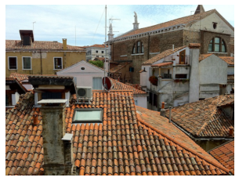

Example: Blurring
To blur an image, we replace each pixel value with a weighted average of values in the neighborhood of the pixel.
Simplest: W x W neighborhood, all weights equal.
img = plt.imread('images/roofs1.jpg')
# create a WxW matrix of ones
W = 3
kernel = np.ones((W, W))
# divide values so they sum up to 1.
kernel = kernel / kernel.sum()
result = convolve2Db(img, kernel)
img
blurred, W=3

Slide 50
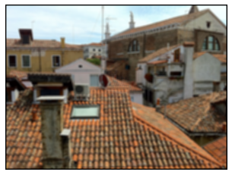
Example: Blurring
To blur an image, we replace each pixel value with a weighted average of values in the neighborhood of the pixel.
Simplest: W x W neighborhood, all weights equal.
img = plt.imread('images/roofs1.jpg')
# create a WxW matrix of ones
W = 7
kernel = np.ones((W, W))
# divide values so they sum up to 1.
kernel = kernel / kernel.sum()
result = convolve2Db(img, kernel)
img
blurred, W=7

Slide 51
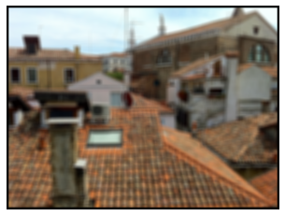
Example: Blurring
To blur an image, we replace each pixel value with a weighted average of values in the neighborhood of the pixel.
Simplest: W x W neighborhood, all weights equal.
As the kernel size gets larger, the result looks more blurry.
img
blurred, W=11

Slide 52
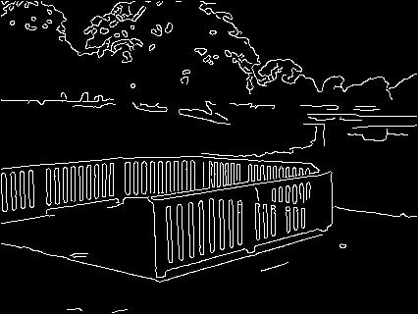
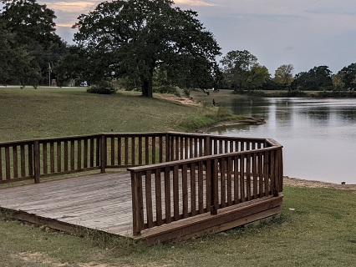
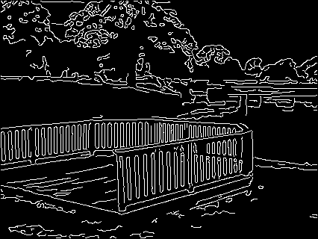
Example: Edges
An edge pixel is a pixel at a “boundary” of an image part
There is no single definition for what is a “boundary”.
Breaking up an image into parts can be done in many ways.
fewer edges
input
more edges

Slide 53
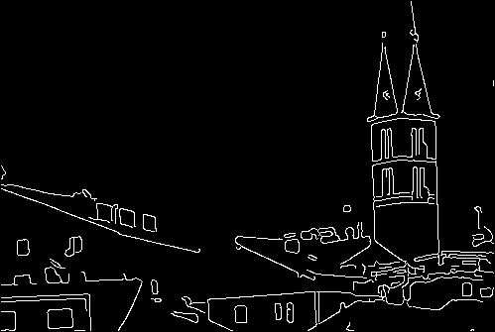
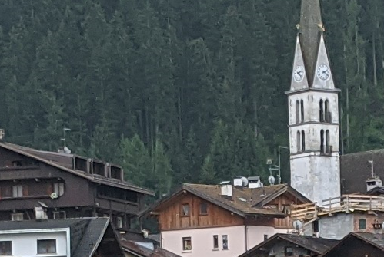
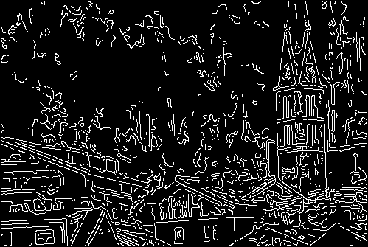
Example: Edges
fewer edges
An edge pixel is a pixel at a “boundary” of an image part
There is no single definition for what is a “boundary”.
Breaking up an image into parts can be done in many ways.
input
more edges

Slide 54
Example: Edges
fewer edges
Producing such edge images is a computer vision topic.
However, some preprocessing steps involve convolutions, and we can see how they work.
input
more edges

Slide 55
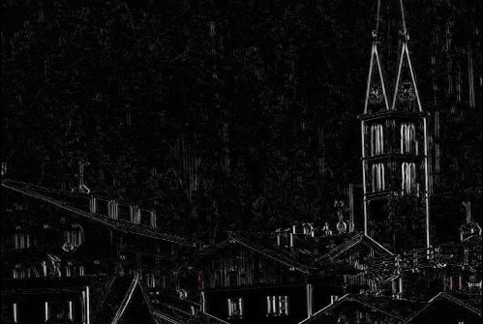
Vertical Edges
dx = np.array([[-1, 0, 1]])
img_dx = convolve2D(img, dx)
abs_dx = np.abs(img_dx)
show_image(abs_dx)
What pixel (r,c) would get the highest value if we convolve with [-1,0,1]?
A pixel such that the value at (r,c+1) is as low as possible, and the value at (r,c+1) is as high as possible.
So, a high value in the result indicates a boundary between a darker region on the left and a brighter region on the right.
input
output

Slide 56
Vertical Edges
dx = np.array([[-1, 0, 1]])
img_dx = convolve2D(img, dx)
abs_dx = np.abs(img_dx)
show_image(abs_dx)
What pixel (r,c) would get the lowest value if we convolve with [-1,0,1]?
A pixel such that the value at (r,c+1) is as high as possible, and the value at (r,c+1) is as low as possible.
So, a high negative value in the result indicates a boundary between a brighter region on the left and a darker region on the right.
input
output

Slide 57
Vertical Edges
dx = np.array([[-1, 0, 1]])
img_dx = convolve2D(img, dx)
abs_dx = np.abs(img_dx)
show_image(abs_dx)
So, the absolute value of the result is high if the pixel is at a boundary between a region on the left and a region on the right with a high difference in intensity.
This is why we take the absolute value.
input
output

Slide 58
Helper Function: show_image
def show_image(img):
mn = np.min(img)
mx = np.max(img)
img2 = (img-mn)/(mx-mn)
plt.imshow(img2, cmap="gray")
input
output

Slide 59
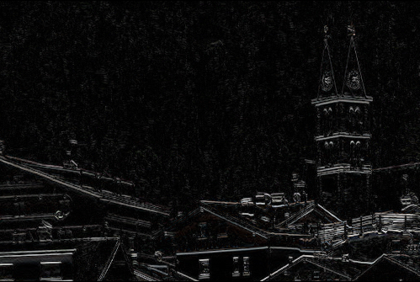
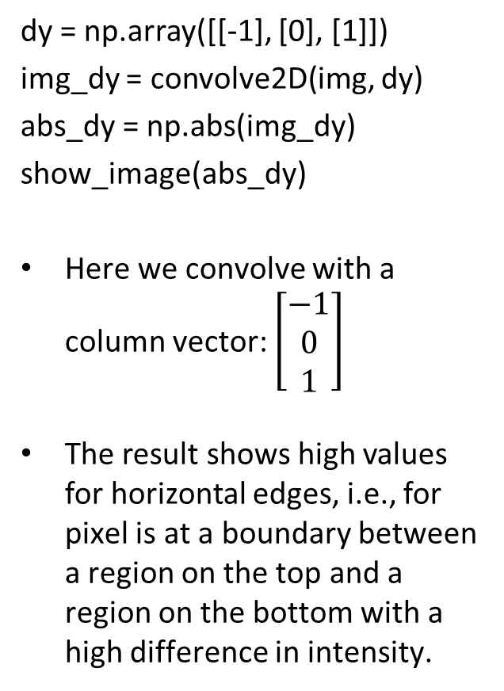
Horizontal Edges
dy = np.array([[-1], [0], [1]])
img_dy = convolve2D(img, dy)
abs_dy = np.abs(img_dy)
show_image(abs_dy)
Here we convolve with a column vector: $\left[\begin{aligned}−1 \\ 0 \\ 1\end{aligned}\right]$
The result shows high values for horizontal edges, i.e., for pixel is at a boundary between a region on the top and a region on the bottom with a high difference in intensity.
input
output

Slide 60
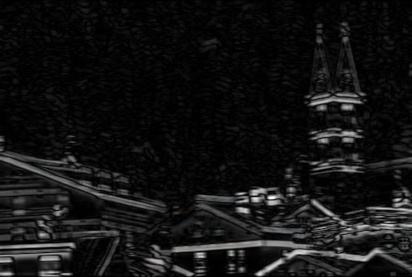
Convolutions Using SciPy
import numpy as np
import matplotlib.pyplot as plt
import scipy.ndimage as ndimage
img = plt.imread('images/alleghe2.png')
img = img[:,:,0:3]
kernel = np.ones((7, 7, 7))
blurred = ndimage.convolve(img, kernel)
dy = np.array([[-1], [0], [1]])
dy = np.repeat(dy[:,:,np.newaxis],3,axis=2)
blur_dy = ndimage.convolve(blurred, dy)
abs_dy = np.abs(blur_dy)
show_image(abs_dy)
Here we first blur the image, and then we find vertical edges.
input
output

Slide 61
Convolutions Using SciPy
Convolutions can be done using the built-in scipy.ndimage.convolve() function.
In this function, if the image is a 3D array (like an RGB image), then the kernel should also be 3D.
This code defines two kernels and combines two convolutions (blurring and convolving with dy).
We make sure that each kernel is a 3D array.
Note how np.repeat() is used to repeat dy 3 times, so as to convert it to a 3D array.
import numpy as np
import matplotlib.pyplot as plt
import scipy.ndimage as ndimage
img = plt.imread('images/alleghe2.png')
img = img[:,:,0:3]
kernel = np.ones((7, 7, 7))
blurred = ndimage.convolve(img, kernel)
dy = np.array([[-1], [0], [1]])
dy = np.repeat(dy[:,:,np.newaxis],3,axis=2)
blur_dy = ndimage.convolve(blurred, dy)
abs_dy = np.abs(blur_dy)
show_image(abs_dy)
Here we first blur the image, and then we find vertical edges.

