Slide 1
Time Series
CSE 4311 – Neural Networks and Deep Learning
Vassilis Athitsos
Computer Science and Engineering Department
University of Texas at Arlington

Slide 2
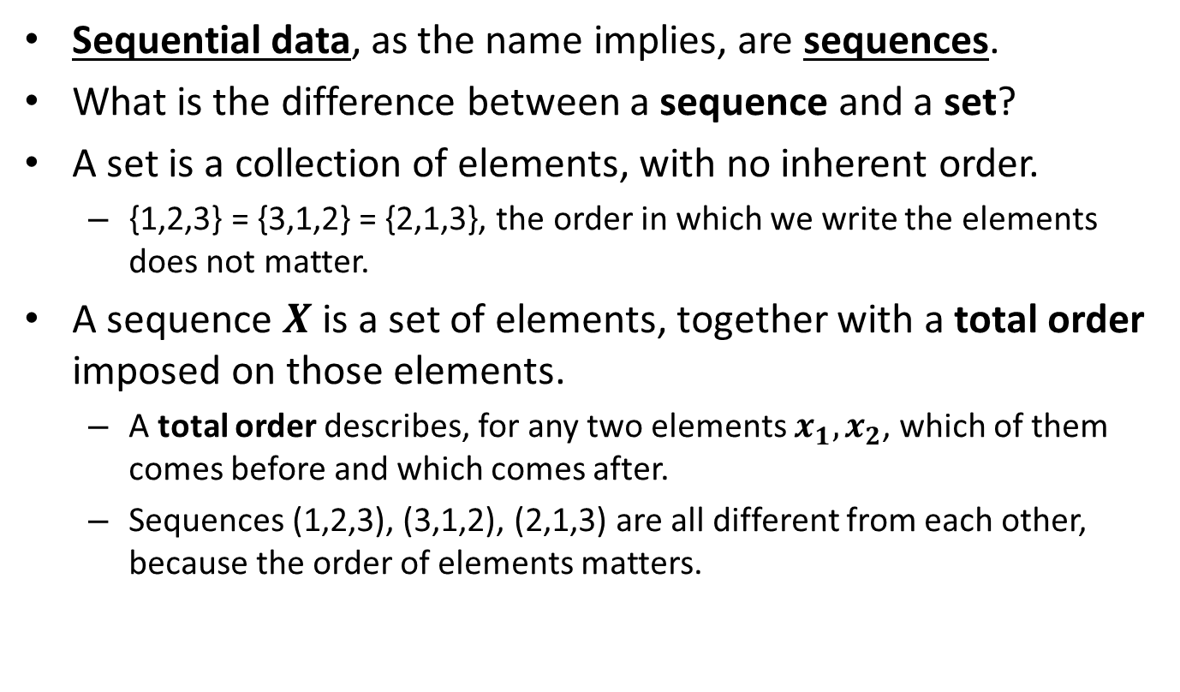
Sequential Data
Sequential data, as the name implies, are sequences.
What is the difference between a sequence and a set?
A set is a collection of elements, with no inherent order.
  {1,2,3} = {3,1,2} = {2,1,3}, the order in which we write the elements does not matter.
A sequence $X$ is a set of elements, together with a total order imposed on those elements.
  A total order describes, for any two elements $x_{1},x_{2}$, which of them comes before and which comes after.
  Sequences (1,2,3), (3,1,2), (2,1,3) are all different from each other, because the order of elements matters.

Slide 3
Time Series
A time series is a sequence of vectors.
Each vector can be thought of as an observation, or measurement, that corresponds to one specific moment in time.
Examples:
  Stock market prices (for a single stock, or for multiple stocks).
  Heart rate of a patient over time.
  Position of one or multiple people/cars/airplanes over time.
  Speech: represented as a sequence of audio measurements at discrete time steps.
  A musical melody: represented as a sequence of pairs (note, duration).

Slide 4
Dimensionality of Vectors
In the simplest case, a time series is just a sequence of numbers.
An example is the sequence of daily high temperatures (in Fahrenheit) in Arlington, from January 1 to January 4, 2022.
  We get the time series (74, 40, 54, 54).
  This time series has length 4.
In general, a time series is a sequence of vectors.
  All vectors in the time series must have the same dimensionality.
For example, we can take the previous sequence of daily high temperatures, and include the daily low temperature as well.
  We get the time series ((74,24), (40,19), (55, 25), (64,33)).
  It has length 4, and every element is a 2D vector.

Slide 5
Time Series Terminology
We can use the term “sequence” to refer to a time series.
  This is correct usage. Any time series is a sequence. The reverse is not true, there are sequences (for example, strings) that are NOT time series.
The length of a sequence is the number of elements in the sequence.
  For example, sequence ((74,24), (40,19), (55, 25), (64,33)) has length 4.
A feature refers to a specific dimension of the vectors that the time series contains.
  For example, in an earlier slide we said that the first feature in sequence ((74,24), (40,19), (55, 25), (64,33)) is the daily high temperature. The second feature is the daily low temperature.
We can refer to an element of a time series as a “feature vector”.

Slide 6
Strings and Time Series
Strings are an example of sequential data: a string is a sequence of characters from some alphabet.
Strings are sequential: the order of the characters matters.
  Strings “mile” and “lime” are not equal.
  Compare to sets {‘m’, ‘i’, ‘l’, ‘e’} and {‘l’, ‘i’, ‘m’, ‘e’}, which are equal.
Strings are not time series, because their elements are characters (symbols from a finite and discrete alphabet) and not vectors.
However, we can easily convert a string dataset to a time series dataset.
  We map each character to a one-hot vector.
  The dimensionality of these one-hot vectors is equal to the number of letters in the alphabet.

Slide 7
Text and Time Series
Text is another example of sequential data: a piece of text data can be seen as a sequence of letters, or as a sequence of words.
Using one-hot vectors we can convert a text dataset to a time series dataset.
  We can map each letter to a one-hot vector, or each word to a one-hot vector. Mapping words is more common.
  There are other methods as well for converting a piece of text to a time series.
  We will cover this topic in detail in a few weeks.

Slide 8
Speech and Time Series
The difference between speech and text is that speech data comes from audio, whereas text data is written.
We will not cover speech recognition this semester.

Slide 9
Types of Time Series Analysis
Forecasting future elements (commodity prices, temperature, …).
Classification: assigning a class label to a time series.
  Song recognition: sing a tune to your phone, have it recognize the song.
  Activity recognition: observe a human activity, recognize the type, such as walking, cooking, talking on the phone, etc.
Spotting: identifying the start and end points of an event of interest.
  Find in an audio recording the time interval when a specific phrase is said.
  Find in a video the time interval when a specific activity occurs.
Sequence-to-sequence translation.
  Take an audio recording as input, produce text as output.
  Take English text as input, produce a Spanish translation as output.

Slide 10
Time Series Example: Signs
0.5 to 2 million users of American Sign Language (ASL) in the US.
Different regions in the world use different sign languages.
  For example, British Sign Language (BSL) is different than American Sign Language.
These languages have vocabularies of thousands of signs.

Slide 11

Example: The ASL Sign for "again"

Slide 12

Example: The ASL Sign for "bicycle"

Slide 13
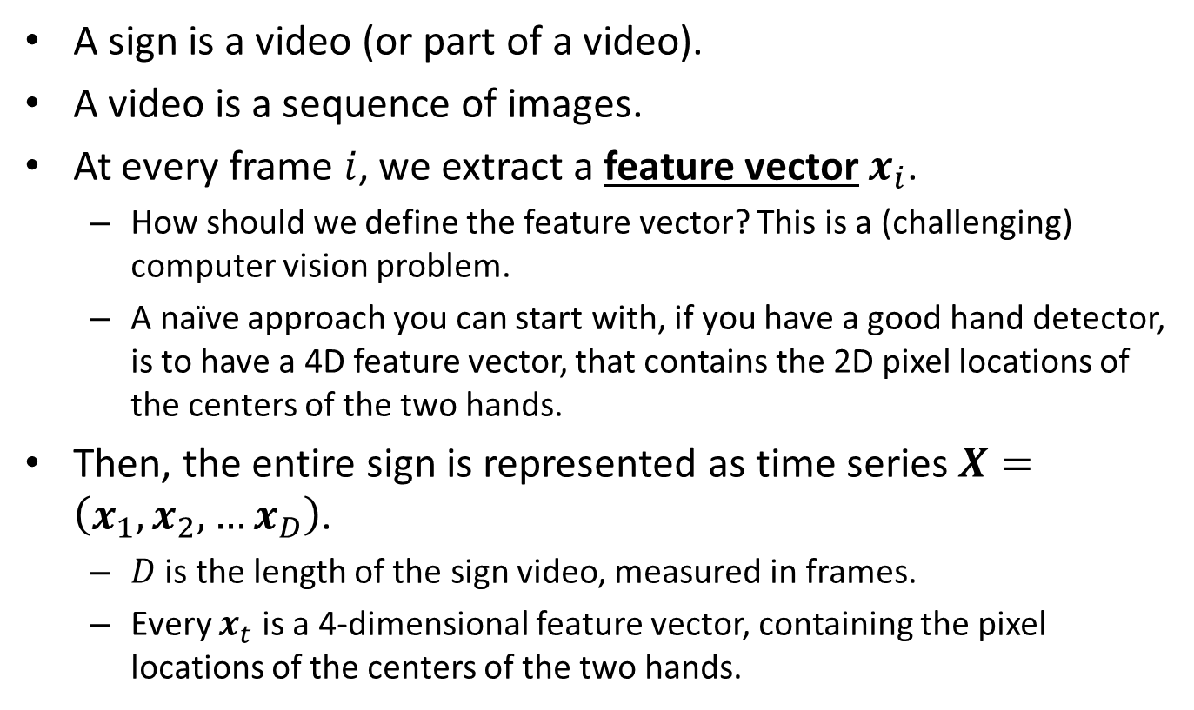
Representing Signs as Time Series
A sign is a video (or part of a video).
A video is a sequence of images.
At every frame $i$, we extract a feature vector $x_{i}$.
  How should we define the feature vector? This is a (challenging) computer vision problem.
  A naïve approach you can start with, if you have a good hand detector, is to have a 4D feature vector, that contains the 2D pixel locations of the centers of the two hands.
Then, the entire sign is represented as time series $X=\left(x_{1},x_{2},…x_{D}\right)$.
  $D$ is the length of the sign video, measured in frames.
  Every $x_{t}$ is a 4-dimensional feature vector, containing the pixel locations of the centers of the two hands.

Slide 14


Example: Hand Positions as Features
Here we see how hand locations are used to define feature vectors.
Frame 1:
Right hand center:
$(247,236)$
Left hand center:
$(281,365)$
Feature vector $x_{1}$:
$$\left(247,236,281,365\right)$$

Slide 15


Example: Hand Positions as Features
Here we see how hand locations are used to define feature vectors.
Frame 2:
Right hand center:
$(242,236)$
Left hand center:
$(279,367)$
Feature vector $x_{2}$:
$$\left(242,236,279,367\right)$$

Slide 16


Example: Hand Positions as Features
Here we see how hand locations are used to define feature vectors.
Frame 3:
Right hand center:
$(235,237)$
Left hand center:
$(277,368)$
Feature vector $x_{3}$:
$$\left(235,237,277,368\right)$$

Slide 17
Example: The Jena Climate Dataset
The Jena Climate dataset is a weather time series dataset.
  Publicly available at: https://www.kaggle.com/mnassrib/jena-climate
The data was recorded at the Weather Station of the Max Planck Institute for Biogeochemistry in Jena, Germany.
8 years of data: January 1, 2009 to December 31, 2016.
A feature vector was recorded every 10 minutes during those eight years.
Each feature vector is 14-dimensional.
These are some of the recorded features:
  Air temperature.
  Atmospheric pressure.
  Humidity.
  Wind direction…

Slide 18
Plan for the Next Few Weeks
We will work with the Jena Climate dataset and apply various methods for time series analysis.
In working with this dataset, we will follow Chapter 10 of the textbook “Deep Learning with Python”, Second Edition, 2021, by François Chollet.
The learning task we will address is forecasting:
  Given data from the last five days, the goal is to predict the temperature exactly 24 hours from now.
We first will try some simple methods, based on what we already know.
Then we will introduce Recurrent Neural Networks (RNNs), which are explicitly designed to process time series data.
  They are based on a new type of layer, called “Recurrent Layer”.

Slide 19
Plan for the Next Few Weeks
After that, we will work with text data.
  One task: recognizing if an IMDB movie review is positive or negative.
  Another task: translating from English to Spanish.
On the topic of working with text data, we will follow Chapter 11 of the textbook “Deep Learning with Python”, Second Edition, 2021, by François Chollet.
We will study various methods for converting text data to time series.
We will apply and evaluate RNNs on our two tasks.
We will then introduce and apply yet another type of neural networks, called Transformers.

Slide 20
Jena Climate Dataset: A Closer Look
You can download the dataset from:
https://www.kaggle.com/mnassrib/jena-climate
The dataset is saved in a CSV file with 15 columns:
  0: Date and Time
  1: Atmospheric pressure, in millibars.
  2: Temperature in Celsius.
  3: Temperature in Kelvin.
  4: Temperature in Celsius relative to humidity. According to the dataset web page, “Dew Point is a measure of the absolute amount of water in the air, the DP is the temperature at which the air cannot hold all the moisture in it and water condenses.”
  5: Relative humidity.
  6: Saturation vapor pressure.
  7: Vapor pressure.

Slide 21
Jena Climate Dataset: A Closer Look
The dataset is saved in a CSV file with 15 columns:
  8: Vapor pressure deficit.
  9: Specific humidity.
  10: Water vapor concentration.
  11: Airtight.
  12: Wind speed.
  13: Maximum wind speed.
  14: Wind direction in degrees.
As you see, some of these features (like “saturation vapor pressure”, “airtight”) are pretty esoteric to non-specialists, whereas others (like temperature, wind speed) have a meaning that we can all understand.

Slide 22
Reading the Data
fname = "jena_climate_2009_2016.csv"
with open(fname) as f:
data = f.read()
lines = data.split("\n")
lines = lines[1:] # The first line in the file is header information
temperature = np.zeros((len(lines),))
raw_data = np.zeros((len(lines), len(header) - 1))
for i, line in enumerate(lines):
values = [float(x) for x in line.split(",")[1:]]
temperature[i] = values[1]
raw_data[i] = values
This code creates two time series: temperature, and raw_data.

Slide 23
Reading the Data
for i, line in enumerate(lines):
values = [float(x) for x in line.split(",")[1:]]
temperature[i] = values[1]
raw_data[i] = values
Variable temperature is a 1D time series.
  temperature[i] is the i-th temperature observation, in Celsius.
Variable raw_data is a 14-dimensional time series.
  raw_data[i] is a 14-dimensional vector.
  From the original 15 columns of the dataset, we exclude column 0, which was the date and time.

Slide 24
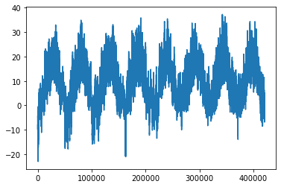
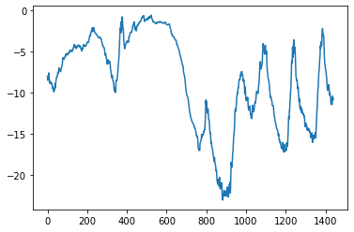
Visualizing the Data
plt.plot(range(0, len(temperature)), temperature)
plots all 420,451 values in the temperature array (one observation every ten minutes, for eight years).
plt.plot(range(0, 1440), temperature[:1440])
plots the first 1440 values, corresponding to the first 10 days.

Slide 25
Training, Validation, Test Data
Forecasting task: given data from the last five days, the goal is to predict the temperature exactly 24 hours from now.
We separate our data into:
  training data (first 50% of the data).
  validation data (subsequent 25% of the data).
  test data (last 25% of the data).
num_train_samples = int(0.5 * len(raw_data))
num_val_samples = int(0.25 * len(raw_data))
num_test_samples = len(raw_data) - num_train_samples - num_val_samples
print("num_train_samples:", num_train_samples)
print("num_val_samples:", num_val_samples)
print("num_test_samples:", num_test_samples)
Output:
num_train_samples: 210225
num_val_samples: 105112
num_test_samples: 105114

Slide 26
Normalizing the Data
We have seen before that we should normalize the data, so that values are not too big or too small.
One approach we have used is to scale each dimension to have values between 0 and 1.
Another popular approach is to scale each dimension so that the mean value along that dimension is 0, and the standard deviation is 1.
  This is the approach we will use here.

Slide 27
Normalizing the Data
(number, dimensions) = raw_data.shape
normalized_data = np.zeros((number, dimensions))
for d in range (0, dimensions):
feature_values = raw_data[0:num_train_samples,d]
m = np.mean(feature_values)
s = np.std(feature_values)
normalized_data[:,d] = (raw_data[:,d] - m) / s
This piece of code does the normalization we want.
For every dimension (i.e., for every attribute of the data), we subtract the mean, and then we divide by the std.
After that, each dimension has mean 0 and std 1 (at least for the training data).

Slide 28
Normalizing the Data
(number, dimensions) = raw_data.shape
normalized_data = np.zeros((number, dimensions))
for d in range (0, dimensions):
feature_values = raw_data[0:num_train_samples,d]
m = np.mean(feature_values)
s = np.std(feature_values)
normalized_data[:,d] = (raw_data[:,d] - m) / s
Why do we only compute the mean and std on the training data?
Why not use all columns, like: feature_values = raw_data[:, d]

Slide 29
Normalizing the Data
(number, dimensions) = raw_data.shape
normalized_data = np.zeros((number, dimensions))
for d in range (0, dimensions):
feature_values = raw_data[0:num_train_samples,d]
m = np.mean(feature_values)
s = np.std(feature_values)
normalized_data[:,d] = (raw_data[:,d] - m) / s
Why do we only compute the mean and std on the training data?
Why not use all columns, like: feature_values = raw_data[:, d]
Because, in the real world, when we normalize the training data, we have no idea what test data the system will be applied to.

Slide 30
Normalizing the Data
mean = raw_data[:num_train_samples].mean(axis=0)
normalized_data = raw_data - mean
std = raw_data[:num_train_samples].std(axis=0)
normalized_data = raw_data / std
A shorter version of the previous code is shown here.
  No need to loop over each dimension, this code operates on all dimensions simultaneously.
If you are comfortable with (or interested in learning more about) numpy shortcuts, you can use this type of coding.
If you would rather use code that is more simple and more readable, then you can use a coding style similar to the previous version.

Slide 31
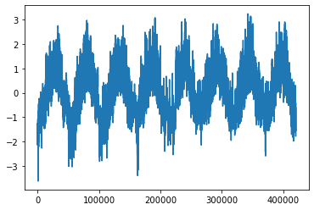
Normalizing the Data
Top: plot of temperatures over the entire 8 years.
Bottom: plot of normalized temperatures over the entire 8 years.
The shapes of the plots are identical, but the ranges are different.
  Top range: -23.01 to 37.28.
  Bottom range: -3.63 to 3.24

Slide 32
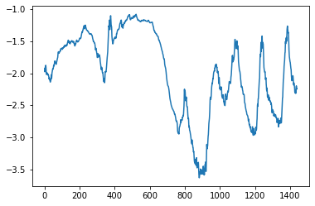
Normalizing the Data
Top: plot of temperatures over the first 10 days.
Bottom: plot of normalized temperatures over the first 10 days.
Again, the shapes of the plots are identical, but the ranges are different.

Slide 33
Inputs and Target Outputs
Let’s look at our forecasting task description again: given data from the last five days, the goal is to predict the temperature exactly 24 hours from now.
What will be the input to this “forecasting” system?
What will be the output of the system?

Slide 34
Inputs and Target Outputs
Let’s look at our forecasting task description again: given data from the last five days, the goal is to predict the temperature exactly 24 hours from now.
What will be the input to this “forecasting” system?
What will be the output of the system?
The input will be a sequence of feature vectors containing all values from a period of five days.
  Number of columns: 14, since we have 14 features in our data.
  Number of rows: 5 days * 24 hours * 6 observations per hour = 720.
  Shape of the input: 720x14, which gives 10080 numbers.
The output will be a single number: the temperature (in Celsius) 24 hours after the last observation in the input.

Slide 35
Creating a Training Set
So far, we have said that our training is the first half of all observations.
num_train_samples = int(0.5 * len(normalized_data))
training_data = normalized_data[0:num_train_samples, :]
print(training_data.shape)
How do we extract a random training example out of this data?
Output:
(210225, 14)

Slide 36
Creating a Training Set
Our training data is a 14-dimensional time series of length 210,225.
We want to extract a random training example of length 720.
So, we pick a random start point in the time series, and we get the next 720 elements.
What is the smallest and largest legal value for the start point?
Smallest: 0
Largest: timeseries length – 720 – 24*6.
  Why? We need enough room to choose 720 elements, plus enough room to look 24 hours past the last element, to get the target value that we aim to forecast.

Slide 37
Creating a Training Set
What is the smallest and largest legal value for the start point?
Smallest: 0
Largest: timeseries length – 720 – 24*6.
  Why? We need enough room to choose 720 elements, plus enough room to look 24 hours past the last element, to get the target value that we aim to forecast.
input length = 720
target value
Random start point
24 hours = 24*6 time steps after last element of input

Slide 38
Selecting a Random Input
def random_input_v1(timeseries, length, target_time, target_data):
(ts_length, dimensions) = timeseries.shape
max_start = ts_length - length - target_time
start = np.random.randint(0,max_start)
end = start + length
result_input = timeseries[start:end, :]
target = target_data[end+target_time-1]
return (result_input, target)
(input1, target1) = random_input_v1(normalized_data, 720, 24*6, temperature)
This code does what we discussed. It returns:
  A time series called “result_input”, of the desired length.
  The corresponding target value.

Slide 39
Sampling the Input
As we said, the input has 14 columns and 720 rows
  Number of rows: 5 days * 24 hours * 6 observations per hour = 720.
We can reduce the amount of data, by sampling only one observation per hour, instead of 6.
The weather does not (usually) fluctuate radically within a single hour, so hopefully the data we discard does not contain much additional information over the data we keep.
  We can always do an experiment without sampling, to compare running times and accuracy.
So, this way the input will only have 120 rows instead of 720 rows.
  In other words, viewed as a time series, the input will have 120 elements instead of 720 elements.

Slide 40
Updated Code for Random Sample
def random_input(timeseries, length, target_time, target_data,
sampling_rate = 1):
(ts_length, dimensions) = timeseries.shape
max_start = ts_length - length - target_time
start = np.random.randint(0,max_start)
end = start + length
result_input = timeseries[start:end:sampling_rate, :]
target = target_data[end+target_time-1]
return (result_input, target)
(input2, target2) = random_input(training_data, 720, 24*6, temperature, 6)
This version does sampling.
The length of the returned sample is length / sampling_rate.

Slide 41
Creating a Set of Examples
def example_set(timeseries, number, length, target_time, target_data,
sampling_rate = 1):
(ts_length, dimensions) = timeseries.shape
input_length = math.ceil(length/sampling_rate)
inputs = np.zeros((number, input_length, dimensions))
targets = np.zeros((number))
for i in range(0, number):
(inp, target) = random_input(timeseries, length, target_time,
target_data, sampling_rate)
inputs[i] = inp
targets[i] = target
return (inputs, targets)
To create a set of examples, we just call random_input() as many times as we need.

Slide 42
Creating a Training Set
training_data = normalized_data[0:num_train_samples, :]
training_temperature = temperature[0:num_train_samples]
(training_inputs, training_targets) = example_set(training_data, 50000, 720,
24*6, training_temperature, 6)
print("\ntraining time range: (%d, %d)" % (0, num_train_samples))
print("training_inputs.shape:", training_inputs.shape)
print("training_targets.shape:", training_targets.shape)
Output:
training time range: (0, 210225)
training_inputs.shape: (50000, 120, 14)
training_targets.shape: (50000,)

Slide 43
Creating a Validation Set
validation_start = num_train_samples
validation_end = validation_start + num_val_samples
validation_data = normalized_data[validation_start:validation_end, :]
validation_temperature = temperature[validation_start:validation_end]
(validation_inputs, validation_targets) = example_set(validation_data, 50000,
720, 24*6, validation_temperature, 6)
print("\nvalidation time range: (%d, %d)" % (validation_start, validation_end))
print("validation_inputs.shape:", validation_inputs.shape)
print("validation_targets.shape:", validation_targets.shape)
Output:
validation time range: (210225, 315337)
validation_inputs.shape: (50000, 120, 14)
validation_targets.shape: (50000,)

Slide 44
Creating a Test Set
test_start = validation_end
test_end = test_start + num_test_samples
test_data = normalized_data[test_start:test_end, :]
test_temperature = temperature[test_start:test_end]
(test_inputs, test_targets) = example_set(test_data, 50000, 720,
24*6, test_temperature, 6)
print("\ntest time range: (%d, %d)" % (test_start, test_end))
print("test_inputs.shape:", test_inputs.shape)
print("test_targets.shape:", test_targets.shape)
Output:
test time range: (315337, 420451)
test_inputs.shape: (50000, 120, 14)
test_targets.shape: (50000,)

Slide 45
A Naïve Method
def naive_forecast(timeseries, means, stds):
(length, dimensions) = timeseries.shape
temperature_column = 1
last_temperature = timeseries[length-1, temperature_column]
mean_temperature = means[temperature_column]
temperature_std = stds[temperature_column]
prediction = last_temperature * temperature_std + mean_temperature
return prediction
Here is a naïve forecasting method, not using machine learning.
What does this method do?

Slide 46
A Naïve Method
def naive_forecast(timeseries, means, stds):
(length, dimensions) = timeseries.shape
temperature_column = 1
last_temperature = timeseries[length-1, temperature_column]
mean_temperature = means[temperature_column]
temperature_std = stds[temperature_column]
prediction = last_temperature * temperature_std + mean_temperature
return prediction
The temperature predicts that the temperature 24 hours later is equal to the temperature right now.
  It returns the last observed temperature value.
  Note that we multiply by std and add the mean, to account for the data normalization that we did.

Slide 47
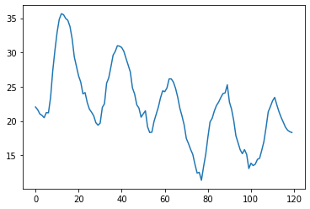
Rationale for the Naïve Method
Here is an example input.
We can see that temperature values usually follow a 24-hour pattern.
  Highest values in the afternoon.
  Lowest values at night.
So, the current temperature is a reasonable quick guess about the temperature 24 hours later.
Notes:
start index = 191233

Slide 48
Example Results of the Naïve Method
prediction = 18.33
true value = 17.81

Slide 49
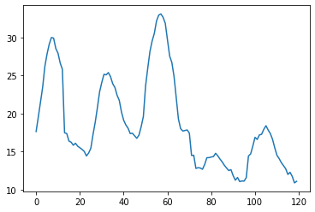
Example Results of the Naïve Method
prediction = 11.08
true value = 8.39

Slide 50
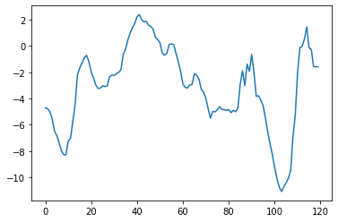
Example Results of the Naïve Method
prediction = -1.59
true value = 1.43

Slide 51
Evaluating the Naïve Method
def evaluate_naive_forecast(inputs, targets, means, stds):
(number, ) = targets.shape
predictions = np.zeros((number,))
for t in range(0, number):
predictions[t] = naive_forecast(inputs[t], means, stds)
errors = np.abs(predictions - targets)
mean_abs_error = errors.mean()
return mean_abs_error
This function computes the MAE (mean absolute error) of the predictions on a specific dataset.

Slide 52
Evaluating the Naïve Method
training_mae = evaluate_naive_forecast(training_inputs, training_targets,
mean, std)
print("training MAE: %.2f" % (training_mae))
validation_mae = evaluate_naive_forecast(validation_inputs, validation_targets,
mean, std)
print("validation MAE: %.2f" % (validation_mae))
test_mae = evaluate_naive_forecast(test_inputs, test_targets, mean, std)
print("test MAE: %.2f" % (test_mae))
Output:
training MAE: 2.70
validation MAE: 2.46
test MAE: 2.62

Slide 53
Why Bother with a Naïve Method
In machine learning, it is important to establish some baseline accuracy.
Baseline accuracy is accuracy we can get with relatively little effort.
  Can be using a naïve method.
  Can be using a method that already exists and we can use.
Then, we can compare the results of whatever fancy method we come up with with the baseline method.
  Is the fancy method more accurate?
  We hope yes, but sometimes the answer is no. If the answer is no, it is better if you are the first one to find out.
Comparing to a baseline method helps us find bugs and do sanity checking on our solution.

Slide 54
Using a Neural Network
input_shape = training_inputs[0].shape
model = keras.Sequential([keras.Input(shape=input_shape),
keras.layers.Flatten(),
keras.layers.Dense(16, activation="relu"),
keras.layers.Dense(1),])
Here is a simple neural network for this task.
Each input is a 2D array, of dimensions 120x14.
  The input is a time series of 120 elements.
  Each element a 14-dimensional vector.
We flatten each input into a 1D array of size 120*14 = 1680.
We use one hidden layer, with 16 units, ReLU activation.

Slide 55
MAE on Validation and Test Set
val_mae = np.array(history_dense.history["val_mae"])
min_val_mae = val_mae.min()
min_epoch = val_mae.argmin()+1
print("\nmin_val_mae: %.2f, epoch %d" % (min_val_mae, min_epoch))
model = keras.models.load_model("jena_dense1_16.keras")
(loss, test_mae) = model.evaluate(test_inputs, test_targets)
print("Test MAE: %.2f" % (test_mae))
Output:
Smallest validation MAE: 2.56, reached in epoch 4
Test MAE: 2.64

Slide 56
MAE on Validation and Test Set
I ran the training 8 times.
The validation MAE ranged from 2.54 to 2.66.
  With the “naïve” method we got a validation MAE of 2.46.
The test MAE ranged from 2.63 to 2.71.
  With the “naïve” method we got a test MAE of 2.62
Interestingly, the “naïve” method outperforms our neural network.
  I tried two hidden layers, 120 units per layer, similar results.
This is a good example of why it is useful to implement and evaluate some “naïve” baseline methods.

Slide 57
“Naïve” vs. Neural Network
Neural network: validation MAE ranged from 2.54 to 2.66.
“Naïve” method: validation MAE = 2.46.
Neural network: test MAE ranged from 2.63 to 2.71.
“Naïve” method: test MAE = 2.62
What are some possible reasons that the “naïve” method gives better results than the neural network?

Slide 58
“Naïve” vs. Neural Network
The “naïve” method is designed by humans, and uses knowledge that we have about this problem.
  We know that, more often than not, the weather does not change dramatically from one day to the next.
The neural network training simply searches over a very large space of parameters (26,913 weights).
The larger the search space, the harder it is to find a good solution.
  There can be too many local optima that correspond to worse solutions than the “naïve” method.

Slide 59
A Closer Look at the Model
input_shape = training_inputs[0].shape
model = keras.Sequential([keras.Input(shape=input_shape),
keras.layers.Flatten(),
keras.layers.Dense(16, activation="relu"),
keras.layers.Dense(1),])
Even though this specific model does not work as well, we should take a closer look.
There are many important new concepts that are introduced here, that we should explain.
  As we try more sophisticated models, we will continue using some of these concepts.

Slide 60
Output of the Network
input_shape = training_inputs[0].shape
model = keras.Sequential([keras.Input(shape=input_shape),
keras.layers.Flatten(),
keras.layers.Dense(16, activation="relu"),
keras.layers.Dense(1),])
The output layer has a single unit.
This makes sense, since we want to predict a single value: the temperature 24 hours after the last observation in the input.
Notice that we specify no activation function for the output unit.
This means that the identity function will be used as activation.
  The output unit will output the weighted sum of its inputs.
Why?

Slide 61
Regression Problem
input_shape = training_inputs[0].shape
model = keras.Sequential([keras.Input(shape=input_shape),
keras.layers.Flatten(),
keras.layers.Dense(16, activation="relu"),
keras.layers.Dense(1),])
This is our first regression problem.
In a classification problem, the targets are integer class labels, or one-hot vectors.
In a regression problem, the targets are real numbers.
  We use no activation for the output layer, so that we do not limit the range of the output values.

Slide 62
Regression Problem
model.compile(optimizer="rmsprop", loss="mse", metrics=["mae"])
Notice the use of Mean Squared Error (MSE) as the loss function.
Mathematically, MSE is equivalent to using the sum-of-squared errors (SSE).
  We just divide SSE by the number of training objects.
Categorical Cross-Entropy would not make sense to use here.
  The targets are real numbers, NOT integer class labels or one-hot vectors.
Also, note that we specify Mean Absolute Error (MAE) as the metric to watch during training.

Slide 63
Callbacks for Saving Best Model
callbacks = [keras.callbacks.ModelCheckpoint("jena_dense1_16.keras",
save_best_only=True)]
history_dense = model.fit(training_inputs, training_targets, epochs=10,
validation_data=(validation_inputs, validation_targets),
callbacks=callbacks)
The callbacks argument to fit() specifies actions that should be taken at specific points in the training.
Here we specify ModelCheckpoint() as the callback.
ModelCheckpoint() saves a model to a file during training, so that we keep track of the values of the weights after each epoch.
  The save_best_only=True parameter specifies to save only the best intermediate model (best according to the metric we have specified, on the validation set).

Slide 64
Loading the Best Model
model = keras.models.load_model("jena_dense1_16.keras")
(loss, test_mae) = model.evaluate(test_inputs, test_targets)
print("Test MAE: %.2f" % (test_mae))
To measure the test error, we load the best model.
This is a good example of how to use validation data.
  The training ran for 20 epochs.
  It may be that, after a certain point, we started getting overfitting.
  The error on the validation data is a good way to identify the epoch where the model was the most accurate on non-training data.
  We save the weights that worked the best on the validation data, and we load that version of the model whenever we need to use the model.

Slide 65
Using the Training History
history_dense = model.fit(training_inputs, training_targets, epochs=10,
validation_data=(validation_inputs, validation_targets),
callbacks=callbacks)
val_mae = np.array(history_dense.history["val_mae"])
min_val_mae = val_mae.min()
min_epoch = val_mae.argmin()+1
print("\nSmallest validation MAE: %.2f, reached in epoch %d" %
(min_val_mae, min_epoch))
We can use the training history to identify the best epoch.
Output:
Smallest validation MAE: 2.56, reached in epoch 4

Slide 66
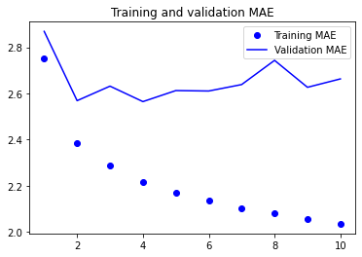
Visualizing the
Training Progress
This piece of code shows the
training and validation MAE
achieved after each epoch.
loss = history_dense.history["mae"]
val_loss = history_dense.history["val_mae"]
epochs = range(1, len(loss) + 1)
plt.figure()
plt.plot(epochs, loss, "bo", label="Training MAE")
plt.plot(epochs, val_loss, "b", label="Validation MAE")
plt.title("Training and validation MAE")
plt.legend()
plt.show()

Slide 67
Visualizing the
Training Progress
We have a mild case of
overfitting.
The training MAE decreases
steadily.
The validation MAE reaches
a minimum of 2.56 after epoch 4,
and then it gets somewhat worse.

Slide 68
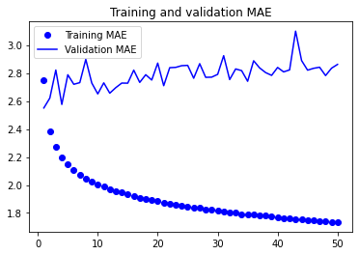
Visualizing the
Training Progress
Here is the result of another
experiment, where we train
for 50 epochs.
The behavior is similar.
The best value for the validation
MAE is reached after epoch 4.
After that, values get slightly worse.

Slide 69
Preview: RNNs
Our next topic is recurrent neural networks (RNNs).
RNNs have been explicitly designed for time series.
Compared to the simple neural network we tried before, the design of RNNs incorporates our human understanding of how we should analyze a time series.
Not surprisingly, RNNs work (somewhat) better than simple fully-connected models on the temperature forecasting problem, and in many other time-series problems.

Slide 70
Preview: RNNs
model = keras.Sequential([keras.Input(shape=input_shape),
keras.layers.SimpleRNN(16),
keras.layers.Dense(1),])
model.compile(optimizer="rmsprop", loss="mse", metrics=["mae"])
history_lstm = model.fit(training_inputs, training_targets, epochs=20,
validation_data=(validation_inputs, validation_targets))
This is our first RNN model.
It uses a “SimpleRNN” layer.
We will see in detail how RNNs work in the next set of slides.

Slide 71
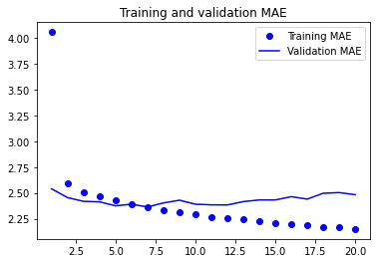
RNN Results
Validation MAE:
  RNN: 2.31 to 2.34.
  Fully-connected network:
  2.54 to 2.66.
  “Naïve” method: 2.46.
Test MAE:
  RNN: 2.45-2.48.
  Fully-connected network: ranged from 2.63 to 2.71.
  “Naïve” method: 2.62.
Each model was trained and evaluated 8 times.
The RNN works better, but the improvement is not dramatic.
  In other datasets, bigger (or smaller) differences in accuracy can be observed.

