Slide 1
Recurrent Neural Networks
CSE 4311 – Neural Networks and Deep Learning
Vassilis Athitsos
Computer Science and Engineering Department
University of Texas at Arlington

Slide 2
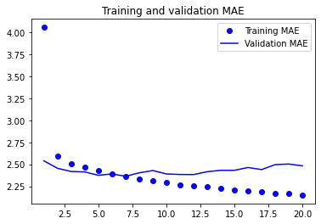
Jena Climate:
RNN Results
Validation MAE:
  RNN: 2.31 to 2.34.
  Simple fully-connected
  network: ranged from
  2.54 to 2.66.
  “Naïve” method: 2.46.
Test MAE:
  RNN: 2.45-2.48.
  Simple fully-connected network: ranged from 2.63 to 2.71.
  “Naïve” method: 2.62.
The improvement is not really spectacular.
  In other datasets, bigger (or smaller) differences in accuracy can be observed.

Slide 3

























A Simple RNN Model
This is an example model that is small enough to draw easily:
  The input to the model is a time series $x$of length 3.
  Each element of the $x$has two dimensions.
So, $x=\left(\left(x_{1,1},x_{1,2}\right),\left(x_{2,1},x_{2,2}\right),\left(x_{3,1},x_{3,2}\right)\right)$
$$z_{2,1}$$
$$z_{2,2}$$
$$z_{2,3}$$
$$u_{2,1}$$
$$u_{2,1}$$
$$U_{2,1}$$
$$U_{2,2}$$
$$U_{2,3}$$
$$w_{2,1,1}$$
$$w_{2,1,2}$$
$$w_{2,1,1}$$
$$w_{2,1,2}$$
$$w_{2,1,1}$$
$$w_{2,1,2}$$
$$U_{1,1,1}$$
$$U_{1,1,2}$$
$$U_{1,2,1}$$
$$U_{1,2,2}$$
$$U_{1,3,1}$$
$$U_{1,3,2}$$
$$x_{1,1}$$
$$x_{1,2}$$
$$x_{2,1}$$
$$x_{2,2}$$
$$x_{3,1}$$
$$x_{3,2}$$

Slide 4
A Simple RNN Model
Previously, we used to draw input layers on the left, and output layers on the right.
Here, it is easier to draw input layers at the bottom, and output layers at the top.
$$z_{2,1}$$
$$z_{2,2}$$
$$z_{2,3}$$
$$u_{2,1}$$
$$u_{2,1}$$
$$U_{2,1}$$
$$U_{2,2}$$
$$U_{2,3}$$
$$w_{2,1,1}$$
$$w_{2,1,2}$$
$$w_{2,1,1}$$
$$w_{2,1,2}$$
$$w_{2,1,1}$$
$$w_{2,1,2}$$
$$U_{1,1,1}$$
$$U_{1,1,2}$$
$$U_{1,2,1}$$
$$U_{1,2,2}$$
$$U_{1,3,1}$$
$$U_{1,3,2}$$
$$x_{1,1}$$
$$x_{1,2}$$
$$x_{2,1}$$
$$x_{2,2}$$
$$x_{3,1}$$
$$x_{3,2}$$

Slide 5

A Simple RNN Model
There is nothing different about the input layer, it is as usual.
$x=\left(\left(x_{1,1},x_{1,2}\right),\left(x_{2,1},x_{2,2}\right),\left(x_{3,1},x_{3,2}\right)\right)$, so we need six input units to represent the input.
$$z_{2,1}$$
$$z_{2,2}$$
$$z_{2,3}$$
$$u_{2,1}$$
$$u_{2,1}$$
$$U_{2,1}$$
$$U_{2,2}$$
$$U_{2,3}$$
$$w_{2,1,1}$$
$$w_{2,1,2}$$
$$w_{2,1,1}$$
$$w_{2,1,2}$$
$$w_{2,1,1}$$
$$w_{2,1,2}$$
$$U_{1,1,1}$$
$$U_{1,1,2}$$
$$U_{1,2,1}$$
$$U_{1,2,2}$$
$$U_{1,3,1}$$
$$U_{1,3,2}$$
$$x_{1,1}$$
$$x_{1,2}$$
$$x_{2,1}$$
$$x_{2,2}$$
$$x_{3,1}$$
$$x_{3,2}$$

Slide 6
A Simple RNN Model
The second layer is a recurrent layer.
  Because of this layer, this network is not a feedforward neural network.
  In a feedforward neural network, the inputs to a layer come from the outputs of the previous layer.
  Here, some inputs to the second layer come from the second layer itself.
$$z_{2,1}$$
$$z_{2,2}$$
$$z_{2,3}$$
$$u_{2,1}$$
$$u_{2,1}$$
$$U_{2,1}$$
$$U_{2,2}$$
$$U_{2,3}$$
$$w_{2,1,1}$$
$$w_{2,1,2}$$
$$w_{2,1,1}$$
$$w_{2,1,2}$$
$$w_{2,1,1}$$
$$w_{2,1,2}$$
$$U_{1,1,1}$$
$$U_{1,1,2}$$
$$U_{1,2,1}$$
$$U_{1,2,2}$$
$$U_{1,3,1}$$
$$U_{1,3,2}$$
$$x_{1,1}$$
$$x_{1,2}$$
$$x_{2,1}$$
$$x_{2,2}$$
$$x_{3,1}$$
$$x_{3,2}$$

Slide 7

A Simple RNN Model
Notice that unit $U_{2,2}$ receives inputs not only from input units, but also from second-layer unit $U_{2,1}$.
Similarly, unit $U_{2,3}$ receives inputs not only from input units, but also from second-layer unit $U_{2,2}$.
These connections between units of the same layer are called recurrent connections.
$$z_{2,1}$$
$$z_{2,2}$$
$$z_{2,3}$$
$$u_{2,1}$$
$$u_{2,1}$$
$$U_{2,1}$$
$$U_{2,2}$$
$$U_{2,3}$$
$$w_{2,1,1}$$
$$w_{2,1,2}$$
$$w_{2,1,1}$$
$$w_{2,1,2}$$
$$w_{2,1,1}$$
$$w_{2,1,2}$$
$$U_{1,1,1}$$
$$U_{1,1,2}$$
$$U_{1,2,1}$$
$$U_{1,2,2}$$
$$U_{1,3,1}$$
$$U_{1,3,2}$$
$$x_{1,1}$$
$$x_{1,2}$$
$$x_{2,1}$$
$$x_{2,2}$$
$$x_{3,1}$$
$$x_{3,2}$$

Slide 8







A Simple RNN Model
Notice that all units in the second layer share the same weights.
The weights connecting two input units to a second-layer unit are denoted with the same two symbols.
There is also a new symbol, the recurrent weight $u_{2,1}$ for the recurrent connections between $U_{2,1}$ and $U_{2,2}$, and between $U_{2,2}$ and $U_{2,3}$.
$$z_{2,1}$$
$$z_{2,2}$$
$$z_{2,3}$$
$$u_{2,1}$$
$$u_{2,1}$$
$$U_{2,1}$$
$$U_{2,2}$$
$$U_{2,3}$$
$$w_{2,1,1}$$
$$w_{2,1,2}$$
$$w_{2,1,1}$$
$$w_{2,1,2}$$
$$w_{2,1,1}$$
$$w_{2,1,2}$$
$$U_{1,1,1}$$
$$U_{1,1,2}$$
$$U_{1,2,1}$$
$$U_{1,2,2}$$
$$U_{1,3,1}$$
$$U_{1,3,2}$$
$$x_{1,1}$$
$$x_{1,2}$$
$$x_{2,1}$$
$$x_{2,2}$$
$$x_{3,1}$$
$$x_{3,2}$$

Slide 9



Computing the Output
The outputs of the second layer play two roles:
  They are used as inputs to other units in the second layer.
  They are also the outputs of the entire network.
In more complicated models, we could have more layers on top.
$$z_{2,1}$$
$$z_{2,2}$$
$$z_{2,3}$$
$$u_{2,1}$$
$$u_{2,1}$$
$$U_{2,1}$$
$$U_{2,2}$$
$$U_{2,3}$$
$$w_{2,1,1}$$
$$w_{2,1,2}$$
$$w_{2,1,1}$$
$$w_{2,1,2}$$
$$w_{2,1,1}$$
$$w_{2,1,2}$$
$$U_{1,1,1}$$
$$U_{1,1,2}$$
$$U_{1,2,1}$$
$$U_{1,2,2}$$
$$U_{1,3,1}$$
$$U_{1,3,2}$$
$$x_{1,1}$$
$$x_{1,2}$$
$$x_{2,1}$$
$$x_{2,2}$$
$$x_{3,1}$$
$$x_{3,2}$$

Slide 10





Computing the Output
Computing the output of each unit needs to be follow the order of the time steps.
First we compute, from bottom to top, the output of all units that correspond to time step 1.
$$z_{2,1}$$
$$z_{2,2}$$
$$z_{2,3}$$
$$u_{2,1}$$
$$u_{2,1}$$
$$U_{2,1}$$
$$U_{2,2}$$
$$U_{2,3}$$
$$w_{2,1,1}$$
$$w_{2,1,2}$$
$$w_{2,1,1}$$
$$w_{2,1,2}$$
$$w_{2,1,1}$$
$$w_{2,1,2}$$
$$U_{1,1,1}$$
$$U_{1,1,2}$$
$$U_{1,2,1}$$
$$U_{1,2,2}$$
$$U_{1,3,1}$$
$$U_{1,3,2}$$
$$x_{1,1}$$
$$x_{1,2}$$
$$x_{2,1}$$
$$x_{2,2}$$
$$x_{3,1}$$
$$x_{3,2}$$

Slide 11






Computing the Output
Computing the output of each unit needs to be follow the order of the time steps.
Second we compute, from bottom to top, the output of all units that correspond to time step 2.
  This way we can use $z_{2,1}$ from time step 1.
$$z_{2,1}$$
$$z_{2,2}$$
$$z_{2,3}$$
$$u_{2,1}$$
$$u_{2,1}$$
$$U_{2,1}$$
$$U_{2,2}$$
$$U_{2,3}$$
$$w_{2,1,1}$$
$$w_{2,1,2}$$
$$w_{2,1,1}$$
$$w_{2,1,2}$$
$$w_{2,1,1}$$
$$w_{2,1,2}$$
$$U_{1,1,1}$$
$$U_{1,1,2}$$
$$U_{1,2,1}$$
$$U_{1,2,2}$$
$$U_{1,3,1}$$
$$U_{1,3,2}$$
$$x_{1,1}$$
$$x_{1,2}$$
$$x_{2,1}$$
$$x_{2,2}$$
$$x_{3,1}$$
$$x_{3,2}$$

Slide 12






Computing the Output
Computing the output of each unit needs to be follow the order of the time steps.
Third we compute, from bottom to top, the output of all units that correspond to time step 3.
  This way we can use $z_{2,2}$ from time step 2.
$$z_{2,1}$$
$$z_{2,2}$$
$$z_{2,3}$$
$$u_{2,1}$$
$$u_{2,1}$$
$$U_{2,1}$$
$$U_{2,2}$$
$$U_{2,3}$$
$$w_{2,1,1}$$
$$w_{2,1,2}$$
$$w_{2,1,1}$$
$$w_{2,1,2}$$
$$w_{2,1,1}$$
$$w_{2,1,2}$$
$$U_{1,1,1}$$
$$U_{1,1,2}$$
$$U_{1,2,1}$$
$$U_{1,2,2}$$
$$U_{1,3,1}$$
$$U_{1,3,2}$$
$$x_{1,1}$$
$$x_{1,2}$$
$$x_{2,1}$$
$$x_{2,2}$$
$$x_{3,1}$$
$$x_{3,2}$$

Slide 13
Order of Output Computations
In a feedforward neural network, we simply followed the order of layers, from input to output.
In an RNN, we first follow the order of time steps.
  Within a single time step, we follow the order of layers, from input to output.
$$z_{2,1}$$
$$z_{2,2}$$
$$z_{2,3}$$
$$u_{2,1}$$
$$u_{2,1}$$
$$U_{2,1}$$
$$U_{2,2}$$
$$U_{2,3}$$
$$w_{2,1,1}$$
$$w_{2,1,2}$$
$$w_{2,1,1}$$
$$w_{2,1,2}$$
$$w_{2,1,1}$$
$$w_{2,1,2}$$
$$U_{1,1,1}$$
$$U_{1,1,2}$$
$$U_{1,2,1}$$
$$U_{1,2,2}$$
$$U_{1,3,1}$$
$$U_{1,3,2}$$
$$x_{1,1}$$
$$x_{1,2}$$
$$x_{2,1}$$
$$x_{2,2}$$
$$x_{3,1}$$
$$x_{3,2}$$

Slide 14
Translating to Keras
model = keras.Sequential([keras.Input(shape=(3,2)),
keras.layers.SimpleRNN(1)])
This piece of code implements our network.
  Parameter 1 for the SimpleRNN layer specifies one unit per time step.
$$z_{2,1}$$
$$z_{2,2}$$
$$z_{2,3}$$
$$u_{2,1}$$
$$u_{2,1}$$
$$U_{2,1}$$
$$U_{2,2}$$
$$U_{2,3}$$
$$w_{2,1,1}$$
$$w_{2,1,2}$$
$$w_{2,1,1}$$
$$w_{2,1,2}$$
$$w_{2,1,1}$$
$$w_{2,1,2}$$
$$U_{1,1,1}$$
$$U_{1,1,2}$$
$$U_{1,2,1}$$
$$U_{1,2,2}$$
$$U_{1,3,1}$$
$$U_{1,3,2}$$
$$x_{1,1}$$
$$x_{1,2}$$
$$x_{2,1}$$
$$x_{2,2}$$
$$x_{3,1}$$
$$x_{3,2}$$

Slide 15









Translating to Keras
model = keras.Sequential([keras.Input(shape=(3,2)),
keras.layers.SimpleRNN(3)])
Here the SimpleRNN layer has three units per time step.
We do not show the connections and weights anymore.
  Within a time step, all three 2nd layer units are connected to all two inputs.
  All 2nd layer units from the previous step are inputs to all 2nd layer units in the next step.
$$U_{2,1,1}$$
$$U_{2,1,2}$$
$$U_{2,1,3}$$
$$U_{2,2,1}$$
$$U_{2,2,2}$$
$$U_{2,2,3}$$
$$U_{2,3,1}$$
$$U_{2,3,2}$$
$$U_{2,3,3}$$
$$U_{1,1,1}$$
$$U_{1,1,2}$$
$$U_{1,2,1}$$
$$U_{1,2,2}$$
$$U_{1,3,1}$$
$$U_{1,3,2}$$
$$x_{1,1}$$
$$x_{1,2}$$
$$x_{2,1}$$
$$x_{2,2}$$
$$x_{3,1}$$
$$x_{3,2}$$

Slide 16
Simplifying the Drawings
When we draw an RNN, we typically do not show each individual unit.
Instead, we group units into blocks, such that all units in a block belong to the same layer and the same time step.
$$U_{2,1,1}$$
$$U_{2,1,2}$$
$$U_{2,1,3}$$
$$U_{2,2,1}$$
$$U_{2,2,2}$$
$$U_{2,2,3}$$
$$U_{2,3,1}$$
$$U_{2,3,2}$$
$$U_{2,3,3}$$
$$U_{1,1,1}$$
$$U_{1,1,2}$$
$$U_{1,2,1}$$
$$U_{1,2,2}$$
$$U_{1,3,1}$$
$$U_{1,3,2}$$
$$x_{1,1}$$
$$x_{1,2}$$
$$x_{2,1}$$
$$x_{2,2}$$
$$x_{3,1}$$
$$x_{3,2}$$

Slide 17
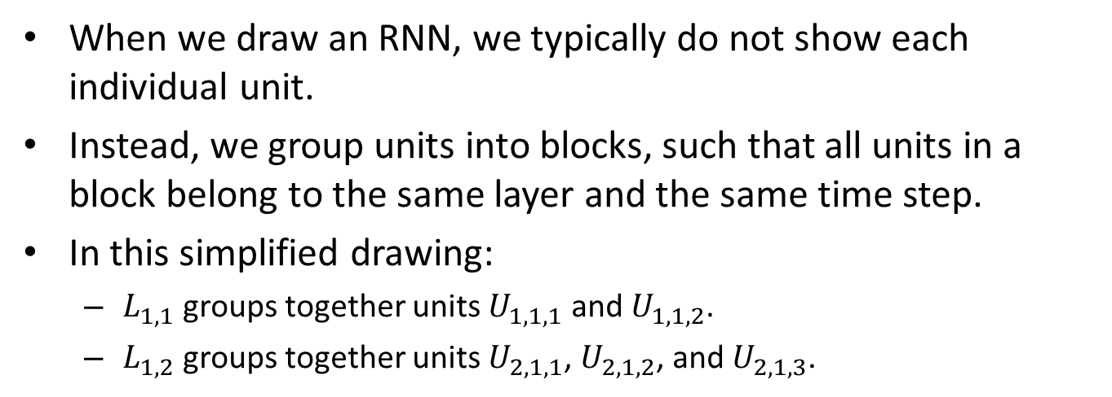






Simplifying the Drawings
When we draw an RNN, we typically do not show each individual unit.
Instead, we group units into blocks, such that all units in a block belong to the same layer and the same time step.
In this simplified drawing:
  $L_{1,1}$ groups together units $U_{1,1,1}$ and $U_{1,1,2}$.
  $L_{1,2}$ groups together units $U_{2,1,1}$, $U_{2,1,2}$, and $U_{2,1,3}$.
$$L_{1,2}$$
$$L_{2,2}$$
$$L_{3,2}$$
$$L_{1,1}$$
$$L_{2,1}$$
$$L_{3,1}$$
$$x_{1,1}$$
$$x_{1,2}$$
$$x_{2,1}$$
$$x_{2,2}$$
$$x_{3,1}$$
$$x_{3,2}$$

Slide 18
Simplifying the Drawings
Now that we have simplified the drawing, we can draw connections again.
An arrow means that all units of one group are connected to all units of the other group.
Of course, now it is not clear how many units are in each layer.
  When we simplify, some details are inevitably lost.
$$L_{1,2}$$
$$L_{2,2}$$
$$L_{3,2}$$
$$L_{1,1}$$
$$L_{2,1}$$
$$L_{3,1}$$
$$x_{1,1}$$
$$x_{1,2}$$
$$x_{2,1}$$
$$x_{2,2}$$
$$x_{3,1}$$
$$x_{3,2}$$

Slide 19
Simplifying the Drawings
We can always make up conventions to provide more information.
For example, here we show for each block:
  The type of layer that it belongs to.
  The number of units.
Recurrent(3)
Recurrent(3)
Recurrent(3)
Input(2)
Input(2)
Input(2)
$$x_{1,1}$$
$$x_{1,2}$$
$$x_{2,1}$$
$$x_{2,2}$$
$$x_{3,1}$$
$$x_{3,2}$$

Slide 20



Simplifying the Drawings
This is a common way to draw RNNs.
Since the structure at each time step looks the same, we just show three steps:
  “Previous”, “current”, and next”.
  Oftentimes more detail in shown in the current step.
SimpleRNN(3)
Input(2)
$$t−1$$
$$t$$
$$t+1$$

Slide 21
An RNN Network for Jena Climate
model = keras.Sequential([keras.Input(shape=input_shape),
keras.layers.SimpleRNN(16),
keras.layers.Dense(1),])
model.compile(optimizer="rmsprop", loss="mse", metrics=["mae"])
callbacks = [keras.callbacks.ModelCheckpoint("jena_LSTM1_16.keras",
save_best_only=True)]
history_lstm = model.fit(training_inputs, training_targets, epochs=20,
validation_data=(validation_inputs, validation_targets),
callbacks=callbacks)
This code trains a network with an RNN layer.

Slide 22
An RNN Network for Jena Climate
model = keras.Sequential([keras.Input(shape=input_shape),
keras.layers.SimpleRNN(16),
keras.layers.Dense(1),])
The highlighted line creates the recurrent layer.
  It has 16 units for each time step.
  There are 120 time steps (not shown in this drawing).
Recurrent(16)
Recurrent(16)
Recurrent(16)
Input(14)
Input(14)
Input(14)

Slide 23
An RNN Network for Jena Climate
model = keras.Sequential([keras.Input(shape=input_shape),
keras.layers.SimpleRNN(16),
keras.layers.Dense(1),])
We have a fully connected output layer.
This layer only connects to the recurrent
units of the LAST TIME STEP.
Dense(1)
Recurrent(16)
Recurrent(16)
Recurrent(16)
Input(14)
Input(14)
Input(14)

Slide 24
Detour: The return_sequences option
model = keras.Sequential([keras.Input(shape=input_shape),
keras.layers.SimpleRNN(16, return_sequences=False),
keras.layers.Dense(1),])
SimpleRNN layers have an option called return_sequences.
  The default value is False.
  This specifies that the output of the layer
  is just the output of the last time step.
Dense(1)
Recurrent(16)
Recurrent(16)
Recurrent(16)
Input(14)
Input(14)
Input(14)

Slide 25
Detour: The return_sequences option
model = keras.Sequential([keras.Input(shape=input_shape),
keras.layers.SimpleRNN(16, return_sequences=True),
keras.layers.Flatten(),
keras.layers.Dense(1),])
If return_sequences is true, the output of the layer is the output of all time steps.
Dense(1)
Recurrent(16)
Recurrent(16)
Recurrent(16)
Input(14)
Input(14)
Input(14)

Slide 26
Detour: The return_sequences option
model = keras.Sequential([keras.Input(shape=input_shape),
keras.layers.SimpleRNN(16, return_sequences=True),
keras.layers.Flatten(),
keras.layers.Dense(1),])
Note the flattening step in this case, between the SimpleRNN layer and the Dense layer.
Dense(1)
Recurrent(16)
Recurrent(16)
Recurrent(16)
Input(14)
Input(14)
Input(14)

Slide 27
Detour: The return_sequences option
model = keras.Sequential([keras.Input(shape=input_shape),
keras.layers.SimpleRNN(16, return_sequences=True),
keras.layers.Flatten(),
keras.layers.Dense(1),])
We will revisit the return_sequences=True option later.
  For temperature forecasting, it gives worse accuracy.
Dense(1)
Recurrent(16)
Recurrent(16)
Recurrent(16)
Input(14)
Input(14)
Input(14)

Slide 28



LSTM Layer
LSTM stands for Long Short-Term Memory.
Like SimpleRNN, an LSTM layer is a recurrent layer.
LSTM layers are used widely in practice.
However, the description of an LSTM layer is more complicated than that of a SimpleRNN layer.
  An LSTM layer produces a secondary output, shown in red. This is called the carry, and it is computed using some special rules.
LSTM(M)
Input(N)
$$t−1$$
$$t$$
$$t+1$$

Slide 29

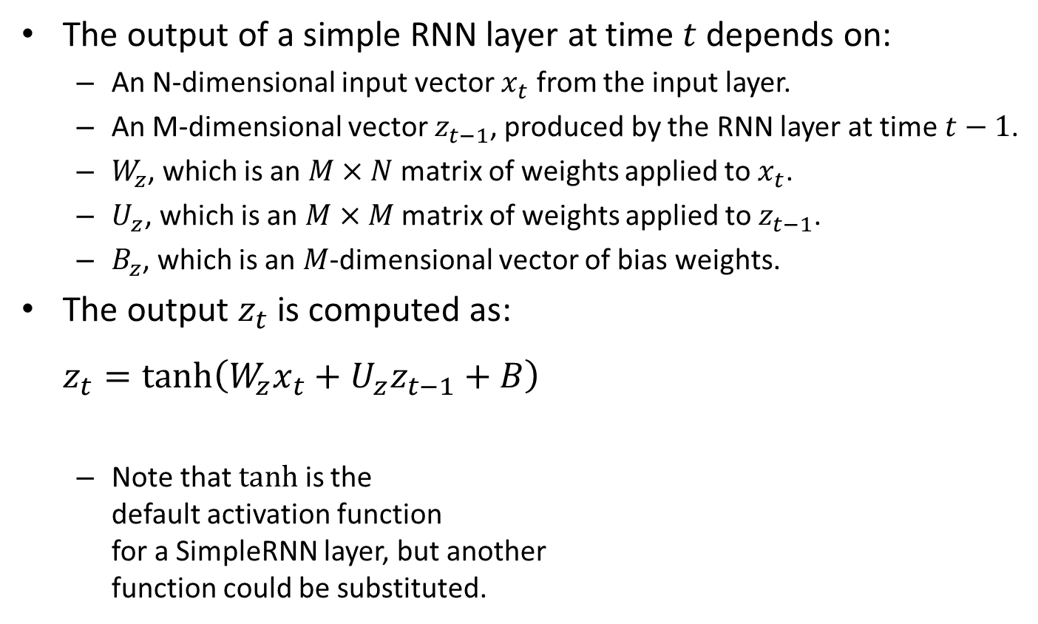



SimpleRNN Computations at Time t
The output of a simple RNN layer at time $t$ depends on:
  An N-dimensional input vector $x_{t}$ from the input layer.
  An M-dimensional vector $z_{t−1}$, produced by the RNN layer at time $t−1$.
  $W_{z}$, which is an $M×N$ matrix of weights applied to $x_{t}$.
  $U_{z}$, which is an $M×M$ matrix of weights applied to $z_{t−1}$.
  $B_{z}$, which is an $M$-dimensional vector of bias weights.
The output $z_{t}$ is computed as:
$z_{t}=tanh\left(W_{z}x_{t}+U_{z}z_{t−1}+B\right)$
  Note that $tanh$ is the
  default activation function
  for a SimpleRNN layer, but another
  function could be substituted.
$$z_{t}$$
$$z_{t−1}$$
SimpleRNN(M)
$$z_{t}$$
Input(N)
Time $t$

Slide 30



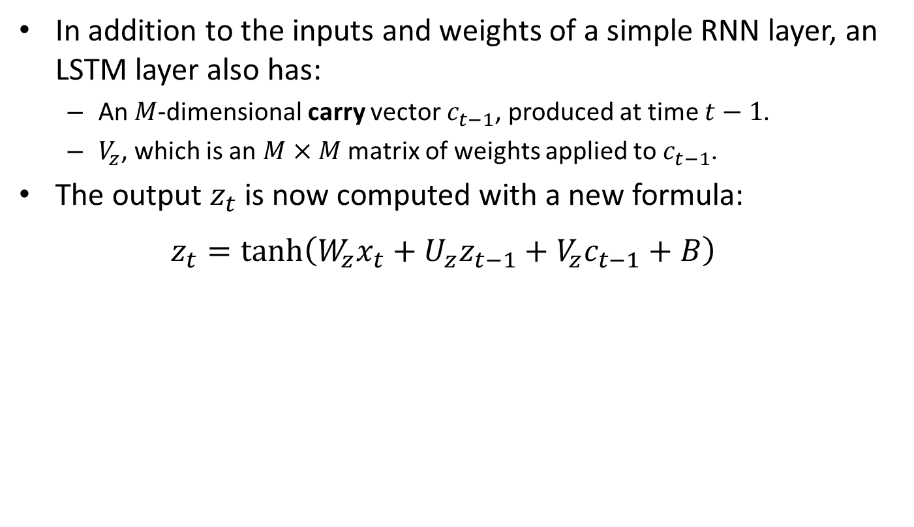


LSTM Computations at Time t
In addition to the inputs and weights of a simple RNN layer, an LSTM layer also has:
  An $M$-dimensional carry vector $c_{t−1}$, produced at time $t−1$.
  $V_{z}$, which is an $M×M$ matrix of weights applied to $c_{t−1}$.
The output $z_{t}$ is now computed with a new formula:
$z_{t}=tanh\left(W_{z}x_{t}+U_{z}z_{t−1}+V_{z}c_{t−1}+B\right)$
$$c_{t−1}$$
$$z_{t}$$
$$c_{t}$$
$$z_{t−1}$$
LSTM(M)
$$z_{t}$$
Input(N)
Time $t$

Slide 31
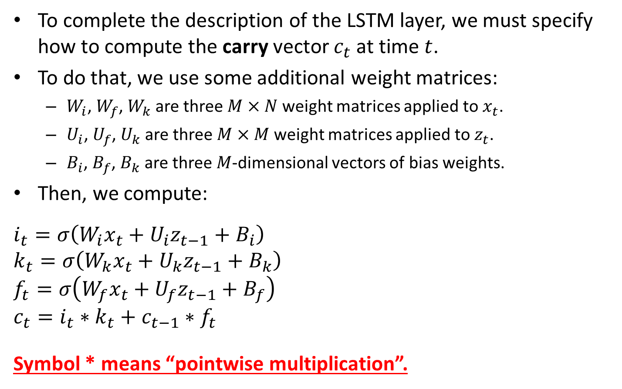
LSTM Computations at Time t
To complete the description of the LSTM layer, we must specify how to compute the carry vector $c_{t}$ at time $t$.
To do that, we use some additional weight matrices:
  $W_{i}$, $W_{f}$, $W_{k}$ are three $M×N$ weight matrices applied to $x_{t}$.
  $U_{i}$, $U_{f}$, $U_{k}$ are three $M×M$ weight matrices applied to $z_{t}$.
  $B_{i}$, $B_{f}$, $B_{k}$ are three $M$-dimensional vectors of bias weights.
Then, we compute:
$$i_{t}=σ\left(W_{i}x_{t}+U_{i}z_{t−1}+B_{i}\right)$$
$$k_{t}=σ\left(W_{k}x_{t}+U_{k}z_{t−1}+B_{k}\right)$$
$$f_{t}=σ\left(W_{f}x_{t}+U_{f}z_{t−1}+B_{f}\right)$$
$$c_{t}=i_{t}∗k_{t}+c_{t−1}∗f_{t}$$
Symbol * means “pointwise multiplication”.
$$c_{t−1}$$
$$z_{t}$$
$$c_{t}$$
$$z_{t−1}$$
LSTM(M)
$$z_{t}$$
Input(N)
Time $t$

Slide 32
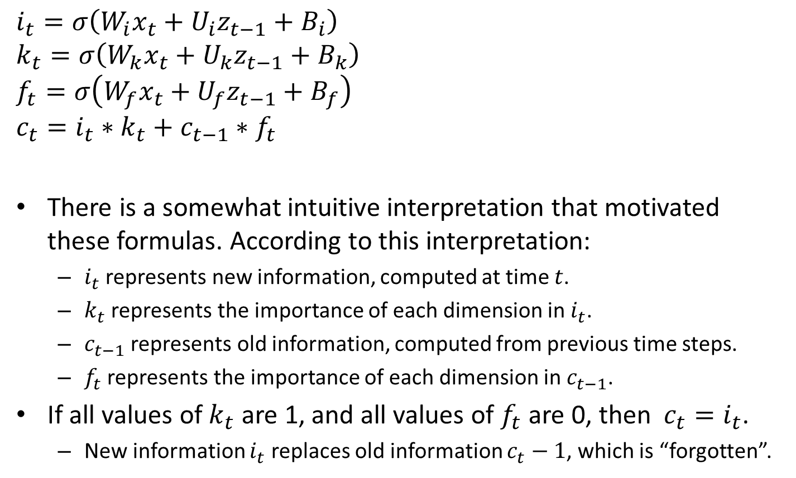
An Intuitive Interpetation
$$i_{t}=σ\left(W_{i}x_{t}+U_{i}z_{t−1}+B_{i}\right)$$
$$k_{t}=σ\left(W_{k}x_{t}+U_{k}z_{t−1}+B_{k}\right)$$
$$f_{t}=σ\left(W_{f}x_{t}+U_{f}z_{t−1}+B_{f}\right)$$
$$c_{t}=i_{t}∗k_{t}+c_{t−1}∗f_{t}$$
There is a somewhat intuitive interpretation that motivated these formulas. According to this interpretation:
  $i_{t}$ represents new information, computed at time $t$.
  $k_{t}$ represents the importance of each dimension in $i_{t}$.
  $c_{t−1}$ represents old information, computed from previous time steps.
  $f_{t}$ represents the importance of each dimension in $c_{t−1}$.
If all values of $k_{t}$ are 1, and all values of $f_{t}$ are 0, then $c_{t}=i_{t}$.
  New information $i_{t}$ replaces old information $c_{t}−1$, which is “forgotten”.

Slide 33
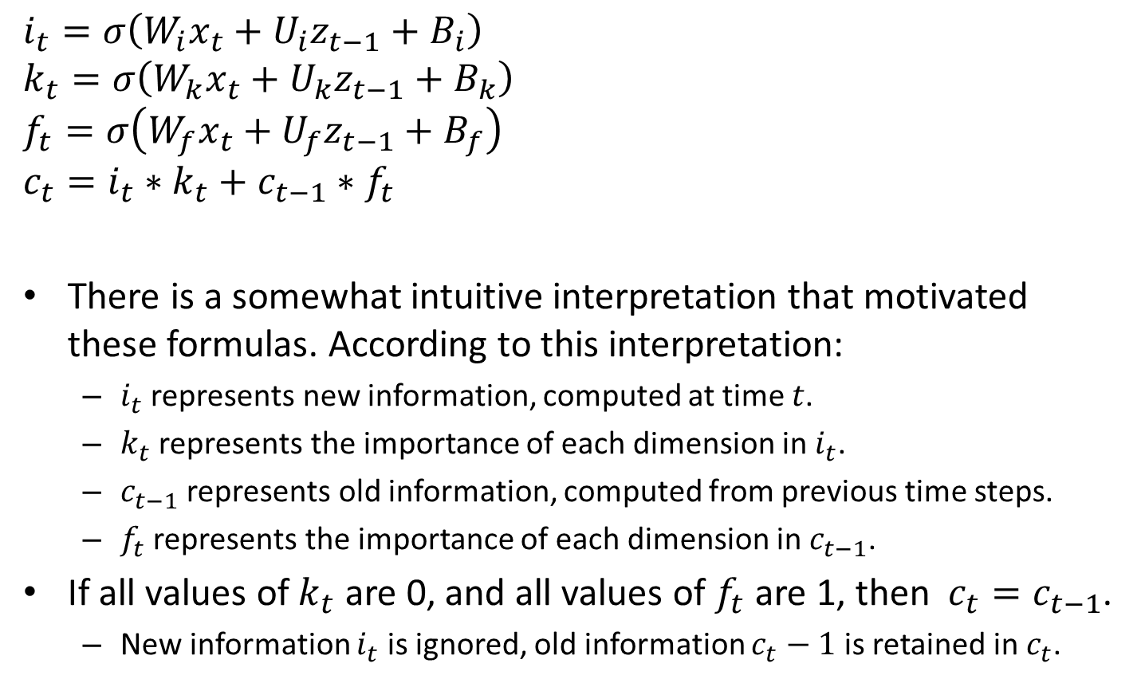
An Intuitive Interpetation
$$i_{t}=σ\left(W_{i}x_{t}+U_{i}z_{t−1}+B_{i}\right)$$
$$k_{t}=σ\left(W_{k}x_{t}+U_{k}z_{t−1}+B_{k}\right)$$
$$f_{t}=σ\left(W_{f}x_{t}+U_{f}z_{t−1}+B_{f}\right)$$
$$c_{t}=i_{t}∗k_{t}+c_{t−1}∗f_{t}$$
There is a somewhat intuitive interpretation that motivated these formulas. According to this interpretation:
  $i_{t}$ represents new information, computed at time $t$.
  $k_{t}$ represents the importance of each dimension in $i_{t}$.
  $c_{t−1}$ represents old information, computed from previous time steps.
  $f_{t}$ represents the importance of each dimension in $c_{t−1}$.
If all values of $k_{t}$ are 0, and all values of $f_{t}$ are 1, then $c_{t}=c_{t−1}$.
  New information $i_{t}$ is ignored, old information $c_{t}−1$ is retained in $c_{t}$.

Slide 34
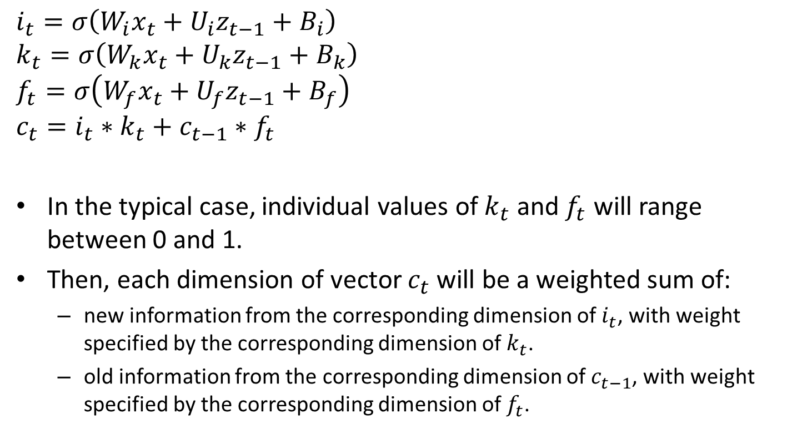
An Intuitive Interpetation
$$i_{t}=σ\left(W_{i}x_{t}+U_{i}z_{t−1}+B_{i}\right)$$
$$k_{t}=σ\left(W_{k}x_{t}+U_{k}z_{t−1}+B_{k}\right)$$
$$f_{t}=σ\left(W_{f}x_{t}+U_{f}z_{t−1}+B_{f}\right)$$
$$c_{t}=i_{t}∗k_{t}+c_{t−1}∗f_{t}$$
In the typical case, individual values of $k_{t}$ and $f_{t}$ will range between 0 and 1.
Then, each dimension of vector $c_{t}$ will be a weighted sum of:
  new information from the corresponding dimension of $i_{t}$, with weight specified by the corresponding dimension of $k_{t}$.
  old information from the corresponding dimension of $c_{t−1}$, with weight specified by the corresponding dimension of $f_{t}$.

Slide 35
The Vanishing Gradient Problem
An additional justification for the LSTM architecture is the “vanishing gradient” problem.
  Under some neural network architectures, some weights do not get sufficiently updated during backpropagation, due to very small gradients.
  Consequently, backpropagation does not learn good values for those weights.
$$z_{2,1}$$
$$z_{2,2}$$
$$z_{2,3}$$
$$u_{2,1}$$
$$u_{2,1}$$
$$U_{2,1}$$
$$U_{2,2}$$
$$U_{2,3}$$
$$w_{2,1,1}$$
$$w_{2,1,2}$$
$$w_{2,1,1}$$
$$w_{2,1,2}$$
$$w_{2,1,1}$$
$$w_{2,1,2}$$
$$U_{1,1,1}$$
$$U_{1,1,2}$$
$$U_{1,2,1}$$
$$U_{1,2,2}$$
$$U_{1,3,1}$$
$$U_{1,3,2}$$
$$x_{1,1}$$
$$x_{1,2}$$
$$x_{2,1}$$
$$x_{2,2}$$
$$x_{3,1}$$
$$x_{3,2}$$

Slide 36

The Vanishing Gradient Problem
To understand the problem, consider the toy RNN model below.
  Let’s assume that the only output of the model is $z_{2,3}$, so that the model estimates a single number.
  Consider how weight $w_{2,1,1}$ (as an example) gets updated during training.
$$z_{2,1}$$
$$z_{2,2}$$
$$z_{2,3}$$
$$u_{2,1}$$
$$u_{2,1}$$
$$U_{2,1}$$
$$U_{2,2}$$
$$U_{2,3}$$
$$w_{2,1,1}$$
$$w_{2,1,2}$$
$$w_{2,1,1}$$
$$w_{2,1,2}$$
$$w_{2,1,1}$$
$$w_{2,1,2}$$
$$U_{1,1,1}$$
$$U_{1,1,2}$$
$$U_{1,2,1}$$
$$U_{1,2,2}$$
$$U_{1,3,1}$$
$$U_{1,3,2}$$
$$x_{1,1}$$
$$x_{1,2}$$
$$x_{2,1}$$
$$x_{2,2}$$
$$x_{3,1}$$
$$x_{3,2}$$

Slide 37

The Vanishing Gradient Problem
Weight $w_{2,1,1}$ influences the output in multiple ways.
  It gets multiplied by input $x_{1,1}$ during the first time step.
  It gets multiplied by input $x_{2,1}$ during the second time step.
  It gets multiplied by input $x_{3,1}$ during the third time step.
$$z_{2,1}$$
$$z_{2,2}$$
$$z_{2,3}$$
$$u_{2,1}$$
$$u_{2,1}$$
$$U_{2,1}$$
$$U_{2,2}$$
$$U_{2,3}$$
$$w_{2,1,1}$$
$$w_{2,1,2}$$
$$w_{2,1,1}$$
$$w_{2,1,2}$$
$$w_{2,1,1}$$
$$w_{2,1,2}$$
$$U_{1,1,1}$$
$$U_{1,1,2}$$
$$U_{1,2,1}$$
$$U_{1,2,2}$$
$$U_{1,3,1}$$
$$U_{1,3,2}$$
$$x_{1,1}$$
$$x_{1,2}$$
$$x_{2,1}$$
$$x_{2,2}$$
$$x_{3,1}$$
$$x_{3,2}$$

Slide 38

The Vanishing Gradient Problem
During backpropagation, we update $w_{2,1,1}$ based on the three different ways in which it influenced the output.
However, the third time step will often influence disproportionately how $w_{2,1,1}$ is updated.
Why?
$$z_{2,1}$$
$$z_{2,2}$$
$$z_{2,3}$$
$$u_{2,1}$$
$$u_{2,1}$$
$$U_{2,1}$$
$$U_{2,2}$$
$$U_{2,3}$$
$$w_{2,1,1}$$
$$w_{2,1,2}$$
$$w_{2,1,1}$$
$$w_{2,1,2}$$
$$w_{2,1,1}$$
$$w_{2,1,2}$$
$$U_{1,1,1}$$
$$U_{1,1,2}$$
$$U_{1,2,1}$$
$$U_{1,2,2}$$
$$U_{1,3,1}$$
$$U_{1,3,2}$$
$$x_{1,1}$$
$$x_{1,2}$$
$$x_{2,1}$$
$$x_{2,2}$$
$$x_{3,1}$$
$$x_{3,2}$$

Slide 39

The Vanishing Gradient Problem
$$\frac{∂E}{∂w_{2,1,1}}=\frac{∂E}{∂z_{2,3}}\frac{∂z_{2,3}}{∂a_{2,3}}\frac{∂a_{2,3}}{∂w_{2,1,1}}$$
We start by applying the chain rule to compute the partial derivative of the loss $E$ with respect to $w_{2,1,1}$.
$$z_{2,1}$$
$$z_{2,2}$$
$$z_{2,3}$$
$$u_{2,1}$$
$$u_{2,1}$$
$$U_{2,1}$$
$$U_{2,2}$$
$$U_{2,3}$$
$$w_{2,1,1}$$
$$w_{2,1,2}$$
$$w_{2,1,1}$$
$$w_{2,1,2}$$
$$w_{2,1,1}$$
$$w_{2,1,2}$$
$$U_{1,1,1}$$
$$U_{1,1,2}$$
$$U_{1,2,1}$$
$$U_{1,2,2}$$
$$U_{1,3,1}$$
$$U_{1,3,2}$$
$$x_{1,1}$$
$$x_{1,2}$$
$$x_{2,1}$$
$$x_{2,2}$$
$$x_{3,1}$$
$$x_{3,2}$$

Slide 40

The Vanishing Gradient Problem
$$\frac{∂a_{2,3}}{∂w_{2,1,1}}=x_{3,1}+\frac{∂a_{2,3}}{∂z_{2,2}}\frac{∂z_{2,2}}{∂a_{2,2}}\frac{∂a_{2,2}}{∂w_{2,1,1}}$$
$$=x_{3,1}+\frac{∂a_{2,3}}{∂z_{2,2}}\frac{∂z_{2,2}}{∂a_{2,2}}\left(x_{2,1}+\frac{∂a_{2,2}}{∂z_{2,1}}\frac{∂z_{2,1}}{∂a_{2,1}}\frac{∂a_{2,1}}{∂w_{2,1,1}}\right)$$
$$z_{2,1}$$
$$z_{2,2}$$
$$z_{2,3}$$
$$u_{2,1}$$
$$u_{2,1}$$
$$U_{2,1}$$
$$U_{2,2}$$
$$U_{2,3}$$
$$w_{2,1,1}$$
$$w_{2,1,2}$$
$$w_{2,1,1}$$
$$w_{2,1,2}$$
$$w_{2,1,1}$$
$$w_{2,1,2}$$
$$U_{1,1,1}$$
$$U_{1,1,2}$$
$$U_{1,2,1}$$
$$U_{1,2,2}$$
$$U_{1,3,1}$$
$$U_{1,3,2}$$
$$x_{1,1}$$
$$x_{1,2}$$
$$x_{2,1}$$
$$x_{2,2}$$
$$x_{3,1}$$
$$x_{3,2}$$

Slide 41
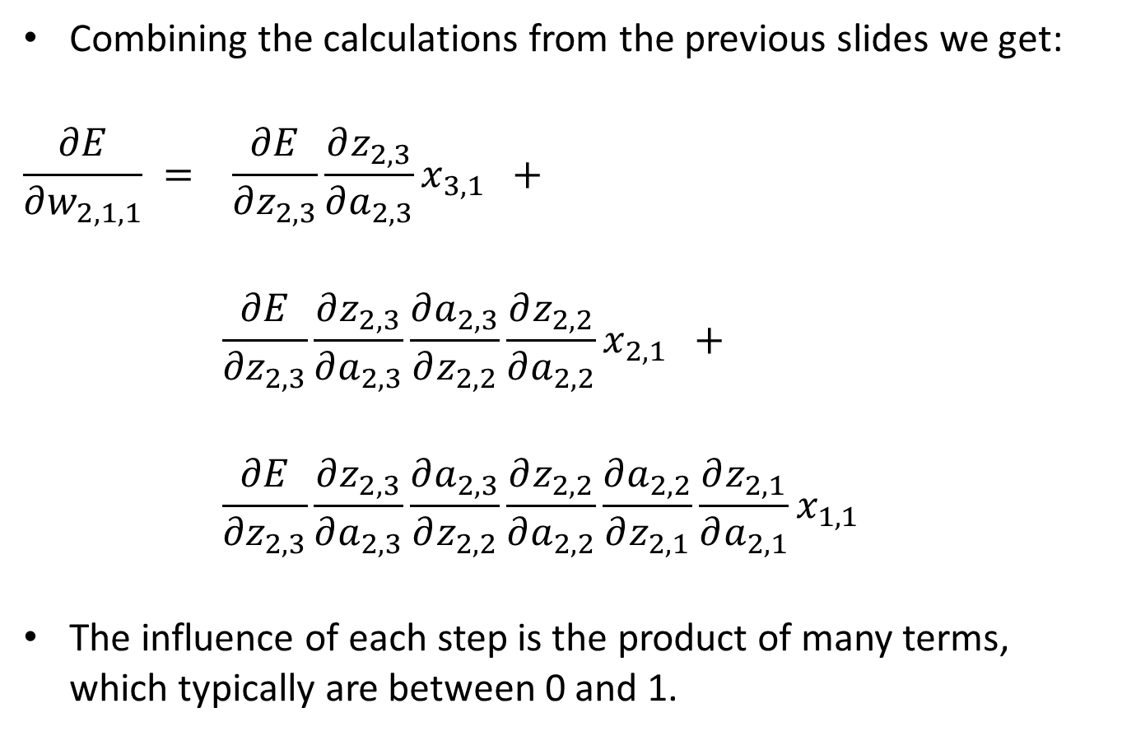
The Vanishing Gradient Problem
Combining the calculations from the previous slides we get:
$$\frac{∂E}{∂w_{2,1,1}} = \frac{∂E}{∂z_{2,3}}\frac{∂z_{2,3}}{∂a_{2,3}}x_{3,1} +$$
$$\frac{∂E}{∂z_{2,3}}\frac{∂z_{2,3}}{∂a_{2,3}}\frac{∂a_{2,3}}{∂z_{2,2}}\frac{∂z_{2,2}}{∂a_{2,2}}x_{2,1} +$$
$$\frac{∂E}{∂z_{2,3}}\frac{∂z_{2,3}}{∂a_{2,3}}\frac{∂a_{2,3}}{∂z_{2,2}}\frac{∂z_{2,2}}{∂a_{2,2}}\frac{∂a_{2,2}}{∂z_{2,1}}\frac{∂z_{2,1}}{∂a_{2,1}}x_{1,1}$$
The influence of each step is the product of many terms, which typically are between 0 and 1.
Influence of 3rd time step: product of 3 numbers.
Influence of 2nd time step: product of 5 numbers.
Influence of 3rd time step: product of 7 numbers.

Slide 42
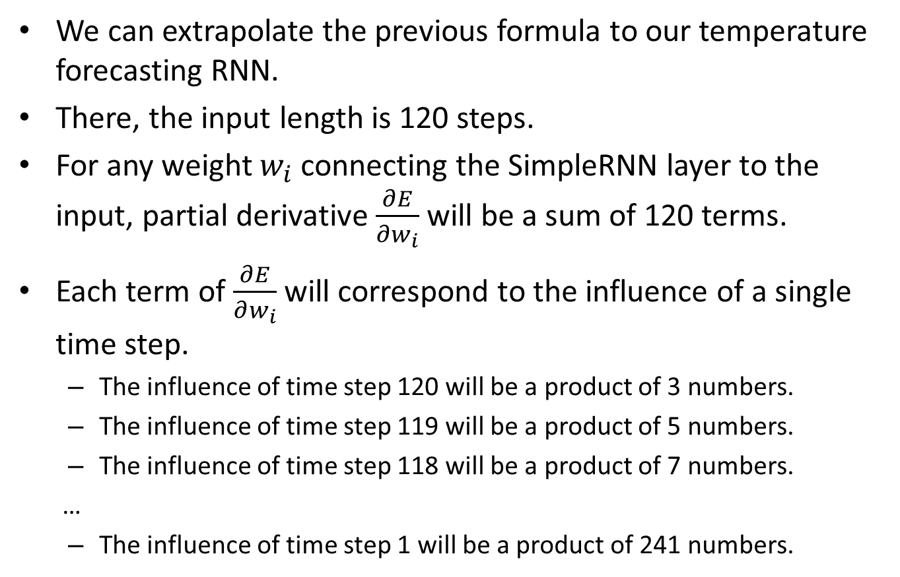
The Vanishing Gradient Problem
We can extrapolate the previous formula to our temperature forecasting RNN.
There, the input length is 120 steps.
For any weight $w_{i}$ connecting the SimpleRNN layer to the input, partial derivative $\frac{∂E}{∂w_{i}}$ will be a sum of 120 terms.
Each term of $\frac{∂E}{∂w_{i}}$ will correspond to the influence of a single time step.
  The influence of time step 120 will be a product of 3 numbers.
  The influence of time step 119 will be a product of 5 numbers.
  The influence of time step 118 will be a product of 7 numbers.
  …
  The influence of time step 1 will be a product of 241 numbers.

Slide 43
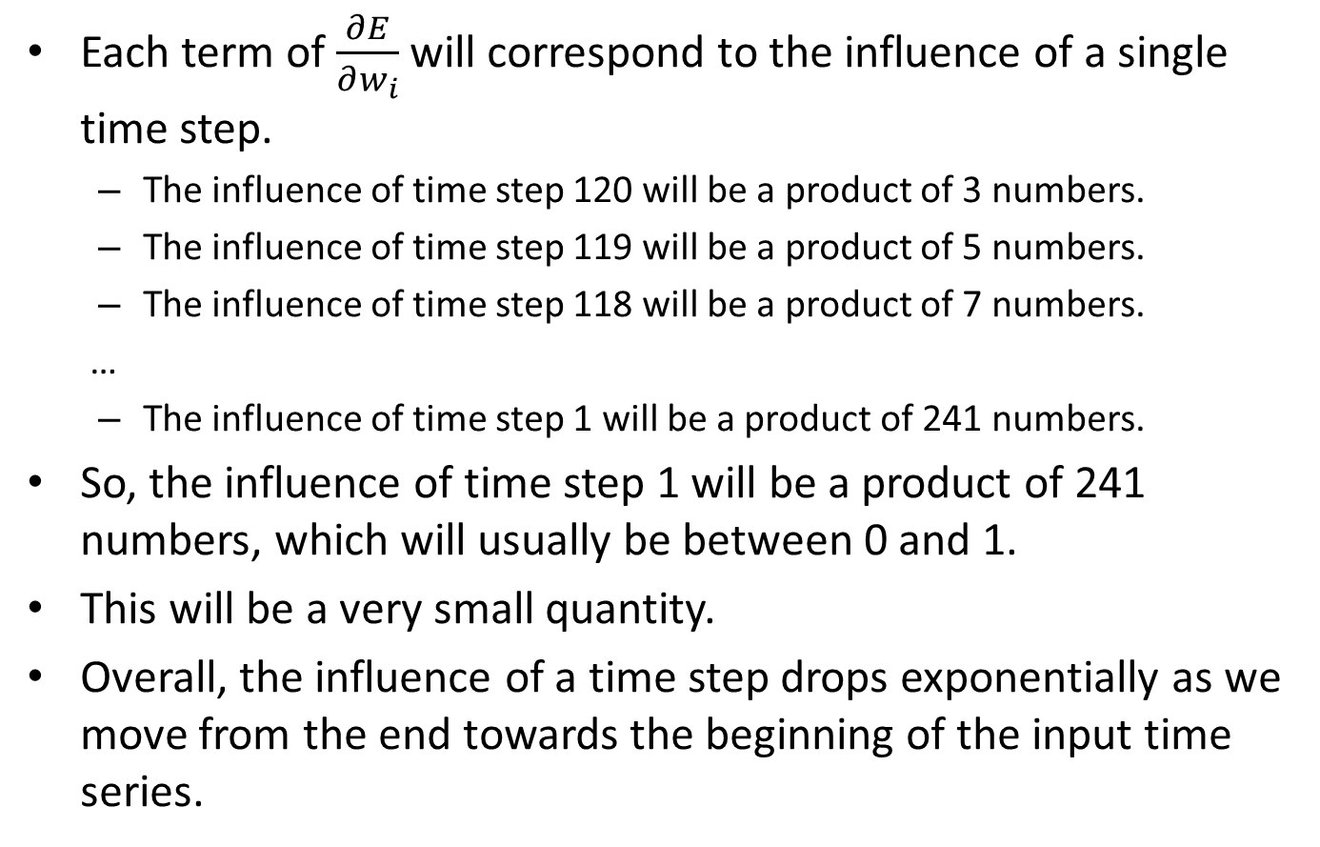
The Vanishing Gradient Problem
Each term of $\frac{∂E}{∂w_{i}}$ will correspond to the influence of a single time step.
  The influence of time step 120 will be a product of 3 numbers.
  The influence of time step 119 will be a product of 5 numbers.
  The influence of time step 118 will be a product of 7 numbers.
  …
  The influence of time step 1 will be a product of 241 numbers.
So, the influence of time step 1 will be a product of 241 numbers, which will usually be between 0 and 1.
This will be a very small quantity.
Overall, the influence of a time step drops exponentially as we move from the end towards the beginning of the input time series.

Slide 44
LSTMs and Vanishing Gradients
The carry output can (potentially) remember information from earlier time steps.
This allows calculations from earlier time steps to influence the output more heavily than in a SimpleRNN layer.
  Influencing the output more heavily means higher contributions to the partial derivatives of weights.
  That way, the model can learn to give more importance to earlier time steps.
LSTM(M)
Input(N)
$$t−1$$
$$t$$
$$t+1$$

Slide 45
Detour: ResNet
The vanishing gradient problem is not particular to RNNs.
Any deep network involves a sequence of calculations, mapping inputs to outputs.
  Calculations earlier in the sequence end up making smaller contributions to partial derivatives of weights.
For convolutional neural networks (CNNs), a popular method for resolving the vanishing gradient problem is ResNet.
We will not discuss ResNet in this class.
  The method is somewhat similar to LSTM, by providing a way for earlier calculations to be “remembered” in later layers.
If you are interested in learning more about ResNet, a good starting point is the Wikipedia article:
https://en.wikipedia.org/wiki/Residual_neural_network

Slide 46
GRU
GRU stands for Gated Recurrent Unit.
GRU layers are yet another type of recurrent layer.
GRU layers can be used instead of SimpleRNN or LSTM.
You can think of a GRU layer as an approach that is more complicated than a SimpleRNN layer and more simple than an LSTM layer.
We will not discuss GRU layers any further in this class.
As usual, the Wikipedia article is a good starting point for more info:
https://en.wikipedia.org/wiki/Gated_recurrent_unit

Slide 47
Recurrent Dropout
Dropout can be used with recurrent layers (such as SimpleRNN, LSTM, GRU).
However, the picture is more complicated, because the same weights are used in multiple time steps.
In practice, better results are usually obtained if the same weights are “dropped” at each time step.
A normal Keras dropout layer does not know how to do that.
To use dropout properly with recurrent layers, you should use the optional parameters dropout and recurrent_dropout.

Slide 48
Recurrent Dropout
model = keras.Sequential([keras.Input(shape=input_shape),
keras.layers.LSTM(32, dropout=0.3, recurrent_dropout=0.25),
keras.layers.Dropout(0.5),
keras.layers.Dense(1),])
This piece of code shows an example of how to combine different dropouts.
The LSTM layer specifies a dropout value of 0.3.
  This means that 30% of the weights between the input layer and the LSTM layer will be dropped for each training object.
The LSTM layer specifies a recurrent_dropout value of 0.25.
  This means that 25% of the weights applied to outputs and carry values from the previous time step will be dropped for each training object.

Slide 49
Recurrent Dropout
model = keras.Sequential([keras.Input(shape=input_shape),
keras.layers.LSTM(32, dropout=0.3, recurrent_dropout=0.25),
keras.layers.Dropout(0.5),
keras.layers.Dense(1),])
Notice that we still use a regular Keras dropout layer between the LSTM layer and the fully connected output layer.
  Here we specify that, for each training object, 50% of the weights connecting the LSTM outputs to the Dense layer will be dropped.
Optional parameters dropout and recurrent_dropout specify how to do dropout of weights incoming to the recurrent layer.
For weights outgoing from the layer and incoming to a fully connected layer, a regular dropout layer should be used.

Slide 50
Bidirectional Layers
A recurrent layer processes information from time step to time step, in chronological order.
Would it make a difference if information was processed in reverse chronological order?
  It might.
How can we know which order is better?
  We usually don’t.
Recurrent
Input
$$t−1$$
$$t$$
$$t+1$$

Slide 51


















Bidirectional Layers
A bidirectional layer processes information in both chronological and anti-chronological order.
Essentially, a bidirectional layer consists of two recurrent layers, each processing information in different order.
The output of the bidirectional layer is simply the merged output of both layers.
$$z_{1}$$
$$z_{2}$$
$$z_{3}$$
$$z_{4}$$
$$z_{5}$$
$$z_{6}$$
$$x_{1}$$
$$x_{2}$$
$$x_{3}$$
$$x_{1}$$
$$x_{2}$$
$$x_{3}$$
$$t=1$$
$$t=2$$
$$t=3$$
$$t=1$$
$$t=2$$
$$t=3$$

Slide 52


















Recurrent layer (SimpleRNN, LSTM, GRU) processing information in chronological order.
Recurrent layer (SimpleRNN, LSTM, GRU) processing information in REVERSE chronological order.
$$z_{1}$$
$$z_{2}$$
$$z_{3}$$
$$z_{4}$$
$$z_{5}$$
$$z_{6}$$
$$x_{1}$$
$$x_{2}$$
$$x_{3}$$
$$x_{1}$$
$$x_{2}$$
$$x_{3}$$
$$t=1$$
$$t=2$$
$$t=3$$
$$t=1$$
$$t=2$$
$$t=3$$

Slide 53
Recurrent layer (SimpleRNN, LSTM, GRU) processing information in chronological order.
Recurrent layer (SimpleRNN, LSTM, GRU) processing information in REVERSE chronological order.
$$z_{1}$$
$$z_{2}$$
$$z_{3}$$
$$z_{4}$$
$$z_{5}$$
$$z_{6}$$
$$x_{1}$$
$$x_{2}$$
$$x_{3}$$
Both layers receive the exact same inputs.
$$x_{1}$$
$$x_{2}$$
$$x_{3}$$
$$t=1$$
$$t=2$$
$$t=3$$
$$t=1$$
$$t=2$$
$$t=3$$

Slide 54
These two recurrent layers, combined, form what we call a bidirectional layer.
$$z_{1}$$
$$z_{2}$$
$$z_{3}$$
$$z_{4}$$
$$z_{5}$$
$$z_{6}$$
$$x_{1}$$
$$x_{2}$$
$$x_{3}$$
$$x_{1}$$
$$x_{2}$$
$$x_{3}$$
$$t=1$$
$$t=2$$
$$t=3$$
$$t=1$$
$$t=2$$
$$t=3$$

Slide 55
The output of the bidirectional layer is the concatenation of the outputs of the two recurrent layers.
$$z_{1}$$
$$z_{2}$$
$$z_{3}$$
$$z_{4}$$
$$z_{5}$$
$$z_{6}$$
$$x_{1}$$
$$x_{2}$$
$$x_{3}$$
$$x_{1}$$
$$x_{2}$$
$$x_{3}$$
$$t=1$$
$$t=2$$
$$t=3$$
$$t=1$$
$$t=2$$
$$t=3$$

Slide 56
Bidirectional Layers in Keras
model = keras.Sequential([keras.Input(shape=input_shape),
keras.layers.Bidirectional(keras.layers.LSTM(32)),
keras.layers.Dense(1),])
The Bidirectional layer takes as argument a recurrent layer.
The Bidirectional layer creates two replicas of the recurrent layer.
  The first replica processes information in chronological order.
  The second replica processes information in antichronological order.
The output of the Bidirectional layer is the concatenated output of the two replicas.

Slide 57
RNN Summary
Recurrent layers process information one time step at a time.
The most simple recurrent layer is SimpleRNN.
The LSTM layer is a more complicated recurrent layer, that allows the model to learn when to remember old information and when to replace that “memory” with new information.
Recurrent dropout must be handled differently than regular dropout, using optional parameters when creating the recurrent layers.
  dropout for weights connecting the previous layer to the recurrent layer.
  recurrent_dropout for weights connecting outputs of the recurrent layer from previous time to the current time step.
Bidirectional layers allow processing information both in chronological and in antichronological order.

