Slide 1
Processing Text with Neural Networks
CSE 4311 – Neural Networks and Deep Learning
Vassilis Athitsos
Computer Science and Engineering Department
University of Texas at Arlington

Slide 2
An Example of Text Classification
Input: the following text, containing a movie review.
“From the beginning of the movie, it gives the feeling the director is trying to portray something, what I mean to say that instead of the story dictating the style in which the movie should be made, he has gone in the opposite way, he had a type of move that he wanted to make, and wrote a story to suite it. And he has failed in it very badly. I guess he was trying to make a stylish movie. Any way I think this movie is a total waste of time and effort. In the credit of the director, he knows the media that he is working with, what I am trying to say is I have seen worst movies than this. Here at least the director knows to maintain the continuity in the movie. And the actors also have given a decent performance.”
Output: Is this a positive review or negative review?
Classification problem, two classes: “positive” and “negative”.
The correct answer here is “negative”.

Slide 3
An Example of Text Classification
Here is an example of a positive review:
“Very good drama although it appeared to have a few blank areas leaving the viewers to fill in the action for themselves. I can imagine life being this way for someone who can neither read nor write. This film simply smacked of the real world: the wife who is suddenly the sole supporter, the live-in relatives and their quarrels, the troubled child who gets knocked up and then, typically, drops out of school, a jackass husband who takes the nest egg and buys beer with it. 2 thumbs up.”
These examples were taken from the Large Movie Review Dataset. 25,000 IMDB reviews for training, 25,000 for testing.
Andrew L. Maas, Raymond E. Daly, Peter T. Pham, Dan Huang, Andrew Y. Ng, and Christopher Potts. (2011). Learning Word Vectors for Sentiment Analysis. The 49th Annual Meeting of the Association for Computational Linguistics (ACL 2011).
https://ai.stanford.edu/~amaas/data/sentiment/

Slide 4
An Example of Language Translation
Dataset: an English-to-Spanish translation dataset available here: www.manythings.org/anki/
Example input:
"Soccer is more popular than tennis."
Target output:
"[start] El fútbol es más popular que el tenis. [end]“
Translation is different than other learning problems we have seen.
It cannot be treated either as a classification or a regression problem.
The goal is to map a sequence of tokens to another sequence of tokens. This problem is called sequence-to-sequence translation.

Slide 5
Other Text Processing Tasks
Complete a sentence by filling in the blanks.
Input: sentence with blanks.
Output: completed sentence.
Summarize a news article (sequence-to-sequence translation).
Input: the text from a news article.
Output: a summary of that text.
Process some text and answer reading comprehension questions about that text.
Input: the text and a set of questions.
Output: answers to the questions.
For our class, we will focus on the first two problems we saw:
Classification of reviews as “positive” or “negative”.
Translating from English text to Spanish text.

Slide 6
Text Vectorization
Neural Networks work with numbers, not text.
To use text as input to a neural network, we have to vectorize the text:
Map the text to an input vector for the neural network.
Alternatively, map the text to a time series (sequence of vectors), that can be processed by an RNN.
Similarly, to generate text using a neural network (which we need to do for English-to-Spanish translation), we need to de-vectorize the network output, and convert it to text.

Slide 7
Steps in Text Vectorization
Text standardization.
Removing variability of words, using manual rules such as converting upper case to lower case, removing punctuation symbols, etc.
Text tokenization.
Converting the text into a sequence of distinct tokens.
We get to choose if each token is a character, a part of a word, a word, or a sequence of multiple words.
Vocabulary indexing.
Mapping each token to an integer.
We will see each step in more detail.

Slide 8
Text Standardization
This is an example from Chapter 11 of the book “Deep Learning with Python”, Second Edition, 2021, by François Chollet.
Consider these two sentences:
“sunset came. i was staring at the Mexico sky. Isnt nature splendid??”
“Sunset came; I stared at the México sky. Isn’t nature splendid?”
The meaning of the two sentences is more or less the same.
The second may be more correct grammatically, but the meaning of the first sentence is clear despite the grammar mistakes.
However, as binary representations (sequences of ASCII codes) the two sentences are different.
A neural network does not have the prior knowledge that English speakers have, to understand that these two sentences are similar.

Slide 9
Text Standardization
“sunset came. i was staring at the Mexico sky. Isnt nature splendid??”
“Sunset came; I stared at the México sky. Isn’t nature splendid?”
Text standardization is a manual preprocessing step (you can also call it a “feature engineering” step).
The goal is “standardize” each sentence, in a way that reduces the differences between sentences that have the same meaning.
This way, the neural network model does not have to learn to account for those differences.
The easier we make the learning task, the better accuracy we should expect to get after training.

Slide 10
Standardization Steps
“sunset came. i was staring at the Mexico sky. Isnt nature splendid??”
“Sunset came; I stared at the México sky. Isn’t nature splendid?”
As a system designer, you get to decide what rules to apply.
Some commonly used ones:
Map upper case to lower case.
Remove punctuation.
Convert special characters (like “é” in “México”) to standard forms. For example, we can map “é” to “e”, so that “México” becomes “Mexico”.
Applying these three rules, the two sentences become:
“sunset came i was staring at the mexico sky isnt nature splendid”
“sunset came I stared at the mexico sky isnt nature splendid”
Any comments about these “standardization” rules?

Slide 11
Standardization Steps
“sunset came. i was staring at the Mexico sky. Isnt nature splendid??”
“Sunset came; I stared at the México sky. Isn’t nature splendid?”
After our “standardization”, the two sentences become:
“sunset came i was staring at the mexico sky isnt nature splendid”
“sunset came I stared at the mexico sky isnt nature splendid”
Some standardization rules may hurt accuracy.
In this case: is it a good idea to remove periods and question marks? They may have useful information.
As is often the case in machine learning, the best way to resolve this question is to try both ways and see which one gives the best results.

Slide 12
Standardization: Stemming
Stemming means converting variations of a term (such as a verb or noun) into a standard form.
“mouse”, “mouse’s”, “mice” would all map to [mouse].
“go”, “goes”, “is going”, “went”, “has gone” would all map to [go].
Our original sentences were:
“sunset came. i was staring at the Mexico sky. Isnt nature splendid??”
“Sunset came; I stared at the México sky. Isn’t nature splendid?”
Combining stemming with the previous standardization steps, both sentences map to the same “standardized” sentence:
“sunset [come] i [stare] at the mexico sky [be] [not] nature splendid”

Slide 13
Standardization: Stemming
Our original sentences were:
“sunset came. i was staring at the Mexico sky. Isnt nature splendid??”
“Sunset came; I stared at the México sky. Isn’t nature splendid?”
Combining stemming with the previous standardization steps, both sentences map to the same “standardized” sentence:
“sunset [come] i [stare] at the mexico sky [be] [not] nature splendid”
Stemming can help or hurt accuracy, depending on the dataset.
Stemming provides additional simplification of the learning problem.
Stemming throws away information that may or may not be useful. For example, verb tenses may not be important in classifying a review as positive or negative, but they are important for translation to Spanish.

Slide 14
Tokenization
A piece of text is a sequence.
However, to fully implement a text processing model, we need to answer this question: text is a sequence of what?
Tokenization converts the input text into a sequence of tokens. We get to decide what a token should be.
At one extreme, each token is a character.
Then, we view the text as a sequence of characters.
This is a rare approach, it typically does not give good results.
We can also have each token be a word.
Then, the text is a sequence of words.
We can have each token be part of a word, for example separating “going” into token [go] and token [ing].
This is more challenging to do correctly, but it can be useful.

Slide 15
Tokenization: N-Grams
For our purposes, an N-gram is a sequence of N consecutive words.
In other applications, an N-gram can be a sequence of N consecutive letters, or N consecutive items of some other type.
We can choose to use N-grams for tokenization.
Most often we use 2-grams (bigrams) or 3-grams (trigrams).
Keras has predefined methods for text tokenization. We can specify if we want those methods to use words or N-grams as tokens.
We will see sample code in a bit.

Slide 16
N-Grams in Keras
In Keras, if we use N-grams, it will create a token for each sequence of consecutive words with length up to length N, as opposed to just length N.
For example: suppose that our standardized text is:
“it is a beautiful day”
If we use 2-gram (bigram) tokenization, then Keras produces the token sequence on the right:
We get a token for each word (word sequence of length 1).
We get a token for each sequence of two consecutive words.
("it",
"is",
"a",
"beautiful",
"day",
"it is",
"is a",
"a beautiful",
"beautiful day")

Slide 17
A Trigram Example
With the same standardized text:
“it is a beautiful day”
If we use 3-gram (trigram) tokenization, then Keras produces the token sequence on the right:
We get a token for each word (word sequence of length 1).
We get a token for each sequence of two consecutive words.
We get a token for each sequence of three consecutive words.
("it",
"is",
"a",
"beautiful",
"day",
"it is",
"is a",
"a beautiful",
"beautiful day",
"it is a",
"is a beautiful",
"a beautiful day“)

Slide 18
Computing the Vocabulary
Given a text dataset, the vocabulary is the list of all unique tokens in that dataset.
Note that if we use N-grams, the vocabulary contains sequences of words in addition to individual words.
For example: Here is a dataset consisting of these sentences:
"It is a beautiful day"
"The sun is shining"
"The weather is a bit warmer"
If we use words as tokens, then the vocabulary is:
['is', 'the', 'a', 'weather', 'warmer', 'sun', 'shining', 'it', 'day', 'bit', 'beautiful‘]

Slide 19
Computing the Vocabulary
Given a text dataset, the vocabulary is the list of all unique tokens in that dataset.
Note that if we use N-grams, the vocabulary contains sequences of words in addition to individual words.
For example: Here is a dataset consisting of these sentences:
"It is a beautiful day"
"The sun is shining"
"The weather is a bit warmer"
If we use bigram tokenization, then the vocabulary is:
['is', 'the', 'is a', 'a', 'weather is', 'weather', 'warmer', 'the weather', 'the sun', 'sun is', 'sun', 'shining', 'it is', 'it', 'is shining', 'day', 'bit warmer', 'bit', 'beautiful day', 'beautiful', 'a bit', 'a beautiful']

Slide 20
Vocabulary Indexing
In vocabulary indexing, we convert a sequence of tokens into a sequence of integers.
Our vocabulary is a list of tokens.
Each token in the sequence is replaced by the position of that token in the vocabulary.
This way, we end up with a numerical sequence, i.e., a time series.
This time series can be used as input to a neural network, or it can be (and typically is) further processed.

Slide 21
Vocabulary Indexing: An Example
Suppose that we use words as tokens, and the vocabulary is:
['is', 'the', 'a', 'weather', 'warmer', 'sun', 'shining', 'it', 'day', 'bit', 'beautiful‘]
Input sentence: "It is a beautiful day"
Sequence of tokens: ("it", "is", "a", "beautiful", "day“)
7 is the position of “it” in the vocabulary.
0 is the position of “is” in the vocabulary.
2 is the position of “a” in the vocabulary.
10 is the position of “beautiful” in the vocabulary.
8 is the position of “day” in the vocabulary.
Result of vocabulary indexing: sequence (7, 0, 2, 10, 8)
index: 0 1 2 3 4 5 6 7 8 9 10

Slide 22
Vocabulary Indexing: An Example
Suppose that we use bigrams as tokens, and the vocabulary is:
['is', 'the', 'is a', 'a', 'weather is', 'weather', 'warmer', 'the weather', 'the sun',
'sun is', 'sun', 'shining', 'it is', 'it', 'is shining', 'day', 'bit warmer', 'bit',
'beautiful day', 'beautiful', 'a bit', 'a beautiful']
Input sentence: "It is a beautiful day"
Sequence of tokens:
("it", "is", "a", "beautiful", "day", "it is", "is a", "a beautiful", "beautiful day")
Result of vocabulary indexing: (13, 0, 3, 19, 15, 12, 2, 21, 18)
0 1 2 3 4 5 6 7 8
9 10 11 12 13 14 15 16 17
18 19 20 21

Slide 23
From Indices to One-Hot Vectors
In our previous example using words as tokens:
The vocabulary was:
['is', 'the', 'a', 'weather', 'warmer', 'sun', 'shining', 'it', 'day', 'bit', 'beautiful‘]
Input sentence: "It is a beautiful day"
Result of vocabulary indexing: sequence (7, 0, 2, 10, 8)
Using this sequence of integers directly as input to a neural network is a bad idea.
Why?

Slide 24
From Indices to One-Hot Vectors
Input sentence: "It is a beautiful day"
Result of vocabulary indexing: sequence (7, 0, 2, 10, 8)
Using this sequence of integers directly as input to a neural network is a bad idea.
Why? For the same reason that using integer labels as target outputs (in previous homeworks) was a bad idea.
In the Jena Climate dataset, each number stood for a physical observation.
Numbers close to each other corresponded to physical quantities (like temperatures in Celsius) close to each other.
The numbers we get from vocabulary indexing do not have that property.
Similar numbers do not correspond to tokens with similar meanings. They just correspond to positions in a list of tokens.

Slide 25
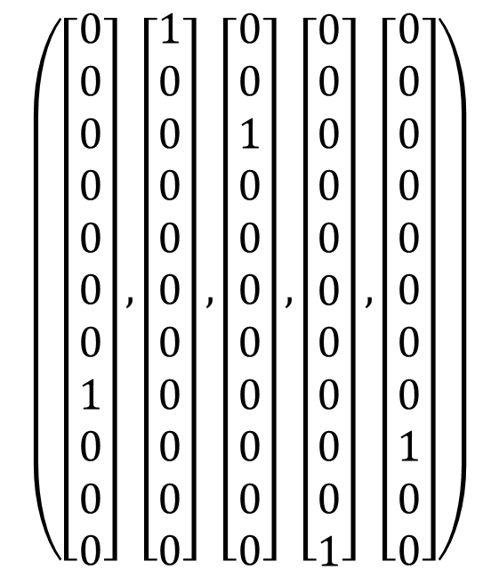
From Indices to One-Hot Vectors
Input sentence
"It is a beautiful day“
Sequence of indices
(7, 0, 2, 10, 8)
We map each index to a one-hot vector.
This way, the sentence becomes a time series of one-hot vectors.
$$\left(\left[\begin{aligned}0 \\ 0 \\ 0 \\ 0 \\ 0 \\ 0 \\ 0 \\ 1 \\ 0 \\ 0 \\ 0\end{aligned}\right],\left[\begin{aligned}1 \\ 0 \\ 0 \\ 0 \\ 0 \\ 0 \\ 0 \\ 0 \\ 0 \\ 0 \\ 0\end{aligned}\right],\left[\begin{aligned}0 \\ 0 \\ 1 \\ 0 \\ 0 \\ 0 \\ 0 \\ 0 \\ 0 \\ 0 \\ 0\end{aligned}\right],\left[\begin{aligned}0 \\ 0 \\ 0 \\ 0 \\ 0 \\ 0 \\ 0 \\ 0 \\ 0 \\ 0 \\ 1\end{aligned}\right],\left[\begin{aligned}0 \\ 0 \\ 0 \\ 0 \\ 0 \\ 0 \\ 0 \\ 0 \\ 1 \\ 0 \\ 0\end{aligned}\right]\right)$$
Sequence of one-hot vectors

Slide 26
From Indices to One-Hot Vectors
Input sentence
"It is a beautiful day“
Sequence of indices
(7, 0, 2, 10, 8)
So, first we map all text samples in our dataset to sequences of one-hot vectors.
Then, we can use a neural network on our dataset.
What type of network?
Fully connected?
RNN?
$$\left(\left[\begin{aligned}0 \\ 0 \\ 0 \\ 0 \\ 0 \\ 0 \\ 0 \\ 1 \\ 0 \\ 0 \\ 0\end{aligned}\right],\left[\begin{aligned}1 \\ 0 \\ 0 \\ 0 \\ 0 \\ 0 \\ 0 \\ 0 \\ 0 \\ 0 \\ 0\end{aligned}\right],\left[\begin{aligned}0 \\ 0 \\ 1 \\ 0 \\ 0 \\ 0 \\ 0 \\ 0 \\ 0 \\ 0 \\ 0\end{aligned}\right],\left[\begin{aligned}0 \\ 0 \\ 0 \\ 0 \\ 0 \\ 0 \\ 0 \\ 0 \\ 0 \\ 0 \\ 1\end{aligned}\right],\left[\begin{aligned}0 \\ 0 \\ 0 \\ 0 \\ 0 \\ 0 \\ 0 \\ 0 \\ 1 \\ 0 \\ 0\end{aligned}\right]\right)$$
Sequence of one-hot vectors

Slide 27
Applying a Neural Network
At this point, we have seen how to convert a text sequence to a time series (sequence of vectors).
The next step is to apply a neural network to the data.
We will see three different approaches.
First: bag-of-words.
We map the sequence of one-hot vectors into a single “summary” vector, called a “bag of words”.
We use a fully connected model to process these “bags of words”.
Second: RNNs.
RNNs are designed for time series, and a sequence of one-hot vectors is already a time series.
Third: Transformers.
This is a more complicated approach, but it is very widely used.

Slide 28
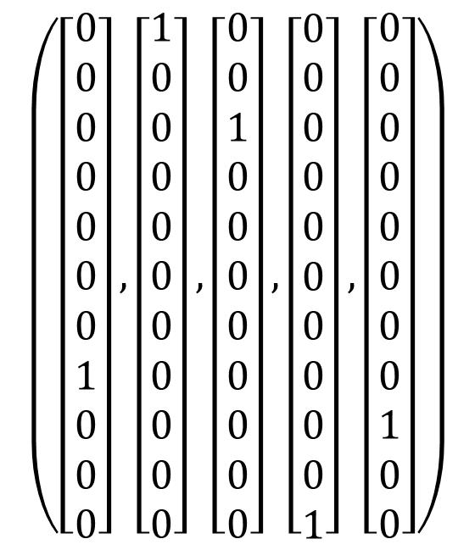

Bag of Words (BoW)
The BoW vector has the same number of dimensions as the number of tokens in the vocabulary.
In other words, the BoW vector has the same number of dimensions as any element of the sequence of one hot vectors.
The BoW vector is what we call a multi-hot vector. Each value is equal to 0 or 1, and multiple values can be equal to 1.
In contrast, in a one-hot vector, only one value can be equal to 1.
Sequence of one-hot vectors
Bag-of-words vector
$$\left(\left[\begin{aligned}0 \\ 0 \\ 0 \\ 0 \\ 0 \\ 0 \\ 0 \\ 1 \\ 0 \\ 0 \\ 0\end{aligned}\right],\left[\begin{aligned}1 \\ 0 \\ 0 \\ 0 \\ 0 \\ 0 \\ 0 \\ 0 \\ 0 \\ 0 \\ 0\end{aligned}\right],\left[\begin{aligned}0 \\ 0 \\ 1 \\ 0 \\ 0 \\ 0 \\ 0 \\ 0 \\ 0 \\ 0 \\ 0\end{aligned}\right],\left[\begin{aligned}0 \\ 0 \\ 0 \\ 0 \\ 0 \\ 0 \\ 0 \\ 0 \\ 0 \\ 0 \\ 1\end{aligned}\right],\left[\begin{aligned}0 \\ 0 \\ 0 \\ 0 \\ 0 \\ 0 \\ 0 \\ 0 \\ 1 \\ 0 \\ 0\end{aligned}\right]\right)$$
$$\left[\begin{aligned}1 \\ 0 \\ 1 \\ 0 \\ 0 \\ 0 \\ 0 \\ 1 \\ 1 \\ 0 \\ 1\end{aligned}\right]$$

Slide 29
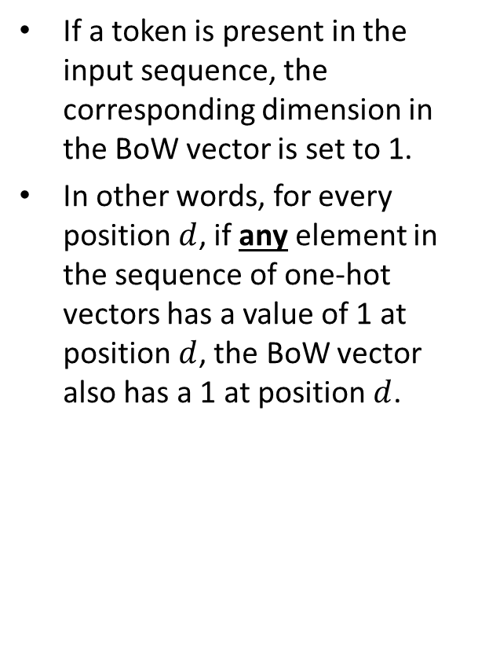
Bag of Words (BoW)
If a token is present in the input sequence, the corresponding dimension in the BoW vector is set to 1.
In other words, for every position $d$, if any element in the sequence of one-hot vectors has a value of 1 at position $d$, the BoW vector also has a 1 at position $d$.
Sequence of one-hot vectors
Bag-of-words vector
$$\left(\left[\begin{aligned}0 \\ 0 \\ 0 \\ 0 \\ 0 \\ 0 \\ 0 \\ 1 \\ 0 \\ 0 \\ 0\end{aligned}\right],\left[\begin{aligned}1 \\ 0 \\ 0 \\ 0 \\ 0 \\ 0 \\ 0 \\ 0 \\ 0 \\ 0 \\ 0\end{aligned}\right],\left[\begin{aligned}0 \\ 0 \\ 1 \\ 0 \\ 0 \\ 0 \\ 0 \\ 0 \\ 0 \\ 0 \\ 0\end{aligned}\right],\left[\begin{aligned}0 \\ 0 \\ 0 \\ 0 \\ 0 \\ 0 \\ 0 \\ 0 \\ 0 \\ 0 \\ 1\end{aligned}\right],\left[\begin{aligned}0 \\ 0 \\ 0 \\ 0 \\ 0 \\ 0 \\ 0 \\ 0 \\ 1 \\ 0 \\ 0\end{aligned}\right]\right)$$
$$\left[\begin{aligned}1 \\ 0 \\ 1 \\ 0 \\ 0 \\ 0 \\ 0 \\ 1 \\ 1 \\ 0 \\ 1\end{aligned}\right]$$

Slide 30
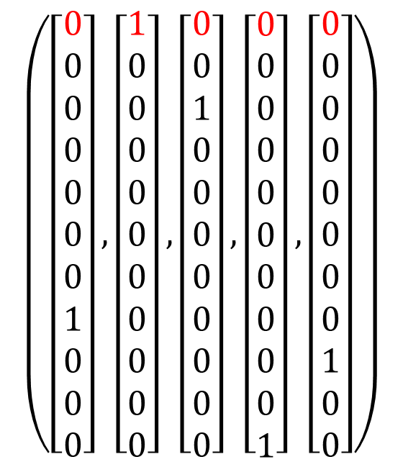

Bag of Words (BoW)
For example: to determine the value at position 0 (using Python-style indexing) of the BoW vector, we look at row 0 of the 2D matrix of one-hot vectors.
There is a 1 there, so we put a 1 in that position in the BoW vector.
Note: it makes no difference whether there is a single 1 or multiple ones on row 0 of the 2D matrix. In both cases, we put a 1 at position 0 of the BoW vector.
Sequence of one-hot vectors
Bag-of-words vector
$$\left(\left[\begin{aligned}0 \\ 0 \\ 0 \\ 0 \\ 0 \\ 0 \\ 0 \\ 1 \\ 0 \\ 0 \\ 0\end{aligned}\right],\left[\begin{aligned}1 \\ 0 \\ 0 \\ 0 \\ 0 \\ 0 \\ 0 \\ 0 \\ 0 \\ 0 \\ 0\end{aligned}\right],\left[\begin{aligned}0 \\ 0 \\ 1 \\ 0 \\ 0 \\ 0 \\ 0 \\ 0 \\ 0 \\ 0 \\ 0\end{aligned}\right],\left[\begin{aligned}0 \\ 0 \\ 0 \\ 0 \\ 0 \\ 0 \\ 0 \\ 0 \\ 0 \\ 0 \\ 1\end{aligned}\right],\left[\begin{aligned}0 \\ 0 \\ 0 \\ 0 \\ 0 \\ 0 \\ 0 \\ 0 \\ 1 \\ 0 \\ 0\end{aligned}\right]\right)$$
$$\left[\begin{aligned}1 \\ 0 \\ 1 \\ 0 \\ 0 \\ 0 \\ 0 \\ 1 \\ 1 \\ 0 \\ 1\end{aligned}\right]$$

Slide 31
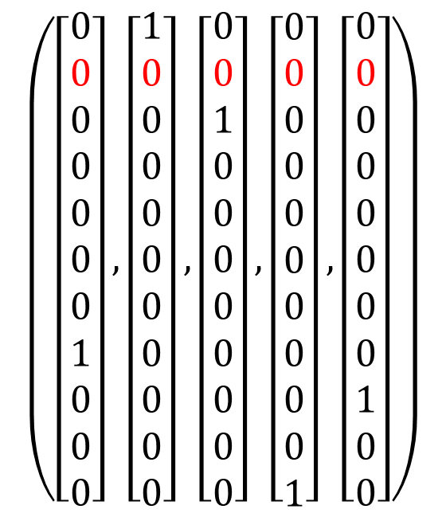

Bag of Words (BoW)
For example: to determine the value at position 1 (using Python-style indexing) of the BoW vector, we look at row 1 of the 2D matrix of one-hot vectors.
All values in that row are equal to zero, so we put a zero in that position in the BoW vector.
Sequence of one-hot vectors
Bag-of-words vector
$$\left(\left[\begin{aligned}0 \\ 0 \\ 0 \\ 0 \\ 0 \\ 0 \\ 0 \\ 1 \\ 0 \\ 0 \\ 0\end{aligned}\right],\left[\begin{aligned}1 \\ 0 \\ 0 \\ 0 \\ 0 \\ 0 \\ 0 \\ 0 \\ 0 \\ 0 \\ 0\end{aligned}\right],\left[\begin{aligned}0 \\ 0 \\ 1 \\ 0 \\ 0 \\ 0 \\ 0 \\ 0 \\ 0 \\ 0 \\ 0\end{aligned}\right],\left[\begin{aligned}0 \\ 0 \\ 0 \\ 0 \\ 0 \\ 0 \\ 0 \\ 0 \\ 0 \\ 0 \\ 1\end{aligned}\right],\left[\begin{aligned}0 \\ 0 \\ 0 \\ 0 \\ 0 \\ 0 \\ 0 \\ 0 \\ 1 \\ 0 \\ 0\end{aligned}\right]\right)$$
$$\left[\begin{aligned}1 \\ 0 \\ 1 \\ 0 \\ 0 \\ 0 \\ 0 \\ 1 \\ 1 \\ 0 \\ 1\end{aligned}\right]$$

Slide 32
Bag of Words (BoW)
There are pros and cons of sequences of one-hot vectors and BoW vectors.
A BoW vector is more compact. Neural network training is faster and easier when the input sizes are smaller.
However, a BoW vector does not “remember” the order of the words in the original sentence.
Consider the sentences
“Mary drove Tom home.”
“Tom drove Mary home.”
If we represent each sentence as a sequence of one-hot vectors, the two representations will be different.
If we represent each sentence as a bag-of-words vector, the two representations will be the same.

Slide 33
An Example of Text Classification
Our first case study for text processing will be classifying movie reviews as “positive or negative”.
This is a text classification problem.
We will use the Large Movie Review Dataset. 25,000 IMDB reviews for training, 25,000 for testing.
Here is an example of a positive review, that we saw earlier.
“Very good drama although it appeared to have a few blank areas leaving the viewers to fill in the action for themselves. I can imagine life being this way for someone who can neither read nor write. This film simply smacked of the real world: the wife who is suddenly the sole supporter, the live-in relatives and their quarrels, the troubled child who gets knocked up and then, typically, drops out of school, a jackass husband who takes the nest egg and buys beer with it. 2 thumbs up.”

Slide 34
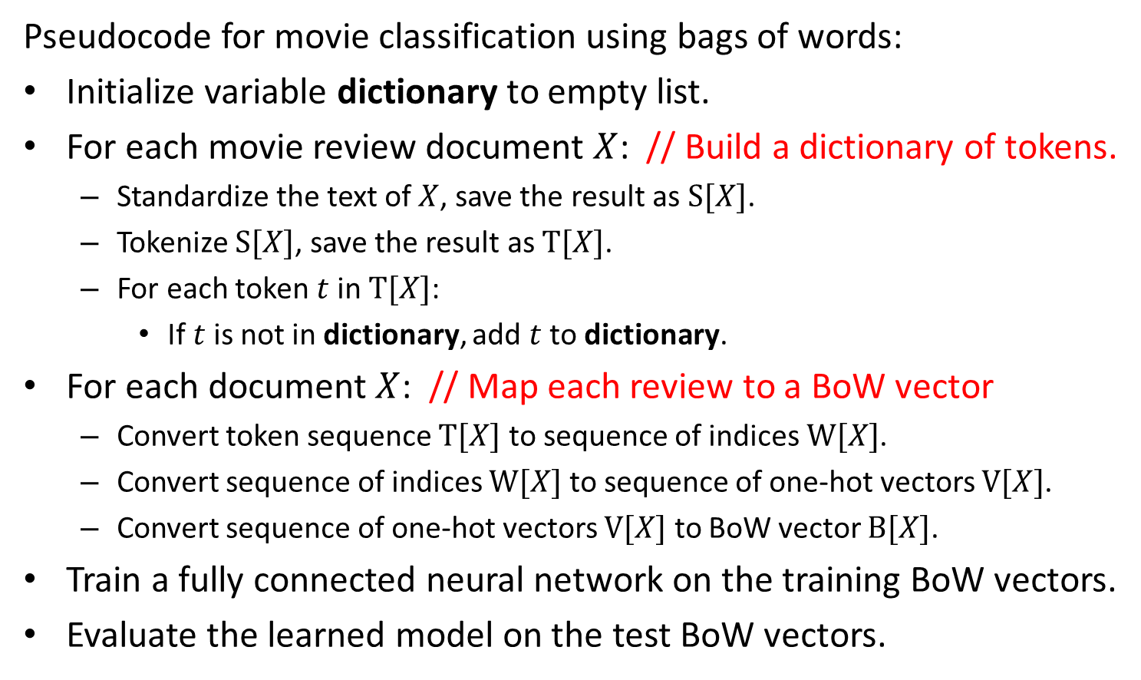
Pseudocode
Pseudocode for movie classification using bags of words:
Initialize variable dictionary to empty list.
For each movie review document $X$: // Build a dictionary of tokens.
Standardize the text of $X$, save the result as $S[X]$.
Tokenize $S[X]$, save the result as $T[X]$.
For each token $t$in $T[X]$:
If $t$is not in dictionary, add $t$to dictionary.
For each document $X$: // Map each review to a BoW vector
Convert token sequence $T[X]$ to sequence of indices $W[X]$.
Convert sequence of indices $W[X]$ to sequence of one-hot vectors $V[X]$.
Convert sequence of one-hot vectors $V[X]$ to BoW vector $B[X]$.
Train a fully connected neural network on the training BoW vectors.
Evaluate the learned model on the test BoW vectors.

Slide 35
Implementation
In the previous pseudocode, we have described how to do each of the steps.
In principle, we can implement each step in code from scratch.
However, the Keras API provides several useful tools, that can make implementation a lot easier.
In the next slides we will describe the Keras-based implementation of the pseudocode.

Slide 36
Case Study in Keras: Movie Review Positive/Negative Classification
The Large Movie Review Dataset can be downloaded from:
https:/ /ai.stanford.edu/~amaas/data/sentiment/aclImdb_v1.tar.gz
Once you extract the files, you have a directory structure that looks like:
aclImdb/
...train/
......pos/
......neg/
......unsup/
...test/
......pos/
......neg/

Slide 37
Movie Review Data
The aclImdb/train directory contains the training data for this dataset.
The aclImdb/train/pos directory contains 12,500 text files.
Each of those files contains a “positive” review.
If you read those reviews, you may often find that they contain positive and negative aspects.
However, each of those reviews, when posted on the original IMDB website, also had a numerical rating from 1 to 10.
Ratings from 1 to 5 were mapped to class label “negative”.
Ratings from 6 to 10 were mapped to “positive”.
Alternatively, one could have kept the original ratings from 1 to 10, and tried to predict those ratings using regression.

Slide 38
Movie Review Data
The aclImdb/train directory contains the training data for this dataset.
The aclImdb/train/pos directory contains 12,500 positive examples.
The aclImdb/train/neg directory contains 12,500 negative examples.
The aclImdb/test directory contains the test data for this dataset.
The aclImdb/test/pos directory contains 12,500 positive examples.
The aclImdb/test/neg directory contains 12,500 negative examples.
There is also an aclImdb/train/unsup directory, that we should manually remove.
If we do not remove it, some of the code may behave differently.

Slide 39
Creating Validation Dataset
We have a training set and a test set, but we would also like to have a validation set.
We will randomly choose 20% of the review files in the “aclImdb/train” directory, and move them to a “val” directory to designate them as our validation set.
The next slide shows Python code that does what we want.
After executing this code, we end up with:
A training set of 20,000 reviews.
A validation set of 5,000 reviews.
A test set of 25,000 reviews.
We will also refer to each review as a “document”.
“Document” is a more general term, referring to text stored in a file.

Slide 40
Creating Validation Dataset
import os, pathlib, shutil, random
base_dir = pathlib.Path("aclImdb")
val_dir = base_dir / "val"
train_dir = base_dir / "train"
for category in ("neg", "pos"):
os.makedirs(val_dir / category)
files = os.listdir(train_dir / category)
random.Random(1337).shuffle(files)
num_val_samples = int(0.2 * len(files))
val_files = files[-num_val_samples:]
for fname in val_files:
shutil.move(train_dir / category / fname, val_dir / category / fname)

Slide 41
Reading the Data
We could write our own code to read the documents.
Instead, we will use a very convenient Keras function called
keras.utils.text_dataset_from_directory, as follows:
bsz = 32
train_ds = keras.utils.text_dataset_from_directory(“aclImdb/train", batch_size=bsz)
val_ds = keras.utils.text_dataset_from_directory(“aclImdb/val", batch_size=bsz)
test_ds = keras.utils.text_dataset_from_directory(“aclImdb/test", batch_size=bsz)
Output:
Found 20000 files belonging to 2 classes.
Found 5000 files belonging to 2 classes.
Found 25000 files belonging to 2 classes.

Slide 42
text_dataset_from_directory
train_ds = keras.utils.text_dataset_from_directory(“aclImdb/train", batch_size=batch_size)
One argument is a directory, such as “aclImdb/train“.
The function looks at all subdirectories under that directory.
We have subdirectories “neg”, “pos”, and “unsup”.
The function assumes (correctly, in our case) that each subdirectory corresponds to one specific class label.
However, this means that the function will include three classes in the training dataset: “neg”, “pos”, and “unsup”.
In order to exclude the “unsup” class, we manually remove the “aclImdb/train/unsup” directory.

Slide 43
text_dataset_from_directory
train_ds = keras.utils.text_dataset_from_directory(“aclImdb/train", batch_size=batch_size)
The return value, train_ds, is of type tensorflow.python.data.ops.dataset_ops.BatchDataset
This type represents a training set, test set, or validation set.
Somewhere in it it stores example inputs, and target outputs for those inputs.
The BatchDataset type has some rather complex behavior.
We will just learn a minimal amount of details, that will allow us to do what we need to do.

Slide 44
The BatchDataset Type
If we simply want the list of training inputs and the list of target values for those inputs, we can use this code:
train_ds = keras.utils.text_dataset_from_directory(“aclImdb/train", batch_size=1)
number = len(train_ds)
train_objects = [None] * number # initialize the list of training inputs
train_labels = [None] * number # initialize the list of training labels
counter = 0
for inputs, targets in train_ds:
train_objects[counter] = inputs[0]
train_labels[counter] = targets[0]
counter = counter+1

Slide 45
The BatchDataset Type
The main way to iterate over the values in train_ds is
for inputs, targets in train_ds:
train_objects[counter] = inputs[0]
train_labels[counter] = targets[0]
counter = counter+1
Things like train_ds[0] will NOT work, they give an error.
In the for loop above, at each iteration, inputs is NOT an individual input, but a BATCH containing batch_size elements.
inputs[i] is an individual input, for 0 <= i < batch_size.
targets[i] is the corresponding class label for inputs[i].
In the previous slide, we wanted to access each individual input, and that is why we specified a batch size of 1.

Slide 46
The BatchDataset Type
train_ds = keras.utils.text_dataset_from_directory(“aclImdb/train", batch_size=1)
number = len(train_ds)
train_objects = [None] * number # initialize the list of training inputs
train_labels = [None] * number # initialize the list of training labels
counter = 0
for inputs, targets in train_ds:
train_objects[counter] = inputs[0]
train_labels[counter] = targets[0]
counter = counter+1
This code (the same that we saw before) stores inputs and class labels into lists, which is a data type we are familiar with.
Now we can do simple things, like print(train_objects[0])

Slide 47
From BatchDataset to List
train_ds = keras.utils.text_dataset_from_directory(“aclImdb/train", batch_size=32)
train_list = list(train_ds.as_numpy_iterator())
print("train_list contains %d batches" % (len(train_list)))
print("Each batch is a tuple of %d elements" % (len(train_list[0])))
print("The first element is an array of %d inputs" % (len(train_list[0][0])))
print("The second element is an array of %d targets" % (len(train_list[0][1])))
print("\nThe first input of the first batch is:\n", train_list[0][0][0])
print("\nThe target for the first input of the first batch is:", train_list[0][1][0])
The line in red is another way to convert a BatchDataset into a list.
The output of this code is shown in the next slide.

Slide 48
From BatchDataset to List
Output:
train_list contains 625 batches
Each batch is a tuple of 2 elements
The first element is an array of 32 inputs
The second element is an array of 32 targets
The first input of the first batch is:
b'Yes I admit I cried during this movie. It was so incredibly disappointing, that I couldn\'t help myself but cry. TBN (Trinity Broadcasting Network) has done it again… (the review continues for a few more lines)
The target for the first input of the first batch is: 0

Slide 49
The BatchDataset Type
train_ds = keras.utils.text_dataset_from_directory(“aclImdb/train", batch_size=32)
train_list = list(train_ds.as_numpy_iterator())
print("train_list contains %d batches" % (len(train_list)))
print("Each batch is a tuple of %d elements" % (len(train_list[0])))
print("The first element is an array of %d inputs" % (len(train_list[0][0])))
print("The second element is an array of %d targets" % (len(train_list[0][1])))
print("\nThe first input of the first batch is:\n", train_list[0][0][0])
print("\nThe target for the first input of the first batch is:", train_list[0][1][0])
These examples of converting BatchDataset objects to lists are just shown to illustrate how a BatchDataset can be used.
Oftentimes, you do NOT have to convert a BatchDataset into a list.
There are Keras functions that work directly with BatchDataset objects.

Slide 50
The BatchDataset Type
Objects of type BatchDataset can be used directly to specify training sets, test sets, and validation sets in Keras functions.
We will see some examples of the following in a few slides:
The train_ds and val_ds objects can be passed to model.fit() for training.
The test_ds object can be passed to model.evaluate() to measure test accuracy.
bsz = 32
train_ds = keras.utils.text_dataset_from_directory(“aclImdb/train", batch_size=bsz)
val_ds = keras.utils.text_dataset_from_directory(“aclImdb/val", batch_size=bsz)
test_ds = keras.utils.text_dataset_from_directory(“aclImdb/test", batch_size=bsz)

Slide 51
Text Vectorization in Keras
Keras has a layer that does text vectorization, and that is called (not surpisingly) TextVectorization.
Here is a first example of how to use it:
text_vectorization = TextVectorization(output_mode="int", ngrams=1)
dataset = ["It is a beautiful day",
"The sun is shining",
"The weather is a bit warmer"]
text_vectorization.adapt(dataset)
words = text_vectorization.get_vocabulary()
print(words)

Slide 52
Text Vectorization in Keras
text_vectorization = TextVectorization(output_mode="int", ngrams=1)
dataset = ["It is a beautiful day",
"The sun is shining",
"The weather is a bit warmer"]
text_vectorization.adapt(dataset)
words = text_vectorization.get_vocabulary()
print(words)
Output:
['', '[UNK]', 'is', 'the', 'a', 'weather', 'warmer', 'sun', 'shining', 'it', 'day', 'bit', 'beautiful']

Slide 53
Text Vectorization in Keras
text_vectorization = TextVectorization(output_mode="int", ngrams=1)
dataset = ["It is a beautiful day",
"The sun is shining",
"The weather is a bit warmer"]
text_vectorization.adapt(dataset)
words = text_vectorization.get_vocabulary()
print(words)
The ngrams optional argument specifies here that we want to use single words as tokens.
The adapt method tells the text_vectorization object what data to compute its vocabulary from.
The get_vocabulary method returns the vocabulary as a list.

Slide 54
Text Vectorization in Keras
Output:
['', '[UNK]', 'is', 'the', 'a', 'weather', 'warmer', 'sun', 'shining', 'it', 'day', 'bit', 'beautiful']
The vocabulary is sorted based on priority.
First in priority are two special tokens that are placed in every vocabulary by default.
Special token '' is the empty string. This allows us to have a valid representation of empty inputs.
Special token '[UNK]' corresponds to an unknown token.
It is possible that a test input contains a token not encountered in the training data. Such a token will be treated as equal to '[UNK]'.

Slide 55
Text Vectorization in Keras
Output:
['', '[UNK]', 'is', 'the', 'a', 'weather', 'warmer', 'sun', 'shining', 'it', 'day', 'bit', 'beautiful']
After the two special tokens '' and '[UNK]', , we get the list of tokens in the dataset.
These tokens (words in this example) are sorted in decreasing order of frequency.
'is' appears three times in our dataset.
'the' appears two times.
'a' appears two times.
The rest of the tokens appear only once.

Slide 56
Using Bigrams as Tokens
text_vectorization = TextVectorization(output_mode="int", ngrams=2)
dataset = ["It is a beautiful day",
"The sun is shining",
"The weather is a bit warmer"]
text_vectorization.adapt(dataset)
words = text_vectorization.get_vocabulary()
print(words)
Here we set ngrams to 2:
Output:
['', '[UNK]', 'is', 'the', 'is a', 'a', 'weather is', 'weather', 'warmer', 'the weather', 'the sun', 'sun is', 'sun', 'shining', 'it is', 'it', 'is shining', 'day', 'bit warmer', 'bit', 'beautiful day', 'beautiful', 'a bit', 'a beautiful']

Slide 57
Default Text Standardization
text_vectorization = TextVectorization(output_mode="int", ngrams=1)
dataset = ["It is a beautiful day!",
"The sun is SHINING.",
"The weather is a bit warmer."]
text_vectorization.adapt(dataset)
words = text_vectorization.get_vocabulary()
print("words =", words)
Note that the text is standardized before computing the vocabulary.
All characters have been converted to lower case.
Punctuation is removed.
TextVectorization does this standardization by default.
Output:
words = ['', '[UNK]', 'is', 'the', 'a', 'weather', 'warmer', 'sun', 'shining', 'it', 'day', 'bit', 'beautiful']

Slide 58
Custom Text Standardization
The TextVectorization layer has an optional parameter called standardize.
We can use that parameter to specify how we want to do text standardization.
This is the description of values we can give to standardize, most of this info is from the Keras documentation webpage:
None: No standardization.
"lower_and_strip_punctuation": Text will be lowercased and all punctuation removed. (this is the default value)
"lower": Text will be lowercased.
"strip_punctuation": All punctuation will be removed.
Callable: Inputs will be passed to the callable function, which should return the result of standardizing the inputs. The callable function can apply any desired customized standardization steps.

Slide 59
From Text to Sequence of Integers
text_vectorization = TextVectorization(output_mode="int", ngrams=1)
dataset = ["It is a beautiful day!",
"The sun is SHINING.",
"The weather is a bit warmer."]
text_vectorization.adapt(dataset)
out = text_vectorization("What a beautiful day!!!")
print(out)
Layer text_vectorization can be used as a function.
It takes text (a string) as input.
It returns a sequence as output.
The output_mode parameter specifies that each token should be mapped to an integer.
Output:
tf.Tensor([ 1 4 12 10], shape=(5,), dtype=int64)

Slide 60
From Text to Sequence of Integers
text_vectorization = TextVectorization(output_mode="int", ngrams=1)
dataset = ["It is a beautiful day!",
"The sun is SHINING.",
"The weather is a bit warmer."]
text_vectorization.adapt(dataset)
out = text_vectorization("What a beautiful day!!!")
print(out)
The result sequence is [1, 4, 12, 10].
Each token (word in this example) is mapped to its position in the vocabulary list.
As a reminder, the vocabulary list here is: ['', '[UNK]', 'is', 'the', 'a', 'weather', 'warmer', 'sun', 'shining', 'it', 'day', 'bit', 'beautiful']
Output:
tf.Tensor([ 1 4 12 10], shape=(5,), dtype=int64)

Slide 61
From Text to Sequence of Integers
text_vectorization = TextVectorization(output_mode="int", ngrams=1)
dataset = ["It is a beautiful day!",
"The sun is SHINING.",
"The weather is a bit warmer."]
text_vectorization.adapt(dataset)
out = text_vectorization("What a beautiful day!!!")
print(out)
Note that the word “what” has been mapped to token '[UNK]‘, which corresponds to integer 1.
Output:
tf.Tensor([ 1 4 12 10], shape=(5,), dtype=int64)

Slide 62
From Text to Bag of Words
text_vectorization = TextVectorization(output_mode=“multi_hot", ngrams=1)
dataset = ["It is a beautiful day!",
"The sun is SHINING.",
"The weather is a bit warmer."]
text_vectorization.adapt(dataset)
out = text_vectorization("What a beautiful day!!!")
print(out)
To convert the text to a bag of words, we assign value "multi_hot“ to output_mode.
In our example, the output is a 12-dimensional vector.
The number of dimensions is equal to the size of the vocabulary.
A value of 1 indicates presence of a token in the text.
Output:
tf.Tensor([1. 0. 0. 1. 0. 0. 0. 0. 0. 1. 0. 1.], shape=(12,), dtype=float32)

Slide 63
BoW Vectors from BatchDataset
train_ds = keras.utils.text_dataset_from_directory(“aclImdb/train", batch_size=32)
val_ds = keras.utils.text_dataset_from_directory(“aclImdb/val", batch_size=32)
test_ds = keras.utils.text_dataset_from_directory(“aclImdb/test", batch_size=32)
We have used the code above to load the movie reviews data.
We can map text data to bag-of-words data as follows:
text_vectorization = TextVectorization(max_tokens=20000, output_mode="multi_hot")
text_only_train_ds = train_ds.map(lambda x, y: x)
text_vectorization.adapt(text_only_train_ds)
binary_1gram_train_ds = train_ds.map(lambda x, y: (text_vectorization(x), y))
binary_1gram_val_ds = val_ds.map(lambda x, y: (text_vectorization(x), y))
binary_1gram_test_ds = test_ds.map(lambda x, y: (text_vectorization(x), y))

Slide 64
BoW Vectors from BatchDataset
text_vectorization = TextVectorization(max_tokens=20000, output_mode="multi_hot")
text_only_train_ds = train_ds.map(lambda x, y: x)
text_vectorization.adapt(text_only_train_ds)
binary_1gram_train_ds = train_ds.map(lambda x, y: (text_vectorization(x), y))
binary_1gram_val_ds = val_ds.map(lambda x, y: (text_vectorization(x), y))
binary_1gram_test_ds = test_ds.map(lambda x, y: (text_vectorization(x), y))
The highlighted line creates a text vectorization layer.
Note that we do not pass any value to the ngrams optional parameter. This means that we will use words as our tokens.
Note the max_tokens parameter. This specifies that we only want to use the 20,000 most frequent tokens (words in this case).
All other tokens will be treated as “Unknown”.

Slide 65
BoW Vectors from BatchDataset
text_vectorization = TextVectorization(max_tokens=20000, output_mode="multi_hot")
text_only_train_ds = train_ds.map(lambda x, y: x)
text_vectorization.adapt(text_only_train_ds)
binary_1gram_train_ds = train_ds.map(lambda x, y: (text_vectorization(x), y))
binary_1gram_val_ds = val_ds.map(lambda x, y: (text_vectorization(x), y))
binary_1gram_test_ds = test_ds.map(lambda x, y: (text_vectorization(x), y))
The highlighted line creates a dataset that includes only the training inputs, and no training labels.
Object train_ds contains pairs of inputs and targets.
(lambda x, y: x) is an anonymous function that takes an (input, target) pair and returns just the input.
The train_ds.map call maps this lambda function to the whole dataset.

Slide 66
BoW Vectors from BatchDataset
text_vectorization = TextVectorization(max_tokens=20000, output_mode="multi_hot")
text_only_train_ds = train_ds.map(lambda x, y: x)
text_vectorization.adapt(text_only_train_ds)
binary_1gram_train_ds = train_ds.map(lambda x, y: (text_vectorization(x), y))
binary_1gram_val_ds = val_ds.map(lambda x, y: (text_vectorization(x), y))
binary_1gram_test_ds = test_ds.map(lambda x, y: (text_vectorization(x), y))
The highlighted line calls the adapt method of TextVectorizer.
We have seen this method in an earlier example.
The adapt method creates the vocabulary of tokens based on the dataset that it is given.
Since max_tokens=20000, the vocabulary size will be at most 20,000.

Slide 67
BoW Vectors from BatchDataset
text_vectorization = TextVectorization(max_tokens=20000, output_mode="multi_hot")
text_only_train_ds = train_ds.map(lambda x, y: x)
text_vectorization.adapt(text_only_train_ds)
binary_1gram_train_ds = train_ds.map(lambda x, y: (text_vectorization(x), y))
binary_1gram_val_ds = val_ds.map(lambda x, y: (text_vectorization(x), y))
binary_1gram_test_ds = test_ds.map(lambda x, y: (text_vectorization(x), y))
The highlighted lines create the bag-of-words versions of the training, validation, and test sets.
The lambda function takes as arguments a pair of an input and a target.
The lambda function returns a new pair:
The input x is replaced by text_vectorization(x), which is a BoW vector.
The target y is kept without changes.

Slide 68
A Fully Connected Model
max_tokens = 20000
model = keras.Sequential([keras.Input(shape=(max_tokens,)),
layers.Dense(16, activation="tanh"),
layers.Dropout(0.5),
layers.Dense(1, activation="sigmoid")])
model.compile(optimizer="rmsprop", loss="binary_crossentropy", metrics=["accuracy"])
Now that we have converted all text objects to vectors, we can train and test a neural network model.
Note that the input is a bag-of-words vector, with 20,000 dimensions (using the 20,000 most frequent tokens).
As usual, there is room for several design choices.
Number and type of layers, activation functions, number of units…

Slide 69
A Fully Connected Model
max_tokens = 20000
model = keras.Sequential([keras.Input(shape=(max_tokens,)),
layers.Dense(16, activation="tanh"),
layers.Dropout(0.5),
layers.Dense(1, activation="sigmoid")])
model.compile(optimizer="rmsprop", loss="binary_crossentropy", metrics=["accuracy"])
The output unit uses the sigmoid function for activation.
The output value can be seen as the probability of class “pos”.
Then, 1 – the output value is the probability of class “neg”.
This is a simpler alternative to the general approach of:
Having two output units (as many as the number of classes).
Using the softmax activation function.

Slide 70
A Fully Connected Model
max_tokens = 20000
model = keras.Sequential([keras.Input(shape=(max_tokens,)),
layers.Dense(16, activation="tanh"),
layers.Dropout(0.5),
layers.Dense(1, activation="sigmoid")])
model.compile(optimizer="rmsprop", loss="binary_crossentropy", metrics=["accuracy"])
The loss function is "binary_crossentropy".
This is still the same cross-entropy function, but it is adapted to be computed based on a single output.
As we saw in the previous slide, the output value is used as the probability of class “pos”, and 1 – the output value is used the probability of class “neg”.

Slide 71
Using a Fully Connected Model
callbacks = [keras.callbacks.ModelCheckpoint("binary_1gram.keras",
save_best_only=True)]
model.fit(binary_1gram_train_ds, validation_data=binary_1gram_val_ds,
epochs=10, callbacks=callbacks)
model = keras.models.load_model("binary_1gram.keras")
(test_loss, test_acc) = model.evaluate(binary_1gram_test_ds)
print("Test accuracy: %.2f%%" % (test_acc*100))
This code trains and tests the network.
Note the use of the BatchDataset objects as arguments in model.fit and model.evaluate.
Output:
Test accuracy: 88.62%

Slide 72
Using a Fully Connected Model
callbacks = [keras.callbacks.ModelCheckpoint("binary_1gram.keras",
save_best_only=True)]
model.fit(binary_1gram_train_ds, validation_data=binary_1gram_val_ds,
epochs=10, callbacks=callbacks)
model = keras.models.load_model("binary_1gram.keras")
(test_loss, test_acc) = model.evaluate(binary_1gram_test_ds)
print("Test accuracy: %.2f%%" % (test_acc*100))
On my computer, training takes about 9 seconds per epoch.
There is a trick that makes the training faster (next slide).

Slide 73
Caching the Datasets
model.fit(binary_1gram_train_ds.cache(),
validation_data=binary_1gram_val_ds.cache(),
epochs=10, callbacks=callbacks)
To speed up the training, we use the BatchDataset.cache() method.
As you see on the highlighted code:
Instead of binary_1gram_train_ds we put binary_1gram_train_ds.cache().
Instead of binary_1gram_val_ds we put binary_1gram_val_ds.cache().
The cache() call caches the datasets to main memory, if they fit.
During the first epoch, the datasets are loaded from wherever they are stored to main memory.
After the first epoch, the datasets stay in main memory.

Slide 74
Caching the Datasets
model.fit(binary_1gram_train_ds.cache(),
validation_data=binary_1gram_val_ds.cache(),
epochs=10, callbacks=callbacks)
To speed up the training, we use the BatchDataset.cache() method.
As a result:
The first epoch takes about 9 seconds.
The rest of the epochs take about 2 seconds each.
The total training time goes down from about 90 seconds to about 27 seconds.

Slide 75
A Model Using Bigrams
To make our model use bigrams, we just need to modify the text vectorization process.
Text vectorization code (used before), using words as tokens:
text_vectorization = TextVectorization(max_tokens=20000,
output_mode="multi_hot")
text_only_train_ds = train_ds.map(lambda x, y: x)
text_vectorization.adapt(text_only_train_ds)
binary_1gram_train_ds = train_ds.map(lambda x, y: (text_vectorization(x), y))
binary_1gram_val_ds = val_ds.map(lambda x, y: (text_vectorization(x), y))
binary_1gram_test_ds = test_ds.map(lambda x, y: (text_vectorization(x), y))

Slide 76
A Model Using Bigrams
To make our model use bigrams, we just need to modify the text vectorization process.
Text vectorization code for using bigrams as tokens:
text_vectorization = TextVectorization(max_tokens=20000, ngrams=2,
output_mode="multi_hot")
text_only_train_ds = train_ds.map(lambda x, y: x)
text_vectorization.adapt(text_only_train_ds)
binary_2gram_train_ds = train_ds.map(lambda x, y: (text_vectorization(x), y))
binary_2gram_val_ds = val_ds.map(lambda x, y: (text_vectorization(x), y))
binary_2gram_test_ds = test_ds.map(lambda x, y: (text_vectorization(x), y))
Only difference: adding the ngrams=2 option when creating the text vectorization layer.

Slide 77
Training and Testing with Bigrams
max_tokens = 20000
model = keras.Sequential([keras.Input(shape=(max_tokens,)),
layers.Dense(16, activation="tanh"),
layers.Dropout(0.5),
layers.Dense(1, activation="sigmoid")])
model.compile(optimizer="rmsprop", loss="binary_crossentropy", metrics=["accuracy"])
callbacks = [keras.callbacks.ModelCheckpoint("binary_2gram.keras",
save_best_only=True)]
model.fit(binary_2gram_train_ds.cache(),
validation_data=binary_2gram_val_ds.cache(),
epochs=10, callbacks=callbacks)
model = keras.models.load_model("binary_2gram.keras")
(test_loss, test_acc) = model.evaluate(binary_2gram_test_ds)
print("Test accuracy: %.2f%%" % (test_acc*100))
Output:
Test accuracy: 90.16%

Slide 78
Words vs. Bigrams
We trained two models:
One model using words as tokens.
Another model using bigrams (where each token can be a single word or a bigram).
Without experiments, we cannot know which one works best.
Bigrams contain more information, because they preserve parts of the order in which words appear in the text.
At the same time, more information may require more data to lead to improvements in accuracy, and it is not clear how much data we need.
In practice, for the movie reviews dataset, bigrams give about 1-2% higher accuracy. Based on 10 runs, we get:
Single words: accuracy 87.62%-88.74%, mean=88.40%, median=88.50%
Bigrams: accuracy 89.80%-90.24%, mean=90.08%, median=90.15%

Slide 79
Applying the Model to a New String
review_text = "One of the best movies of the year. I strongly recommend it."
vectorized_data = text_vectorization([review_text])
predictions = model(vectorized_data)
print("prediction: %.3f\n" % (predictions[0][0].numpy()))
Suppose that we have trained a model.
Now we get a new review, and we want to see what our model outputs for that review.
The code above illustrates how to do it:
Vectorize the string using the text vectorization layer we created.
Apply the model on the vectorized data.
Output:
prediction: 0.773
An output greater than 0.5 corresponds to “positive”.

Slide 80
Applying the Model to a New String
review_text = "One of the best movies of the year. I strongly recommend it."
vectorized_data = text_vectorization([review_text])
predictions = model(vectorized_data)
print("prediction: %.3f\n" % (predictions[0][0].numpy()))
Note the line that does text vectorization.
The argument is not review_text, but [review_text].
We need to pass a list.
This is needed in order to make the input shape appropriate for the model.
The model expects as input a 2D array of shape (1,20000).
text_vectorization(review_text) returns a 1D array with shape (20000).

Slide 81
Applying the Model to a New String
review_text = "One of the best movies of the year. I strongly recommend it."
vectorized_data = text_vectorization([review_text])
predictions = model(vectorized_data)
print("prediction: %.3f\n" % (predictions[0][0].numpy()))
Note the line that prints the output.
If you simply do
print(prediction)
it prints:
tf.Tensor([[0.7726042]], shape=(1, 1), dtype=float32)
It still shows the output, but it is more cumbersome to read.

Slide 82
A Model Taking Strings as Inputs
Our models so far take vectors as inputs.
If we want to process the string, we first need to map it to a vector, as in the previous slides.
However, after training, we can create a model that operates (sort of) directly on strings.
The new model is obtained by adding the text vectorization layer to our previous model.
new_model = keras.Sequential([text_vectorization, model])
review_text = "One of the best movies of the year. I strongly recommend it."
tensorized_input = tf.convert_to_tensor([review_text])
prediction = new_model(tensorized_input)
print("prediction: %.3f\n" % (prediction[0][0].numpy()))

Slide 83
A Model Taking Strings as Inputs
new_model = keras.Sequential([text_vectorization, model])
review_text = "One of the best movies of the year. I strongly recommend it."
tensorized_input = tf.convert_to_tensor([review_text])
prediction = new_model(tensorized_input)
print("prediction: %.3f\n" % (prediction[0][0].numpy()))
However, our model cannot take a string directly as an input.
Why? It is a Keras peculiarity that we need to accommodate.
The text vectorization layer can take a string as input, as we saw a few slides ago: vectorized_data = text_vectorization([review_text])
The model needs the string to be converted to a tensor.
The highlighted line does this conversion.
Again, the argument is NOT just review_text, but list [review_text].

Slide 84
A Model Taking Strings as Inputs
new_model = keras.Sequential([text_vectorization, model])
review_text = "One of the best movies of the year. I strongly recommend it."
tensorized_input = tf.convert_to_tensor([review_text])
prediction = new_model(tensorized_input)
print("prediction: %.3f\n" % (prediction[0][0].numpy()))
prediction2 = new_model.predict(tensorized_input)
print("prediction2: %.3f\n" % (prediction2[0]))
new_model(tensorized_input) returns a tensor.
new_model.predict(tensorized_input) returns a numpy array.
This is why the code for printing them looks a bit different.
Yet another Keras peculiarity that we must be familiar with.

Slide 85
Limitations of Bag-of-Words Models
We know that bag-of-words representations discard information about the order in which the words appear.
Based on that, can we make up text that these models are likely to misclassify?
Word tokens keep no information about word order.
We can use this property to deliberately write text that would fool the model.

Slide 86
Limitations of Bag-of-Words Models
Consider this made-up review text:
mock_review = """I went to watch this movie with the highest expectations. My conclusions after watching it? This movie was not excellent, not good, not OK. A thoroughly bad movie."""
As humans, we see easily that this is a negative review.
However, consider the bag-of-words representation.
Positive tokens appearing: “highest”, “excellent”, “good”, “OK”.
Negative tokens appearing: “not”, “bad”.
There are more positive terms than negative terms.
The model trained with word tokens classifies this review as positive.
The output is 0.668, so it gives a 66.8% probability for class “positive”.

Slide 87
Limitations of Bag-of-Words Models
Consider this made-up review text:
mock_review = """I went to watch this movie with the highest expectations. My conclusions after watching it? This movie was not excellent, not good, not OK. A thoroughly bad movie.""“
So, a model trained with word tokens thinks that this is positive.
How do you think a bigram-trained model would do?

Slide 88
Limitations of Bag-of-Words Models
Consider this made-up review text:
mock_review = """I went to watch this movie with the highest expectations. My conclusions after watching it? This movie was not excellent, not good, not OK. A thoroughly bad movie.""“
So, a model trained with word tokens thinks that this is positive.
How do you think a bigram-trained model would do?
Bigram tokens can carry significantly more information.
Positive tokens appearing: “highest”, “excellent”, “good”, “OK”.
Negative terms appearing: “not”, “bad”, “not excellent”, “not good”, “not OK”.
The bigram-trained model classifies this review correctly.
Output: 0.403, so 59.7% probability of class “negative”.

Slide 89
Fooling a Bigram Model
We can exploit the limitations of bigram models, by deliberately including positive words and bigrams, while inserting some text farther away that negates those positive terms.
Example:
mock_review = """What an awesome movie. Best film of the year, worthy of an Oscar. No, just kidding. Seriously, don't watch it, you will not enjoy it."""
Output of word-trained model: 0.690
Output of bigram-trained model: 0.862

Slide 90
Fooling a Bigram Model
Another example:
mock_review = """I wish I could say that this was an excellent movie,
a good movie, or at least an OK movie. I most definitely cannot say that"""
Output of word-trained model: 0.654
Output of bigram-trained model: 0.842
There are many positive bigrams, that fool the bigram model:
“excellent movie”, “good movie”, “OK movie”.
A recurrent model has the potential (at least theoretically) to avoid such problems, by looking at the text as a sequence.
We will see how that works in practice in the next set of slides.

Slide 91
Effects of Small Changes
"""This is a great movie. It makes you feel what it is like to
live through the horrors of a war, under utterly poor conditions."""
Output of word-trained model: 0.782
Output of bigram-trained model: 0.834
"""This is a great movie. It makes you feel what it is like to
live through the horrors of a war, under utterly poor and awful conditions."""
Output of word-trained model: 0.412
Output of bigram-trained model: 0.746
“poor conditions” changed to “poor and awful conditions”.
Token “awful” is strongly connected with negative reviews.
The bigram model is not affected as much.

Slide 92
Effects of Small Changes
"""This is a great movie. It makes you feel what it is like to
live through the horrors of a war, under utterly poor and awful conditions."""
Output of word-trained model: 0.412
Output of bigram-trained model: 0.746
"""This movie is great. It makes you feel what it is like to
live through the horrors of a war, under utterly poor and awful conditions."""
Output of word-trained model: 0.412
Output of bigram-trained model: 0.630
“This is a great movie” changed to “This movie is great”.
The bigram “great movie” was removed, affecting the bigram model.

Slide 93
Effects of Small Changes
"""This movie is great. It makes you feel what it is like to
live through the horrors of a war, under utterly poor and awful conditions."""
Output of word-trained model: 0.412
Output of bigram-trained model: 0.630
"""This movie is great. It makes you feel what it is like to
live through a horrible war, under utterly poor and awful conditions."""
Output of word-trained model: 0.139
Output of bigram-trained model: 0.403
“the horrors of a war” changed to “a horrible war”.
Token “horrible” is strongly connected with negative reviews.
The bigram model was less affected, but still its output fell under 0.5.

Slide 94
True Understanding vs. Faking It
These examples expose an important problem in interpreting machine learning models.
The question is, to what extent does a machine learning model “understand” its data?
This is a difficult question to address.
How do we define “understanding”?
How can we measure “understanding” quantitatively?
Still, these examples illustrate that these models have a very different “understanding” of the language of movie reviews than we do.
Versions that humans interpret as having the same meaning are mapped to very different outputs.

Slide 95
Adversarial Inputs
This is a small off-topic parenthesis, but the concept of “adversarial inputs” refers to inputs that are deliberately designed to trick the model.
Such inputs may not even be real data. They may be fake images, videos, text, etc., designed to trigger the wrong response from a model.
There is active research on how to design such inputs.
The goal is to come up with algorithms that automatically construct inputs that trick specific models.
There is also active research on how to design models that do not get tricked by such inputs.
Such models may still make mistakes, but it would be more difficult for an adversarial algorithm to come up with inputs that fool the models.

Slide 96
Counting Appearances of Tokens
A bag-of-words vector is a multi-hot vector.
Multi-hot essentially binary (each value is 0 or 1).
Whether a token appears once or ten times makes no difference in the bag-of-words vector.
An alternative is to record the number of appearances of each token.
Then, instead of a binary vector, we have a vector of integers:
The value is 0 for positions corresponding to tokens that do not appear in the text.
For each token that appear in the text, the value in the corresponding position in the vector is the number of appearances.
The number of appearances contains more information than a simple binary value indicating whether a token appears or not.

Slide 97
Counting Appearances in Keras
text_vectorization = TextVectorization(max_tokens=20000, ngrams=2,
output_mode="count")
text_only_train_ds = train_ds.map(lambda x, y: x)
text_vectorization.adapt(text_only_train_ds)
count_2gram_train_ds = train_ds.map(lambda x, y: (text_vectorization(x), y))
count_2gram_val_ds = val_ds.map(lambda x, y: (text_vectorization(x), y))
count_2gram_test_ds = test_ds.map(lambda x, y: (text_vectorization(x), y))
In Keras, changing from bag-of-words to counting appearances is very easy.
We just set output_mode="count" when we create the text vectorization layer.
To get bag-of-words vectors, we used output_mode=“multi_hot".

Slide 98
Counting vs. Bag-of-Words
Mathematically, counting the number of appearances provides more information.
However, in machine learning, more information does not automatically translate to higher accuracy.
What are potential problems with counting the number of appearances?

Slide 99
Pros and Cons of Counting
Mathematically, counting appearances gives more information.
If we know the count-of-tokens vector, we can compute the bag-of-words vector, but not the other way around.
Possible pitfall: common words drown out others.
Words like “the”, “a”, “this”, “is” appear a lot of times.
These words do not provide useful information about whether a review is positive or negative.
However, when we count how often each token appears, the counts of these common tokens will give the highest numbers in the count-of-words vector.
It is harder for the training process to figure out that these dimensions with large values should be ignored, and other dimensions with much lower values should be emphasized.

Slide 100
Results
In our dataset, using the count of appearances for each token does not make much difference in accuracy.
Using bigrams, the test accuracy is around 90% whether we use the "multi_hot" option (corresponding to bag-of-words vectors) or the "count" option.

Slide 101
TF-IDF Normalization
As we saw, in count-of-words vectors, positions corresponding to common tokens tend to have much higher values.
We can deal with this problem using normalization.
We can apply the types of normalization that we used before:
Subtract the min value and divide by (max-min), to map the values of each dimension to the [0,1] interval (at least for the training data).
Subtract the mean value and divide by standard deviation, so that the values of each dimension have a mean of 0 and a standard deviation of 1 (at least for the training data).
For count-of-words vectors, another normalization method is typically used, that is called “TF-IDF”.
TF-IDF stands for “term frequency, inverse document frequency.”

Slide 102
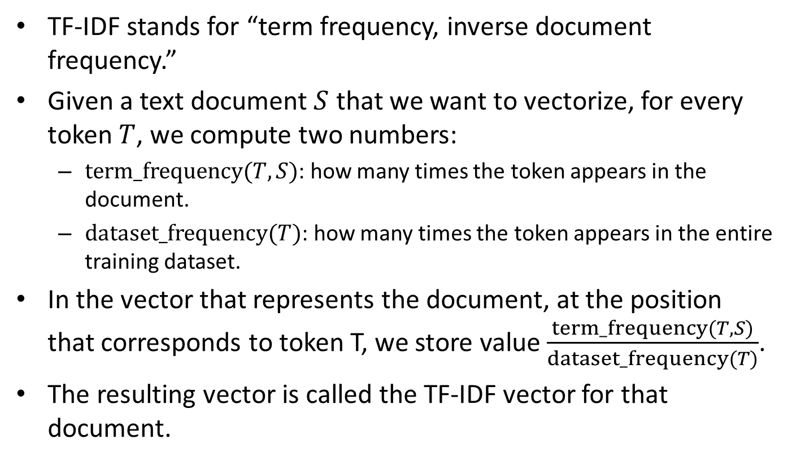
TF-IDF Normalization
TF-IDF stands for “term frequency, inverse document frequency.”
Given a text document $S$ that we want to vectorize, for every token $T$, we compute two numbers:
$term_frequency(T,S)$: how many times the token appears in the document.
$dataset_frequency(T)$: how many times the token appears in the entire training dataset.
In the vector that represents the document, at the position that corresponds to token T, we store value $\frac{term_frequency(T,S)}{dataset_frequency(T)}$.
The resulting vector is called the TF-IDF vector for that document.

Slide 103
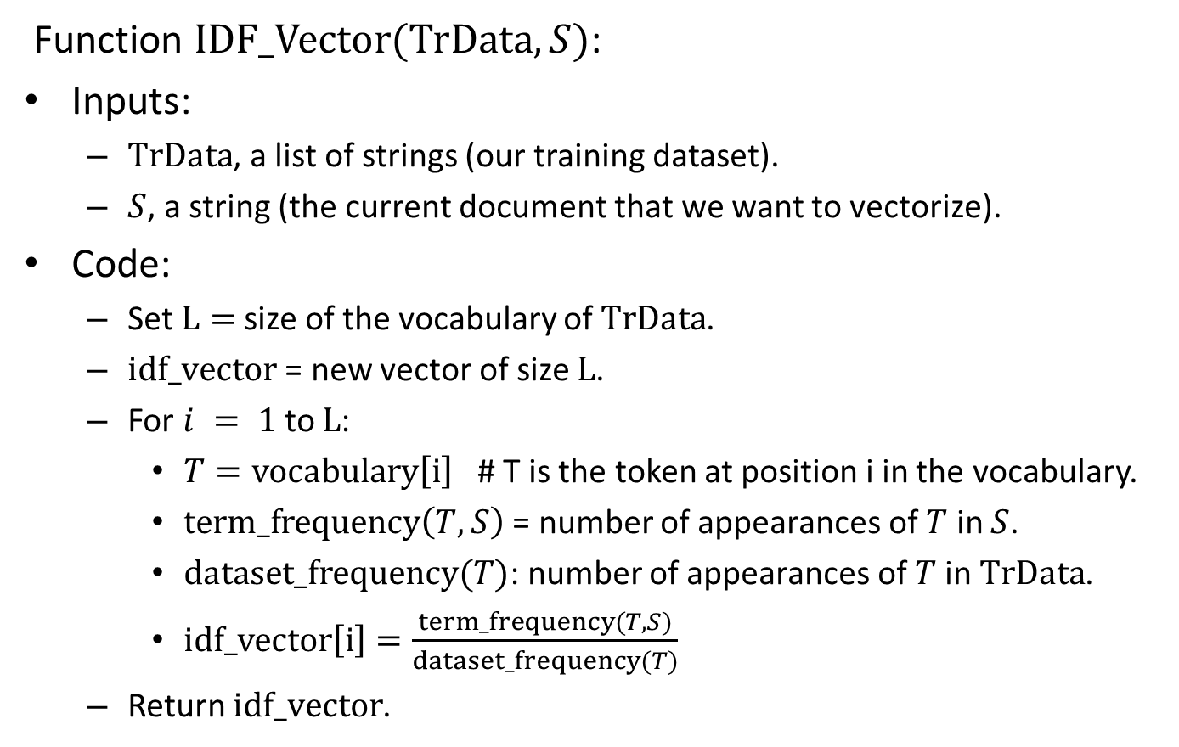
TF-IDF Pseudocode
Function $IDF_Vector(TrData, S)$:
Inputs:
$TrData$, a list of strings (our training dataset).
$S$, a string (the current document that we want to vectorize).
Code:
Set $L=$ size of the vocabulary of $TrData$.
$idf_vector$ = new vector of size $L$.
For $i = 1$to $L$:
$T=vocabulary\left[i\right]$ # T is the token at position i in the vocabulary.
$term_frequency\left(T,S\right)$ = number of appearances of $T$ in $S$.
$dataset_frequency(T)$: number of appearances of $T$in $TrData$.
$idf_vector\left[i\right]=\frac{term_frequency(T,S)}{dataset_frequency(T)}$
Return $idf_vector$.

Slide 104
TF-IDF Vectorization in Keras
text_vectorization = TextVectorization(max_tokens=20000, ngrams=2,
output_mode="tf_idf")
text_only_train_ds = train_ds.map(lambda x, y: x)
text_vectorization.adapt(text_only_train_ds)
tfidf_2gram_train_ds = train_ds.map(lambda x, y: (text_vectorization(x), y))
tfidf_2gram_val_ds = val_ds.map(lambda x, y: (text_vectorization(x), y))
tfidf_2gram_test_ds = test_ds.map(lambda x, y: (text_vectorization(x), y))
TF-IDF vectorization is pre-implemented in Keras
We just use output_mode="tf_idf" when we create the text vectorization layer.
To get bag-of-words vectors, we used output_mode="multi_hot".
To get count-of-tokens vectors, we used output_mode="count".

Slide 105
TF-IDF Results
In our dataset, using TF-IDF vectors does not make much difference in accuracy.
Using bigrams, the test accuracy is around 89.5% using TF-IDF vectors.
We got around 90% with bigrams and bag-of-words vectors.
We also got around 90% with bigrams and count-of-tokens vectors.
In general, people working with text often report that using TF-IDF vectors improves performance, at least by a small amount.

Slide 106
Summary
We have covered some basic methods for text classification using neural networks.
First, we preprocessed the text dataset to obtain a vector dataset.
Standardization.
Tokenization (words or bigrams).
Vocabulary Indexing.
Converting each text input to a bag-of-words vector.
Then, we trained and tested a fully connected model using the bag-of-words vectors.
We saw variations, such as count-of-tokens vectors and TF-IDF vectors.
Next:
Using a recurrent model, and a method called “word embeddings”.
Translation from English to Spanish, using Transformers.

