Slide 1
Text Classification with Recurrent Neural Networks and Word Embeddings
CSE 4311 – Neural Networks and Deep Learning
Vassilis Athitsos
Computer Science and Engineering Department
University of Texas at Arlington

Slide 2
Learning Sequence-Based Features
Bigrams are manually-crafted features that preserve some information about the order of words.
Can we have the model learn to construct its own features that contain information about word order?
This is what recurrent models are designed to do:
They process a sequence one step at a time.
The units of a recurrent layer receive information both from previous steps and from the current step, and combine that information in computing their output.
Compared to SimpleRNN units, LSTM units have even more capacity to preserve information from previous steps, and from longer ago in the past.

Slide 3
Preprocessing Text for an RNN
A text document should be converted to a time series before it is given as an input to an RNN.
We first tokenize the document.
Then, each token is mapped to a number or vector.
What would each element of this time series be?
What should each token map to?
We have already seen two options:
An integer, indicating the position of the token in the vocabulary.
A one-hot vector, whose dimensions equal the size of the vocabulary.
We have discussed why one-hot vectors are a better idea.
Integer representations of tokens can map tokens with very different meanings to integers close to each other.
With one-hot vector, each token is mapped to a vector equally different from all other vectors.

Slide 4
Preprocessing Text for an RNN
train_ds = keras.utils.text_dataset_from_directory(“aclImdb/train", batch_size=32)
val_ds = keras.utils.text_dataset_from_directory(“aclImdb/val", batch_size=32)
test_ds = keras.utils.text_dataset_from_directory(“aclImdb/test", batch_size=32)
text_vectorization = TextVectorization(max_tokens=20000, output_mode="int")
text_only_train_ds = train_ds.map(lambda x, y: x)
text_vectorization.adapt(text_only_train_ds)
int_train_ds = train_ds.map(lambda x, y: (text_vectorization(x), y))
int_val_ds = val_ds.map(lambda x, y: (text_vectorization(x), y))
int_test_ds = test_ds.map(lambda x, y: (text_vectorization(x), y))
This code maps each document into a sequence of integers.
We have used every part of this code before, but not all together.

Slide 5
From Integers to One-Hot Vectors
text_vectorization = TextVectorization(max_tokens=20000, output_mode="int")
text_only_train_ds = train_ds.map(lambda x, y: x)
text_vectorization.adapt(text_only_train_ds)
int_train_ds = train_ds.map(lambda x, y: (text_vectorization(x), y))
int_val_ds = val_ds.map(lambda x, y: (text_vectorization(x), y))
int_test_ds = test_ds.map(lambda x, y: (text_vectorization(x), y))
Our preprocessing code converts each document into a sequence of integers.
As we have discussed several times before, eventually we want to map each integer to a one-hot vector.
Why don’t we do that as part of preprocessing?

Slide 6
Preprocessing Text for an RNN
If we map each document to a sequence of one-hot vectors, and we store the results, we hit a problem: memory.
We have:
50,000 documents (20,000 training, 5,000 validation, 25,000 test).
230 words per document on average.
20,000 dimensions per one-hot vector (since we have set our vocabulary to be 20,000 tokens).
The resulting one-hot vectors consist of 230 billion ones and zeros.
Even if we save them as bits, it requires about 28 gigabytes.
This may or may not fit in a modern computer’s main memory.
A choice that reduces memory requirements dramatically is to:
Preprocess the documents to sequences of integers (<50MB needed).
Convert each document to a one-hot vector on the fly as needed.

Slide 7
An RNN Model for Our Dataset
inputs = keras.Input(shape=(None,), dtype="int64")
oh_vec = tf.one_hot(inputs, depth=max_tokens)
x1 = layers.Bidirectional(layers.LSTM(32))(oh_vec)
x2 = layers.Dropout(0.5)(x1)
outputs = layers.Dense(1, activation="sigmoid")(x2)
model = keras.Model(inputs, outputs)
This code creates an RNN model, using the Functional API.
See slides on the Functional API for reference.
The main steps of the model are shown below.
Input Layer
inputs
one_hot
Bidirectional LSTM + dropout
Dense
Output Layer
oh_vec
x2
outputs

Slide 8
Why Use the Functional API
inputs = keras.Input(shape=(None,), dtype="int64")
oh_vec = tf.one_hot(inputs, depth=max_tokens)
x1 = layers.Bidirectional(layers.LSTM(32))(oh_vec)
x2 = layers.Dropout(0.5)(x1)
outputs = layers.Dense(1, activation="sigmoid")(x2)
model = keras.Model(inputs, outputs)
In this model, we have these layers:
Input layer: outputs sequence of integers
A layer converting the input to a sequence of one-hot vectors.
A bidirectional LSTM layer.
A fully connected output layer, with a 50% dropout rate.
Why not use the Sequential() method to create this model?
Because there is no predefined Keras layer to produce one-hot vectors.

Slide 9
Why Use the Functional API
inputs = keras.Input(shape=(None,), dtype="int64")
oh_vec = tf.one_hot(inputs, depth=max_tokens)
x1 = layers.Bidirectional(layers.LSTM(32))(oh_vec)
x2 = layers.Dropout(0.5)(x1)
outputs = layers.Dense(1, activation="sigmoid")(x2)
model = keras.Model(inputs, outputs)
With the Functional API, we can convert each input, which is a sequence of integers, to a sequence of one-hot vectors using the tf.one_hot() method.

Slide 10
RNN with One-Hot Vectors: Results
Training this model is much slower than what we are used to.
On my computer:
About 1.5 hours per epoch.
15 hours for 10 epochs.
Accuracy: about 87%.
Bigrams with bag-of-words vectors gave us about 90% on average.
Why is it so slow?
The average document is represented using 230 one-hot vectors.
Each one-hot vector is 20,000-dimensional.
So, the average document is represented by 4.6 million numbers.
The model itself has about 5 million trainable parameters.
64 LSTM units, each with about 80,000 weights.

Slide 11
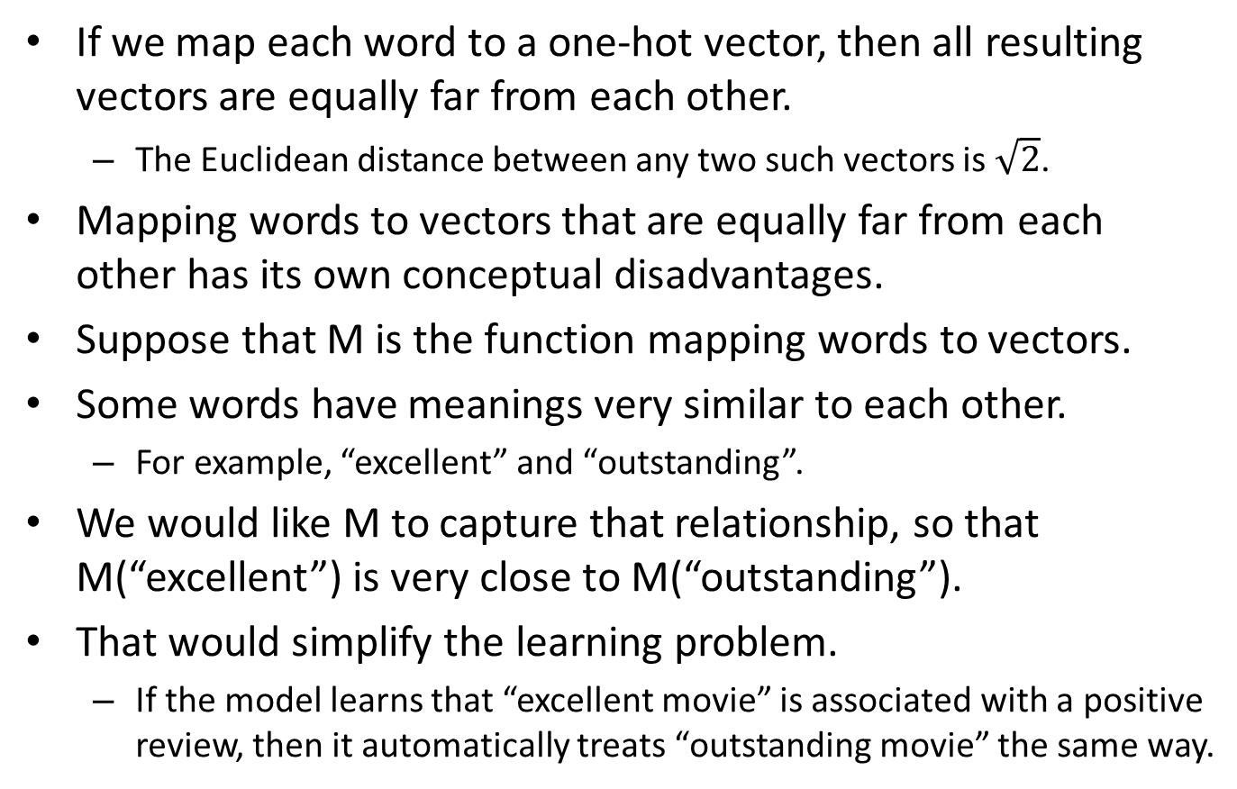
Representing Words as Vectors
If we map each word to a one-hot vector, then all resulting vectors are equally far from each other.
The Euclidean distance between any two such vectors is $\sqrt{2}$.
Mapping words to vectors that are equally far from each other has its own conceptual disadvantages.
Suppose that M is the function mapping words to vectors.
Some words have meanings very similar to each other.
For example, “excellent” and “outstanding”.
We would like M to capture that relationship, so that M(“excellent”) is very close to M(“outstanding”).
That would simplify the learning problem.
If the model learns that “excellent movie” is associated with a positive review, then it automatically treats “outstanding movie” the same way.

Slide 12
Representing Words as Vectors
It would also be useful if the differences between word vectors had meaning in themselves.
For example, consider these pairs:
“boy” and “girl”.
“man” and “woman”.
“male” and “female”.
The difference between these pairs is the gender, going from male in the first element of each pair to female in the second element.
So, intuitively, we would like a mapping M such that:
M(“boy”) – M(“girl”) = M(“man”) – M(“woman”) = M(“male”) – M(“female”)

Slide 13
Word Embeddings
To recap, we would like a mapping M such that:
M(“boy”) – M(“girl”) = M(“man”) – M(“woman”) = M(“male”) – M(“female”)
M(“large”) is similar to M(“big”)
M(“buy”) is similar to M(“purchase”)
One-hot vectors are, by definition, incapable of such behavior.
They do not depend in any way on the meaning of each word.
A word embedding is a function mapping words to vectors, that aims to capture semantic relationships like the ones above.
We can learn such a function as part of training our model.

Slide 14

Learning a Word Embedding
The word embedding can be implemented as a multiplication of one-hot vector $v$ by a matrix $W$:
$v$ = one_hot(token)
M(token) = $W×v$.
RNN model not using word embeddings
Input Layer
inputs
one hot
Bidir. LSTM + dropout
Dense
Output Layer
oh
x2
outputs
RNN model using word embeddings
Input Layer
inputs
one hot
matrix multiplication
em
Bidir. LSTM + dropout
Dense
Output Layer
oh
x2
outputs

Slide 15
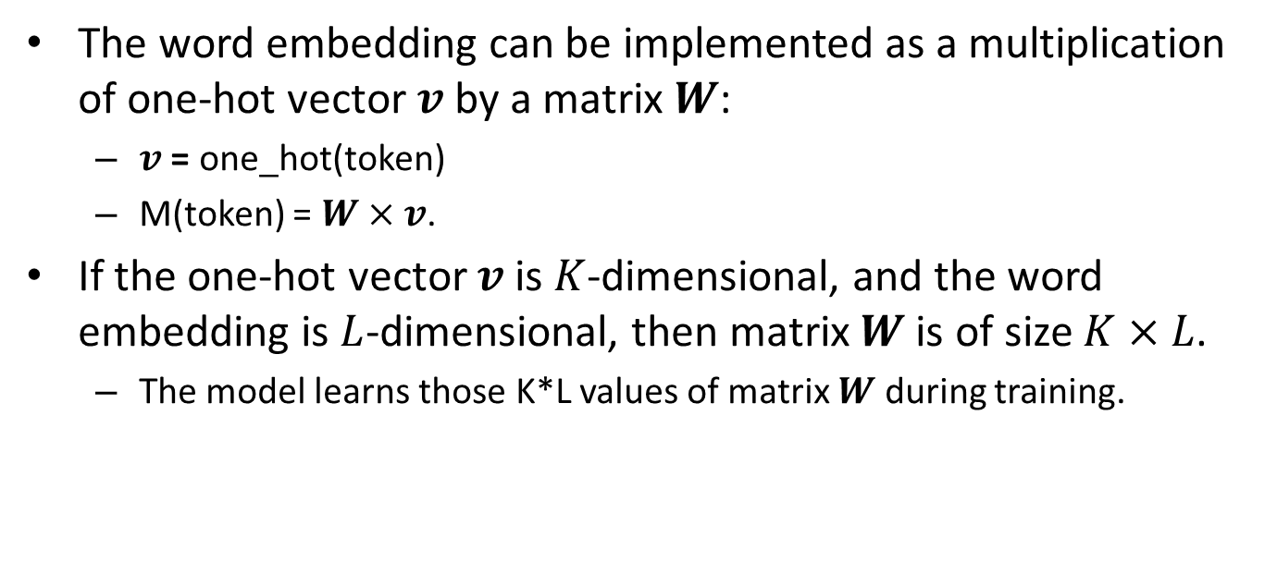
Learning a Word Embedding
The word embedding can be implemented as a multiplication of one-hot vector $v$ by a matrix $W$:
$v$ = one_hot(token)
M(token) = $W×v$.
If the one-hot vector $v$ is $K$-dimensional, and the word embedding is $L$-dimensional, then matrix $W$is of size $K×L$.
The model learns those K*L values of matrix $W$ during training.
Input Layer
inputs
one hot
matrix multiplication
em
Bidir. LSTM + dropout
Dense
Output Layer
oh
x2
outputs

Slide 16
Word Embeddings in Keras
The keras.layers.Embedding layer can be used directly for word embeddings.
It directly maps each integer to a word embedding.
RNN model using word embeddings, NOT using the Keras Embedding layer
Input Layer
inputs
one hot
matrix multiplication
em
Bidir. LSTM + dropout
Dense
Output Layer
oh
x2
outputs
RNN model using word embeddings, using the Keras Embedding layer
Input Layer
inputs
Embedding
em
Bidir. LSTM + dropout
Dense
Output Layer
x2
outputs

Slide 17
Word Embeddings in Keras
inputs = keras.Input(shape=(None,), dtype="int64")
em = layers.Embedding(input_dim=max_tokens, output_dim=256)(inputs)
x1 = layers.Bidirectional(layers.LSTM(32))(em)
x2 = layers.Dropout(0.5)(x1)
outputs = layers.Dense(1, activation="sigmoid")(x2)
model = keras.Model(inputs, outputs)
This code creates an RNN model that uses word embeddings.
Setting output_dim=256 specifies that each embedding is 256-dimensional.
RNN model using word embeddings, using the Keras Embedding layer
Input Layer
inputs
Embedding
em
Bidir. LSTM + dropout
Dense
Output Layer
x2
outputs

Slide 18
Results for Movie Reviews
For movie review classification, the results do not improve much.
We still get around 87% accuracy, same as with the previous RNN model that did not use word embeddings.
As a reminder, bag-of-words with bigrams gave us around 90% accuracy.
Nonetheless, word embeddings are very commonly used in text processing models.
We will use them again for our English-to-Spanish translation system.

Slide 19
Playing with Word Embeddings
We can get the distance of the vectors corresponding to two words, using this code:
def we_diff(model, tv_layer, s1, s2):
em_model = keras.Sequential(model.layers[0:2])
v1 = em_model(tv_layer([s1]))
v2 = em_model(tv_layer([s2]))
diff = v2[0,0,:] - v1[0,0,:]
return diff
def we_distance(model, tv_layer, s1, s2):
diff = we_diff(model, tv_layer, s1, s2)
dist = np.linalg.norm(diff)
return dist
Key idea: em_model contains only the first two layers of our RNN model (input layer, embedding layer), and thus maps a sequence of words to a sequence of the corresponding vectors.

Slide 20
Playing with Word Embeddings
Using the code before, we try out various pairs of words:
we_distance(model, text_vectorization, "great", "excellent")
we_distance(model, text_vectorization, "great", "awful")
Reasonable result:
In the word embedding space, “great” is mapped closer to “excellent” than to “awful”.
Output:
distance from "great" to "excellent" = 1.90
distance from "great" to "awful" = 3.63

Slide 21
Playing with Word Embeddings
Using the code before, we try out various pairs of words:
we_distance(model, text_vectorization, "big", "large")
we_distance(model, text_vectorization, "big", "small")
Unexpected result:
In the word embedding space, “big” is mapped closer to “small” than to “large”.
Perhaps for the purposes of separating positive and negative reviews, distinguishing these three words is not important.
Output:
distance from "big" to "large" = 0.91
distance from "big" to "small" = 0.79

Slide 22
Using Pretrained Word Embeddings
Instead of learning word embeddings from our training data, we can use pre-trained embeddings.
This is another form of transfer learning:
Learn word embeddings from a larger dataset.
Use those pre-learned embeddings in a smaller dataset.
Some popular pre-trained word embeddings include:
GloVe:
Paper: “Global Vectors for Word Representation.” J. Pennington, R. Socher, C. D. Manning. EMNLP 2014. Link: https://nlp.stanford.edu/projects/glove/
word2vec:
Paper: “Distributed Representations of Words and Phrases and their Compositionality.” T. Mikolov, I. Sutskever, K. Chen, G. Corrado, J. Dean. NeurIPS 2013.

Slide 23
GloVe Embeddings
You can download pre-trained GloVe embeddings from here:
https://nlp.stanford.edu/projects/glove
On my computer, using Anaconda, I got errors running the textbook code with those files.
The problem was that some characters (both in the GloVe embedding files and in the movie reviews dataset) had ASCII codes greater than 127.
Some functions complained when encountering these characters.
I wrote code that replaces all those problematic characters with SPACE (ASCII code 32).
The code is posted as glove.py on the lectures web page.

Slide 24
Results with Glove Embeddings
On the movie review dataset, test accuracy using pre-trained GloVe embeddings drops to 80.5%.
We got about 87% using word embeddings that were learned together with the rest of the model.
Likely reasons that accuracy drops:
The embeddings that were learned together with the rest of the model focused on words that correspond to a review positive or negative.
It looks like the movie review dataset had enough training data to learn word embeddings that were more useful than the pre-trained ones.

Slide 25
Comparing the Two Embeddings
Output using word embeddings learned from the movie reviews:
distance from "buy" to "purchase" = 0.85
distance from "buy" to "shop" = 0.73
distance from "buy" to "study" = 0.77
distance from "buy" to "swim" = 1.05
Output using pre-trained GloVe embeddings:
distance from "buy" to "purchase" = 3.31
distance from "buy" to "shop" = 5.86
distance from "buy" to "study" = 6.83
distance from "buy" to "swim" = 7.16
Words “buy”, “purchase”, “shop”, “study”, “swim” are not relevant for classifying movie reviews.
GloVe embeddings capture that buy is closer to “purchase”, and to “shop”.

Slide 26
Comparing the Two Embeddings
Output using word embeddings learned from the movie reviews:
distance from "big" to "large" = 0.91
distance from "big" to "small" = 0.79
Output using pre-trained GloVe embeddings:
distance from "big" to "large" = 4.37
distance from "big" to "small" = 4.25
Surprisingly, “big” is mapped closer to “small” than “large” with both approaches.
Once again, we have models that give reasonably good results in end-to-end systems, but do not exhibit a level of understanding that resembles human intelligence.

