Slide 1
Gradient Ascent: Generating Model Inputs that Maximize Model Outputs
Vassilis Athitsos
Computer Science and Engineering Department
University of Texas at Arlington

Slide 2
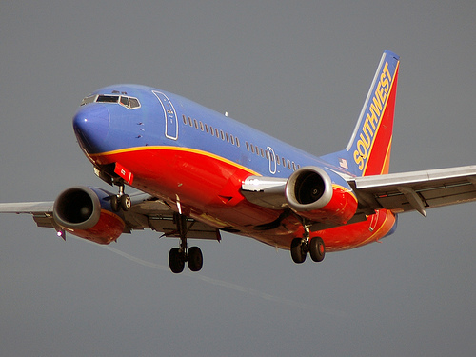



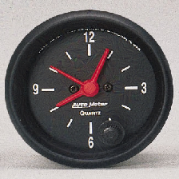
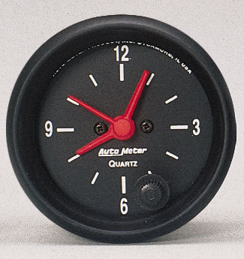
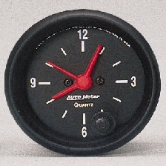

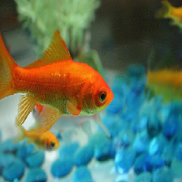



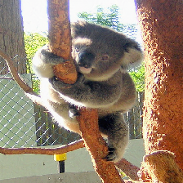



Application 1: Tricking a Model
airliner clock goldfish koala
The images with green background are real.
Part of ImageNet.
Classified correctly by pre-trained model ResNet50V2.
The images with red background are changed versions of the real images.
We used the method described in these slides to make changes that would trick ResNet50V2.
The heading of each column shows the class label that ResNet50V2 produced for the images in that column.

Slide 3
Application 1: Tricking a Model
airliner clock goldfish koala
Why would it be useful to produce such changed images?

Slide 4
Application 1: Tricking a Model
airliner clock goldfish koala
Why would it be useful to produce such changed images?
We may actually want to fool a model, that is operated by adversaries.
Or, we may want to gain intuition about how well these models match human intelligence.

Slide 5
Application 1: Uses Besides Tricking
airliner clock goldfish koala
Or, imagine that, instead of image classification, our model does mortgage approvals.
If someone is declined, it can be useful to understand what minimal changes in their profile could have led to approval.

Slide 6
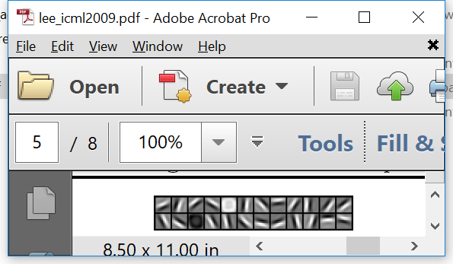
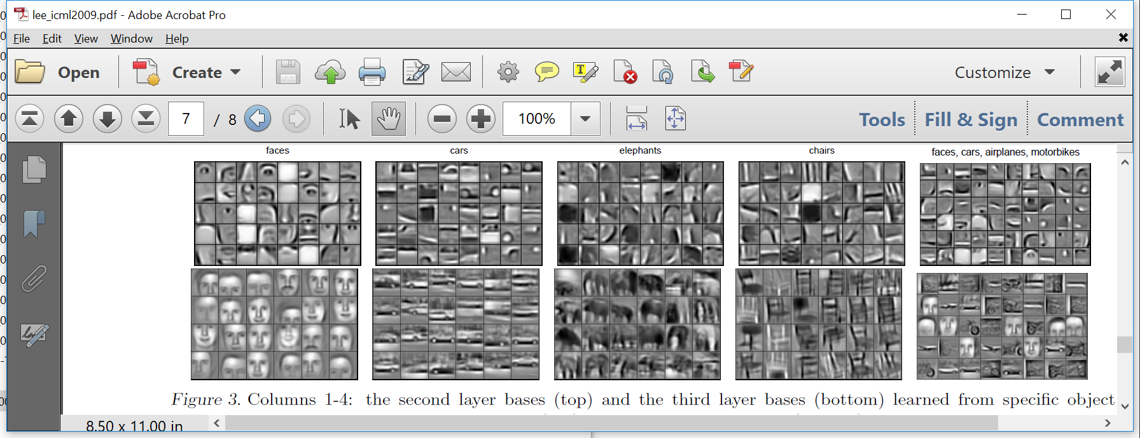
Application 2: CNN Visualization
Early layers, extract simple features.
Middle layers, model shape parts.
Last layers, model (almost) entire faces.
Input
Output
(We have seen this before): Visualization of a neural network trained with face images.
Credit for feature visualizations: [Lee09] Honglak Lee, Roger Grosse, Rajesh Ranganath and Andrew Y. Ng., ICML 2009.

Slide 7
Application 2: CNN Visualization
Early layers, extract simple features.
Middle layers, model shape parts.
Last layers, model (almost) entire faces.
Input
Output
These slides explain how we can get such visualizations.
Idea: for any layer, or any unit, we find the input image that maximizes the output of that layer or unit.

Slide 8
Generating Inputs that Trick a Model
In our case study, we use a pre-trained model, available on Keras, called ResNet50V2.
The model was trained on a subset of ImageNet called “ImageNet Large Scale Visual Recognition Challenge (ILSVRC) 2012-2017 image classification and localization dataset”.
This dataset can be downloaded from: https://www.kaggle.com/competitions/imagenet-object-localization-challenge/data
However, it takes 167GB of disk space.
You do NOT need to download it to run our code.
This dataset contains 1000 classes.

Slide 9
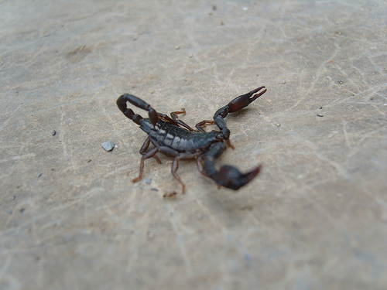
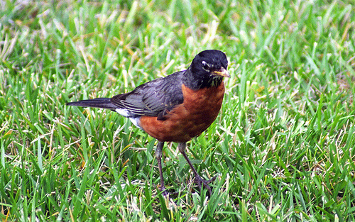
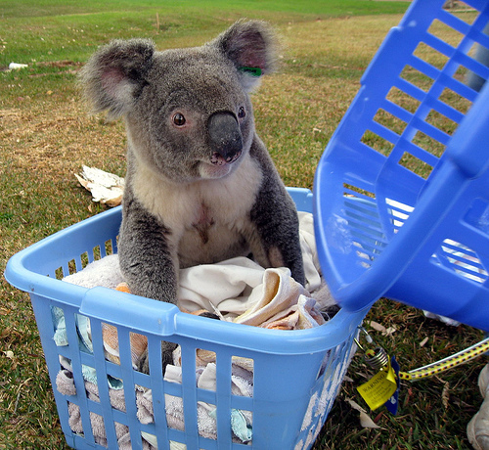
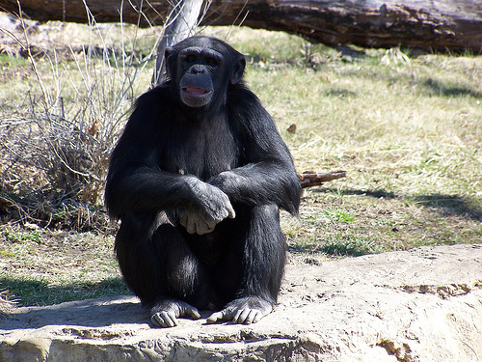
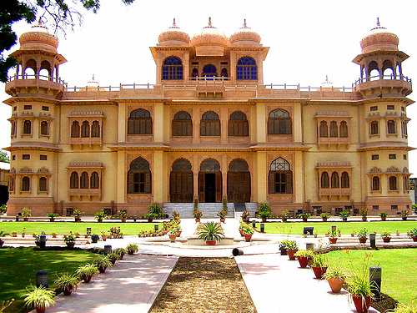
Example Images from Dataset
Here are some example images from the dataset, and their associated class labels (out of the 1000 total class labels).
scorpion robin goldfish koala
chimpanzee airliner palace clock

Slide 10
Our Goal: Trick ResNet50V2
Inputs to our system:
The model we want to trick: ResNet50V2 in our case.
A real image. For example:
A target class label, that does NOT match the real image. For example: “goldfish”.
System output: a changed image, with (hopefully) these two properties:
It looks similar to the real image.
It gets assigned the target class label by ResNet50V2.
For the example inputs, we get this output, which indeed gets classified as “goldfish”, and looks very similar to the real image.

Slide 11
Method: Gradient Ascent
The actual ResNet50V2 model has 192 layers.
The drawing below shows a simplified version, keeping the details that are of interest here.
Output
190 hidden layers, doing convolutions, max pooling, etc.
Input
0
Output unit for target class label

Slide 12
Method: Gradient Ascent
The output unit shown in red is the one corresponding to the target class label.
The output of all output units is between 0 and 1, and sums up to 1.
We want an image that maximizes the red unit’s output.
Output
190 hidden layers, doing convolutions, max pooling, etc.
Input
0
Output unit for target class label

Slide 13
Method: Gradient Ascent
X = original image we are given as input.
Compute the output of the network for image X.
If output of the red unit > threshold, then we are done and we return X.
Compute the gradient of the red unit’s output with respect to image X.
Update image X by adding to X a small vector in the direction of the gradient. Then, go back to step 2.
Output
190 hidden layers, doing convolutions, max pooling, etc.
Input
0
Output unit for target class label

Slide 14
Method: Gradient Ascent
Note that in step 5 we add to X a vector in the direction of the gradient.
Why are moving towards the gradient, not in the opposite direction as in backpropagation?
Because here we want to maximize a quantity (the red unit’s output), and NOT to minimize a quantity (in backpropagation we minimize the loss function).
Hence, the method here is called gradient ascent, not gradient descent.
Output
190 hidden layers, doing convolutions, max pooling, etc.
Input
0
Output unit for target class label

Slide 15
Tensorflow Implementation
See files posted under today’s lecture:
adversarial_input.py: code implementing the approach we are discussing.
adversarial_imagenet.zip contains inputs and outputs:
The data folder contains 24 real images from the ImageNet dataset.
The generated_200_1_7 folder contains 288 images, produced using learning_rate = 1. Each image file follows format A_B_C.png, where:
A is the original filename.
B is the target class used in generating the image.
C is the result of ResNet50V2 on the image.
For 24 of those 288 images, the target class was the true class, and the result was equal to the corresponding real image stored in the data folder.
For the remaining 264 images, they succeeded in tricking the model in 90.5% of the cases (239 out of 264).

Slide 16
Tensorflow Implementation
The generated_200_10_7 folder contains 288 images, produced using learning_rate = 10. Each image file follows the same format A_B_C.png as explained in the previous slide.
Again, 24 of those images were equal to real images in the data folder.
For the remaining 264 images, they succeeded in tricking the model in 98.1% of the cases (259 out of 264).
The success rate was higher than using learning_rate = 1.
However, here the generated images look more noisy and more different than the corresponding real images, compared to using learning_rate = 1.

Slide 17
Loading the ResNet50V2 Model
model = keras.applications.ResNet50V2(weights="imagenet", include_top=True)
path = 'data/001_n01443537_goldfish_1.jpg'
img = image.load_img(path, target_size=(img_width, img_height))
img = image.img_to_array(img)
x = np.expand_dims(img, axis=0)
x = preprocess_input(x)
preds = model.predict(x)
info = decode_predictions(preds, top=3)
print('Predicted:', info[0])
The line in red loads the pre-trained ResNet50V2 model.
The lines in green load and preprocess an image.
expand_dims is used to convert the shape of x from (224, 224, 3) to (1, 224, 224, 3), so that it looks like a batch of size 1.
preprocess_input is imported from the resnet_v2 package, to normalize the input as required by ResNet50V2.
Output:
Predicted: [('n01443537', 'goldfish', 0.99999905), ('n02606052', 'rock_beauty', 3.0257326e-07), ('n01440764', 'tench', 1.5264698e-07)]

Slide 18
Applying the ResNet50V2 Model
model = keras.applications.ResNet50V2(weights="imagenet", include_top=True)
path = 'data/001_n01443537_goldfish_1.jpg'
img = image.load_img(path, target_size=(img_width, img_height))
img = image.img_to_array(img)
x = np.expand_dims(img, axis=0)
x = preprocess_input(x)
preds = model.predict(x)
info = decode_predictions(preds, top=3)
print('Predicted:', info[0])
The line in red applies the model to x and gets the output.
decode_predictions is imported from the resnet_v2 package. It converts the model output for each of the top 3 classes to:
The imagenet class label.
An English version of the class label.
The output of the corresponding output unit.
Output:
Predicted: [('n01443537', 'goldfish', 0.99999905), ('n02606052', 'rock_beauty', 3.0257326e-07), ('n01440764', 'tench', 1.5264698e-07)]

Slide 19
The make_adversarial Function
def make_adversarial(class_index, img, thr=0.99, learning_rate=1):
iterations = 200
for iteration in range(iterations):
previous = img
gain, img = gradient_ascent_step(img,
model, class_index, learning_rate)
if (gain > thr):
break
return gain, previous.numpy()[0]
The make_adversarial function is the top-level function implementing what we want to do.
It takes an input image img, and it changes it to a result image that (hopefully):
looks similar to the input image.
gets classified by the model as belonging to the target class label, specified by class_index.

Slide 20
The make_adversarial Function
def make_adversarial(class_index, img, thr=0.99, learning_rate=1):
iterations = 200
for iteration in range(iterations):
previous = img
gain, img = gradient_ascent_step(img,
model, class_index, learning_rate)
if (gain > thr):
break
return gain, previous.numpy()[0]
Inputs:
class_index is the index of the target class.
img is the input image, typically a real image.
thr specifies the minimum value that we want the output unit of the target class to reach.
learning_rate specifies how much in the direction of the gradient we should move at each step.

Slide 21
The make_adversarial Function
def make_adversarial(class_index, img, thr=0.99, learning_rate=1):
iterations = 200
for iteration in range(iterations):
previous = img
gain, img = gradient_ascent_step(img,
model, class_index, learning_rate)
if (gain > thr):
break
return gain, previous.numpy()[0]
The for loop calls repeatedly gradient_ascent_step, to do the gradient ascent. We will explain this shortly.
gradient_ascent_step returns gain, which is the current output of the model for the target class, and an updated img.
Note that we break out of the loop if gain is high enough.

Slide 22
The make_adversarial Function
def make_adversarial(class_index, img, thr=0.99, learning_rate=1):
iterations = 200
for iteration in range(iterations):
previous = img
gain, img = gradient_ascent_step(img,
model, class_index, learning_rate)
if (gain > thr):
break
return gain, previous.numpy()[0]
We return the final gain, and the image produced by gradient ascent.
Note that the result image that we return is previous, not img.
The reason is that (as we will see shortly), the gain value returned by gradient_ascent_step was attained by previous.

Slide 23
The gradient_ascent_step Function
def gradient_ascent_step(img, model, class_index, learning_rate):
with tf.GradientTape() as tape:
tape.watch(img)
outputs = model(img)
gain = outputs[:, class_index]
# Compute gradients.
grads = tape.gradient(gain, img)
# Normalize gradients.
grads = tf.math.l2_normalize(grads)
img += learning_rate * grads
return gain, img
This function does a single step of gradient ascent.
Inputs:
img: the current version of the image that we are making changes to.
model: the model we want to trick.
class_index: the target class.
learning_rate: specifies how much to change the image.

Slide 24
The gradient_ascent_step Function
def gradient_ascent_step(img, model, class_index, learning_rate):
with tf.GradientTape() as tape:
tape.watch(img)
outputs = model(img)
gain = outputs[:, class_index]
# Compute gradients.
grads = tape.gradient(gain, img)
# Normalize gradients.
grads = tf.math.l2_normalize(grads)
img += learning_rate * grads
return gain, img
The lines in red highlight how we compute gradients in Tensorflow.
In most of our code this semester we did NOT use this approach, because we relied on Keras to hide these details from us.
We use GradientTape to tell Tensorflow to keep track of gradients when it makes computations.

Slide 25
The gradient_ascent_step Function
def gradient_ascent_step(img, model, class_index, learning_rate):
with tf.GradientTape() as tape:
tape.watch(img)
outputs = model(img)
gain = outputs[:, class_index]
# Compute gradients.
grads = tape.gradient(gain, img)
# Normalize gradients.
grads = tf.math.l2_normalize(grads)
img += learning_rate * grads
return gain, img
tape.watch(img) tells Tensorflow to keep track of gradients with respect to the values of img.
Tensorflow needs to be told which gradients to compute, because if it computed all gradients it would be too inefficient.
Some values are watched by default, such as a model’s trainable weights.

Slide 26
The gradient_ascent_step Function
def gradient_ascent_step(img, model, class_index, learning_rate):
with tf.GradientTape() as tape:
tape.watch(img)
outputs = model(img)
gain = outputs[:, class_index]
# Compute gradients.
grads = tape.gradient(gain, img)
# Normalize gradients.
grads = tf.math.l2_normalize(grads)
img += learning_rate * grads
return gain, img
The lines in red compute the output of the model given img as input.
Then, we define variable gain to be the output of the specific output unit corresponding to the target class.
We call it gain as it is the quantity we want to maximize.
Contrast to the term loss, used for the quantity we want to minimize in backpropagation.

Slide 27
The gradient_ascent_step Function
def gradient_ascent_step(img, model, class_index, learning_rate):
with tf.GradientTape() as tape:
tape.watch(img)
outputs = model(img)
gain = outputs[:, class_index]
# Compute gradients.
grads = tape.gradient(gain, img)
# Normalize gradients.
grads = tf.math.l2_normalize(grads)
img += learning_rate * grads
return gain, img
Note that the model output is computed within the GradientTape scope, so Tensorflow keeps track of gradients of these computations with respect to img.
Once these computations are done, the line in green calls tape.gradient to retrieve the gradient vector of gain with respect to img.

Slide 28
The gradient_ascent_step Function
def gradient_ascent_step(img, model, class_index, learning_rate):
with tf.GradientTape() as tape:
tape.watch(img)
outputs = model(img)
gain = outputs[:, class_index]
# Compute gradients.
grads = tape.gradient(gain, img)
# Normalize gradients.
grads = tf.math.l2_normalize(grads)
img += learning_rate * grads
return gain, img
The lines in red update the image by moving it in the direction of the gradient vector.
tf.math.l2_normalize normalizes the gradient vector, so that the sum of the squares of its values is equal to 1.
Notice that the img version that we return is NOT the one that achieved the gain that we return, because it has been updated.
That is why in make_adversarial we return the previous image.

Slide 29
Running the Code
path = ' data/001_n01443537_goldfish_1.jpg'
img0 = image.load_img(path,
target_size=(224, 224))
img = image.img_to_array(img0)
x = np.expand_dims(img, axis=0)
x = preprocess_input(x)
tx = tf.convert_to_tensor(x)
thr = 0.7
learning_rate = 1
(loss, result) = make_adversarial(105, tx, thr=thr,
learning_rate=learning_rate)
The lines in red load the real image from a file.
The lines in green preprocess the image:
Convert to numpy array.
Make 4D (so that the image becomes a batch of one image).
preprocess_input is part of the ResNet50V2 package, it normalizes the input image as needed.
The last line calls make_adversarial with appropriate parameters.

Slide 30
Running the Code
keras.preprocessing.image.save_img("0.png",
result)
img0 = image.load_img("0.png",
target_size=(224, 224))
img = image.img_to_array(img0)
rx = np.expand_dims(img, axis=0)
rx = preprocess_input(rx)
preds = model.predict(x)
print('Prediction on original:’,
decode_predictions(preds, top=3)[0])
preds = model.predict(rx)
print('Prediction on adversarial:’,
decode_predictions(preds, top=3)[0])
The first line saves the image to a file.
The second line loads the image from a file.
Why are we saving and reloading?

Slide 31
Running the Code
keras.preprocessing.image.save_img("0.png",
result)
img0 = image.load_img("0.png",
target_size=(224, 224))
img = image.img_to_array(img0)
rx = np.expand_dims(img, axis=0)
rx = preprocess_input(rx)
preds = model.predict(x)
print('Prediction on original:’,
decode_predictions(preds, top=3)[0])
preds = model.predict(rx)
print('Prediction on adversarial:’,
decode_predictions(preds, top=3)[0])
Why are we saving and reloading?
The generated image that tricked the model was real-valued, with values in a range we are not quite sure of.
We started with values in the [-1, 1] range, but the repeated changes made by gradient ascent may have changed that.
When we save and reload, we get values in the [-1, 1] range.
There is no guarantee that the reloaded image will fool the model, so we doublecheck.

Slide 32
Results
airliner clock goldfish koala
These are the results we saw at the beginning.
The four images with green background are real.
Part of ImageNet.
Classified correctly by pre-trained model ResNet50V2.

Slide 33
Results
airliner clock goldfish koala
The 12 images with red background are results of make_adversarial, with the target class equal to the column heading.
For example, for images in the left column, the target class was “airliner”.
For each of these 12 results, the model output was indeed the target class, so make_adversarial was successful in tricking the model.

Slide 34
Results
airliner clock goldfish koala
In the posted file adversarial_imagenet.zip:
The data folder contains 24 real images.
The generated_200_1_7 folder contains 264 images, generated by giving to make_adversarial each combination of a real image and a target class (out of 11 target classes).
Out of those 264 images, for 239 the model indeed produced the target class as output.
Success rate: 90.5%.

Slide 35
Results
airliner clock goldfish koala
Minor note: the generated_200_1_7 folder in adversarial_imagenet.zip actually contains 288 images, but 24 of those are the real images from the data folder.
That is why we only use 264 images in our evaluation.

Slide 36
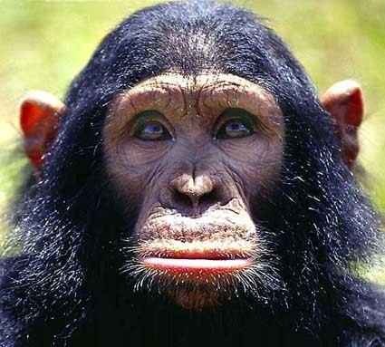
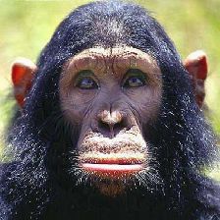


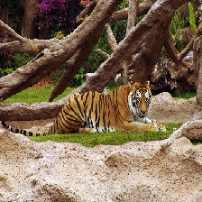







More Results
chimp tiger goldfish koala
Here we see how images of four animals are changed to make the model produce wrong classifications.

Slide 37
More Results
chimp tiger goldfish koala
Minor note: the koala-to-tiger image (4th row, 2nd column) was generated with learning_rate = 10, because the result with learning_rate = 1 did not trick the model.
Images generated with learning_rate = 10 are in the generated_200_10_7 folder of adversarial_imagenet.zip

Slide 38
Observations
chimp tiger goldfish koala
The generated images may look noticeably different with respect to the original images.
At the same time, often the differences are small and hard to notice.
Still, these are all images where a human would easily recognize the object.

Slide 39
Observations
chimp tiger goldfish koala
These results offer some intuition about how a model “understands” the concepts it has been trained to recognize.
ResNetV250 had an overall accuracy of 76%, on 1000 classes.
Still, as these results show, it has limited understanding of what a clock or a goldfish really looks like.

Slide 40

Comparing Images Visually
These two slides contain two images of a goldfish.
One is real, and classified as a goldfish by ResNet50V2.
One was generated by our model, and is classified as a chimpanzee by ResNet50V2.
Can you tell which one is real?

Slide 41
Comparing Images Visually
These two slides contain two images of a goldfish.
One is real, and classified as a goldfish by ResNet50V2.
One was generated by our model, and is classified as a chimpanzee by ResNet50V2.
Can you tell which one is real?

Slide 42
Comparing Images Visually
Answer: the first image (shown on the left here) is the real one.
On the right, you can see a faint “ghost” of a chimp’s upper face.

Slide 43

Comparing Images Visually
These two slides contain two images of a chimpanzee.
One is real, and classified as a chimpanzee by ResNet50V2.
One was generated by our model, and is classified as a goldfish by ResNet50V2.
Can you tell which one is real?

Slide 44
Comparing Images Visually
These two slides contain two images of a chimpanzee.
One is real, and classified as a chimpanzee by ResNet50V2.
One was generated by our model, and is classified as a goldfish by ResNet50V2.
Can you tell which one is real?

Slide 45
Comparing Images Visually
Answer: the first image (shown on the left here) is the real one.

Slide 46
Measuring Quality of Results
chimp tiger goldfish koala
We can define two measures of performance:
Percentage of source images that we change successfully so that they get misclassified.
Average squared (or absolute) difference between original images and changed images.

Slide 47
Further Reading
Here are some good starting points if you want to learn more about generating adversarial inputs, and more sophisticated methods for doing it.
“Intriguing properties of neural networks.”
Christian Szegedy, Wojciech Zaremba, Ilya Sutskever, Joan Bruna, Dumitru Erhan, Ian Goodfellow, Rob Fergus. ICLR 2014 https://arxiv.org/pdf/1312.6199.pdf
“Explaining and Harnessing Adversarial Examples.”
Ian J. Goodfellow, Jonathon Shlens, Christian Szegedy. ICLR 2015.
https://arxiv.org/pdf/1412.6572.pdf
“A survey on adversarial attacks and defences.”
Anirban Chakraborty, Manaar Alam, Vishal Dey, Anupam Chattopadhyay,
Debdeep Mukhopadhyay. CAAI Transactions on Intelligence Technology, 2021.
https://ietresearch.onlinelibrary.wiley.com/doi/epdf/10.1049/cit2.12028

Slide 48
Visualizing Behavior of Hidden Layers
So far, we have seen how we can change images to maximize the response of a specific output unit.
The same idea can be applied to hidden units as well.
Why would it be useful to find images that maximize the response of a specific hidden unit?
Such images can provide intuition about the type of patterns that that specific input unit has learned to identify.

Slide 49
Visualizing a Convolutional Layer
In Keras, a Conv2D layer applies a certain number of 2D filters to an image.
We can write code that:
Chooses one of the Conv2D layers in a model.
Chooses one of the filters in the chosen Conv2D layer.
Generates an image that maximizes the output of that filter.
We will apply this to a simple convolutional neural network trained on the MNIST dataset.
The code for this is posted on the website, as file gradient_ascent_mnist.py.

Slide 50
Our CNN Model
model = keras.Sequential( [
keras.Input(shape=input_shape),
keras.layers.Conv2D(32, kernel_size=(3, 3),
activation="relu"),
keras.layers.MaxPooling2D(pool_size=(2, 2)),
keras.layers.Conv2D(64, kernel_size=(3, 3),
activation="relu"),
keras.layers.MaxPooling2D(pool_size=(2, 2)),
keras.layers.Flatten(),
keras.layers.Dropout(0.5),
keras.layers.Dense(number_of_classes,
activation="softmax"),
])
We used this model early in the semester.

Slide 51
Our CNN Model
filename = "mnist_cnn_1.keras"
model = keras.models.load_model(filename)
model.summary()
Here we load a model that has already been trained on MNIST, and achieves 99.27% accuracy on the test set.
Output:
Model: "sequential"
_________________________________________________________________
Layer (type) Output Shape Param #
=================================================================
conv2d (Conv2D) (None, 26, 26, 32) 320
max_pooling2d_6 (MaxPooling2D) (None, 13, 13, 32) 0
conv2d_1 (Conv2D) (None, 11, 11, 64) 18496
max_pooling2d_7 (MaxPooling2D) (None, 5, 5, 64) 0
flatten (Flatten) (None, 1600) 0
dropout (Dropout) (None, 1600) 0
dense (Dense) (None, 10) 16010
=================================================================

Slide 52
Selecting the Layer to Visualize
layer_name = "conv2d"
layer = model.get_layer(name=layer_name)
truncated_model = keras.Model(inputs=model.inputs, outputs=layer.output)
From the output of model.summary() in the previous slide, we see that the first convolutional layer is named “conv2d”.
We want to visualize the behavior of that layer.
The line in red gets that layer from the model.
The line in green uses the Functional API to create a truncated model, that:
Takes the same input as the original model.
Produces the output of the selected layer as final output.

Slide 53
The visualize_filter Function
def visualize_filter(filter_index):
iterations = 30
learning_rate = 10.0
img = initialize_image()
for iteration in range(iterations):
gain, img = gradient_ascent_step(img,
filter_index, learning_rate)
# Decode the resulting input image
img = deprocess_image(img[0].numpy())
return gain, img
def initialize_image():
img = tf.random.uniform((1, 28, 28, 1))
return img * 0.25
The visualize_filter function is the top-level function.
It follows the same ideas as the make_adversarial function we saw earlier.
Key difference from make_adversarial:
In make_adversarial, the initial image is given as an input argument.
Here, the initial image is created within the function (see lines in red), as a random image.

Slide 54
The gradient_ascent_step Function
def gradient_ascent_step(img, filter_index,
learning_rate):
with tf.GradientTape() as tape:
tape.watch(img)
activation = truncated_model(img)
filter_activation = activation[:, 2:-2, 2:-2,
filter_index]
gain = tf.reduce_mean(filter_activation)
# Compute gradients.
grads = tape.gradient(gain, img)
# Normalize gradients.
grads = tf.math.l2_normalize(grads)
img += learning_rate * grads
return gain, img
Again, there is only a minor difference (shown in red) from the gradient_ascent_step function we used earlier, for generating adversarial inputs.
The difference is how we compute the gain, i.e., the quantity that we want to maximize.
In generating adversarial inputs, the gain was based on the output of the output unit corresponding to the target class.
Here, the filter produces a 2D array as output. We use the mean value of that output as the gain.

Slide 55
The gradient_ascent_step Function
def gradient_ascent_step(img, filter_index,
learning_rate):
with tf.GradientTape() as tape:
tape.watch(img)
activation = truncated_model(img)
filter_activation = activation[:, 2:-2, 2:-2,
filter_index]
gain = tf.reduce_mean(filter_activation)
# Compute gradients.
grads = tape.gradient(gain, img)
# Normalize gradients.
grads = tf.math.l2_normalize(grads)
img += learning_rate * grads
return gain, img
Again, the gain is computing within a GradientTape scope, to keep track of the gradient of the gain with respect to img.
activation is the output of the Conv2D layer. It is a 3D array.
filter_activation is the 2D slice of activation corresponding to the output of the filter specified by filter_index.
We discard the top and bottom two rows, and the left and right two columns.

Slide 56
The gradient_ascent_step Function
def gradient_ascent_step(img, filter_index,
learning_rate):
with tf.GradientTape() as tape:
tape.watch(img)
activation = truncated_model(img)
filter_activation = activation[:, 2:-2, 2:-2,
filter_index]
gain = tf.reduce_mean(filter_activation)
# Compute gradients.
grads = tape.gradient(gain, img)
# Normalize gradients.
grads = tf.math.l2_normalize(grads)
img += learning_rate * grads
return gain, img
gain is the average of all the values in filter_activation.
The rest of the code is the same as in the version used for generating adversarial inputs.

Slide 57
Running the Code
filter_index = 0
gain, img = visualize_filter(filter_index)
filename = "0_%d.png" & (filter_index)
keras.preprocessing.image.save_img(filename, img)
display(Image(filename))
Visualization of filter 0
It looks like filter 0 has been trained to identify horizontal patterns.

Slide 58
Running the Code
filter_index = 1
gain, img = visualize_filter(filter_index)
filename = "0_%d.png" & (filter_index)
keras.preprocessing.image.save_img(filename, img)
display(Image(filename))
Visualization of filter 1
Filter 1 has also been trained to identify horizontal patterns, but:
These patterns slant upwards as we move to the right.
For filter 0, the patterns slant downwards as we move to the right.

Slide 59
More Visualizations
filter 2 filter 3 filter 4 filter 5
filter 6 filter 7 filter 8 filter 9

Slide 60
More Visualizations
filter 10 filter 11 filter 12 filter 13
filter 14 filter 15 filter 16 filter 17

Slide 61
Recap
We saw how to use gradient ascent to construct inputs that maximize outputs of specific units and layers of a model.
We applied this in two different ways:
To generate adversarial inputs, i.e., to tweak existing images so that the tweaked versions get misclassified by the model.
To visualize the types of patterns that hidden units in the network are trained to provide maximal responses to.
Both these applications can help us gain some intuition about the behavior of our models.

