Slide 1
Hand Segmentation and Pose Estimation Research Review
Evan Cornish, 03/31/2023

Slide 2
Hand Pose Summary
Hand Pose Summary and Progress
Hand pose Summary
Different CNN architectures
Accuracies
Segmentation
My Progress
Next Steps

Slide 3
Hand Pose Summary
Early methods
Fit 3D articulated hand model to input visual data
Some non neural network based methods (HOPE network using canny, as well as Tompson paper with LBS (linear blend skinning)
CNN models dominate
Hand only problem has received most attention
HOI (Hand object interaction), and cluttered image are much less explored

Slide 4
Data Driven Approaches
Search based methods
Perform badly in high dimensional space
Random Forests
Heavily reliant on hand crafted features
DNN based methods
Several methods (More coming)

Slide 5
Challenge Analysis
Articulation
Each hand joint is a kinematic chain with 1 or 2 degrees of freedom (DOF)
Orientation
Global orientation has an additional 6 DOF
Between articulation and orieintation we have 26 DOF
Occlusion
Estimating 3D HP from 2D projection is ill-posed problem
Well posed problem:
Existence: at least 1 solution
Uniqueness: only 1 clear answer
Stability: small change to input leads to small change to output
Estimating 3D HP from 2D projection fails uniqueness, there is more than 1 correct answer
Self-Similarity
Depth and Scale Ambiguities
Causes over-fitting for environment
Methods tend to assume scale (distance from camera, or environmental structure)
Noise
Clutter
Most methods tend to assume no clutter
Also no object interaction
Data Collection Expensive

Slide 6
State Of The Art DNN Models (As Per 2021)
Multiple Paradigms
Generative Model Based (Not really DNN necessarily but can be)
Regression Based
Detection Based

Slide 7
Generative Model Based
Hand model with prior anatomy built in as assumption
Use non convex energy function defined to measure discrepancy between hand and model
Energy function
Assigns low energy to correct values of remaining points
High energy to incorrect values
Loss function measures quality of energy produced by energy function
Examples
PSO, ICP (iterative closest point), “Nonlinear optimization” (whatever that means)
Common paradigm used for offline modeling
Weaknesses
Requires good initialization, which is not realistic
Often assumed that the previous frame has good info about the next frames initialization
Over trains on hand crafted from 3D model (doesn’t generalize well to all hand shapes and sizes)

Slide 8
Regression Based Models (Discriminative)
E2E learning with direct prediction of joint locations
Baseline: global regression in 1 stage
Works terribly (This was Preston and I’s first attempt already)
Examples: DeepPrior(2015), DeepPrior++(2017)
Assumes hand is segmented and that depth invariance is not important
One of the best working DNN solutions
Transform into voxels, then do 3d CNN
Examples: 3DCNN, pointnet, pointnet++
pointnet preprocess with knn and point sampling
Some experiments made with CNN on multiple cameras (Not sure which models)

Slide 9
Detection Based Approaches (discriminative)
Take a cluster of pixels and produce a 2D or 3D gaussian per joint
Requires deconvolution process to produce heatmap
Time consuming and expensive
Hurts real time capabilities
Generally more accurate than regression based methods
Only loosely true, not ALWAYS true
Often requires some pose recovery algorithm like inverse kinematics
Examples
Tompson, V2Vnet, PointNet(point clouds)

Slide 10
Structural Based Approaches
Use PCA or structural model to restrict pose to kinematically plausible poses
Don’t know as much about this, there are a bunch of sources, not sure which models are using it

Slide 11
Multi Stage and Ensemble Models
DeepPrior uses a multi stage paradigm (don’t know what that means)
Ensemble methods involve using 2D heatmap, 3D heatmap and 3D directional vector fields
Use each model to predict independently
Examples
Hand Branch Ensemble (HBE), A2J, JGR-2PO

Slide 12
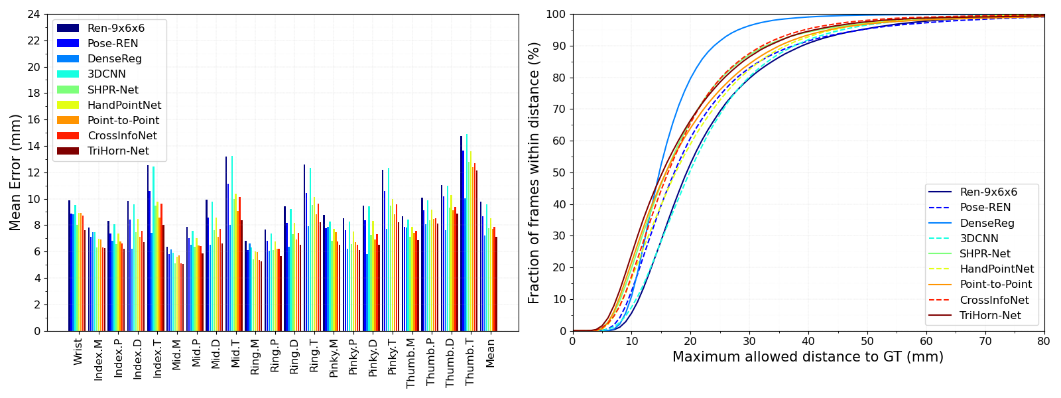
MSRA Error
Notable Models Error in avg mm
TriHorn-Net: 7.13
JGR-P20: 7.55 (Ensemble Method)
DenseReg: 7.23
P2P: 7.7 (CNN method, detection based (heatmap))
DeepPrior++: 9.5 (CNN regression)

Slide 13
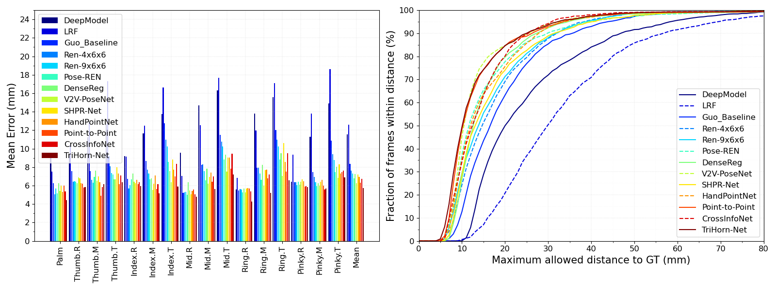
ICVL Error
Notable Models Error in avg mm
TriHorn-Net: 5.73
JGR-P20: 6.02 (ensemble method)
P2P: 6.3 (CNN detection based (heatmap))
V2V-PoseNet: 6.2
A2J: 6.46(Detection)
DeepPrior++: 8.1 (CNN regression based)

Slide 14
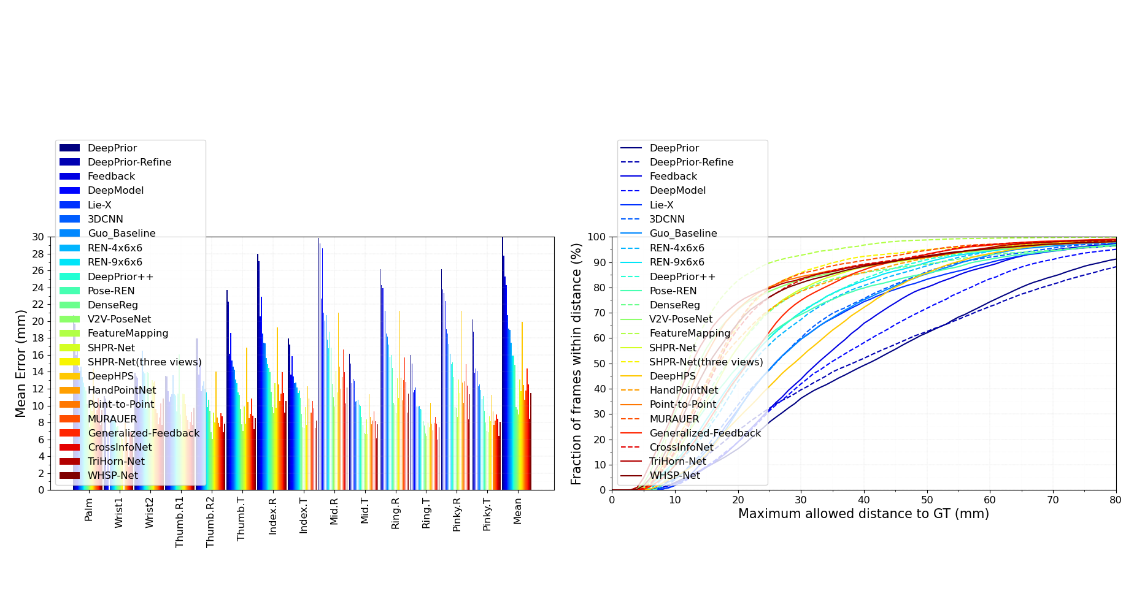
NYU Error
Notable Models Error in avg mm
TriHorn-Net: 7.68
JGR-P20: 8.29 (ensemble method)
P2P: 9.1 (CNN detection based (heatmap))
V2V-PoseNet: 8.42
A2J: 8.61(CNN detection based (heatmap))
DeepPrior++: 12.24 (CNN regression based)

Slide 15
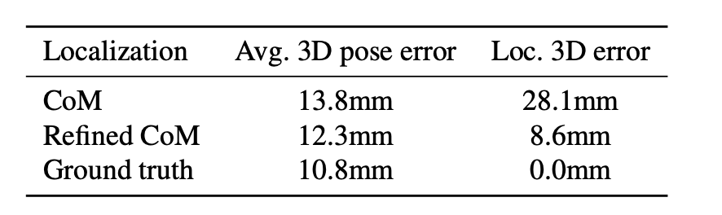
DeepPrior++
Ablation Experiment
Shows the average error improvement with different segmentation methods
Using the ground truth to segment the hand improves accuracy by 2mm
Shows the importance of segmenting the hand with as little error as possible in the process of the problem

Slide 16
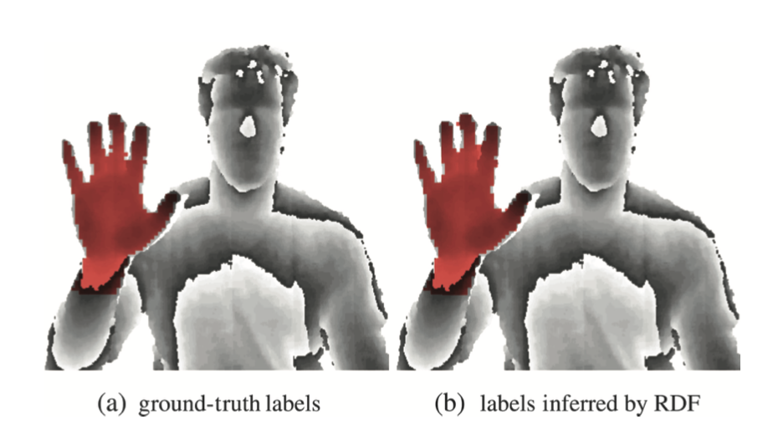
Segmentation Problem
Implementing the segmentation procedure in the Tompson paper
Create manually crafted data features from a random sampling of the input image
Use RDF to segment the hand from the rest of the image
Tompson Paper Figure 2

Slide 17
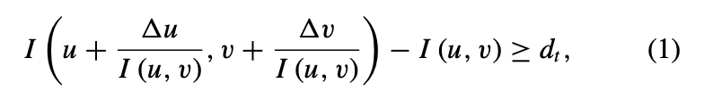
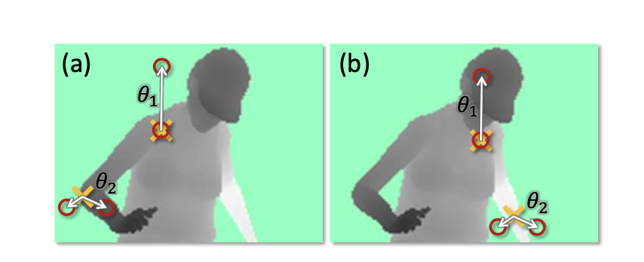
RDF segmentation
Tompson Feature Formula
Don’t just throw Neural Nets at every problem
Manually decide upon feature patterns
Decide upon feature calculation metric
Can pick feature pattern or do so randomly
Shotton Fig. 4

